Slide 1
TASK TRACK
Final Project of INFO6350
Jianan Wen
001678266

Slide 2
Reason of TASK TRACK
I want to create an application which can record my task and trace the actual completion situation;
Can record all my tasks history, and its completion situation, so that I can know what I did in that day;
It’s easy to use

Slide 3
Components
Database:
Firebase real time database to store data
Firebase Authentication to create users and verify users
Cocoapods:
UICircularProgressRing
SVProgressHUD
ChameleonFramework

Slide 4
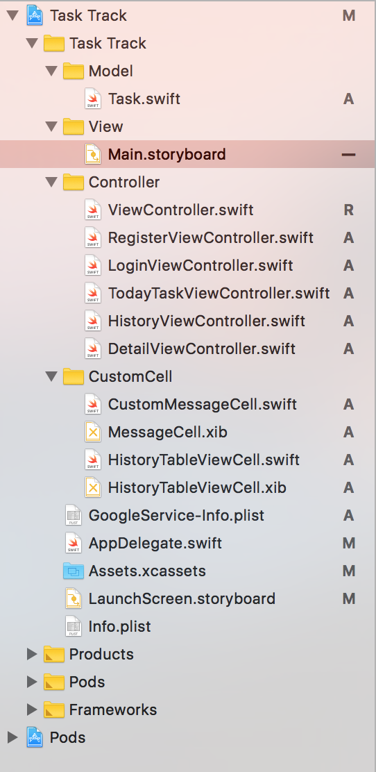
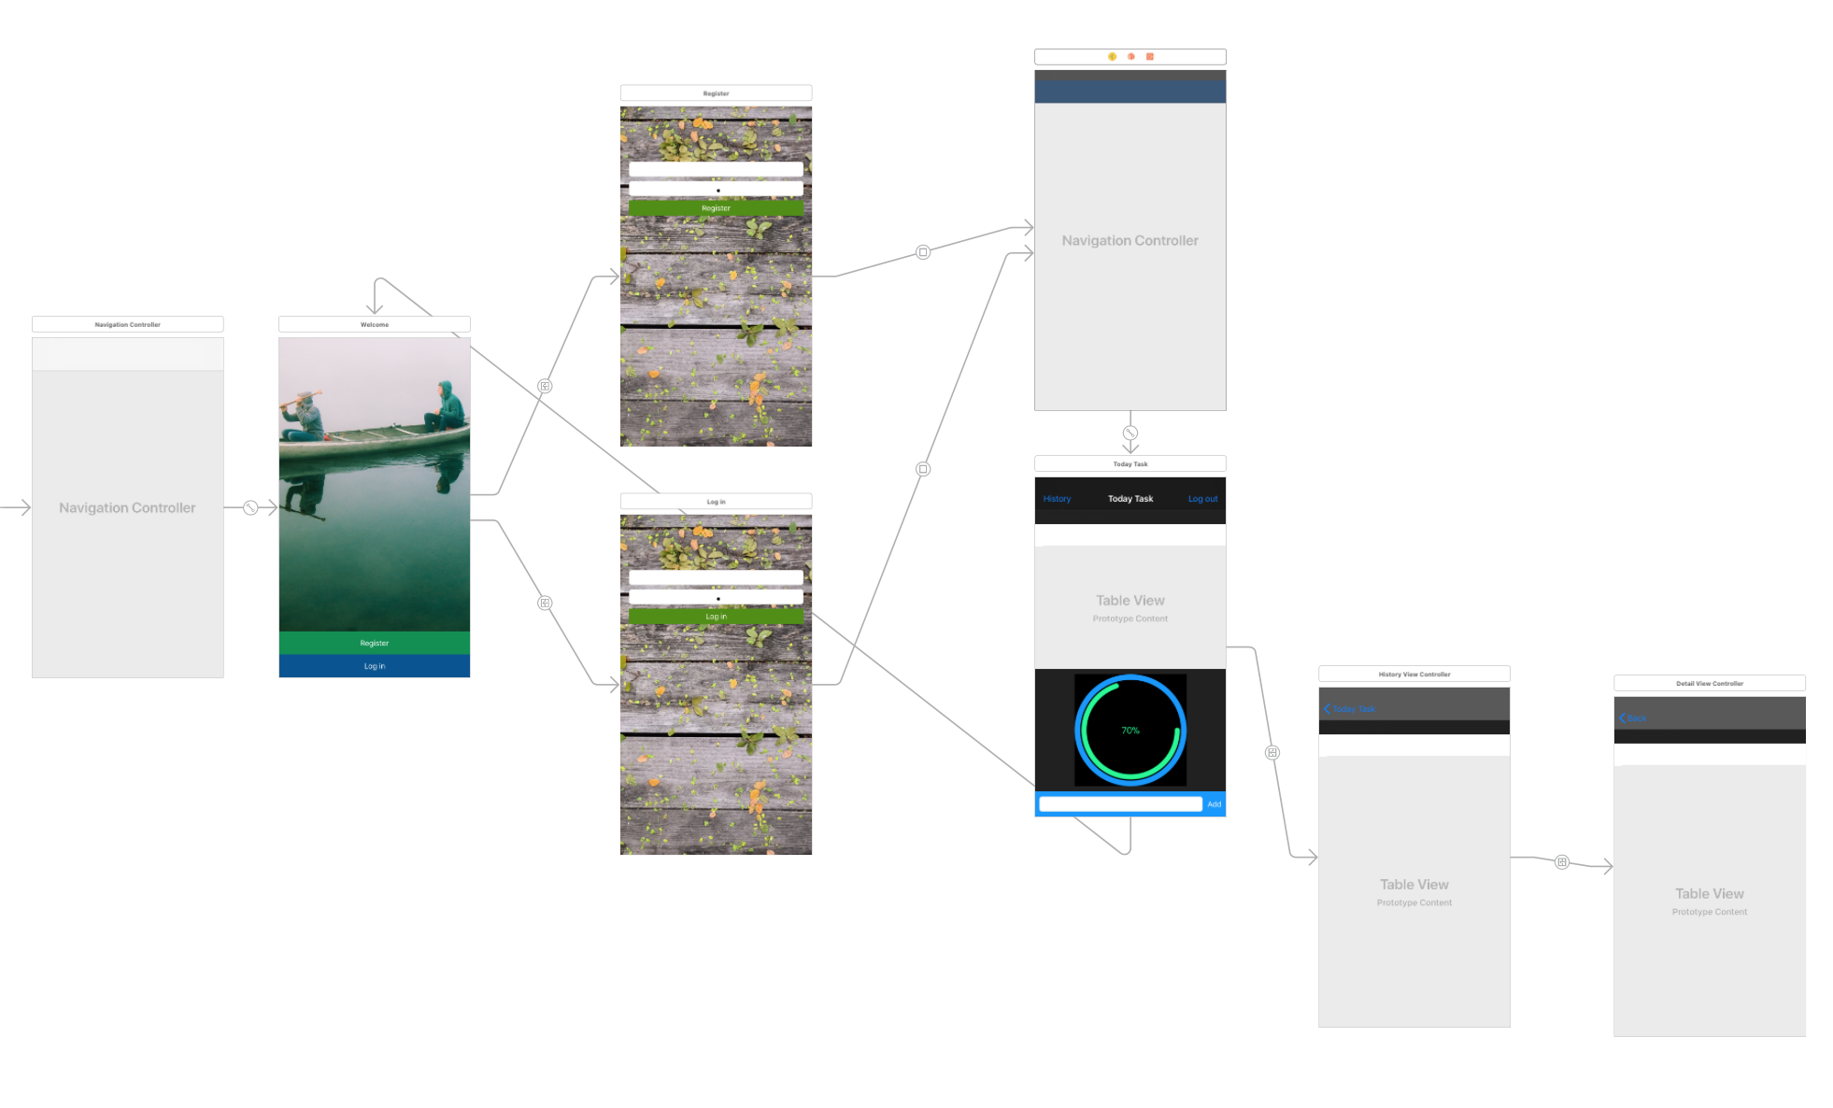
Structure

Slide 5
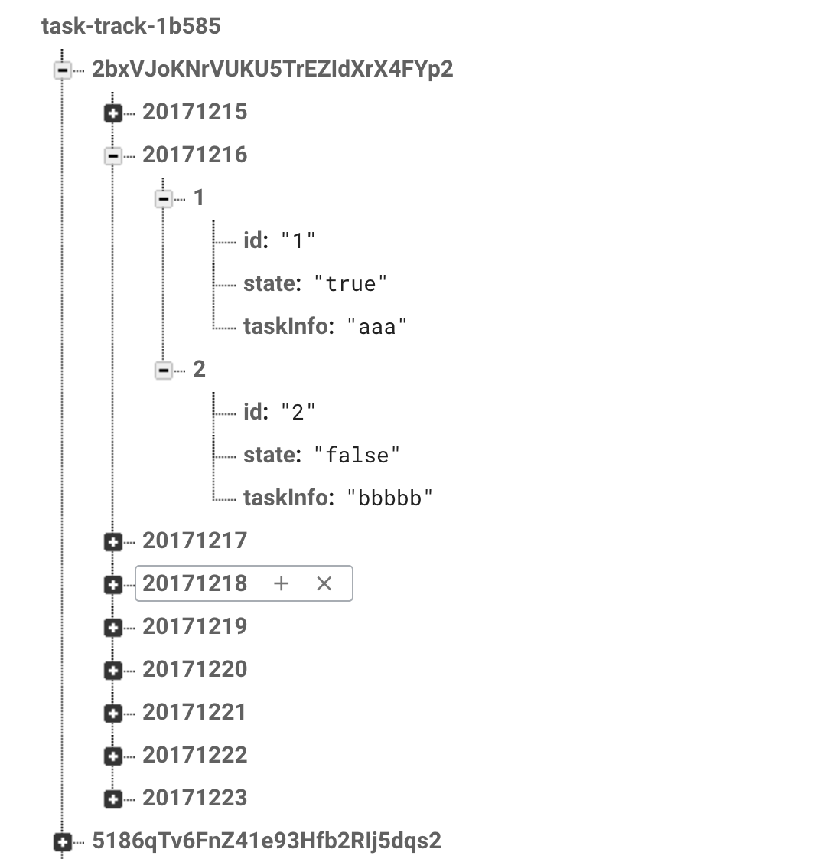
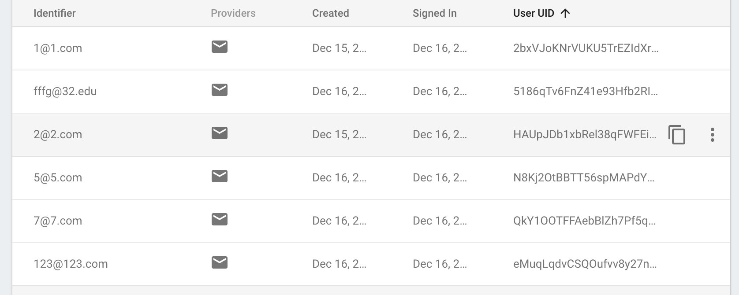
Firebase Structure

Slide 6
Need Improved
Some people like to write their task on paper, so that users can upload their task paper, Using Google Vision API to extract the task detail information;
Make my application can work with others, that means they can share tasks and watch their work progress

Slide 7
Thank You

