Slide 1
Soft Skills & Project Cycles in Data Science

Slide 2
Difference Between Statistician and Data Scientist
Statistician
Data is given (i.e. in text files)
Relatively focus on modeling
Data Scientist
Need to get data (i.e. from database)
Focus on business problems and results
Bring data to model
Bring model to data
Isolated from production system
Embedded in production system

Slide 3
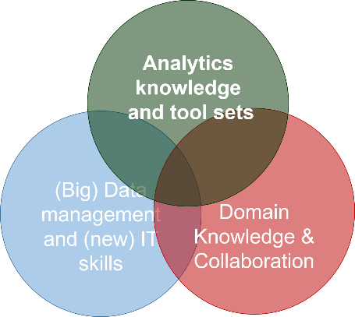
Three Pillars of Knowledge for Success
Understand and prepare data and features
Statistical methods and problem solving
Machine learning and data mining experience
Unstructured data
Big data infrastructure
Database and data retrieval
Software: Spark, SQL, R, Python …
“Cloud” Solution
Leadership
Problem definition
Communication skills
Collaboration &Teamwork
Strategic planning & execution

Slide 4
Three Different Types of Data Science Teams
Embedded within Business Team
Majority of the data scientists belong to
Bridge business team and technology team
Core Machine Learning Team
Hard core machine learning scientists
Focus on specific machine learning algorithms
Embedded within IT Organizations
Typical in many traditional industry sectors
Less effective due to weak link to business teams
Provide models, tools and infrastructure
Clear business objective
Become less common in the “cloud” age

Slide 5
Data Science Project Cycle (Overview)
Soft skills: communication, leadership, collaboration and business insights
Big data infrastructure and tool sets.
Strong modeling background
Resources, milestone and timeline
Data
Information
Knowledge
Insight
Decision & Action
Business problem and value

Slide 6
Data Science Project Cycle (Break down)
Business problem definition and understanding
Quantify business values
Computation resources accessment
Key milestones and timeline
Data science project formulation
Data quality and availability
Data preprocessing
Feature engineering
Model explore and development
Model training, validation, testing
A/B testing in production system
Model deployment in production environment
Monitoring and maintenance
Model update, refresh and addon
Model failure and retire
Business teams
Operation team
Business analyst team
Insight and reporting team
Technology team
Database and data warehouse team
Data engineering team
Software development team
Visualization dashboard team
Infrastructure team
Production implementation
Core machine learning team
Project management team
Program management team
Product management team
Senior leadership team
Leaders across organizations

Slide 7
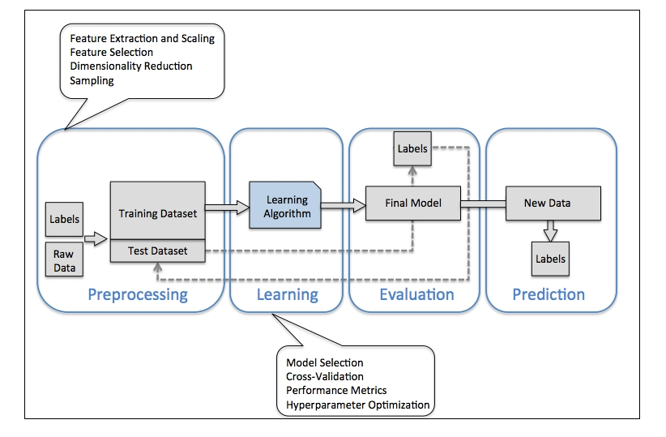
Example: Modeling Cycle for Classification Problems
* Python Machine Learning by Raschka, Sebastian

Slide 8
Online vs Offline Training
Model trained in batch using offline data
Make features used in the model available online
Model use online data to make real time decisions
Concept of offline data
Historical data in the data warehouse system
Slow to retrieve (i.e. hours to get needed data)
Very rich in general (i.e. click stream, detailed shopping history etc.)
Low cost to maintenance in data warehouse (i.e. hard disk)
Can be extracted in batch as raw material for features
Offline data are typical used for
Data exploratory
Feature engineering
Statistical or machine learning model development and selection
Concept of online data
Data available in real time to a model for real time decision making
High cost to maintenance for low latency
Limited selection of data usually available
Additional data can be added with effort
There are also offline-only models with regular batch process; and models training using online real time data and deploy in real time depending on different applications.

Slide 9
Business Domain Knowledge
Many technical skills and soft skills are easily transferable from one business sector to another such as
Statistical and ML methods, SQL, Spark
Procedures and best practices in problem formulation and modeling
Communication, leadership and collaboration
How to quickly obtain business domain knowledge?
Very similar to statistical consulting projects
Understand the current decision making process
Get familiar with current data acquisition procedures
Understand current modeling process and data flow
Outline business problems to solve
Job shadowing with office and field agents
Ask questions to understand business operation procedures
Identify current pain points and known-unknowns
Outbox thinking to identify unknown-unknowns
Current best practice across the industry
Read research/white paper, attend conference, meetup and talks
Reach out to domain specific experts

Slide 10
Communication: Speaking the Same Language
Interact with multiple teams across the entire project cycle
Easy to understand language that everyone understand
Be clean on deliverables, timeline and resource allocation
Technical modeling part requires communication skills too
Statistician, Operation Researcher, Economist, Computer Scientist, Market Researcher, …
Need to be familiar with different terminology, for example:
Label = Target = Outcome = Class = Response = Dependent Variables
Features = Attribute = Independent Variables = Predictors = Covariates
Dimensionality = number of features
Weights = Parameters
Learning = Fitting
Generalization = Applying to population or test data
Sensitivity = recall = hit rate = true positive rate

Slide 11
Common Pitfalls of Data Science Projects
Solve the wrong problem
Vague description of business objectives with potential dynamic change
Many opportunities to introduce misalignment across teams
Different point of views and priorities from different teams
Over promise on business value
Unrealistic high expectation is common for data science project
Assumptions are off-chart such as data and computation resources
We must communicate based on data and fact, not wishful thinking
Too optimistic about the timeline
Many uncertainties are not accounted for at planning stage
Fundamentally different from software develop or business analytics projects
Project management team does not have past experience
Too optimistic about data availability and quality
“Big data” is not a guarantee of good and relevant data
Often “ideal” data for the business problem are not available
Ignore or too optimistic about effort for preprocessing and feature engineering
Model cannot be scaled
Wrong estimation of computation resource and run-time
Mis-specified online / offline data, training, and implementation
Develop in small sample data and try to scale to larger dataset
Take too long to fail
As we are trying to push the boundary of current best practice, many project will fail
But team hesitate to make decisions to fail fast

Slide 12
Keep on Track for Data Science Career
Learning New Methods
Deep Learning
Reinforced Learning
Keep up with New Tools
TensorFlow, MxNet etc.
Spark
R/Python
Dynamic Dashboard
Explore New Applications
Internet of Things (IoT)
Robotics
Automatic Driving Cars
Apply New Methods to Existing Applications
Identify problems at daily work
Apply novel ways for existing solutions
It could be much faster / more accurate / more efficient etc.
Brand Yourself
LinkedIn
GitHub
Blogs and Posts
Personal Professional website

