Slide 1
Deep Learning
The New Tool in Data Scientist’s Tool Box

Slide 2
A Little Bit About Deep Learning History

Slide 3
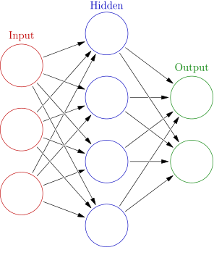

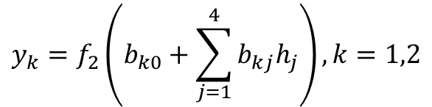
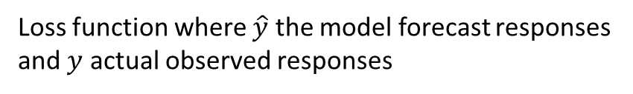


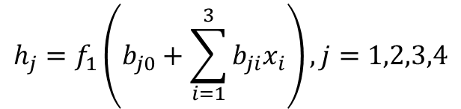











Simple Feed Forward Neural Network (FFNN)
Concepts stated as early as 1940s!
$$h_{1}$$
$$h_{j}=f_{1}\left(b_{j0}+\sum_{i=1}^{3}{b_{ji}x_{i}}\right), j=1,2,3,4$$
$$x_{1}$$
$$h_{2}$$
$$y_{1}$$
$$x_{2}$$
$$y_{k}=f_{2}\left(b_{k0}+\sum_{j=1}^{4}{b_{kj}h_{j}}\right), k=1,2$$
$$h_{3}$$
$$y_{2}$$
$$x_{3}$$
$$h_{4}$$
$$y=f_{2}\left(f_{1}\left(x,b_{1}\right),b_{2}\right)$$
Vector representation
$$\left[x_{1},x_{2},x_{3}\right]:$$
Input features vector for one observation
$$\left[y,y_{2} \right]:$$
Actual output outcome for one observation
$$f_{1}\left(∙\right),f_{2}\left(∙\right):$$
Activation functions, usually non-linear
$$L\left(y,\hat{y}\left(b,x\right) \right):$$
Loss function where $\hat{y}$ the model forecast responses
and $y$ actual observed responses
Total number of parameters (i.e. size of a NN): (3+1)*4 + (4+1)*2 = 26

Slide 4
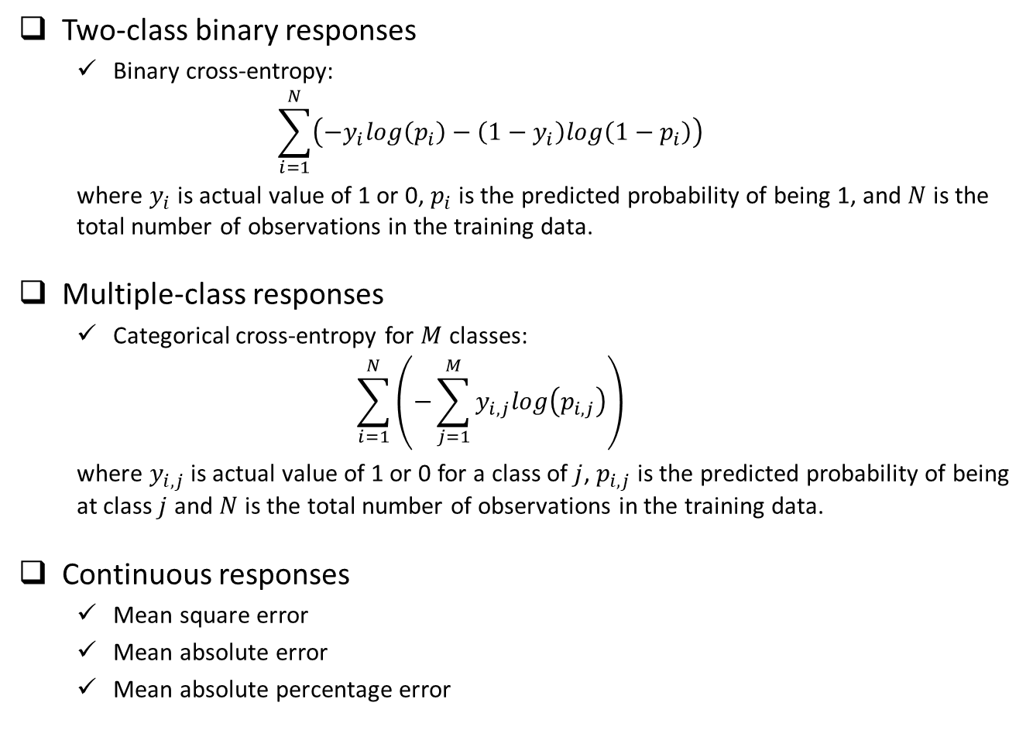
Typical Loss Functions
Two-class binary responses
Binary cross-entropy:
$$\sum_{i=1}^{N}{\left(−y_{i}log\left(p_{i}\right)−\left(1−y_{i}\right)log\left(1−p_{i}\right)\right)}$$
where $y_{i}$ is actual value of 1 or 0, $p_{i}$ is the predicted probability of being 1, and $N$ is the total number of observations in the training data.
Multiple-class responses
Categorical cross-entropy for $M$ classes:
$$\sum_{i=1}^{N}{\left(−\sum_{j=1}^{M}{y_{i,j}log\left(p_{i,j}\right)}\right)}$$
where $y_{i,j}$ is actual value of 1 or 0 for a class of $j$, $p_{i,j}$ is the predicted probability of being at class $j$ and $N$ is the total number of observations in the training data.
Continuous responses
Mean square error
Mean absolute error
Mean absolute percentage error

Slide 5
From Slow Progress to Wide Adoption
1940s – 1980s, very slow progress due to:
Computation hardware capacity limitation
Number of observations with labeled results in the dataset
Lack efficient algorithm to estimate the parameters in the model
1980s – 2010, a few applications in real word due to:
Moore’s Law + GPU
Internet generated large labeled dataset
Efficient algorithm for optimization and better activation functions
2010-Now, very broad application in various areas:
Near-human-level image classification
Near-human-level handwriting transcription
Much improved speech recognition
Much improved machine translation
Now we know working neural network models usually contains many layers (i.e. the depth of the network is deep), and to achieve near-human-level accuracy the deep neural network need huge training dataset (for example millions of labeled pictures for image classification problem).

Slide 6
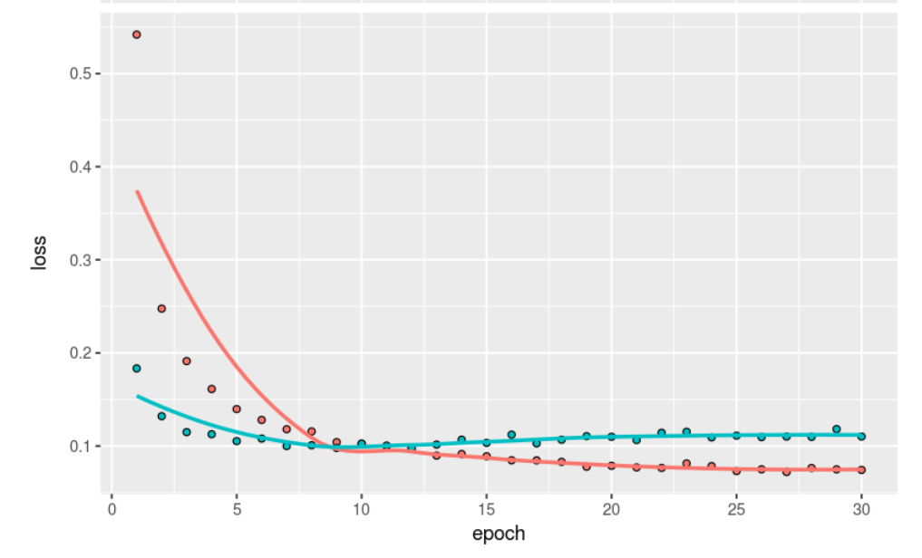
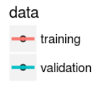
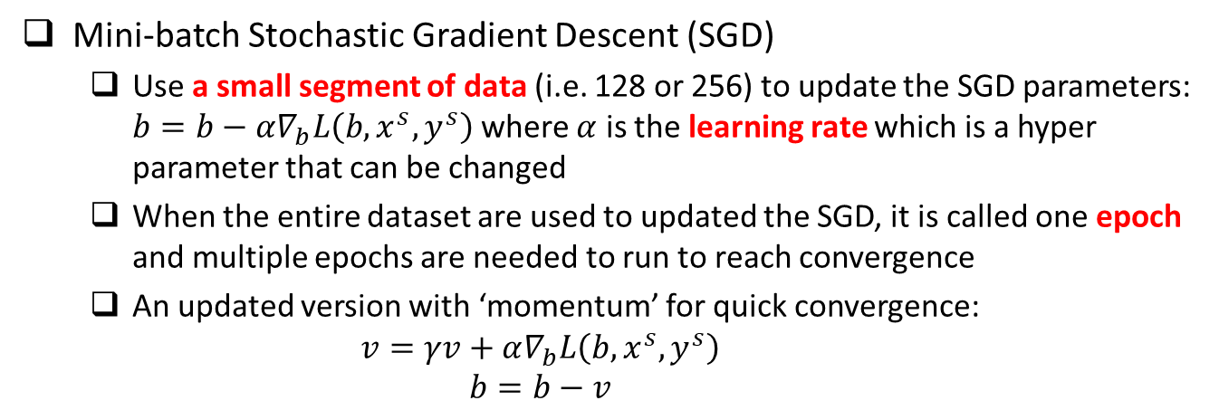
Optimization Methods
Mini-batch Stochastic Gradient Descent (SGD)
Use a small segment of data (i.e. 128 or 256) to update the SGD parameters: $b=b−α∇_{b}L\left(b,x^{s},y^{s}\right)$ where $α$ is the learning rate which is a hyper parameter that can be changed
When the entire dataset are used to updated the SGD, it is called one epoch and multiple epochs are needed to run to reach convergence
An updated version with ‘momentum’ for quick convergence:
$$v=γv+α∇_{b}L\left(b,x^{s},y^{s}\right)$$
$$b=b−v$$

Slide 7


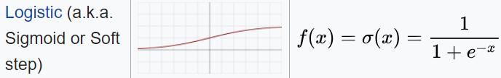
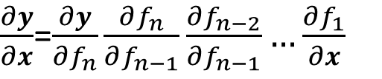
Activation Functions
$$y=f_{n}\left(f_{n−1}\left(f_{n−2}\left(…f_{1}\left(x,b_{1}\right)…,b_{n−2}\right),b_{n−1}\right),b_{n}\right)$$
Gradient:
$\frac{∂y}{∂x}$=$\frac{∂y}{∂f_{n}}\frac{∂f_{n}}{∂f_{n−1}}\frac{∂f_{n−2}}{∂f_{n−1}}…\frac{∂f_{1}}{∂x}$
Intermediate layers
Relu (i.e. rectified linear unit) is usually a good choice which has the following good properties: (1) fast computation; (2) non-linear; (3) reduced likelihood of the gradient to vanish; (4) Unconstrained response
Sigmoid, studied in the past, not as good as Relu in deep learning, due to the gradient vanishing problem when there are many layers
Last layer which connects to the output
Binary classification: sigmoid with binary cross entropy as loss function
Multiple class, single-label classification: softmax with categorical cross entropy for loss function
Continuous responses: identity function (i.e. y = x)

Slide 8
Deal With Overfitting
Huge number of parameters, even with large amount of training data, there is a potential of overfitting
Overfitting due to size of the NN (i.e. total number of parameters)
Overfitting due to using the training data for too many epochs
Solution for overfitting due to NN size
Dropout: randomly dropout some proportion (such as 0.3 or 0.5) of nodes at each layer, which is similar to random forest concept
Using L1 or L2 regularization in the activation function at each layer
Solution for overfitting due to using too many epochs
Run NN with large number of epochs to reach overfitting region through cross validation from training/validation vs. epoch curve
Choose the model with number of epochs that have the minimum validation accuracy as the final NN model

Slide 9
Recap of A Few Key Concepts
Data: Require large well-labeled dataset
Computation: intensive matrix-matrix operation
Structure of fully connected feedforward NN
Size of the NN: total number of parameters
Depth: total number of layers (this is where deep learning comes from)
Width of a particular layer: number of nodes (i.e. neurons) in that layer
Activation function
Intermediate layers
Last layer connecting to outputs
Loss function
Classification (i.e. categorical response)
Regression (i.e. continuous response)
Optimization methods (SGD)
Batch size
Learning rate
Epoch
Deal with overfitting
Dropout
Regularization (L1 or L2)

Slide 10
Deep Learning Models Across Platforms

Slide 11
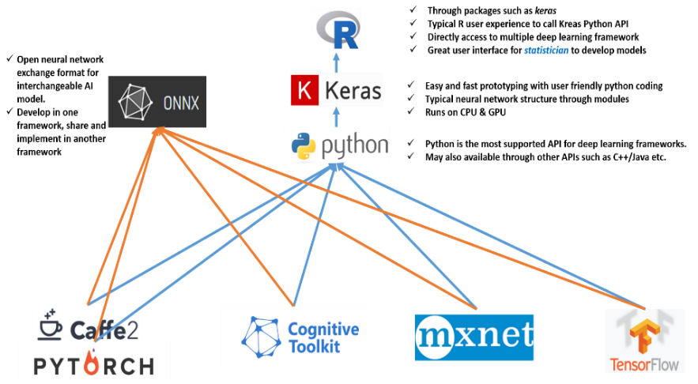
Open NN Exchange Format (ONNX)

Slide 12
The MNIST Dataset

Slide 13
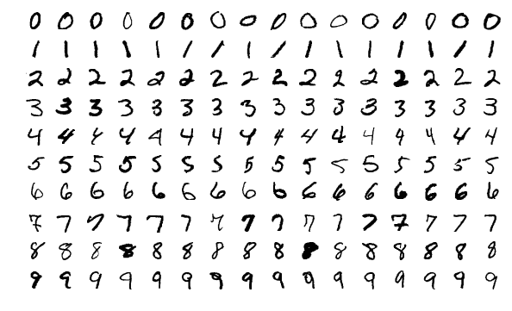
MNIST Dataset
Originally created by NIST, then modified for machine leaning training purpose
Contains 70000 handwritten digit images and the label of the digit in the image where 60000 images are the training dataset and the rest 10000 images are the testing dataset.
Census Bureau employees and American high school students wrote these digits
Each image is 28x28 pixel in greyscale
Yann LeCun used convolutional network LeNet to achieve < 1% error rate at 1990s

Slide 14
Using Keras R Package To Build Deep Neural Network Model

Slide 15
Procedures
Data preprocessing (from image to list of input features)
One image of 28x28 grey scale value matrix → 784 column of features
Scale the value to between 0 and 1, by divide each value by 255
Make response categorical (i.e. 10 columns with the corresponding digit column 1 and rest columns zero.
Load keras package and build a neural network with a few layers
Define a placeholder object for the NN structure
1st layer using 256 nodes, fully connected, using ‘relu’ activation function and connect from the input 784 features
2nd layer using 128 nodes, fully connected, using ‘relu’ activation function
3rd layer using 64 nodes, fully connected, using ‘relu’ activation function
4th layer using 10 nodes, fully connected, using ‘softmax’ activation function and connect to the output 10 columns
Add drop out to the first three layers to prevent overfitting
Compile the NN model, define loss function, optimizer, and metrics to follow
Fit the NN model using the training dataset, define epoch, mini batch size, and validation size used in the training where the metrics will be checked
Predict using the fitted NN model using the testing dataset

Slide 16
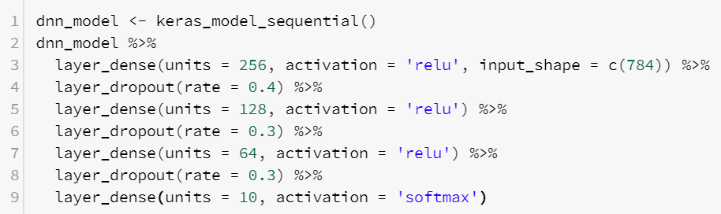
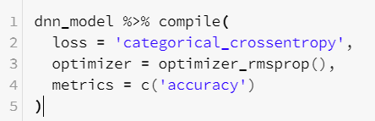
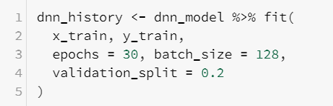

R Scripts
Define NN Structure
Compile and define loss function, optimizer and metrics to monitor during the training
Fit the model using training dataset and define epochs, batch size and validation data
Predict new outcomes using the trained model

Slide 17
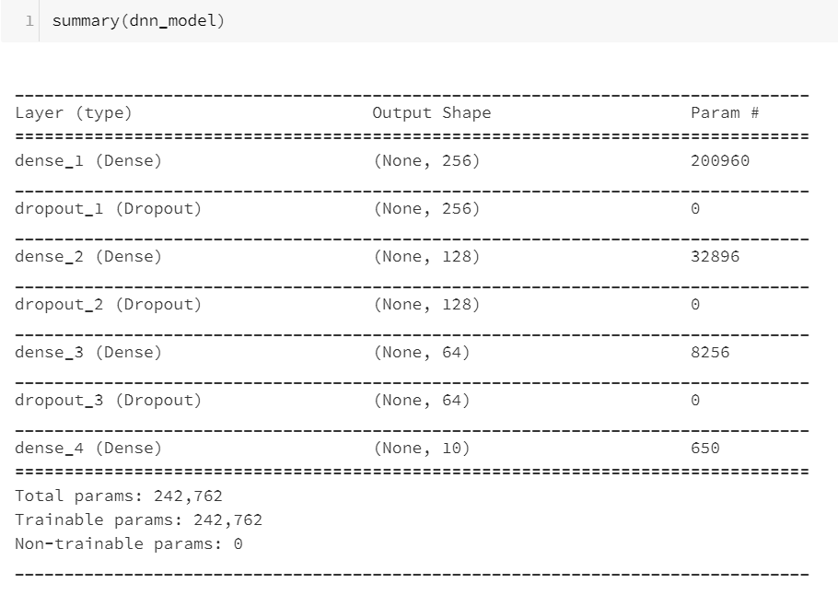
Size of the Model

Slide 18
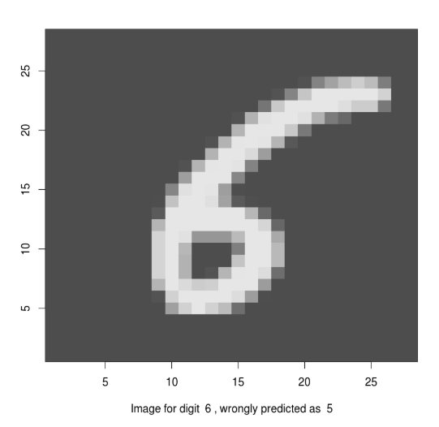
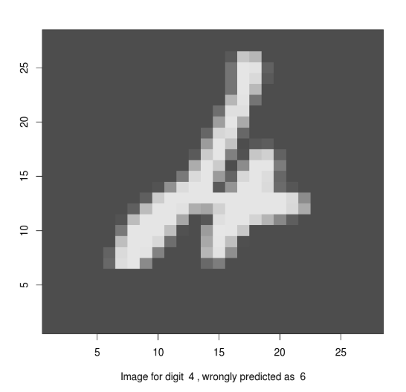
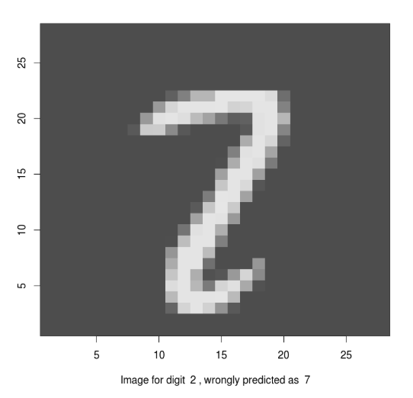
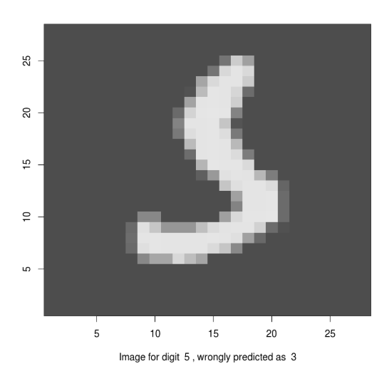
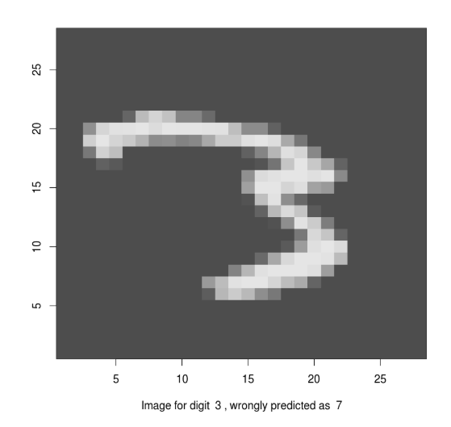
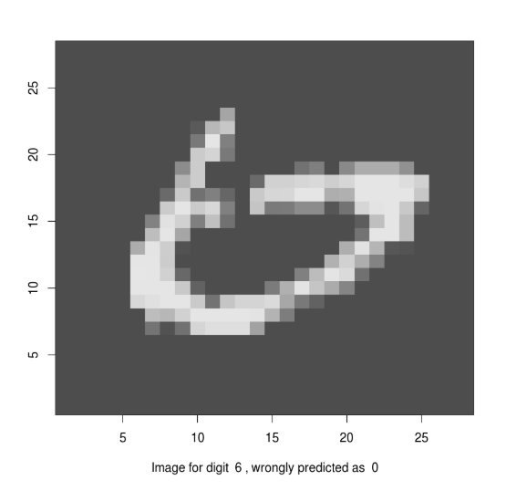
Performance
Accuracy: 97.99% without much fine tuning
A few misclassified images:

Slide 19
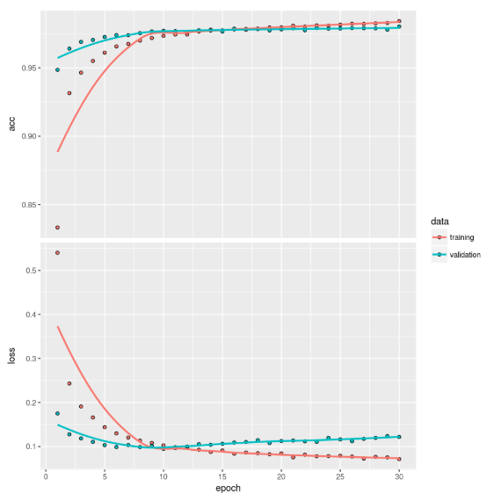
Cross-Validation Curve

Slide 20
Big Data Cloud Platform
The New Essential

Slide 21
A Brief Introduction

Slide 22
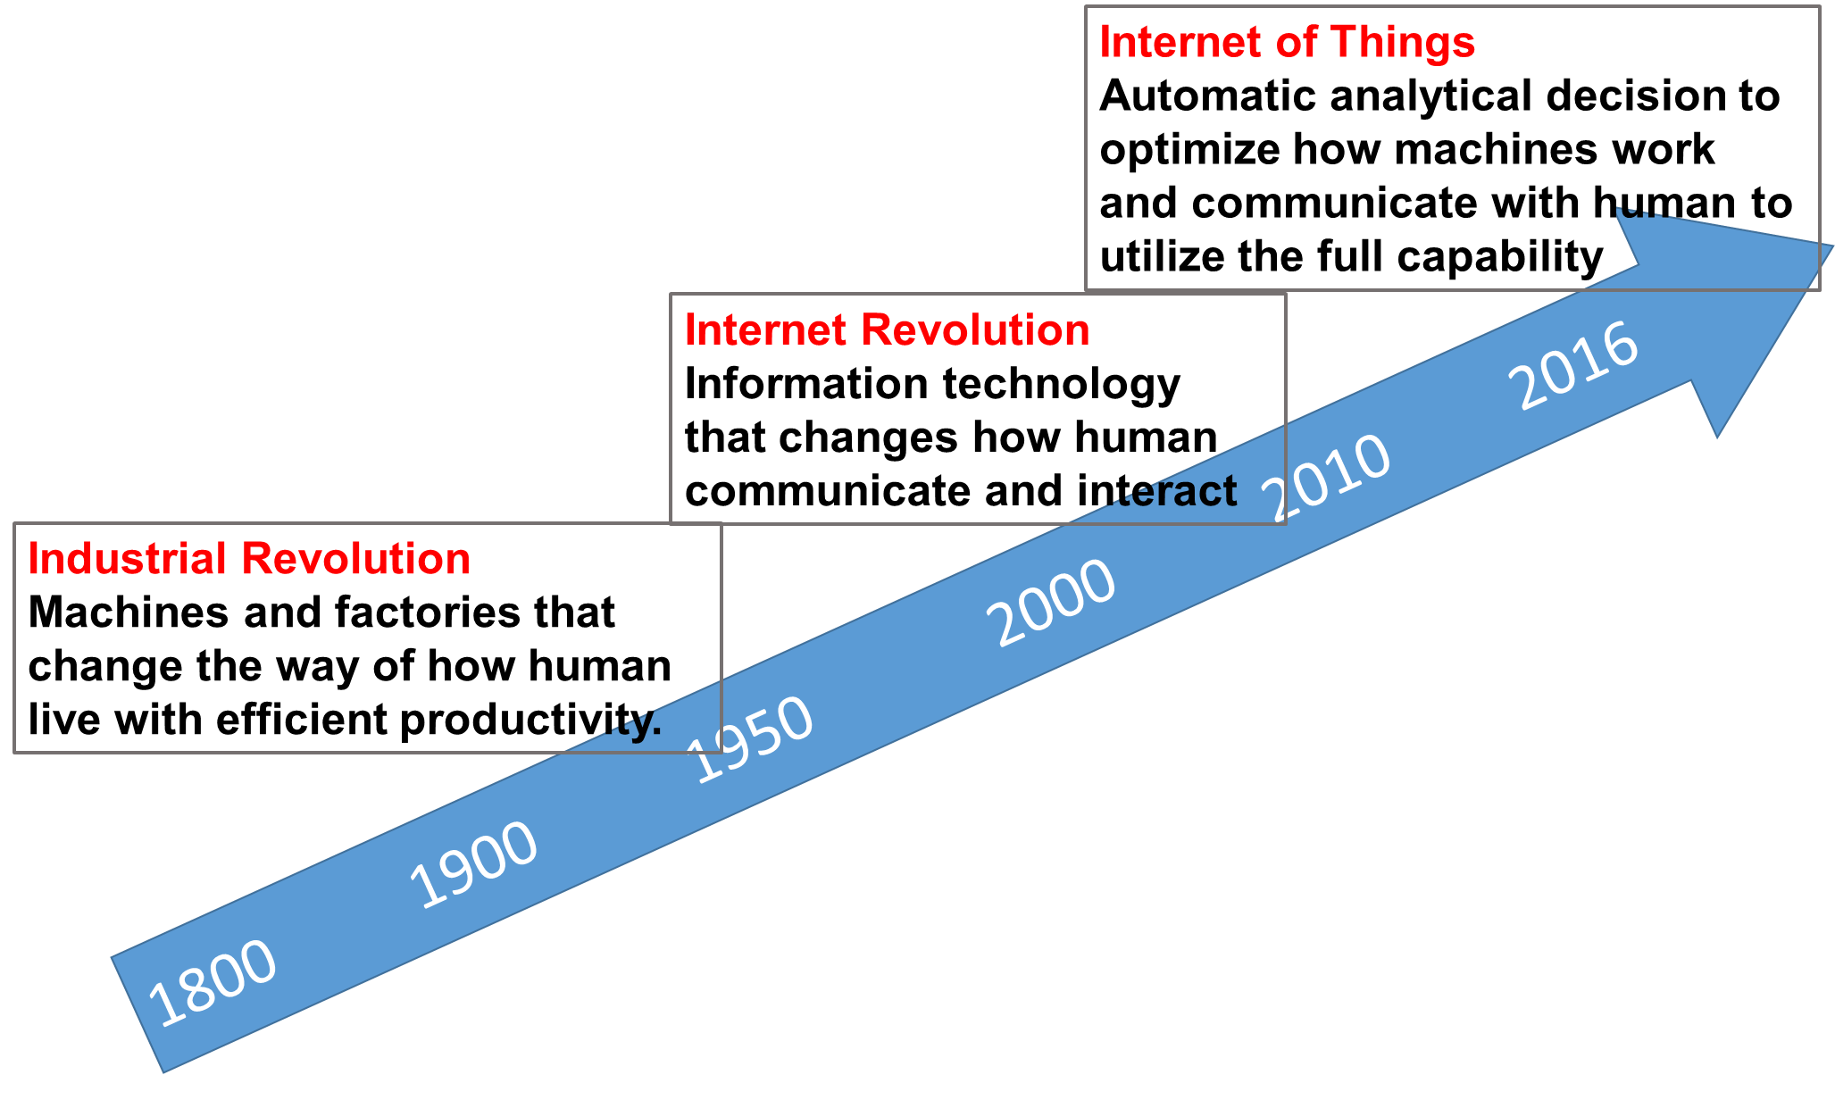
New Wave of Industrial Revolution
PB
TB
KB

Slide 23
History of Statistician in the America
Data in the cloud
Data in one computer’s disk
or memory
Data in
tapes or punch cards
American Statistical Association
1839
First Statistical Laboratory in US Universities
1934
Data Science Revolution
2001
Now
2018
Data in
pieces of
paper
Easy access to data
become universal in all areas
Iowa State University
with study of Agriculture
2nd oldest continuously operating professional society in the US

Slide 24
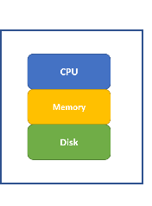
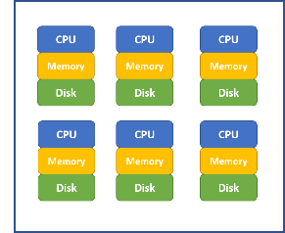
Big Data Cloud Framework
Cluster of Computers
(Cloud)
Single Computer
(Local)
Shared disk
Shared memory
Parallel computation
Data redundancy
Low coast hardware
Professionally managed
Scalability to process large dataset
Centralized data source for easy retrieval
Robust and reliable for data safety
Worry-free behind sense maintenance
Production ready for easy implementation
Automatic refresh and scheduled update

Slide 25
Hadoop / MapReduce / Spark
Hadoop build on Commodity Hardware
Low cost and scalable by simply added more hardware
Low reliability (such as regular hard disk failures) for each individual computation node
Need robust file system to ensure data safety and integrity
HDFS (Hadoop Distributed File System)
Cut data into small segments (i.e. 64MB) as blocks
Duplicate each data block N times (i.e. N=3) and save them across computation nodes in the cluster
Master node saves all the data mapping information (i.e. meta data)
Data nodes save actual data blocks
When a few data nodes are down, data is still safe
MapReduce Operation (Demo)
Hive and Pig: application software for easy access the data stored in HDFS and apply analytics
Spark
Build on top of HDFS and other cluster file systems
Provide in-memory computation for faster speed
Provide parallel algorithm for many machine learning methods through MLib
Provide easy to use interface for data scientist
Users do not need to know the details of how data and algorithm are paralleled

Slide 26
Cloud Environments Providers
Amazon AWS cloud environment
Microsoft Azure cloud environment
Google cloud platform
Databricks Community Edition
For beginners, Databricks provides an easy to use cloud system for learning purpose
It provides a user-friendly web-based notebook environment that can create Hadoop/Spark/GPU cluster on the fly to run R/Python/Scala/SQL
Some reference:
https://docs.databricks.com/user-guide/faq/sparklyr.html
http://spark.rstudio.com/index.html

Slide 27
Databricks Big Data Platform with Spark

Slide 28
Library Installation
First, we need to install sparklyr package which enables the connection between master or local node to Spark cluster environments.
As it will install more than 10 dependencies, it may take more than 5 minutes to finish. Be patient while it is installing!
Once the installation finishes, load the sparklyr package as illustrated by the following code:
if (!require("sparklyr")) { install.packages("sparklyr") }
library(sparklyr)

Slide 29
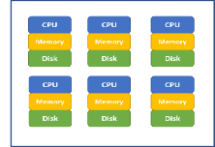

Create Connection
we need to create a Spark Connection to link the local node running the R notebook to the Spark environment. The options for different environments are different, here we set “method” option to “databricks”:
The created Spark Connection (i.e. sc) will be the pipe that connects R notebook to the Spark Cluster.
sc <- spark_connect(method = "databricks")
Spark Cluster
R Notebook
Spark Connection
sc

Slide 30
Establish Connection to Spark DataFrame
For illustration purpose, we will use the iris dataset which is part of the dplyr package:
library(dplyr) head(iris)
Copy local R data frame: iris to Spark DataFrame iris and we can refer Spark DataFrame iris through iris_tbl:
iris_tbl <- sdf_copy_to(sc = sc, x = iris, overwrite = T)
Spark Cluster
R Notebook
Spark Connection
sc
iris_tbl
iris
We can also establish connection between local R object my_df_tbl to existing Spark DataFrame my_df: my_df_tbl <- tbl(sc, my_df)

Slide 31
Manipulate Spark DataFrame Through R
Once connection is established, we can always refer iris_tbl in R notebook to operate on Spark DataFrame iris using the scalable computation power of Spark cluster
iris_tbl %>% mutate(Sepal_Width = ROUND(Sepal_Width * 2) / 2) %>% group_by(Species, Sepal_Width) %>% summarize(count = n(), Sepal_Length = mean(Sepal_Length),
stdev = sd(Sepal_Length))
With the sparklyr packages, we can use many functions in dplyr to Spark DataFrame directly to iris_tbl, same as we are applying dplyr functions to a local R data frame.
The advantage is more significant when the Spark DataFrame is huge (such as the data take 20GB+ of memory to store)

Slide 32
Collect Result Back to R Notebook
Even though we can run many of the dplyr functions on Spark DataFrame, we cannot apply functions from other packages to Spark DataFrame direction (such as ggplot()).
To use functions from other packages, we need to bring data (usually aggregated and much smaller in size) back to R Notebook using collect() function.
Once the data is brought back to R Notebook, we can use any library. With code below, iris_summary is a local R object
iris_summary <- iris_tbl %>% mutate(Sepal_Width = ROUND(Sepal_Width * 2) / 2) %>% group_by(Species, Sepal_Width) %>% summarize(count = n(), Sepal_Length = mean(Sepal_Length),
stdev = sd(Sepal_Length)) %>% collect

Slide 33
Apply Statistical and Machine Learning Models to Spark DataFrame Through R
One of the BIGGEST advantage is that there are many popular statistical and machine learning models developed in Spark system (i.e. MLlib) for Spark DataFrame to leverage the scalable computation power of Spark Cluster.
These models include: linear regression, logistic regression, Survival Regression, Generalized Linear Regression, Decision Trees, Random Forests, Gradient-Boosted Trees, Principal Components Analysis, Naive-Bayes, K-Means Clustering.
Conveniently, we can use R notebook to call functions to apply these machine learning algorithms to Spark DataFrame which enable minimum effort for statistician to leverage the Spark environment.

Slide 34
Fit Regression to Spark DataFrame
We can call ml_linear_regression to fit a linear regression model to Spark DataFrame iris by referring to iris_tbl
The response variable is "Sepal_Length“
The explanatory variables are "Sepal_Width", "Petal_Length", "Petal_Width"
The fitted results are stored in fit1
fit1 <- ml_linear_regression(x = iris_tbl, response = "Sepal_Length", features = c("Sepal_Width", "Petal_Length", "Petal_Width"))
summary(fit1)

Slide 35
Fit K-means Cluster to Spark DataFrame
We can call ml_kmeans() to fit a k-mean clustermodel to Spark DataFrame iris by referring to iris_tbl
The variables are "Petal_Length", "Petal_Width"
The fitted results are stored in fit2
We can then apply the model to a specific dataset (in this case the original dataset) using sdf_predict() function
Finally we can use collect() function to bring results back to R Notebook for further analysis
fit2 <- ml_kmeans(x = iris_tbl, centers = 3, features = c("Petal_Length", "Petal_Width"))
print(fit2)
prediction = collect(sdf_predict(fit2, iris_tbl))

Slide 36
Quick Summary
In the above a few sub-sections, we illustrated:
The relationship between local node (i.e. where R notebook is running) and Spark Clusters (i..e where massive data are stored and computation are done in parallel)
Sparklyr library to established the connection between local node and Spark Cluster
How to copy a local data frame to a Spark DataFrames (please note if your data is already in Spark environment, there is no need to copy).
Establish connection between local R object my_df_tbl to existing Spark DataFrame my_df: my_df_tbl <- tbl(sc, my_df)
How to manipulate Spark DataFrames for data cleaning and preprocessing through dplyr functions
How to fit statistical and machine learning models using R notebook to Spark DataFrame in a truly parallel manner
How to collect information from Spark DataFrames back to a local R object (i.e. local R data frame) for future analysis
List of functions in Sparklyr: http://spark.rstudio.com/reference/index.html

Slide 37
Soft Skills & Project Cycles in Data Science

Slide 38
Difference Between Statistician and Data Scientist

Slide 39
Science
Engineering
Electrical Engineering
Physics
Statistical
Engineering
Statistics
+
Big Data & Software
=
Data Science
Collection of materials for statistical engineering: http://asq.org/divisions-forums/statistics/quality-information/statistical-engineering

Slide 40
Statis-tician
Relatively focus on modeling (i.e. science)
Data is relatively small in size and clean in text file formats
Data Scientist
Mainly focus on business problem & result (i.e. engineering)
Need to work with messy and large amount data in various formats
Usually structured data
Both structured & unstructured data
Usually isolated from production system
Usually embedded in production system
Bring data to model
Bring models to data

Slide 41
Skills Career Title Education
Business
Analyst
Modeling Knowledge with a Scripting Language (Python/R)
BS in
Statistics
Business
Intelligence
Engineer
Data
Engineer
Production System Knowledge &
Programming
(such as SQL, Java, Big Data Platform)
MS in
Statistics
Data
Scientist
Research
Scientist
Business Knowledge and Dashboard Experience (such as Tableau, R-Shiny)
PhD in
Statistics
Applied
Scientist
If you are good at all three areas, you become a "full-stack" data scientist!
Each career path has its own promotion cycle.

Slide 42
Generalist
Business problem formulation skills
Data preprocessing skills
Statistical and machine learning methods
Deep learning applications knowledge
Model building process experience
Specialist
Natural language understanding
Image and video analysis
Voice recognition
Language translation

Slide 43
Data Science Project Cycles

Slide 44
Data Science Project Cycle (Overview)
Soft skills: communication, leadership, collaboration and business insights
Big data infrastructure and tool sets.
Strong modeling background
Resources, milestone and timeline
Data
Information
Knowledge
Insight
Decision & Action
Business problem and value

Slide 45
Model exploring and development
Model training, validation, testing
Model selection

Slide 46
Data science formulation
Data quality and availability
Data preprocessing
Feature engineering

Slide 47
Business problem definition and understanding
Quantifying business value and define key metrics
Computation resources assessment
Key milestones and timeline
Data security, privacy and legal review

Slide 48
A/B testing in production system
Model deployment in production environment
Exception management
Performance monitoring

Slide 49
Model tuning and re-training
Model update and add-on
Model failure and retirement
…

Slide 50
Business problem definition and understanding
Quantifying business value and define key metrics
Computation resources assessment
Key milestones and timeline
Data security, privacy and legal review
Data science formulation
Data quality and availability
Data preprocessing
Feature engineering
Model exploring and development
Model training, validation, testing
Model selection
A/B testing in production system
Model deployment in production environment
Exception management
Performance monitoring
Model tuning and re-training
Model update and add-on
Model failure and retirement
Project Cycle

Slide 51
Cross Team
Collaboration
Business teams
Operation team
Business analyst team
Insight and reporting team
Technology team
Database and data warehouse team
Data engineering team
Infrastructure team
Core machine learning team
Software development team
Visualization dashboard team
Production implementation
Project management team
Program management team
Product management team
Senior leadership team
Leaders across organizations
Agile-Style Project Management

Slide 52
Online vs Offline Training
Model trained in batch using offline data
Make features used in the model available online
Model use online data to make real time decisions
Concept of offline data
Historical data in the data warehouse system
Slow to retrieve (i.e. hours to get needed data)
Very rich in general (i.e. click stream, detailed shopping history etc.)
Low cost to maintenance in data warehouse (i.e. hard disk)
Can be extracted in batch as raw material for features
Offline data are typical used for
Data exploratory
Feature engineering
Statistical or machine learning model development and selection
Concept of online data
Data available in real time to a model for real time decision making
High cost to maintenance for low latency
Limited selection of data usually available
Additional data can be added with effort
There are also offline-only models with regular batch process; and models training using online real time data and deploy in real time depending on different applications.

Slide 53
Common Pitfalls of Data Science Projects

Slide 54
Problem Formulation Stage
Solving the wrong problem
Vague description of business needs
Misalignment across many teams
Data scientists are not involved in the initial discussion
Over promise on business value
Unrealistic high expectation
Assumptions are way off-chart
Data scientist’s data-driven and fact-base voice is not heard

Slide 55
Project Planning Stage
Too optimistic about the timeline
Project management team does not have past experience
Many uncertainties are not accounted for at planning stage
Fundamentally different from other projects
Too optimistic about data availability and quality
Big data is not a guarantee of good and relevant data
Ideal data for the business problem is not available
Unexpected efforts to bring the right data

Slide 56
Modeling Stage
Un-representative data
Too optimistic about preprocessing and feature engineering
Overfitting and obsession for complicated models
Take too long to fail

Slide 57
Productionization Stage
Fail to scale in real time applications
Computation capacity, data storage, or latency constrains
Not enough engineering resources
Missing necessary checkup
Lack model monitoring
Lack Model tuning, re-training and retirement plan
Bad production performance
Lack needed A/B testing or shadow mode
Data availability and stability in real time

Slide 58
Soft Skills

Slide 59
Leading With Statistics
Strong modeling background should guide the project from the beginning of the cycle
Keep a high standard with data-driven and model-backed decision making process
Clearly communicate potential issues for the project as well as providing proactive suggestions

Slide 60
Communication:
Speaking the Same Language
Interact with multiple teams across the entire project cycle
Easy to understand language that everyone understand
Be clean on deliverables, timeline and resource allocation
Technical modeling part requires communication skills too
Statistician, Operation Researcher, Economist, Computer Scientist, Market Researcher, …
Need to be familiar with different terminology, for example:
Label = Target = Outcome = Class = Response = Dependent Variables (i.e. Y)
Features = Attribute = Independent Variables = Predictors = Covariates (i.e. X)
Weights = Parameters
Learning = Fitting
Generalization = Applying to population or test data
Sensitivity = recall = hit rate = true positive rate

Slide 61
Communication: Different Styles
Statistics
Data Science
All kind of errors
Type-I error
Type-II error
Mean square error
Dummy variables
Lack of fit
Loss function
Failure Rate
Hazard Model
Penalty
Discrimination Function
…
Accuracy
Precision
One-hot encoding
Faithfulness
Information gain
Golden Standard
Smart Algorithm
Intelligent Procedure
Knowledge Discovery
…
* Partially Adopted from Dennis Lin’s FTC Talk

Slide 62
Business Domain Knowledge
Many technical skills and soft skills are easily transferable from one business sector to another such as
Statistical and ML methods, SQL, Spark
Procedures and best practices in problem formulation and modeling
Communication, leadership and collaboration
How to quickly obtain business domain knowledge?
Very similar to statistical consulting projects
Understand the current decision making process
Get familiar with current data acquisition procedures
Understand current modeling process and data flow
Outline business problems to solve
Job shadowing with office and field agents
Ask questions to understand business operation procedures
Identify current pain points and known-unknowns
Outbox thinking to identify unknown-unknowns
Current best practice across the industry
Read research/white paper, attend conference, meetup and talks
Reach out to domain specific experts

Slide 63
Keep on Track for Data Science Career
Learning New Methods
Deep Learning
Reinforced Learning
Keep up with New Tools
TensorFlow, MxNet etc.
Spark
R/Python
Dynamic Dashboard
Explore New Applications
Internet of Things (IoT)
Robotics
Automatic Driving Cars
Apply New Methods to Existing Applications
Identify problems at daily work
Apply novel ways for existing solutions
It could be much faster / more accurate / more efficient etc.
Brand Yourself
LinkedIn
GitHub
Blogs and Posts
Personal Professional website

Slide 64
List of References
Deep Learning Using R, François Chollet with J. J. Allaire, ISBN 9781617295546 (2018)
Introduction to Data Science (https://scientistcafe.com/ids/ ), Draft, CRC Press Contracted
https://keras.rstudio.com/
http://spark.rstudio.com/
https://databricks.com/spark/about
https://github.com/onnx/onnx

Slide 65
Thank you!

