Slide 1


Volume Deformations in Action
A Forensic Reconstruction of George Washington
Dianne Hansford

Slide 2
Background
Summer ’05 marks the 250th anniversary of GW as officer in French & Indian war
Mt. Vernon Society will commemorate anniversary
Commissioned three life-sized statues
  19: officer in British army (surveyor)
  45: led revolutionary army (on horse)
  57: sworn in as President (hand on bible)
Notes:
Face expected to be the most accurate

Slide 3
Project Team
Anthropologists
  Jeff Schwarz
  @ Univ. Pittsburg
  Matt Tocheri
Computer Scientists
  Anshuman Razdan
  Gerald Farin
  Dianne Hansford
  Jeremy Hansen
Artist &
Graphic/Digital Artist
  Dan Collins
  Gene Cooper
Rapid Prototyping
  Scott Van Note

Slide 4
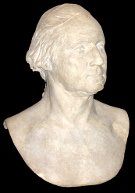
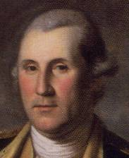
Given Information / Evidence
Bust made at age 53 (Houdon)
Life mask made at age 53 (Houdon)
Life size statue at age 53 (Houdon)
Portraits
  G. Stuart (age 63+)
  C. Peale (age 50+)
Dentures
Clothing and other artifacts
Historic and anecdotal evidence

Slide 5
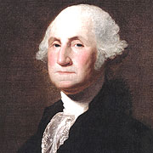
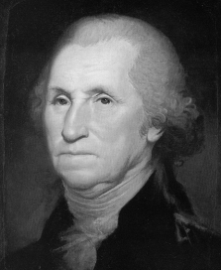
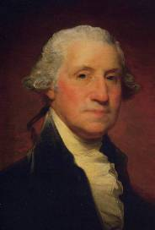
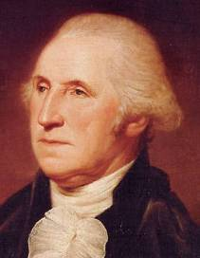
The Many Faces of GW

Slide 6
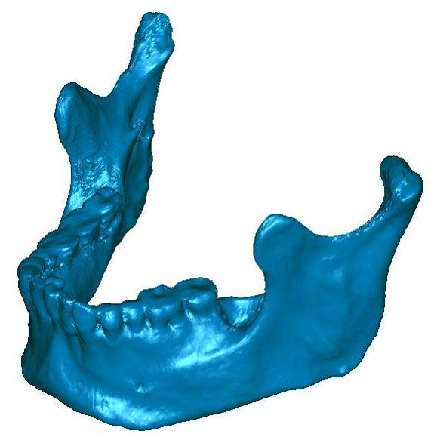
A Hard Problem Made Harder
GW began loosing teeth at age 24
GW dentures did not fit comfortably
Tooth loss Bone loss facial feature changes

Slide 7
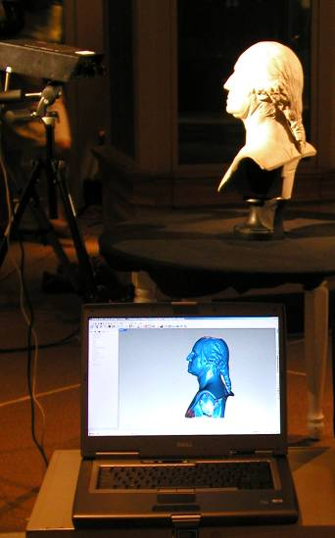

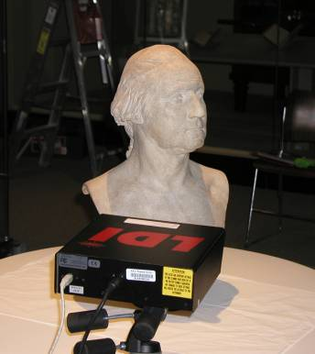
Given Info Scanned
Notes:
Difficulties in scanning and stitching together.
Challenges in getting permission to scan and convincing museum management that the laser scanners will not damage the works.

Slide 8
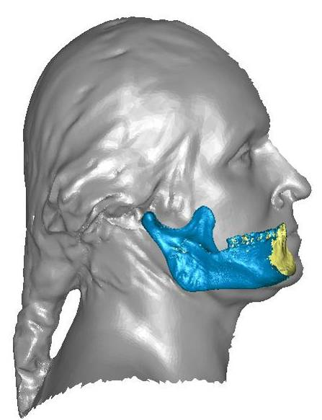
Face Reconstruction Process
Mandibles from 20-year-old contemporary of GW
Modify digital copy to fit into 53-year-old face mask of GW
  Fit to dentures
  Bone loss
  Dimensions of face
  Normal aging

Slide 9
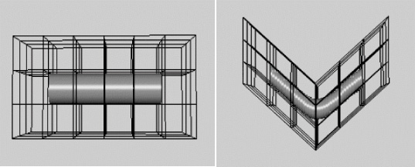
B-spline Volume Deformations
References
  Bezier ’74
  Sederberg & Perry ’86

Slide 10
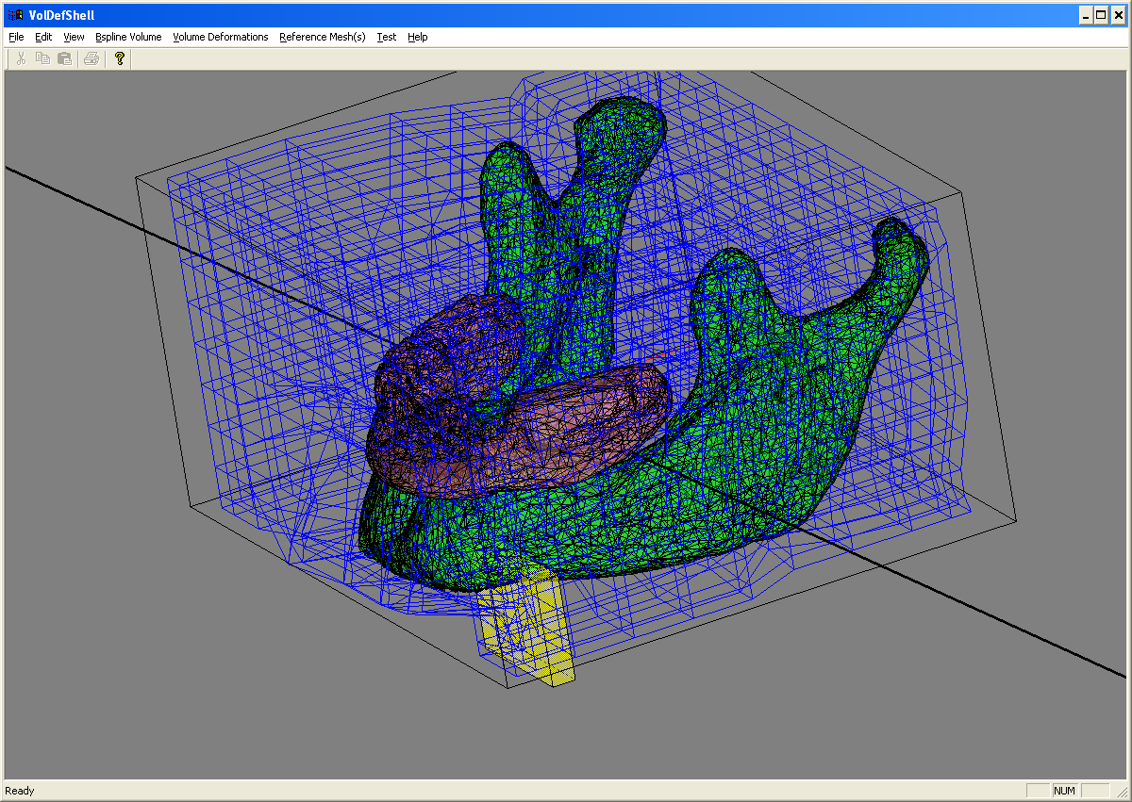
Deformation Operations
Rotate about a line
Bend about a line
Translate sets of control points
Taper cross section(s)
Scale
Move
...
Geomagic
Isolation of deformation effects via a “deformation box”

Slide 11
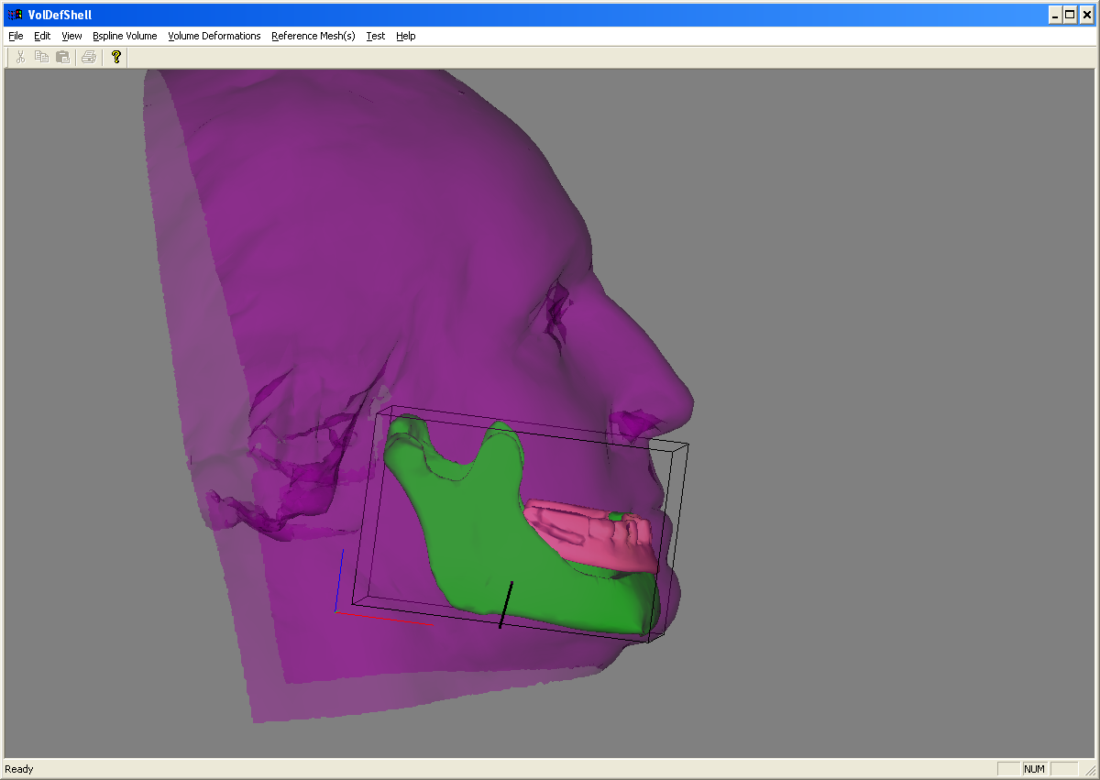
Mandible Deformation I

Slide 12
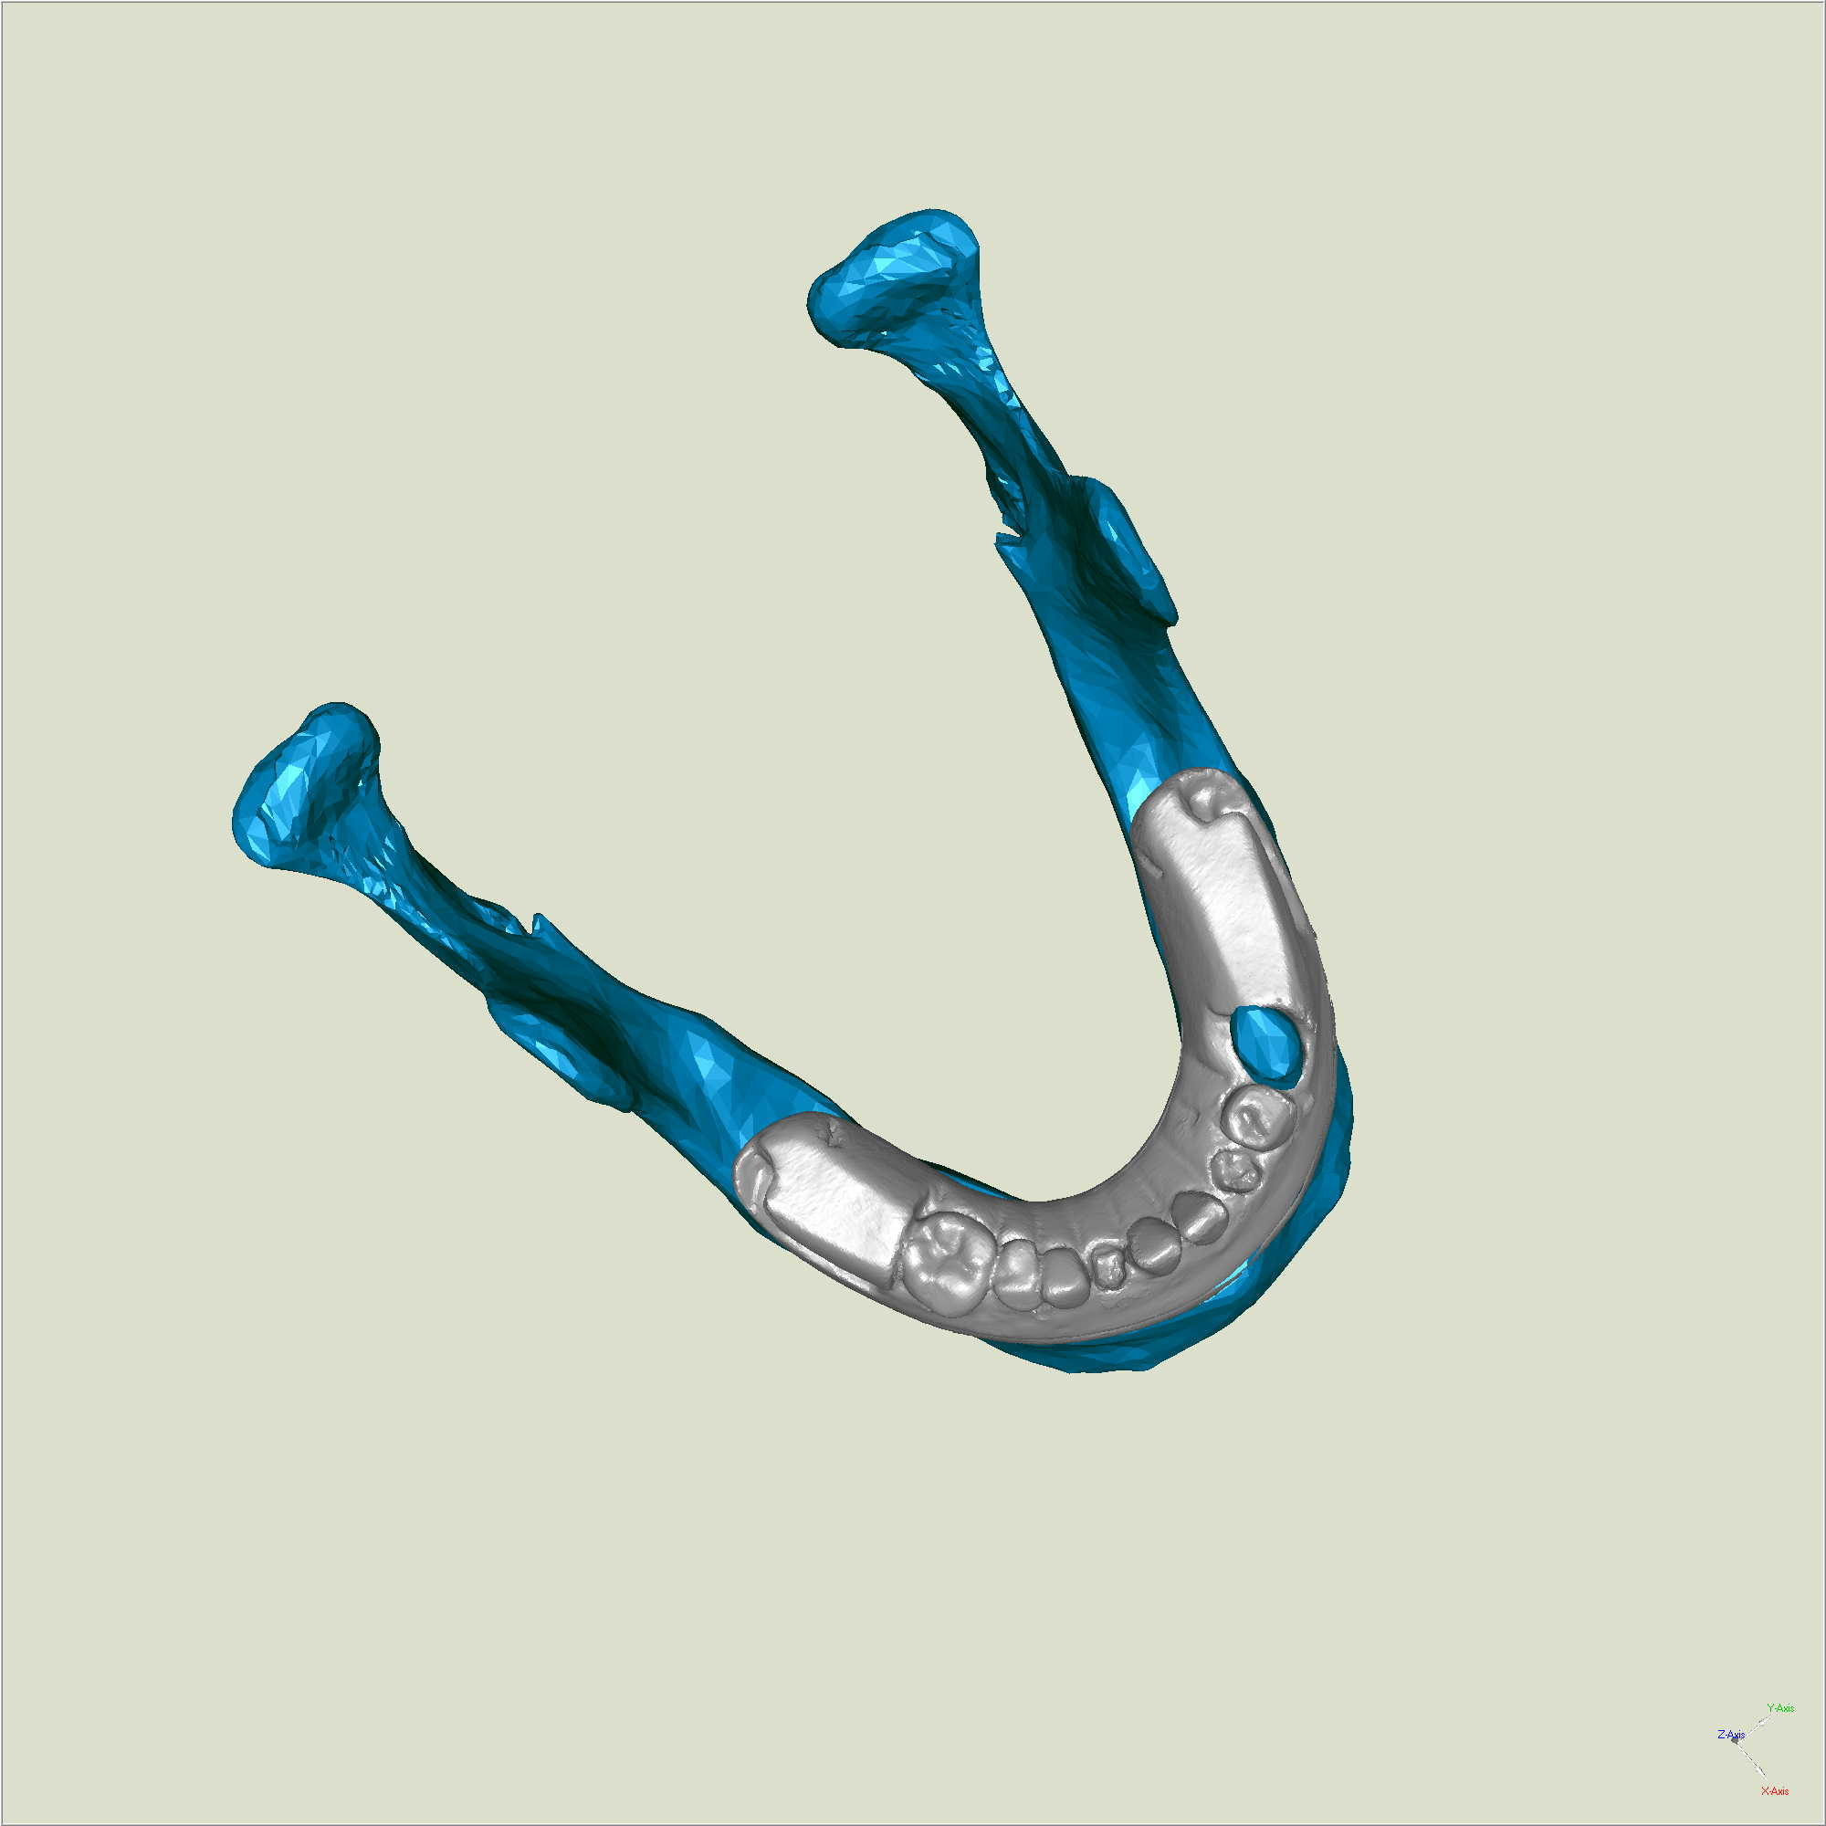
Mandible Deformation II

Slide 13
Mandible Deformation III

Slide 14
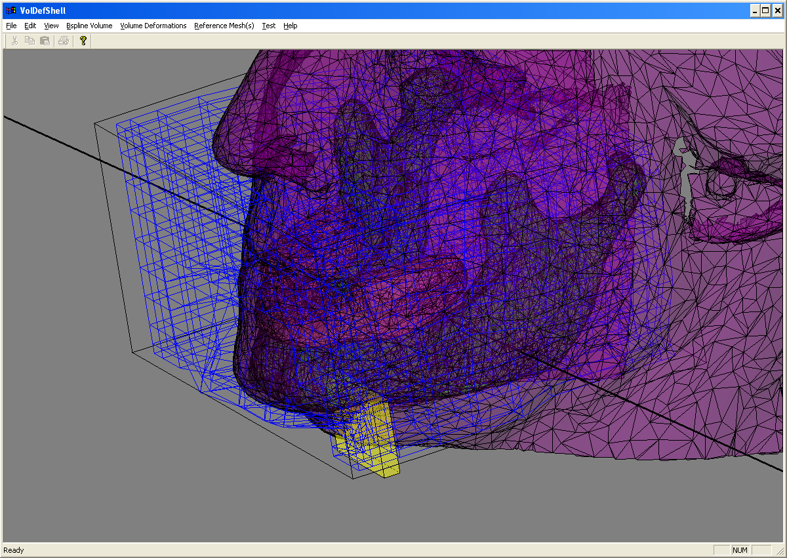
Mandible Deformation IV

Slide 15
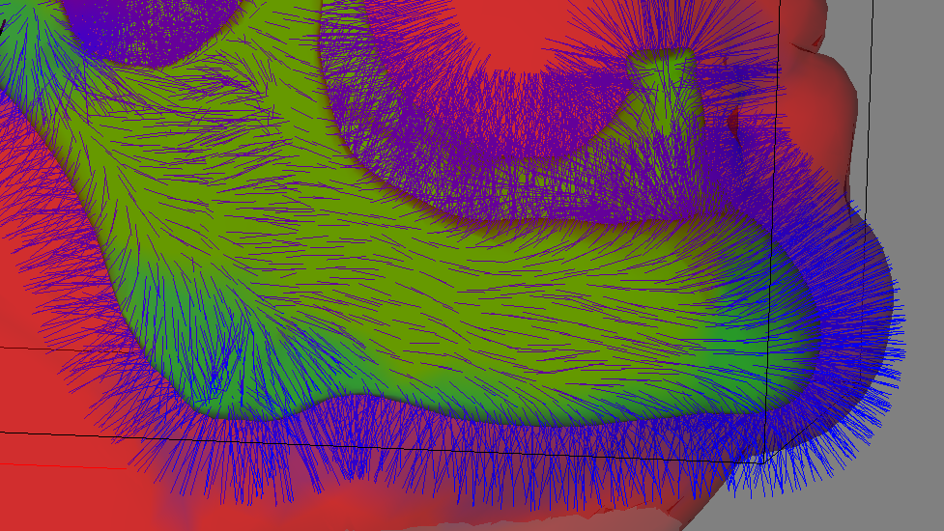
Mandible Deformation V

Slide 16
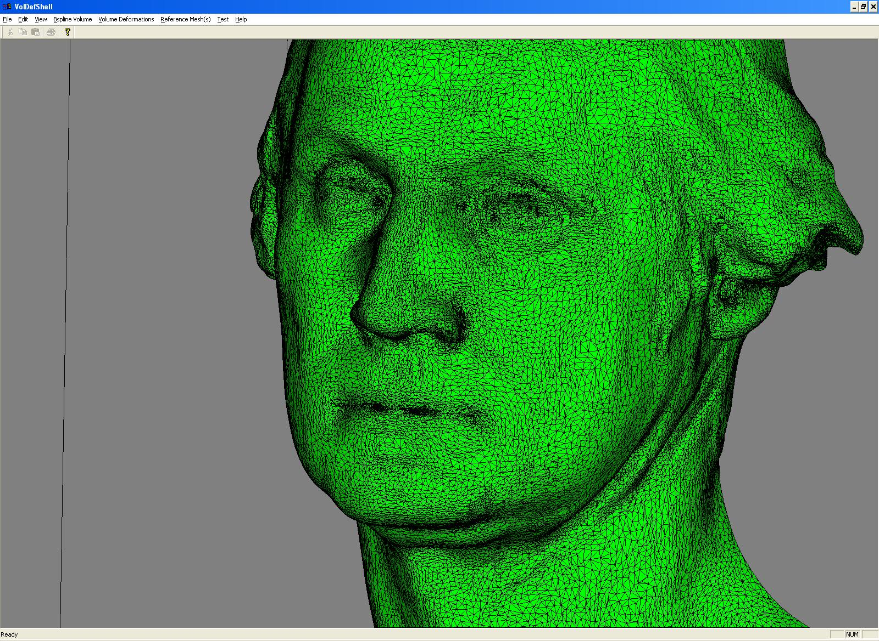
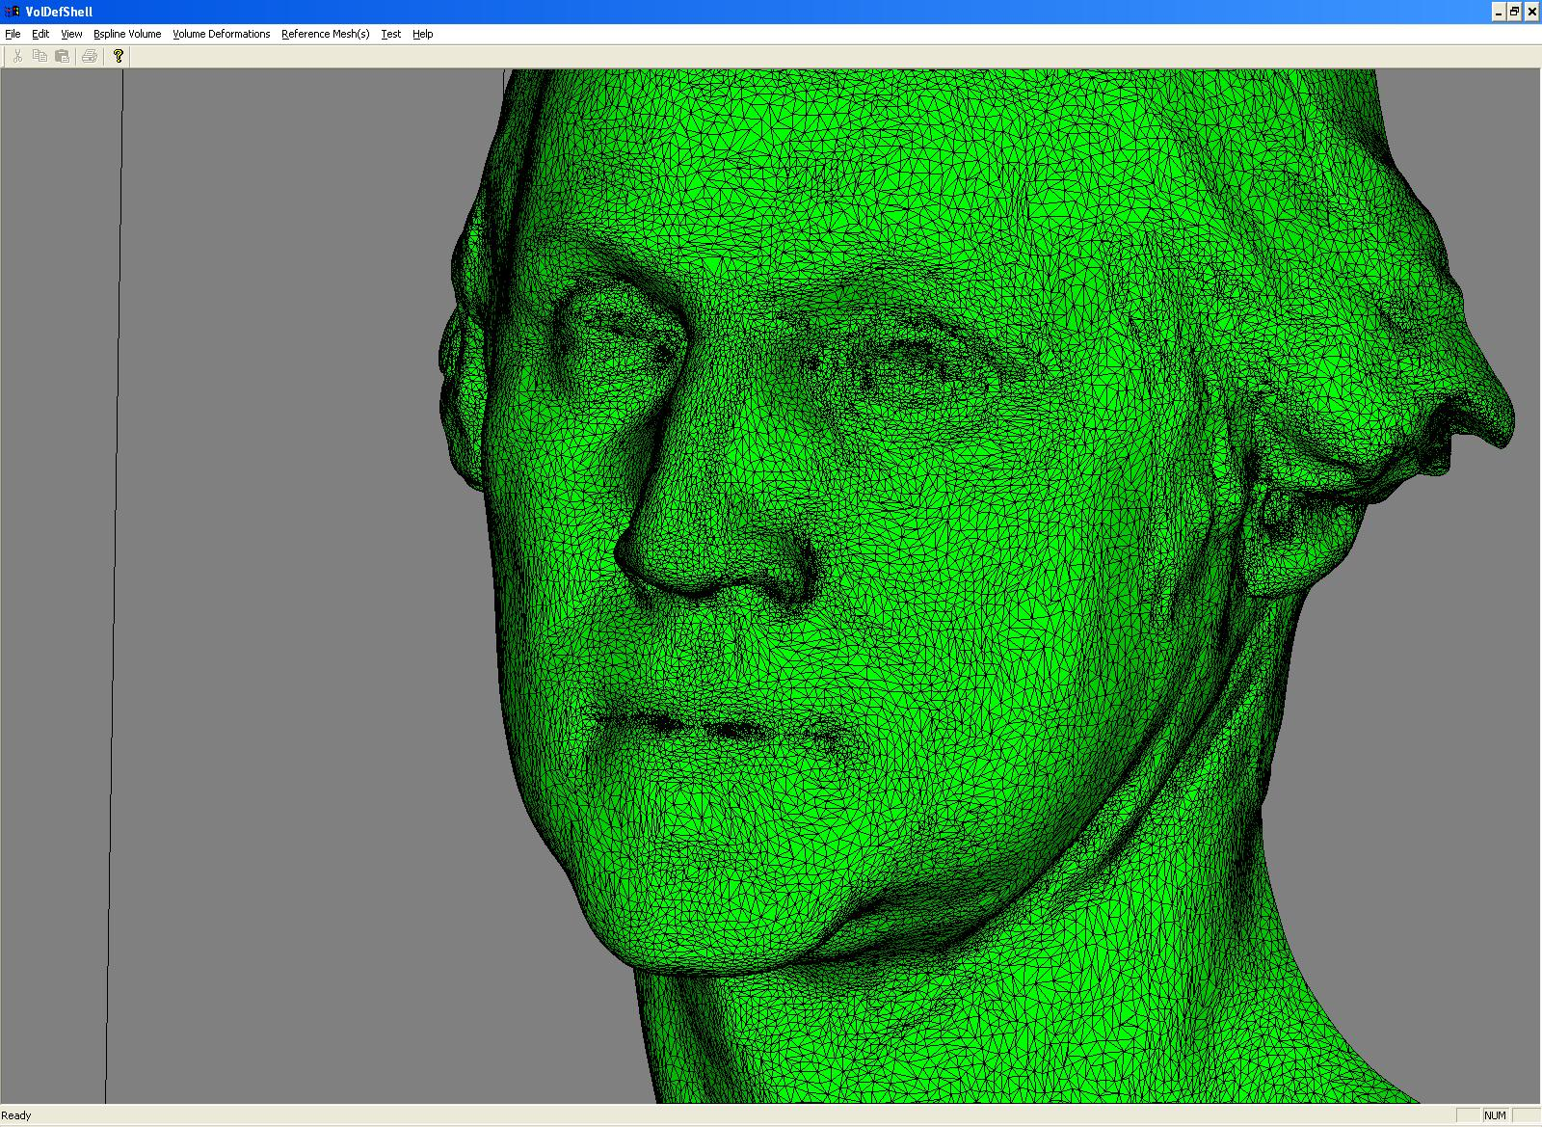
Before (53) & After (45)
(preliminary results)

Slide 17
Summary
Novel use of volume deformations
Advantages & synergy of interdisciplinary work
  NY Times [11/2/04]
  USA Today [12/20/04]
  AZ Republic [4/24/05]
  Reuters [8/23/04]
  Richmond Times Dispatch [9/23/04]
  Bloomberg News [12/6/04]
  History Channel [shoot 4/05]

Slide 18
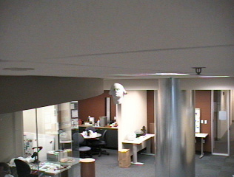
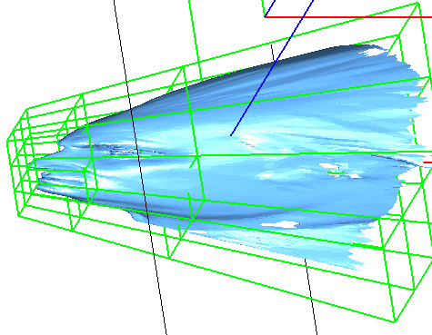
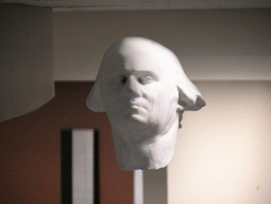
Thank you for your attention!

