Slide 1
Homework 4
Aiqing Jiang

Slide 2
HW 4.1
library('rjson’)
json_file = "http://crix.hu-berlin.de/data/crix.json"
json_data = fromJSON(file=json_file)
crix_data_frame=as.data.frame(json_data)
x=crix_data_frame
dim(x)
n=dim(x)
a=seq(1,n[2],2)
b=seq(2,n[2],2)
date=t(x[1,a])
price=t(x[1,b])
crix=data.frame(date,price)
load("ecrix.RData")
load("efcrix.RData")

Slide 3
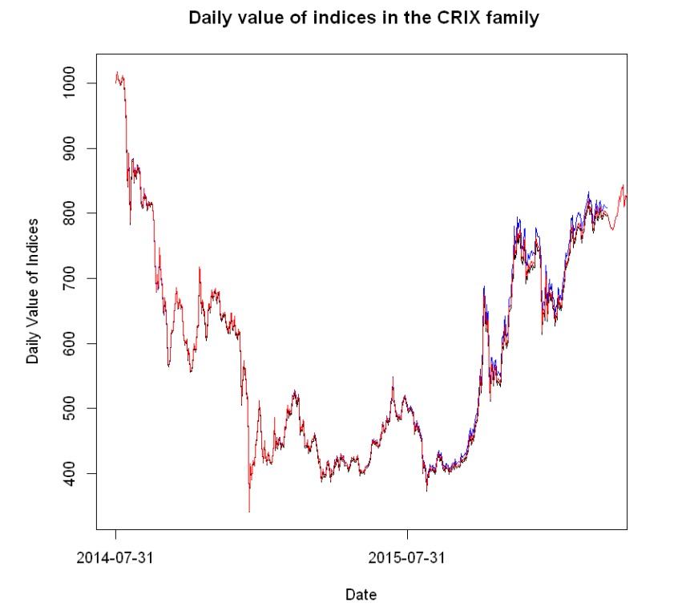
Figure3: Daily value of indices in the CRIX family
plot(ecrix, type = "l", col = "blue", xaxt = "n",main = " Daily value of indices in the CRIX family",xlab = "Date", ylab = "Daily Value of Indices")
lines(efcrix, col = "black")
lines(price, col = "red")
lab=seq(1,n[2],365)
axis(1, at = lab, label = names(ecrix)[lab])

Slide 4
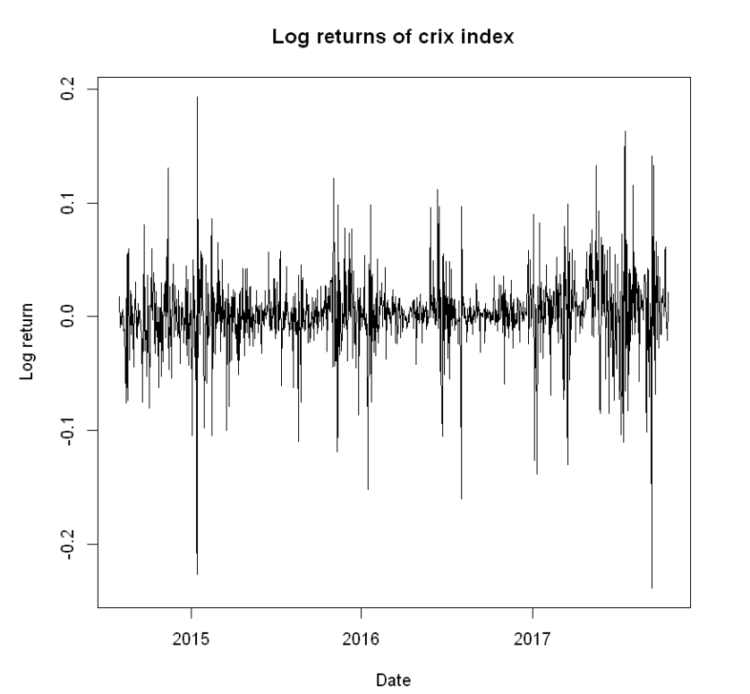
Figure 4: The log returns of CRIX index
ret=diff(log(price))
plot(ret~as.Date(date[-1]), type="l", col="black", xlab="Date", ylab="Log return", main="Log returns of crix index")

Slide 5
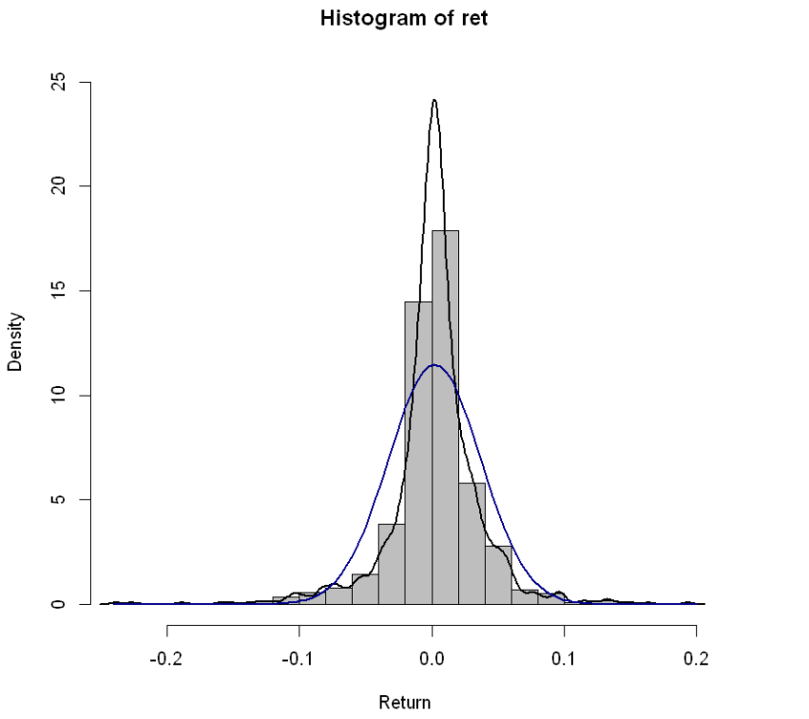
Figure 5: Histogram and QQ plot of CRIX returns
hist(ret, col = "grey", breaks = 20, freq = FALSE, ylim = c(0, 25), xlab = "Return")
lines(density(ret), lwd = 2)
x = seq(-4, 4, length = 100)
curve(dnorm(x, mean = mean(ret), sd = sd(ret)), add=TRUE, col = "darkblue", lwd = 2)

Slide 6
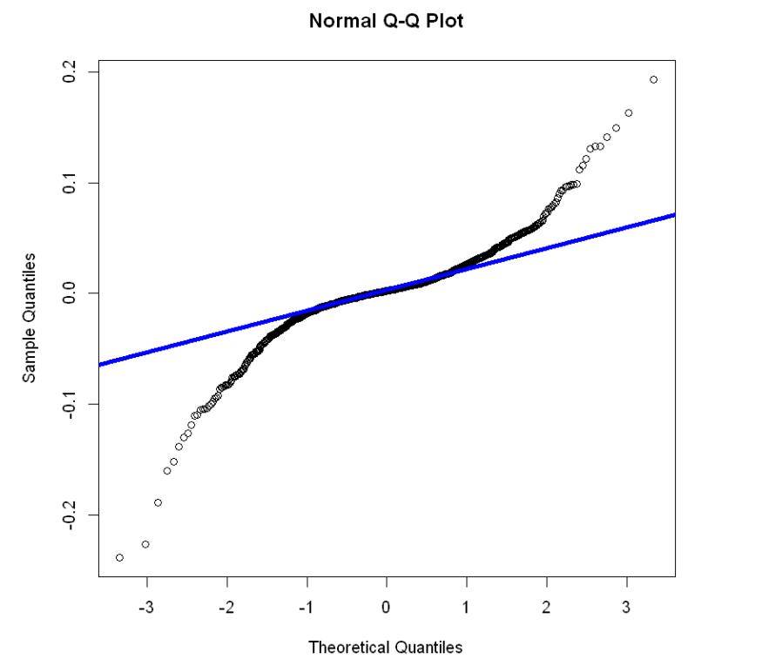
Figure 5: Histogram and QQ plot of CRIX returns
qqnorm(ret)
qqline(ret, col = "blue", lwd = 4)

Slide 7
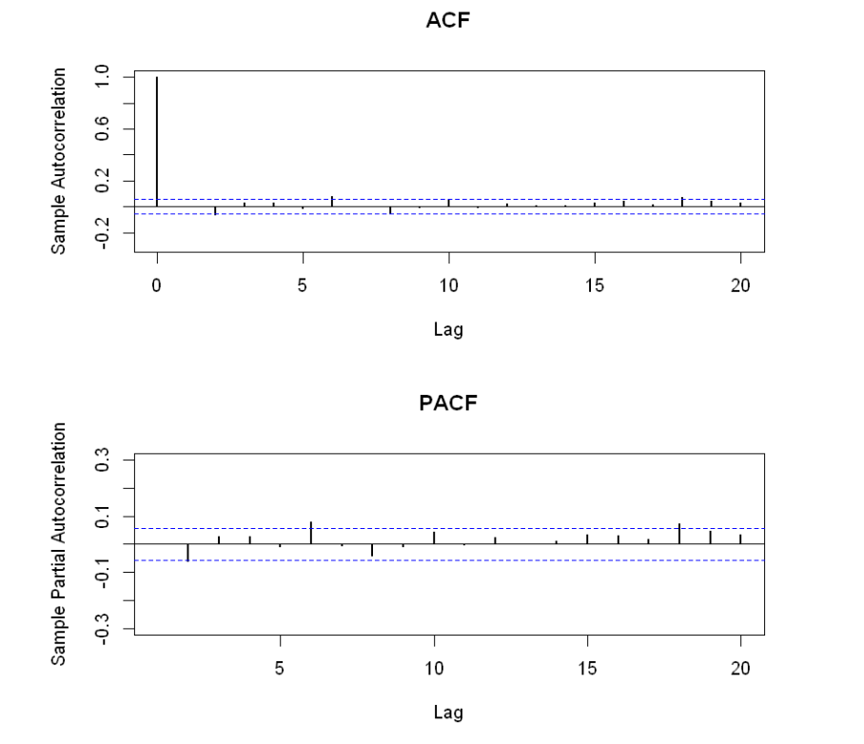
Figure 6: The sample ACF and PACF of CRIX returns
par(mfrow = c(2, 1))
libraries = c("zoo", "tseries")
autocorr = acf(ret, lag.max = 20, ylab = "Sample Autocorrelation", main = "ACF" ,lwd = 2, ylim = c(-0.3, 1))
autopcorr = pacf(ret, lag.max = 20, ylab = "Sample Partial Autocorrelation",main = "PACF" ,ylim = c(-0.3, 0.3), lwd = 2)

Slide 8
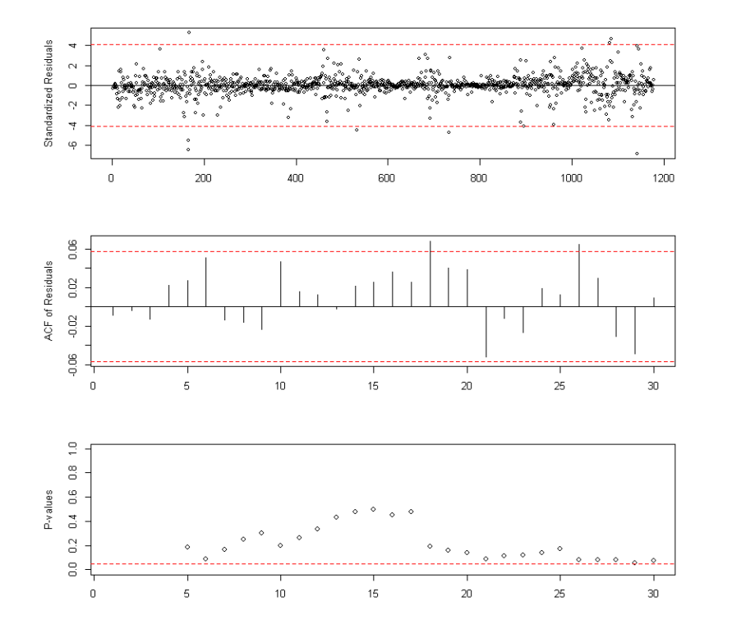
Figure 7:Diagnostic Checking
library(TTR)
library(TSA)
library(caschrono)
Library(forecast)
fit = arima(ret, order = c(2, 0, 2))
tsdiag(fit)

Slide 9
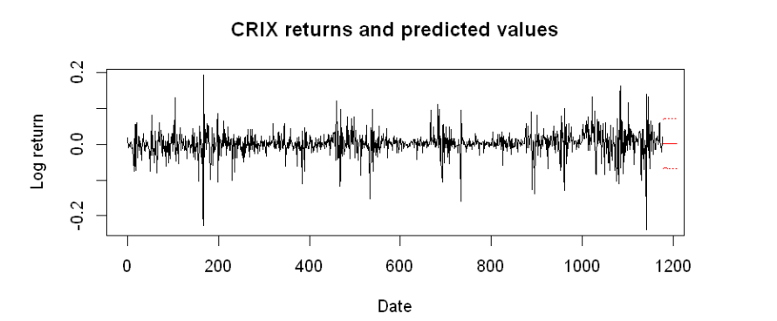
Figure 7:Diagnostic Checking
crix_pre = predict(fit, n.ahead = 30)
plot(ret, type = "l", ylab = "Log return", xlab = "Date",
lwd = 1, main = "CRIX returns and predicted values")
lines(crix_pre$pred, col = "red", lwd = 1)
lines(crix_pre$pred + 2 * crix_pre$se, col = "red", lty = 3, lwd = 1)
lines(crix_pre$pred - 2 * crix_pre$se, col = "red", lty = 3, lwd = 1)

