Slide 1
P4 Language and Software Switches
Notes:
Hi, my name is Muhammad Shahbaz.
Today, I am going to talk about our work on PISCES: A Programmable, Protocol-Independent Software Switch.
It’s a joint work with folks at Princeton, Stanford, VMware, and Barefoot.

Slide 2

A Fixed-Function Switch
Ethernet
IP
TCP
UDP
BGP
VLAN
ARP
Geneve
VxLAN
GRE
MPLS
NSH
NVGRE
SCTP
ICMP
IPSEC
BFD
LISP
IPFix
SFlow
...
Notes:
Fast networks today, such as networks in large data centers, contain Ethernet switches that are built from fixed-function switching asic. These switches usually support a [CLICK] large but fixed set of protocols that are hard-wired into an asic when it is designed and manufactured. Therefore, we cannot typically add or remove the protocols after the asic has been built.
However, lots of work is going about building fast programmable switch asics. There are many reasons why people want programmable asics:

Slide 3
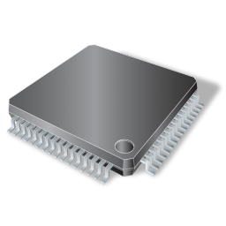



A Programmable Switch
Ethernet
IP
TCP
UDP
BGP
VLAN
ARP
Geneve
VxLAN
GRE
CUSTOM
MPLS
NSH
NVGRE
SCTP
ICMP
IPSEC
BFD
LISP
IPFix
SFlow
...
Notes:
So, the main idea of a programmable switch is that it’s a generic engine, oblivious to how to process packets beforehand. You can then program it support all the existing protocols (if you desire) or can easily [CLICK] remove unnecessary protocols or [CLICK] add new protocols.
In recent years, we’ve seen efforts [CLICK] such as Intel’s FlexPipe, and programmable switch chips from startups like Xpliant and Barefoot. We can see that all this work is going in to help us program hardware switches. However, there is a missing picture here.

Slide 4

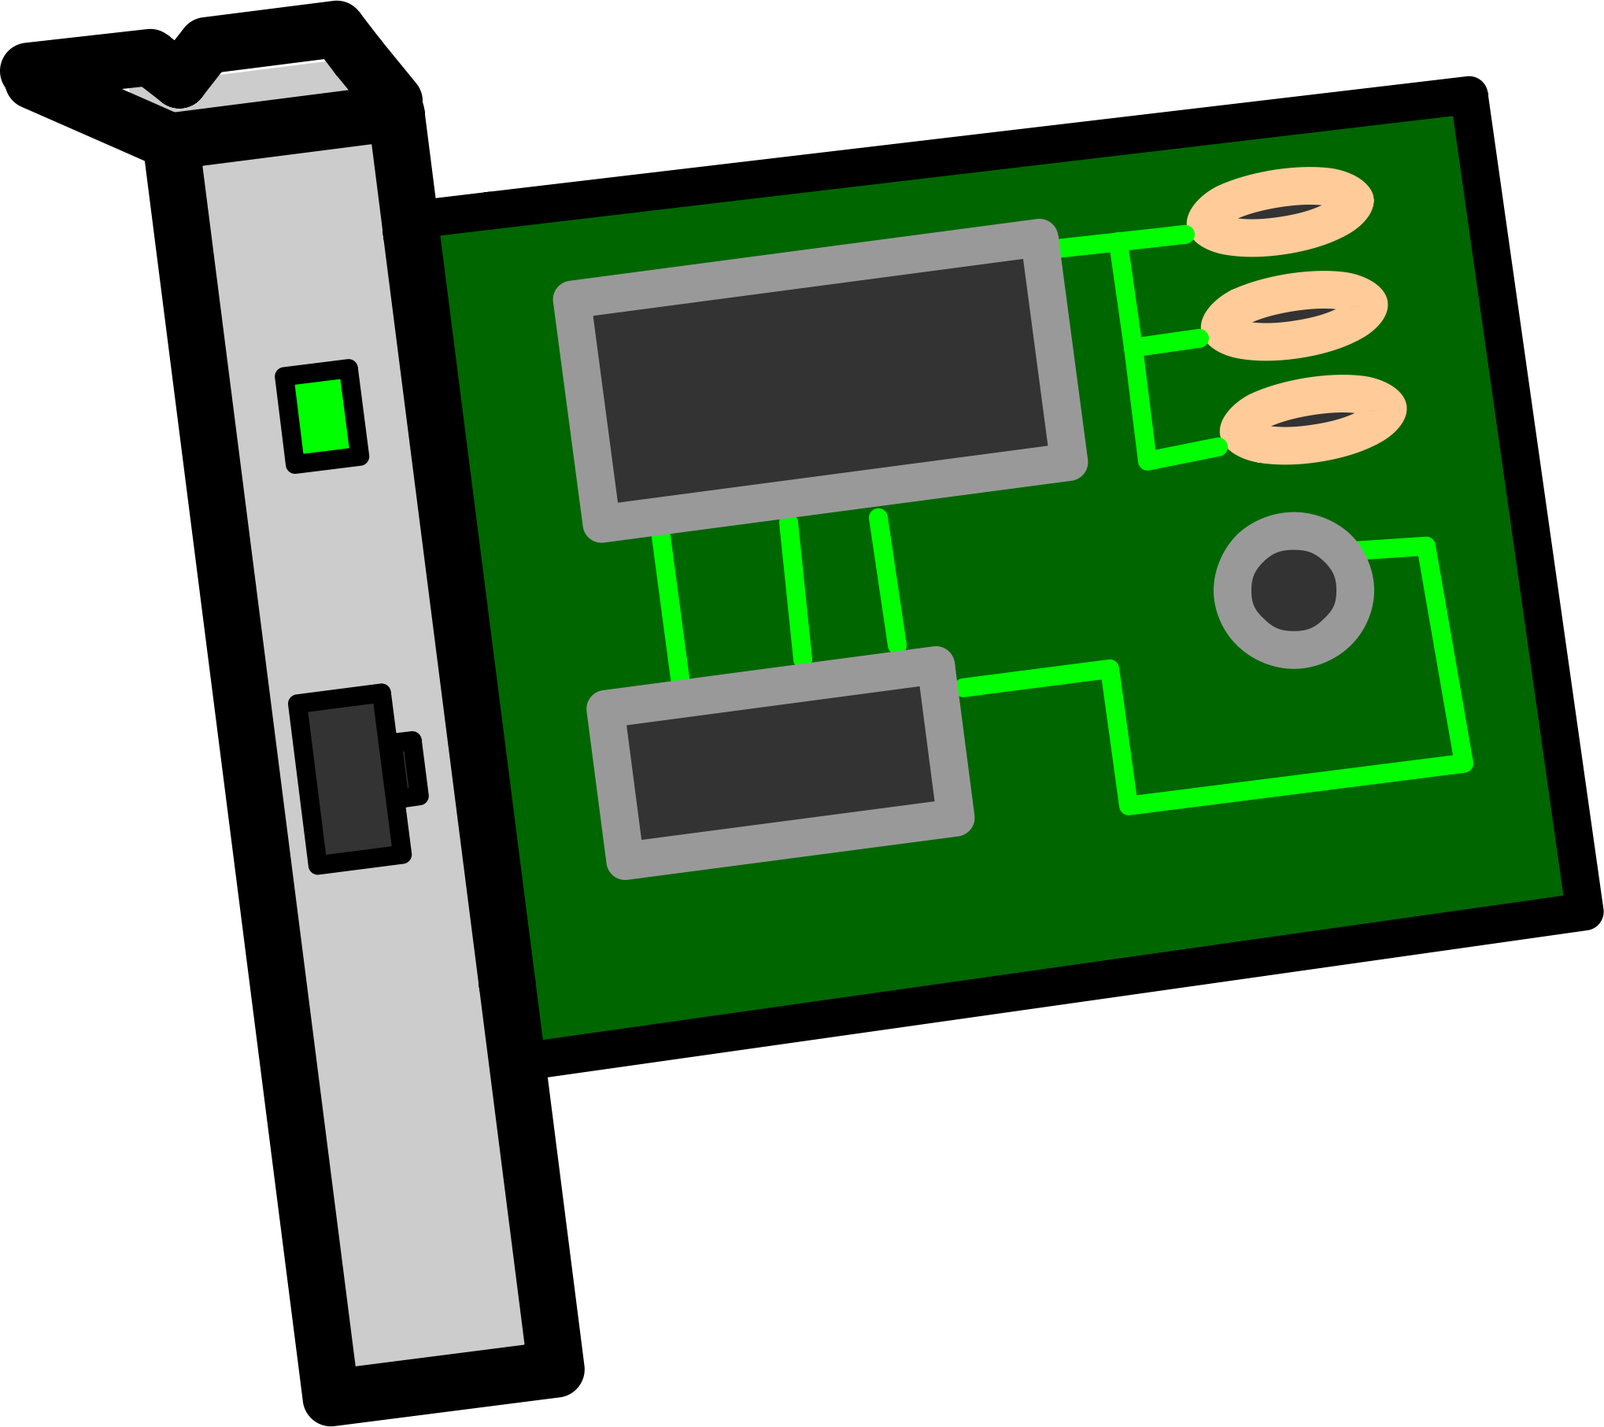
A Software Switch
VM
VM
Software Switch
Virtual Port
Physical Port
Notes:
Consider the modern virtualized data center. In each server of a virtualized data center, there are multiple [CLICK] virtual machines running on the server managed by a hypervisor. And in each hypervisor there is a [CLICK] software switch to pass data between the VMs [2xCLICK] and between a [2xCLICK] VM to the outside world.
We can see that these software switches serve exactly the same function as hardware switches, which is that they route packets between different networking entities.[CLICK]
One interesting thing to notice here is that there are more virtual ports than physical ports in this design.

Slide 5
^{[1]} Martin Casado, VMWorld 2013
Notes:
In fact since 2012, there have been more Ethernet ports in software than in hardware! So, given that software switches manage more network ports than hardware switches, we can clearly see how important they are.

Slide 6
A Software Switch
It should be EASY to program software switches!
Well, not really …
Notes:
It is easy to assume that since software switches are defined in software.
it should be *very* easy to change the behavior of a software. right?
[CLICK]
Well, we found that it is not that easy. And let me tell you why.

Slide 7




PISCES: A Programmable, Protocol-Independent Software Switch
Muhammad Shahbaz
Nick Feamster
Jennifer Rexford
Sean Choi
Nick McKeown
Cian Ferriter
Mark Gray
Ben Pfaff
Changhoon Kim
Notes:
Hi, my name is Muhammad Shahbaz.
Today, I am going to talk about our work on PISCES: A Programmable, Protocol-Independent Software Switch.
It’s a joint work with folks at Princeton, Stanford, VMware, and Barefoot.

Slide 8
PISCES: A Protocol-Independent Software Switch
P4
PISCES
vSwitch
OVS
Notes:
So far, we have seen P4 as a language to program hardware switches. But what does it mean to have P4 program software switches. Aren’t software switches already programmable.
Well, yes they are but from a perspective of a network programmer, they still can’t program these software switches. It requires specialized skills in systems, operating systems … For example, OVS …

Slide 9

Internal Architecture of OVS
OVS
Kernel
DPDK
Fast Packet IO (or Forwarding)
Notes:
A software switch is based on a [click] large body of complex codebase like [click] Kernel, [click] DPDK, and more that is needed to set up the machinery for fast packet IO (or forwarding).

Slide 10
Internal Architecture of OVS
OVS
Parser
Packet Processing Logic
Match-Action Pipeline
Complex APIs
Kernel
DPDK
Notes:
And at the same time, one has to specify the logic for packet processing, [click] like parser and match-action pipeline, using [click] complex methods and interfaces exposed by these complex codebases.
[click]

Slide 11


Internal Architecture of OVS
OVS
Parser
Match-Action Pipeline
Kernel
DPDK
Notes:
However, there is a conflict here. As protocol designers, we are interested in specifying how to parse packet headers and the structure of the match-action tables (i.e., which header fields to match and which actions to perform on matching headers).
[click]
We do not need to understand the complexities of the underlying codebase and the arcane APIs that they expose to enable for fast packet IO.

Slide 12

Internal Architecture of OVS
OVS
Parser
Match-Action Pipeline
Kernel
DPDK
Notes:
So what should we do about this? How should we address this conflict?

Slide 13
Internal Architecture of OVS
OVS
Parser
Match-Action Pipeline
Kernel
DPDK

Slide 14
Road to Protocol Independence
Domain-Specific Language
Parser
Match-Action Pipeline
Compile
OVS
Parser
Match-Action Pipeline
Kernel
DPDK
Notes:
How about we separate the packet processing logic from the switch and [click] specify it using a high-level domain-specific language (DSL). [click] And then compile it down to underlying switch, letting the compilation process takes care of the arcane APIs provided by these various large and complex codebases.
[click]
A natural question now arises is that what domain-specific language should we use for specifying the packet processing logic.

Slide 15
Road to Protocol Independence
P4^{[1]}
P4 is an open-source language.^{[1]}
Describes different aspects of a packet processor:
Packet headers and fields
Metadata
Parser
Actions
Match-Action Tables (MATs)
Control Flow
Parser
Match-Action Pipeline
Compile
OVS
Parser
Match-Action Pipeline
Kernel
DPDK
^{[1]} http://www.p4.org
Notes:
For this work, we choose P4: a high-level language for programming protocol-independent packet processors. [click] It’s an open-source language [click] that let’s a programmer describe different aspects of a packet processor e.g., packet headers and fields, parser, actions, match-action tables, and control flow.

Slide 16
Road to Protocol Independence
P4^{[1]}
341 lines of code
Parser
Match-Action Pipeline
Compile
Native OVS
OVS
Parser
Match-Action Pipeline
14,535 lines of code
Kernel
DPDK
^{[1]} http://www.p4.org
Notes:
Now, using P4, [click] a protocol designer can specify the packet processing logic of the native OVS using roughly [click] 341 lines of code, whereas,
[click] it can take roughly forty times more lines of code, or around fourteen thousand lines of code, when writing the same packet processing logic using the APIs exposed by the underlying codebases.
So, for a protocol designer, separating the packet processing logic from the switch clearly has its benefits.
We will quantify such benefits in more detail in the later part of this presentation.

Slide 17
Reduction in Complexity
Development Complexity
Notes:
First, we measure the development complexity.
We compare the native OVS with the equivalent baseline functionality implemented in PISCES. We use three metrics: lines of code, method count, and average method size. Note that these measurements only consider the set of code that is responsible for match, parse and action.
We see that PISCES reduces the lines of code by about factor of 40 and the average method size by about a factor of 20.

Slide 18
Reduction in Complexity
Change Complexity
Notes:
Second, we evaluate the change complexity.
We compare the effort required in adding support for a new header field in a protocol that is otherwise already supported in OVS and in PISCES.
We add support for three fields (…) and measure how many lines and files need to be changed in adding those fields.
We see that modifying just a few lines of code in a single P4 file in PISCES is sufficient to support a new field, whereas in OVS, the corresponding change often requires hundreds of lines of changes over tens of files.

Slide 19
Road to Protocol Independence
P4^{[1]}
P4 Forwarding Model
Compile
Performance Overhead!
OVS
OVS Forwarding Model
Kernel
DPDK
^{[1]} http://www.p4.org
Notes:
Now, using P4, [click] a protocol designer can specify the packet processing logic of the native OVS using roughly [click] 341 lines of code, whereas,
[click] it can take roughly forty times more lines of code, or around fourteen thousand lines of code, when writing the same packet processing logic using the APIs exposed by the underlying codebases.
So, for a protocol designer, separating the packet processing logic from the switch clearly has its benefits.
We will quantify such benefits in more detail in the later part of this presentation.

Slide 20
P4 Forwarding Model
(Post-Pipeline Editing)
Ingress
Packet
Parser
Checksum
Verify
Checksum
Update
Packet
Deparser
Egress
Match-Action
Tables
Header
Fields
Notes:
In P4 packet forwarding model, [click] a packet parser [click] identifies the headers and [click] extracts them as packet header fields (i.e., essentially a copy of the content of the packets). [click] The checksum verify block then [click] verifies the checksum based on the header fields specified in the P4 program. [click] The match-action tables [click] operate on these header fields. [click] A checksum update block [click] updates the checksum. [click] Finally, a packet deparser [click] writes the changes from these header fields back on to the packet. [click] We name this mode of operating on header fields as “post-pipeline editing.”

Slide 21
OVS Forwarding Model
Match-Action
Tables
Egress
Slow-path
Flow Rule
Fast-path
Miss
Ingress
Match-Action
Cache
Packet
Parser
Notes:
Whereas, in OVS packet forwarding model, [click] a packet parser only [click] identifies the headers. The [click] packet is then looked up in a match-action cache. If there is a [click] miss, the packet is sent to the match-action tables (that form the actual switch pipeline). [click] A new flow rule is calculated and installed in the match-action cache. [click] And the original packet, as processed by the match-action pipeline is sent to the egress.

Slide 22
OVS Forwarding Model
Match-Action
Tables
Egress
Slow-path
Fast-path
Hit
Ingress
Match-Action
Cache
Egress
Packet
Parser
Notes:
Next time, when another packet belonging to the same flow, enters the switch. [click] The parser identifies the headers as before. [click] This time the cache will result in a hit, and [click] the packet is processed and sent to the egress without traversing the match-action pipeline.

Slide 23
OVS Forwarding Model
(Inline Editing)
Match-Action
Tables
Egress
Slow-path
Fast-path
Ingress
Match-Action
Cache
Egress
Packet
Parser
Notes:
In OVS, tables directly operate on the headers inside the packet (i.e., not copy is maintained). We name this mode of operating on packet header fields as “inline editing.”

Slide 24
PISCES Forwarding Model (Modified OVS)
Supports both editing modes:
Inline Editing
Post-pipeline Editing
Match-Action
Tables
Slow-path
Fast-path
Match-Action
Cache
Egress
Ingress
Packet
Parser
Checksum
Verify
Checksum
Update
Packet
Deparser
Notes:
So, in order to map P4 to OVS, we modified OVS to provide support for both these editing modes. We call this modified OVS model, a PISCES forwarding model.

Slide 25
PISCES: Compiling P4 to OVS
P4
Ingress
Packet
Parser
Checksum
Verify
Checksum
Update
Packet
Deparser
Egress
Match-Action
Tables
Match-Action
Tables
modified
OVS
Ingress
Packet
Parser
Checksum
Verify
Match-Action
Cache
Checksum
Update
Packet
Depraser
Egress
Notes:
So, now the problem is how to efficiently compile the P4 forwarding model [click] to this modified OVS forwarding model.

Slide 26
PISCES Forwarding Model (Modified OVS)
Match-Action
Tables
Slow-path
Fast-path
Match-Action
Cache
Egress
Ingress
Packet
Parser
Checksum
Verify
Checksum
Update
Packet
Deparser

Slide 27
PISCES Forwarding Model (Modified OVS)
Match-Action
Tables
Slow-path
Fast-path
Megaflow Cache
Egress
Ingress
Packet
Parser
Checksum
Verify
Microflow Cache
Checksum
Update
Packet
Deparser

Slide 28
PISCES Forwarding Model (Modified OVS)
Match-Action
Tables
Slow-path
Fast-path
Megaflow Cache
Egress
Ingress
Packet
Parser
Checksum
Verify
Checksum
Update
Packet
Deparser

Slide 29
Naïve Compilation from P4 to OVS (L2L3-ACL)
Performance overhead of
~ 40%
Notes:
We see that a naïve compilation of our benchmark application (which is essentially a router with an access-control list) shows [click] that PISCES has a performance overhead of about 40% compared to the native OVS.

Slide 30
Causes of Performance Overhead
Match-Action
Tables
Cache Misses
Ingress
Megaflow Cache
Egress
Packet
Parser
Checksum
Verify
Checksum Update
Packet
Deparser
CPU Cycles per Packet
Notes:
We observe that there are two main aspects that significantly affect the performance of PISCES.
[click]
The first one is the number of CPU cycles consumed in processing a single packet.
[click]
And the second one is the number of cache misses.

Slide 31
Cause: CPU Cycles per Packet
Notes:
To understand the causes of CPU cycles per packet, we looked at the cycles consumed by each component of the forwarding model (in the fast path) …

Slide 32
Factors affecting CPU Cycles per Packet
Extra copy of headers
Fully-specified Checksum
Parsing unused header fields
and more …
Notes:
We studied different factors that affected the CPU cycles per-packet [click] like …

Slide 33
Different Optimizations for L2L3-ACL

Slide 34
Optimized Compilation from P4 to OVS (L2L3-ACL)
Performance overhead of
< 2%

Slide 35
Cause: Cache Misses
3500+ Cycles (50x Cache hit)
Throughput < 1 Mpps
Match-Action
Tables
Cache Misses
Megaflow
Cache
Egress
Ingress
Packet
Parser
Checksum
Verify
Checksum Update
Packet
Deparser

Slide 36
Factors affecting Cache Misses
Entropy of packet header fields
Stateful operations in the match-action cache (or fast path).

Slide 37


Factor: Entropy of Packet Header Fields
We loosely define “high entropy” header fields as those which are likely to have differing values from packet to packet flowing through a switch^{[1]}.
Similar Layer-2 MAC addresses.
Layer-4 Ports vary connection to connection,
e.g., HTTP (80), HTTPS(443), SSH (22) etc.
Layer-4 fields have higher entropy than layer-2 fields
^{[1]} N. Shelly et.al. Flow caching for high entropy packet fields. In HotSDN '14.
Notes:
[click] We loosely define high entropy packet fields as those which are likely to have differing values from packet to packet flowing through a switch.
[click]
For example, all traffic originating from a particular host [click] will likely have the same source and destination MAC fields, [click] but the source and destination L4 port fields are likely to change from connection to connection. [click] Thus, we say the L4 port fields have higher entropy than the L2 address fields.

Slide 38
Factor: Entropy of Packet Header Fields
Match-Action Cache is highly sensitive to the entropy of header fields.
Cache rules matching on high-entropy fields would result in more misses, thus, leading to poor performance.
Megaflow
Cache
Egress
Ingress

Slide 39
Factor: Entropy of Packet Header Fields
Objective: “generate cache rules that match on low-entropy header fields whenever possible.”
Megaflow
Cache
Egress
Ingress

Slide 40
Factor: Entropy of Packet Header Fields
OVS
Match-Action
Tables
Megaflow
Egress
Ingress

Slide 41
Factor: Entropy of Packet Header Fields
OVS
Match-Action Tables
Match: L2, L3, L4, Metadata
Actions
Megaflow
Cache
Egress
Ingress

Slide 42
Factor: Entropy of Packet Header Fields
OVS
Match-Action Tables
“Staged Lookups^{[1]}”
Match:
Metadata,
L2
Match:
Metadata,
L2,L3
Match:
Metadata,
L2,L3,L4
Actions
Match:
Metadata
Entropy
Megaflow
Cache
Egress
Ingress
^{[1]} B. Pfaff et.al. The design and implementation of open vSwitch. In NSDI'15.

Slide 43
Factor: Entropy of Packet Header Fields
OVS
Match-Action Tables
“Staged Lookups^{[1]}”
Match:
Metadata,
L2
Match:
Metadata,
L2,L3
Match:
Metadata,
L2,L3,L4
Actions
Match:
Metadata
Miss
Match: Metadata,L2,L3
Megaflow
Cache
Egress
Ingress
^{[1]} B. Pfaff et.al. The design and implementation of open vSwitch. In NSDI'15.
Notes:
This optimization was possible because the OVS designers knew the semantics and entropy of these headers, and that caching this way would yield a high hit rate.

Slide 44
Factor: Entropy of Packet Header Fields
PISCES
Match-Action Tables
Match: H1, H2, H3, H4, …
Actions
No information about the
“entropy” of headers (H1, H2, ...)
Megaflow
Cache
Egress
Ingress

Slide 45
Factor: Entropy of Packet Header Fields
PISCES
Match-Action Tables
Match: H1, H2, H3, H4, …
Actions
Match: H?, H?, H?, …
Megaflow
Cache
Egress
Ingress

Slide 46
Optimization: Stage Assignment
PISCES
P4 Program
Header H1 {...}
Header H2 {...}
Header H3 {...}
Header H4 {...}
Notes:
To get the benefits of staging in PISCES, …

Slide 47
Optimization: Stage Assignment
PISCES
P4 Program
Entropy
Header H1 {...} 0
Header H2 {...} 2
Header H3 {...} 1
Header H4 {...} 3
Notes:
... we augmented the P4 language to enable a user to tag each header with a relative entropy value.

Slide 48
Optimization: Stage Assignment
PISCES
Entropy
Header H1 {...} 0
Header H3 {...} 1
Header H2 {...} 2
Header H4 {...} 3
Notes:
The compiler then sorts these headers in the increasing order of their entropy value.

Slide 49
Optimization: Stage Assignment
PISCES
Match-Action Tables
Match:
H1,H3,H2,
H4
Actions
Match:
H1
Match:
H1,H3
Match:
H1,H3,H2
Megaflow
Cache
Egress
Ingress
Notes:
Once the headers are sorted, the compiler then generates the stages as shown.
This way of generating cache rules based on low entropy header fields, has shown to significantly reduce the cache miss rate in the average cases.

Slide 50
Optimization: Stage Assignment
PISCES
Match-Action Tables
Match:
H1,H3,H2,
H4
Actions
Match:
H1
Match:
H1,H3
Match:
H1,H3,H2
Miss
Match: H1,H3,H2
Megaflow
Cache
Egress
Ingress

Slide 51
PISCES Forwarding Model (Modified OVS)
Match-Action
Tables
Slow-path
Fast-path
Megaflow Cache
Egress
Ingress
Packet
Parser
Checksum
Verify
Microflow Cache
Checksum
Update
Packet
Deparser
Notes:
So the reason that the Microflow Cache was disabled was because of it’s protocol dependence. The Microflow Cache relies on matching using a hash of the packet’s 5tuple. This 5tuple is made up of the IP addresses, L4 ports, and IP protocol field.
We wanted to re-enable the microflow cache in PISCES to allow performance comparisons between OVS and PISCES in a more “real-life OVS” testing scenario.

Slide 52
PISCES Forwarding Model (Modified OVS)
Microflow Cache
Notes:
So let’s talk about the microflow cache pipeline in more detail. First I’ll talk about how the microflow cache works in standard OVS, then about how P4 modifies this. A packet comes in from the previous stage of the PISCES forwarding pipeline, the checksum verify stage, and certain fields are extracted from the packet. After this a hash of the packet is calculated, using the packet’s 5tuple.
Then a lookup is performed which either results in a hit or a miss, where the packet is sent to the megaflow cache.
P4 changes this by dynamically generating the stages of the pipeline. This allows the hash fields stage to be independent of the packet’s 5tuple, allowing the user of PISCES to specify in P4 which fields they want to include in the hash calculation.

Slide 53
Internals of the Microflow Cache
P4 File
to Megaflow Cache
Packet in
Miss
Packet
out
Extract Fields
Hash Fields
Perform Lookup
Hit
Microflow Cache
Notes:
So let’s talk about the microflow cache pipeline in more detail. First I’ll talk about how the microflow cache works in standard OVS, then about how P4 modifies this. A packet comes in from the previous stage of the PISCES forwarding pipeline, the checksum verify stage, and certain fields are extracted from the packet. After this a hash of the packet is calculated, using the packet’s 5tuple.
Then a lookup is performed which either results in a hit or a miss, where the packet is sent to the megaflow cache.
P4 changes this by dynamically generating the stages of the pipeline. This allows the hash fields stage to be independent of the packet’s 5tuple, allowing the user of PISCES to specify in P4 which fields they want to include in the hash calculation.

Slide 54
Performance with the Microflow Cache
Notes:
An initial test was carried out comparing the performance of the microflow cache in standard OVS and PISCES for the 5tuple hash calculation scenario. This showed PISCES performing worse than standard OVS. I looked into why PISCES has a performance overhead, which lead to some interesting findings.

Slide 55
Cause of Performance Degradation
Cacheline | 64 Bytes
0 | Metadata
1 | Metadata |  |  | Ethernet Header
2 | IPv4 (1st 16Bytes) | IPv4 + Pad | UDP + Pad
3 | TCP + Pad |  | Empty
Simplified “flow” Structure
Notes:
I disabled and enabled different parts of the P4 generated code in OVS to get a good idea where the performance hit was coming from. It turned out that the location of particular header fields generated by P4 would affect performance. These header fields are defined as members of structs, where these structs will often span multiple cachelines. An example of one of these structs is the “flow” struct.
Moving these fields could result in lower or higher performance. So the factor here is the cacheline which the field was residing in. In my case, moving PISCES metadata from cacheline 1 in a struct to cacheline 0 resulted in a performance boost.
But the message I want to get across here is that there is a potential for compiler optimizations where the match action pipeline of a P4 program could be looked at and used to influence the placement of particular headers within a struct for optimal performance. Take the simple example above where
Take the simplified version of the flow struct which spans 3 64Byte cache lines. Suppose you have a P4 program with a table which matches on an Ethernet and IPv4 address together. Having the Ethernet header in a separate cacheline to the IPv4 header would be detrimental to performance. Identifying this through analysis of the P4 program would prevent this problem from occurring.
(Shahbaz: maybe say matching one metadata and IPv4, this way there is a gap of one cacheline between the two from the figure, above.)

Slide 56
Performance with the Microflow Cache
Notes:
In any case, manual analysis of the program and permanently moving the declaration location of the P4 header fields to a more frequently accessed cacheline resulted in the following performance, where PISCES more closely follows the performance of standard OVS.

Slide 57
Varying the Number of Hash Fields
Notes:
Finally I wanted to compare two PISCES test cases, the 5tuple scenario we saw on the previous slide, with a L2switch scenario, where the Ethernet addresses are used for hash calculation. Here we see the L2 address hash calculation perform better than the 5tuple hash calculation. This is because of the lower amount of fields and total bytes used in the hash calculation.
This shows the relationship between performance and the number of fields used to calculate the hash of a packet. This holds potential boosts in performance for users of PISCES, where they can decide which fields are suitable to be used in the hash calculation and saving on potentially unnecessary processing.

Slide 58
PVPP: A Programmable Vector Packet Processor
Sean Choi
Notes:
Hi, my name is Muhammad Shahbaz.
Today, I am going to talk about our work on PISCES: A Programmable, Protocol-Independent Software Switch.
It’s a joint work with folks at Princeton, Stanford, VMware, and Barefoot.

Slide 59
Need for a Flexible Backend Abstraction

Slide 60
What is Vector Packet Processing (VPP)?
Open source packet-processor in user space (DPDK)
Graph-based packet forwarding model
Process a vector of packet at a time
Optimize instruction cache and data cache misses
Highly extensible via a plugin
Programmable VPP (PVPP)

Slide 61
Programmable VPP (PVPP) Compiler

Slide 62
Packet Vector
…
dpdk-input
Enabled via CLI
…
PVPP-input
arp-input
ip4input
ip6-input
llc-input
…
Table 1
Table 2
Table i
ip6-lookup
ip6-rewrite-transmit
Table j
Table k
PVPP Plugin
Vanilla VPP Nodes
dpdk-output

Slide 64
Questions?
Notes:
With this I conclude my presentation. Thank you, and I’m happy to take any questions.

Slide 65
Disclaimers
Intel does not control or audit third-party benchmark data or the web sites referenced in this document. You should visit the referenced web site and confirm whether referenced data are accurate.
Intel technologies’ features and benefits depend on system configuration and may require enabled hardware, software or service activation. Performance varies depending on system configuration. No computer system can be absolutely secure. Check with your system manufacturer or retailer or learn more at [intel.com].

