Slide 1
Comparative Sentiment Analysis of Mainstream Social Platforms
11810112 JIANG Runzhi
11910117 LI Haobo
Instructor: Dr. James

Slide 2

CONTENT
00、 Realistic Significance and Applications
01、 Explore Other Platforms
02、 Website Platform Design
03、 Systematic Design
04、 Future
05、 Some of Overview

Slide 3
0
Realistic Significance and Applications

Slide 4
Realistic Significance and Applications
Provide a basis for the for mulation and adjustment of relevant policies, thus promoting national development and social progress.
Achieve more accurate advertising and bring more business value.
Help individual media operators choose the right platform and content to create.

Slide 5
1
Explore Other Platforms

Slide 6

Explore Other Platforms
Considering that comment data collection is not always done using crawlers and the complexity of crawler design, we started to explore other methods of collecting comments of Douyin and Xiaohongshu.
We finally used the thirdparty crawler software ”Houyi Collector” to successfully crawl the comment information of Xiaohongshu and Douyin.

Slide 7
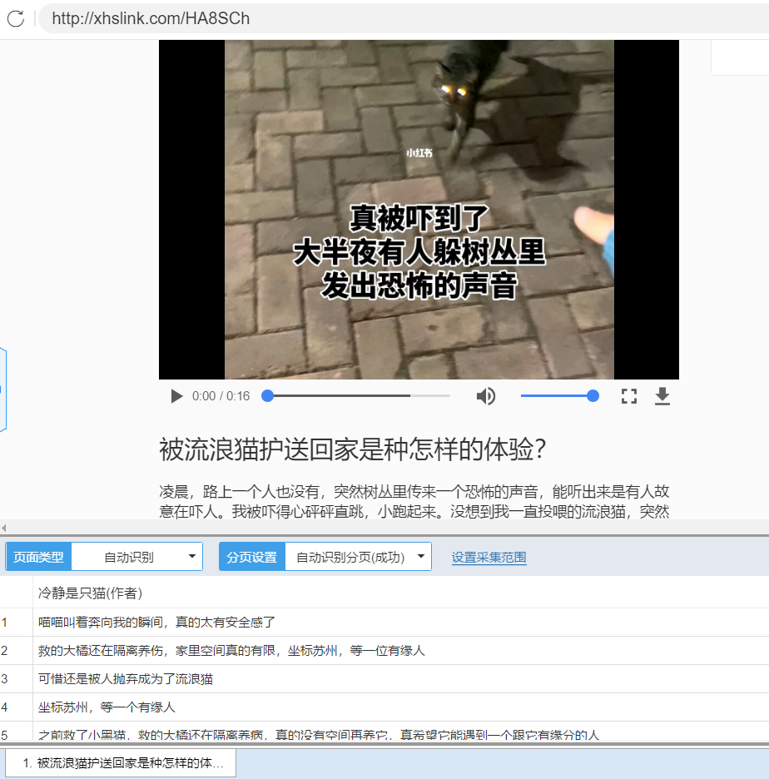
Explore Other Platforms

Slide 8
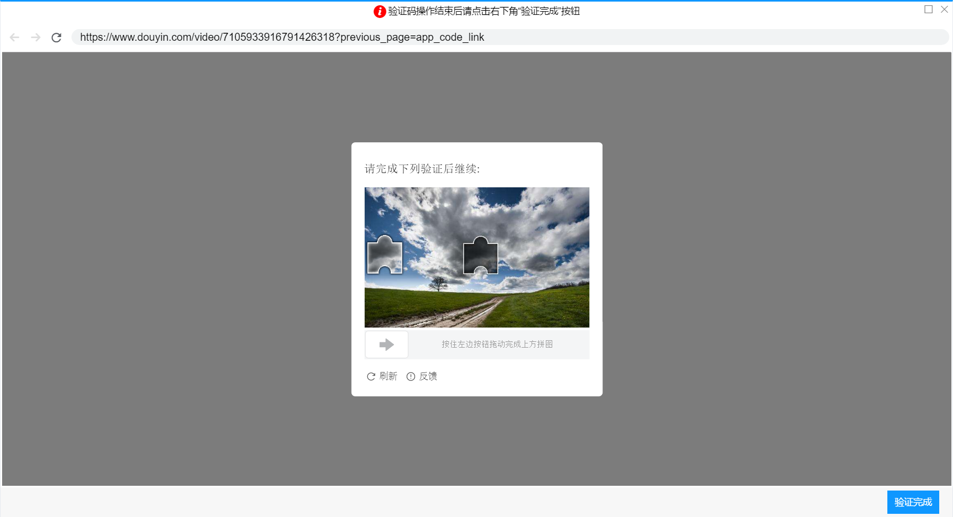
Explore Other Platforms

Slide 9
2
Website Platform Design

Slide 10
Website Platform Design
In order to better display our analysis results with word clouds, we created a web front-end.
The existence of web platforms is of great importance in helping target customers to more easily view the topics and emotional tendencies of users on different platforms.

Slide 11
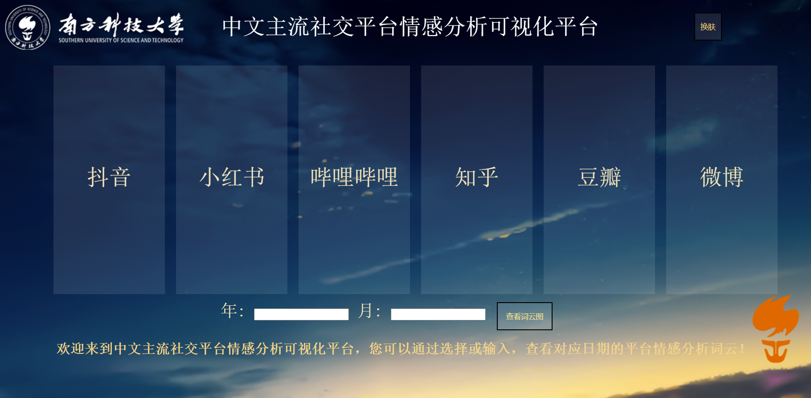
Website Platform Design

Slide 12
Website Platform Design
Home page design should follow the design principles of web page and software engineering design.
A beautiful and simple design can make users more willing to use the
platform designed by us. Clear instructions and prompts will be
easy for users to operate, easy to use.
The home page also has a “Change the skin” function for users to use.

Slide 13
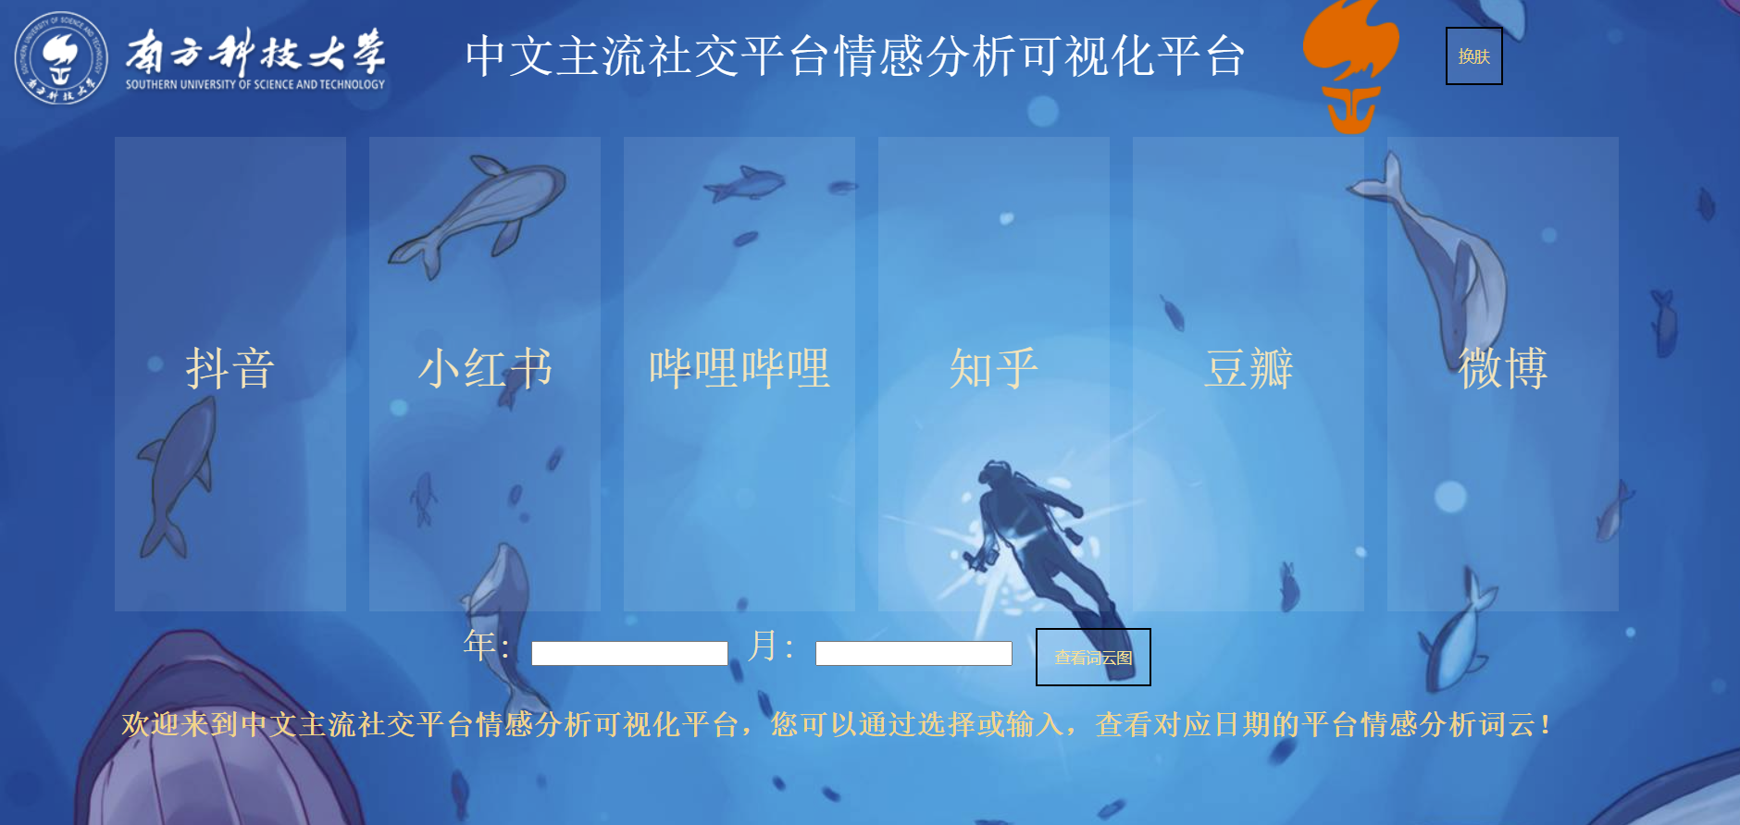
Website Platform Design

Slide 14
3
Systematic Design

Slide 15
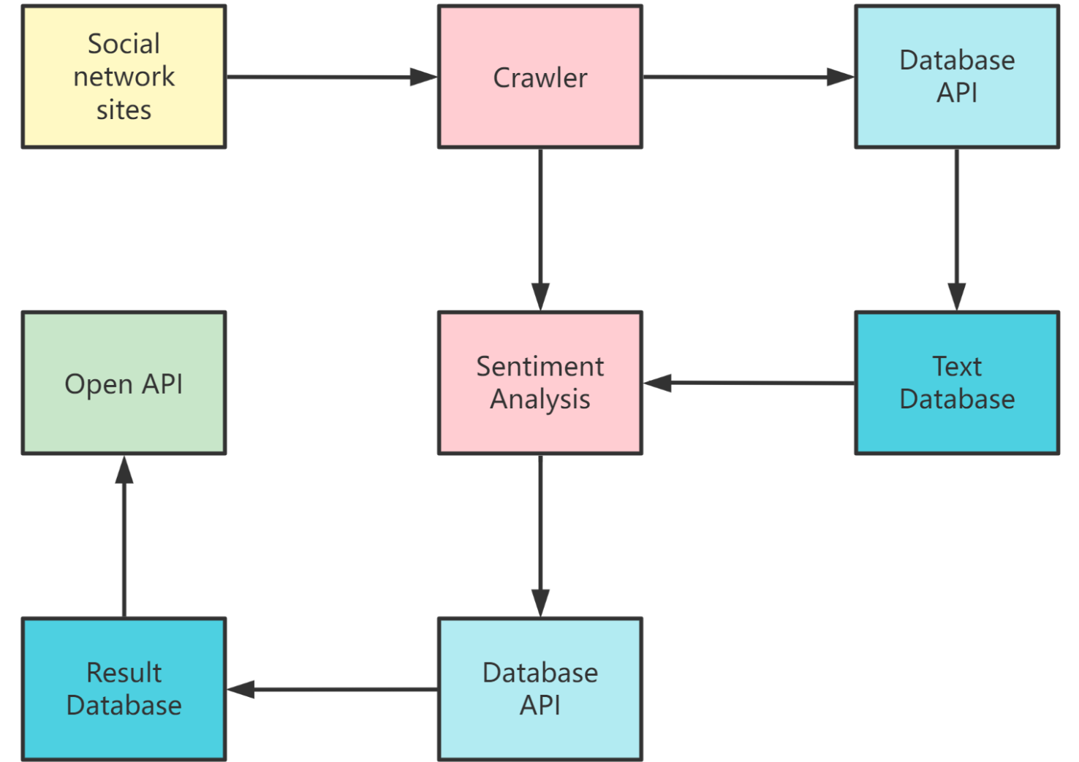
Design graph

Slide 16
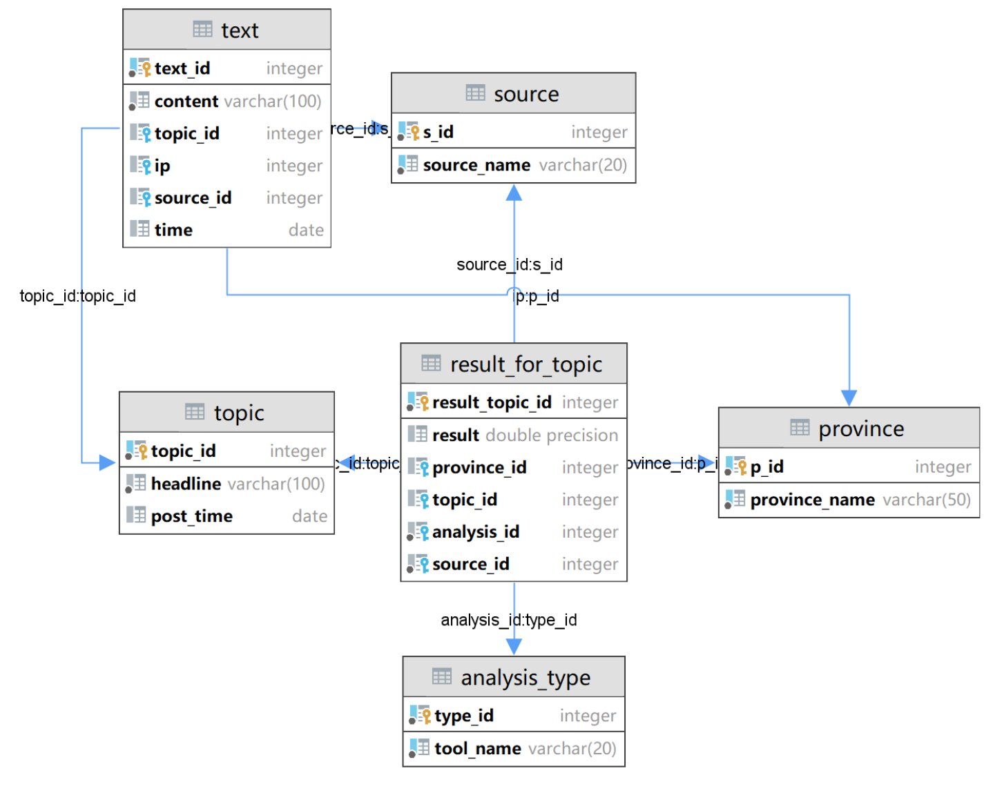
Database design

Slide 17
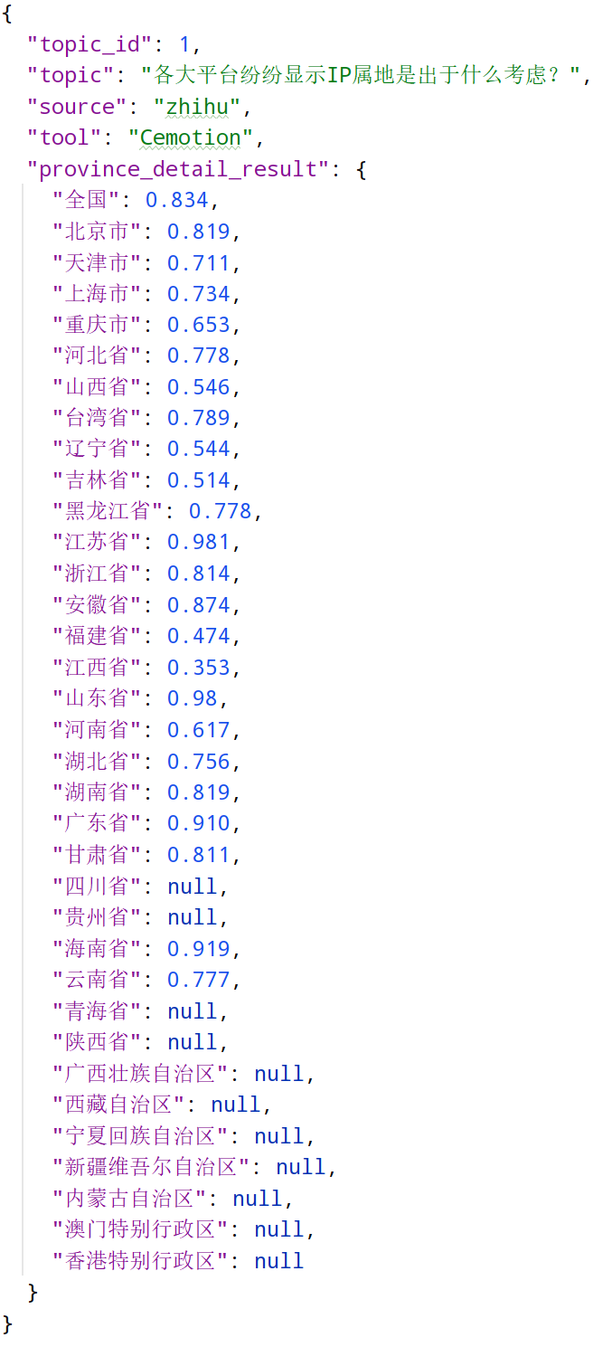
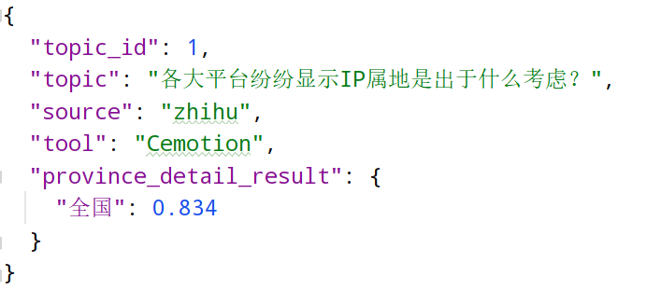
Open API

Slide 18
4
Future Task

Slide 19
Contain More Platforms.
This semester we have analyzed the sentiment of 6 mainstream Chinese social media platforms, but there are much more than that. Being able to analyze an increasing number of platforms is a way forward.

Slide 20
Optimize Analysis Results
We used two Chinese sentiment analysis libraries, SnowNLP and Cemotion, for sentiment analysis, but unfortunately the results did not meet expectations.
Better analysis results can be obtained through more scientific use of the tools in the future.

Slide 21
About Home Page
The homepage still has relatively few features, only being able to view the word cloud for one period per platform.
One possible future direction is to view word clouds from different platforms at different times by entering the query time, and another is to query more sentiment analysis results instead of being limited to word clouds

Slide 22
API optimization
Provide more query interface, for example, can compare the sentiment analysis results of similar topics on different platforms, compare the analysis results of similar topics in different regions.

Slide 23
5
Some of Overview

Slide 24
Some of Overview
What we learned in this project?
Crawlers.
Methods of data-clean (e.g. regular expressions, stop words).
Methods for sentiment analysis (e.g. words clouds, neural networks).
Website front-end design. (html, css, javascript)
Systematic Design
Database
…

Slide 25
Some of Overview
What are difficult in this project?
Crawlers. (hard to design, especially for Douyin)
Solution:
Try our best to design crawlers.
Make good use of tools:
Use third party crawlers app for help.

Slide 26
Some of Overview
Other things that have been tried but not worked?
Get data via Android emulator + packet capture.
…

Slide 27
Thank You

