Slide 1
Mock server for api test
Frank.Chen

Slide 2
Mock server for api test
Design base on wiremock
Enhance
Custom response (cache)
Replay
Times
steps

Slide 3
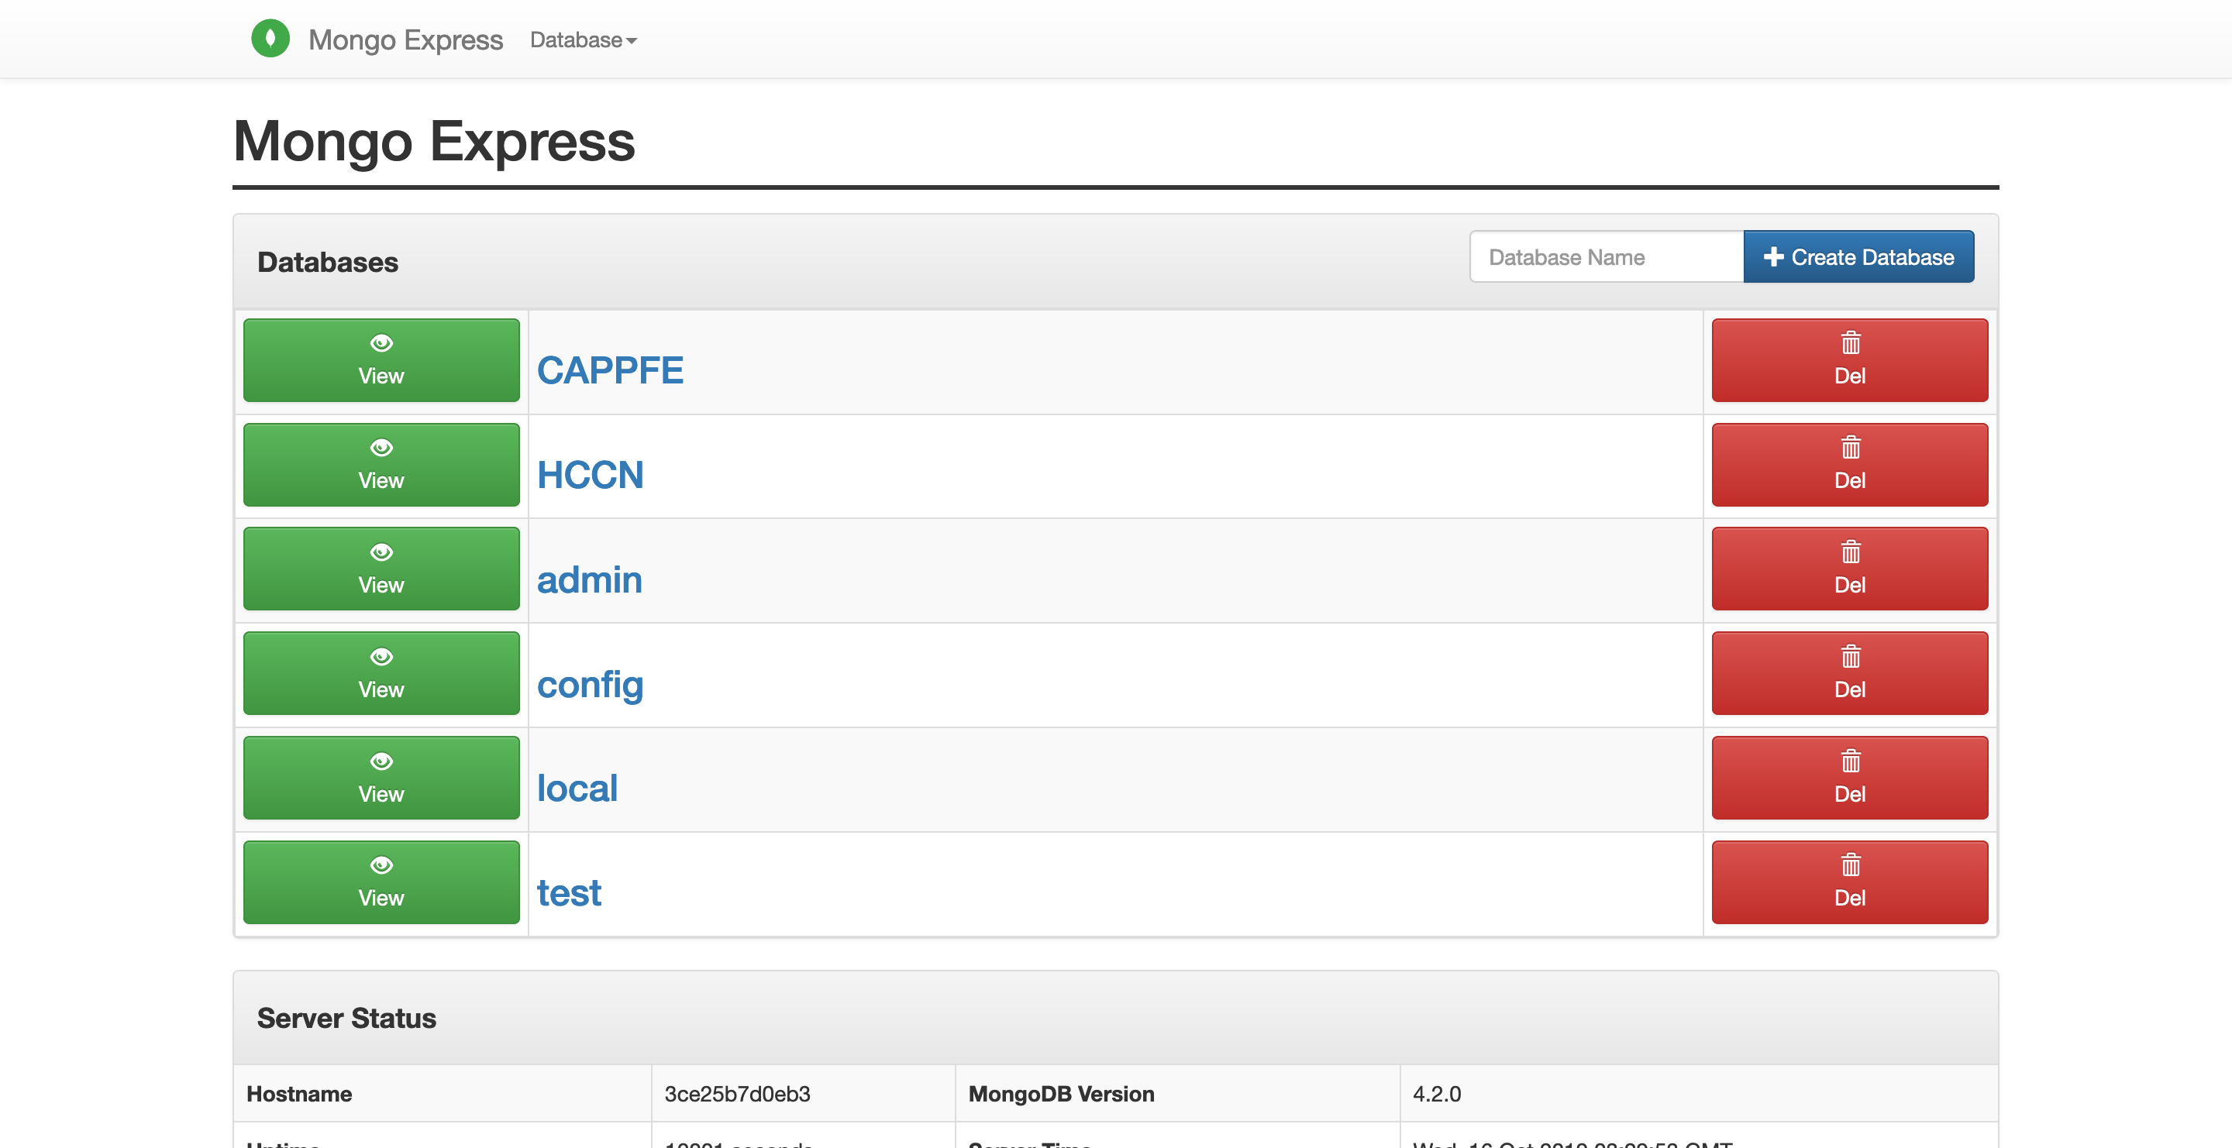
Portal
Project name=DAtabase

Slide 4
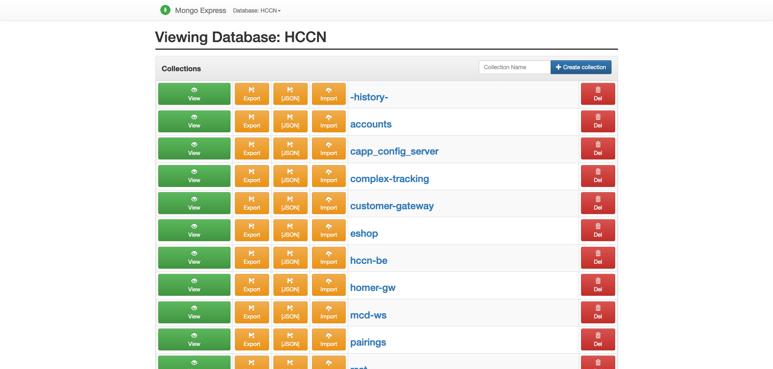
Module_name = collection (table)

Slide 5
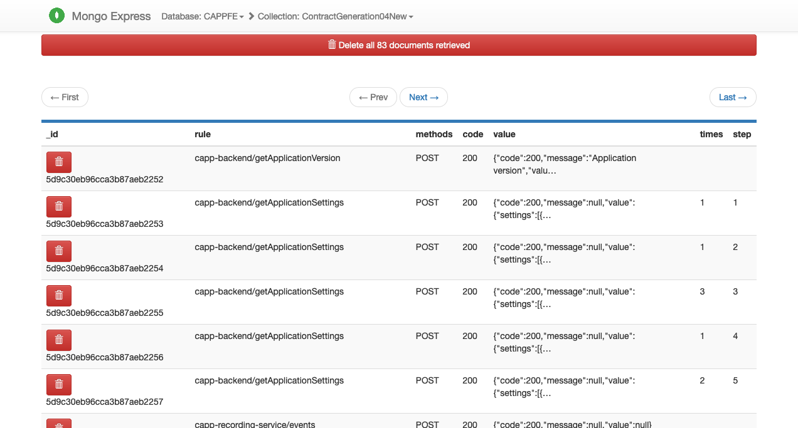
url = http://mockerserver:port/database/collection/rule

Slide 6
Mock data format
Required
rule (url)
methods (GET, POST, DELETE,PUT)
queryParameters
bodyPatterns
headers
code (HTTPStatus)
value (response data)

Slide 7
Mock data format
Optional
Status (‘FALSE’, False, ’Duplicated’)
Comments
Delay (second)
Permanent (custom response)
User (custom response)
Step (replay)
Times (replay)

Slide 8
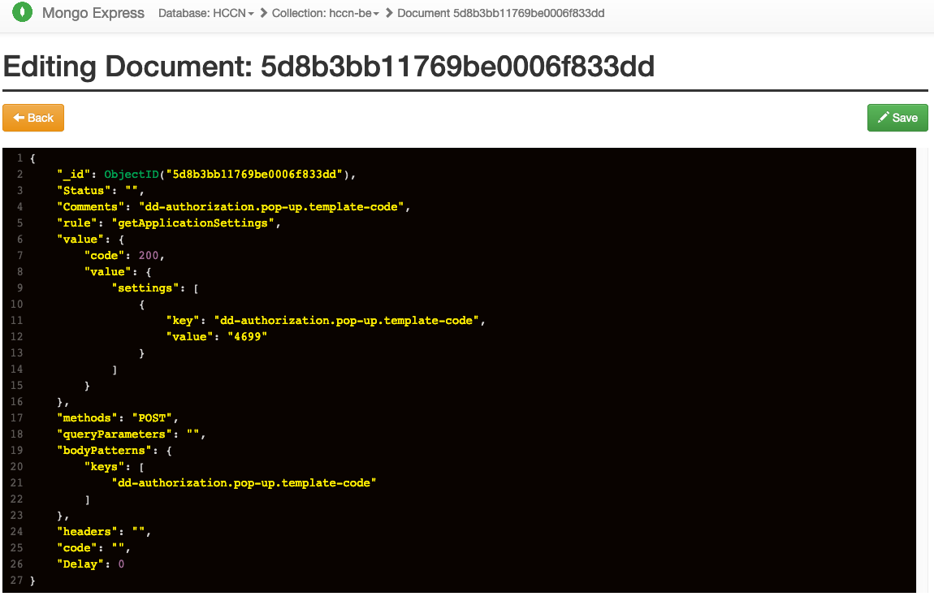

Slide 9
Q&A

