Slide 1
Bicoid dictates the head development
wt
bcdE1
Driever and Nusslein-Volhard, 1988

Slide 2
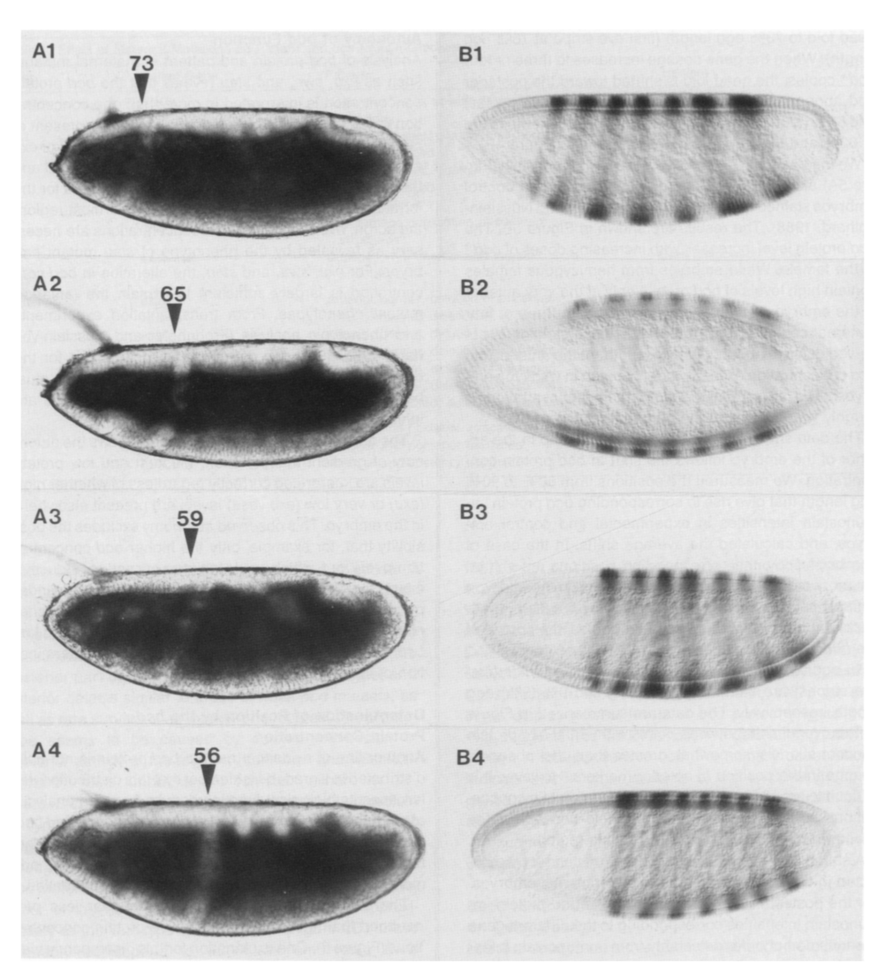
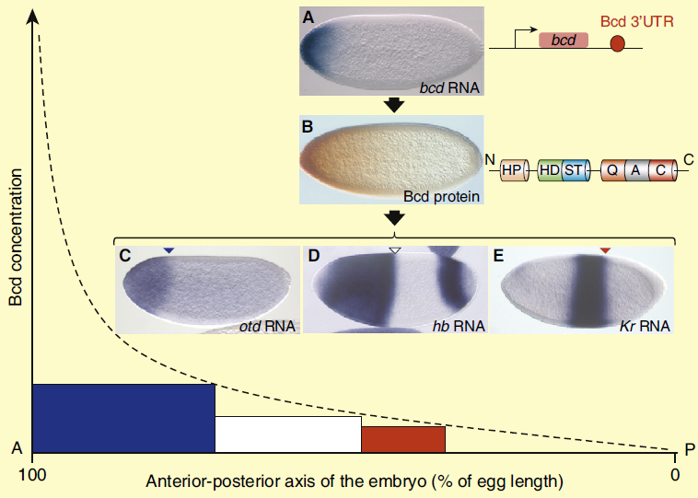
Bicoid morphogen gradient and the embryonic fate map
1xBcd
2xBcd
Porcher & Dostatni, 2010
3xBcd
4xBcd
eve
Driver & Nusslein-Volhard, 1988

Slide 3
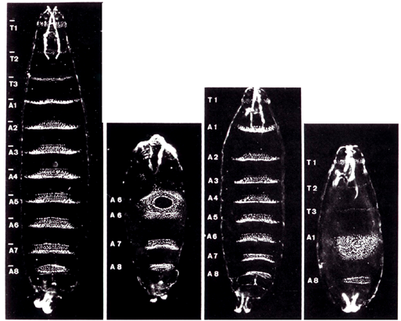
Gap gene mutants lack different body regions
Wild type
Krüppel
hunchback
knirps
Notes:
This slide is from: http://www.google.com/url?sa=t&rct=j&q=&esrc=s&frm=1&source=web&cd=14&cad=rja&ved=0CDUQFjADOAo&url=http%3A%2F%2Fcourses.bio.unc.edu%2F2011Spring%2FBiol205Section6%2FReed%2520lecture%2520slides%25202011%2FLecture%252016%2520-%2520Drosophila%2520A-P%2520axis.ppt&ei=t20_UvrZDfGj4AOKpYDYCg&usg=AFQjCNEgJBq6L_3tUTUHJiLcRD-YsT8VuA&bvm=bv.52434380,d.dmg

Slide 4
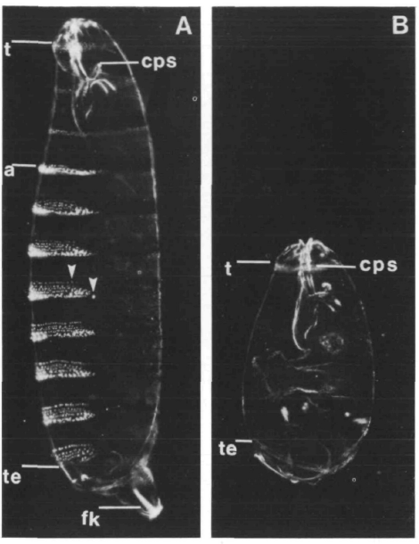
Nanos- posterior patterning
Lehman and Nusslein-Volhard, 1991

Slide 5
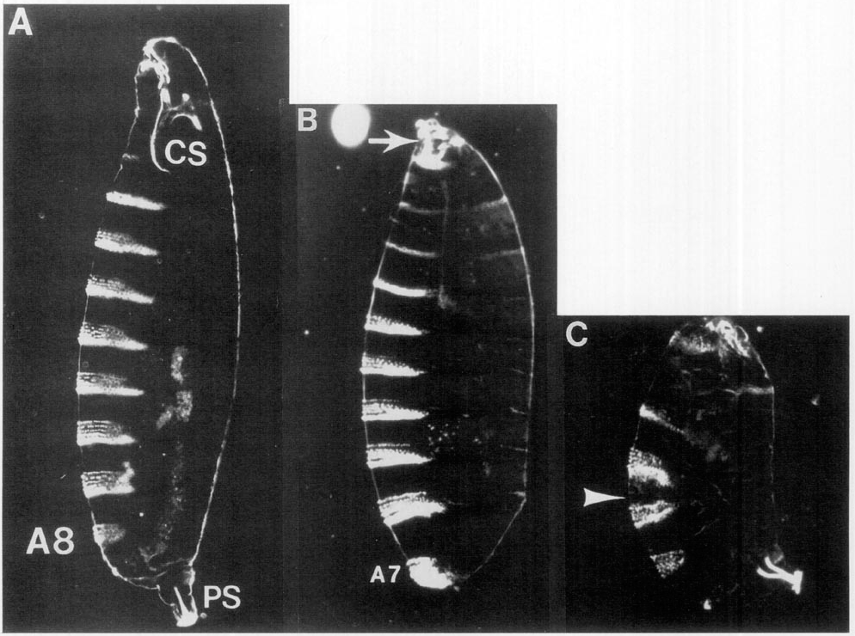
Torso signaling- terminal specification
wt
torLOF
torGOF
Duffy and Perrimon, 1994

Slide 6
Acknowledgement
中科院生物物理所
焦仁杰 研究员
伍洪刚 博士

