Slide 1
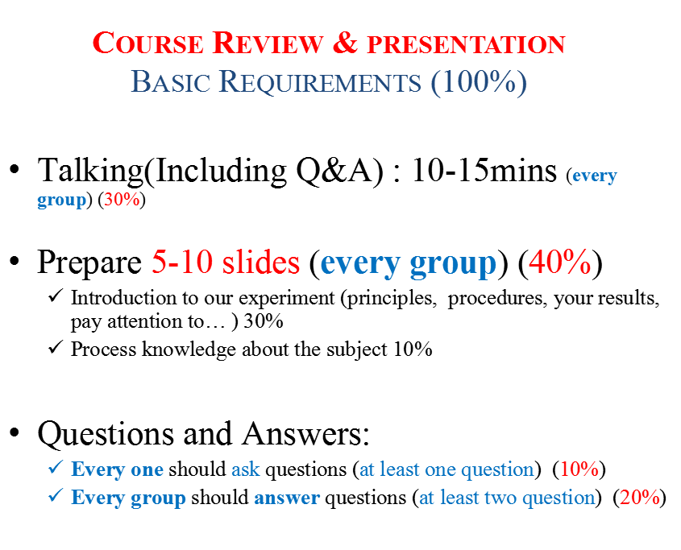

Slide 2
Presentation Topics
Class | Experiments | Monday | Tuesday
1 | Introduction and Lab Safety
2 | Exp. 1 Cell Morphology Observation and Determination of Cell Culture Density | G10 | G7
3 | Exp. 2 Cell Culture (Subculture, Freezing Cells,Thawing and Recovering Cells) | G11 | G2
4 | Exp. 3 Determination of Red Blood Cell Membrane Permeability | G4 | G11
4 | Exp. 4 Red Blood Cell Lysis and Flow Cytometry Analysis of White Blood Cell |  | G9
5 | Exp. 5 Cell Transfection | G9 | G8
6 | Exp. 6 Chromosome Observation of U-937 Cell | G8 | G4
7 | Exp. 7 Cell Differentiation | G2 | G5
8 | Exp. 8 Cell Proliferation and Cell Cycle | G7 | G1
9 | Exp.9 Phagocytosis | G6 | G3
10 | Exp.10 Analysis of Cell Apoptosis | G1 | G6
11 | Exp.11 Cytoprotein Extraction and Quantification | G3 | G10
12 | Exp.12 Western Blotting I | G5 | G12
13 | Exp.12 Western Blotting II Experimental Skills Examination
14 | Presentation

