Slide 1
Exp5: Cell Transfection
11510511 Yuejian Mo
11612218 Wenhao Zhang

Slide 2
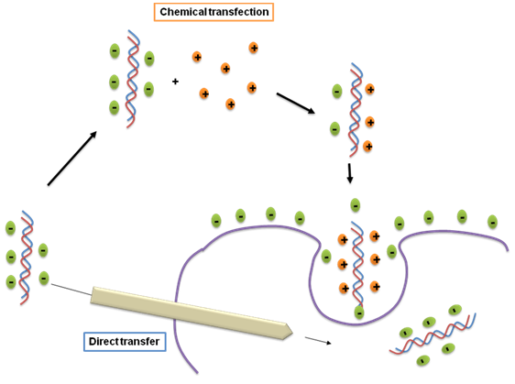
Principles --- Transfection
Calcium
phosphate
Co-precipitation

Slide 3
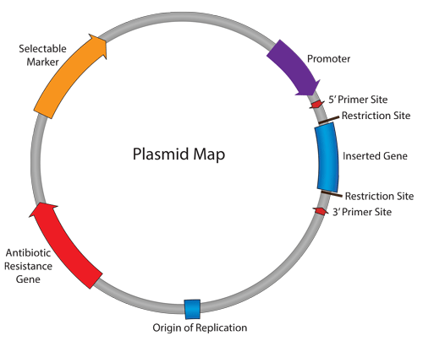
Principles --- Vector Design
Reporter Gene
Fluorescence Protein
NLS, Actin

Slide 4
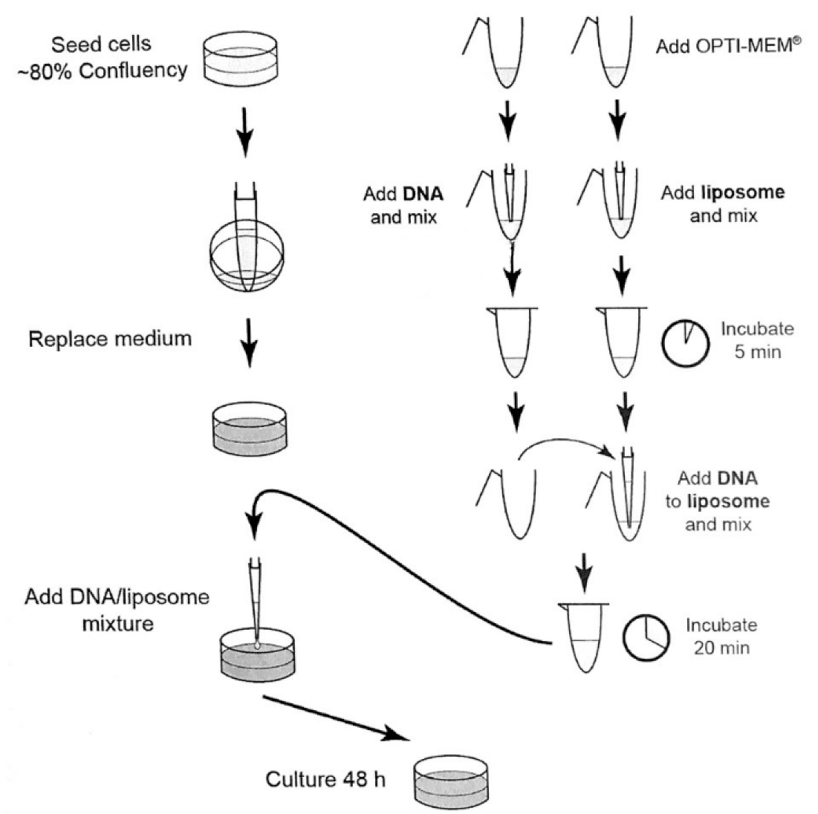
Procedures

Slide 5
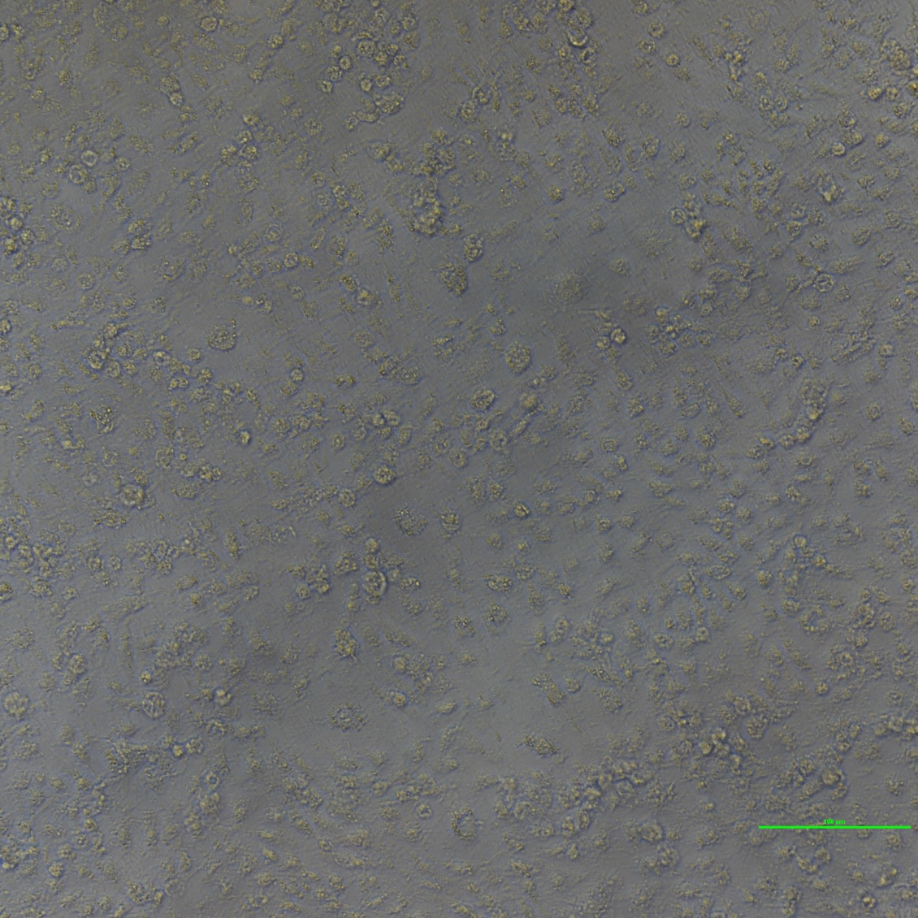
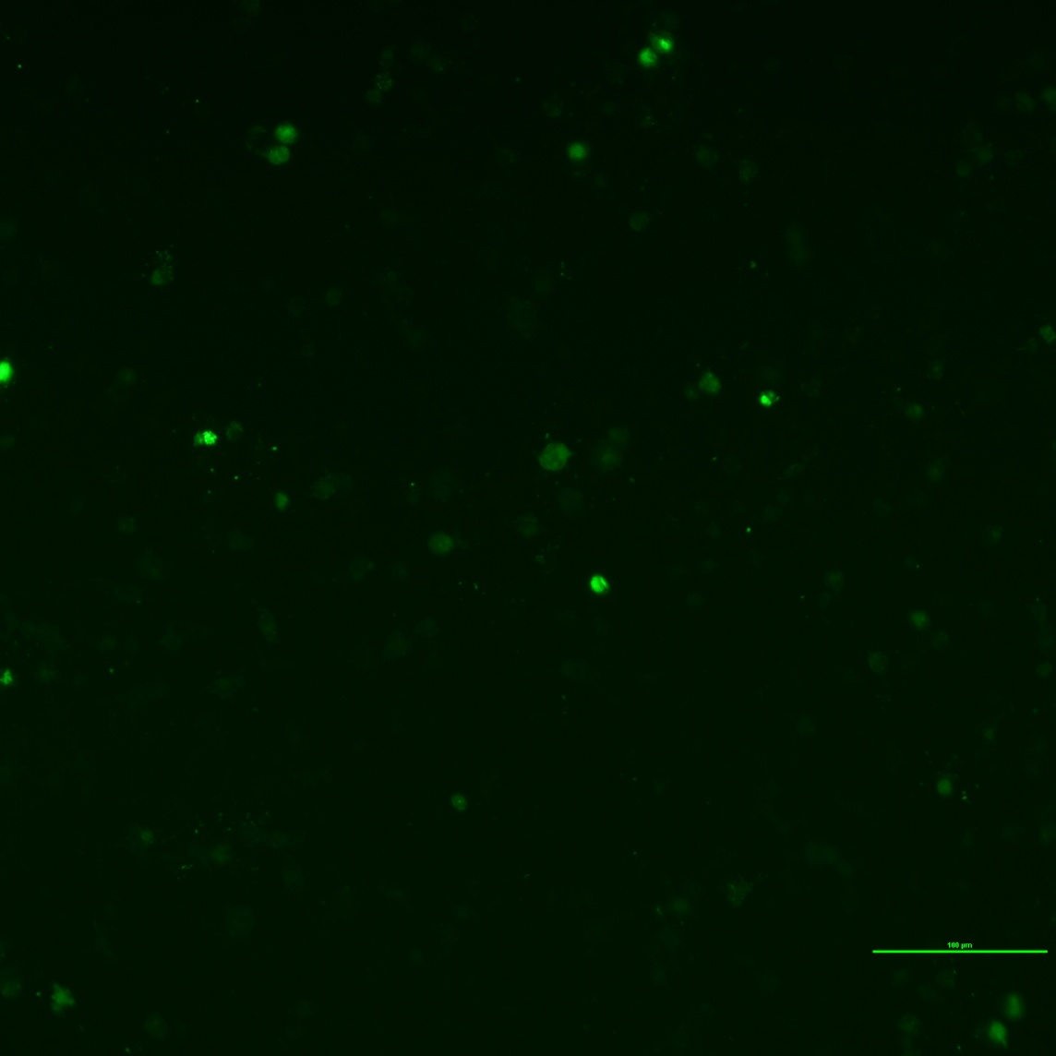
Result

Slide 6
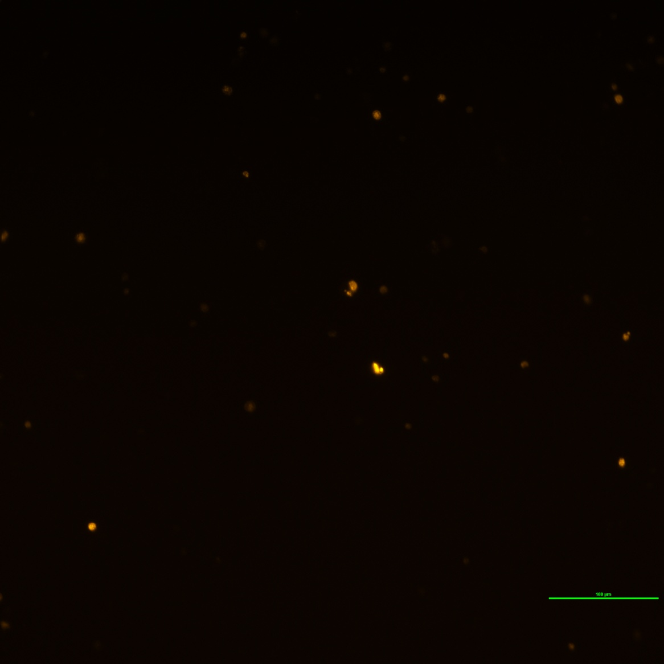
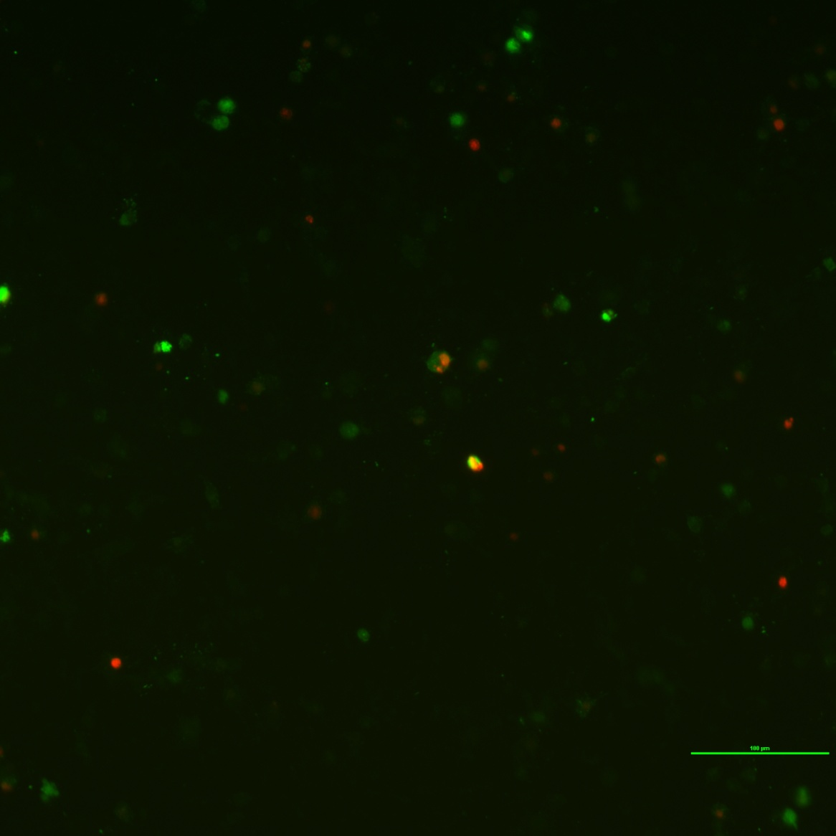
Result

Slide 7
Notice
· Incubate mixture for 20 min
· Add mixture drop by drop
· Mix well

Slide 8
Efficiency factors
· Cell condition
· DNA quality
· Avoid serum and antibiotics
· Time exposed to transfection reagent

Slide 9
Other methods
· Stable transfection
· Viral transduction

Slide 10
Reference
https://blog.addgene.org/plasmids-101-what-is-a-plasmid

