Slide 1
Exp5: Cell Transfection
Yuejian Mo
Wenhao Zhang

Slide 2
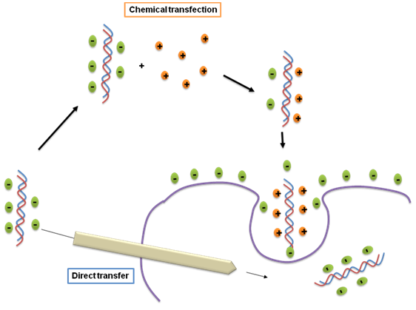
Principles --- Transfection
Calcium
phosphate
Co-precipitation

Slide 3
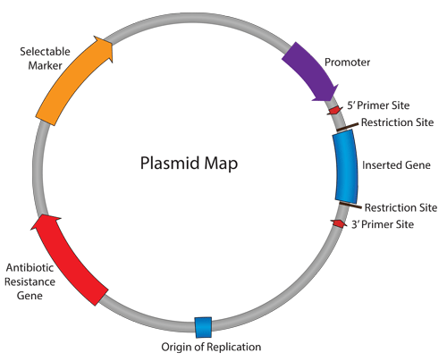
Principles --- Vector Design
Reporter Gene
Fluorescence Protein
NLS, Actin

Slide 4
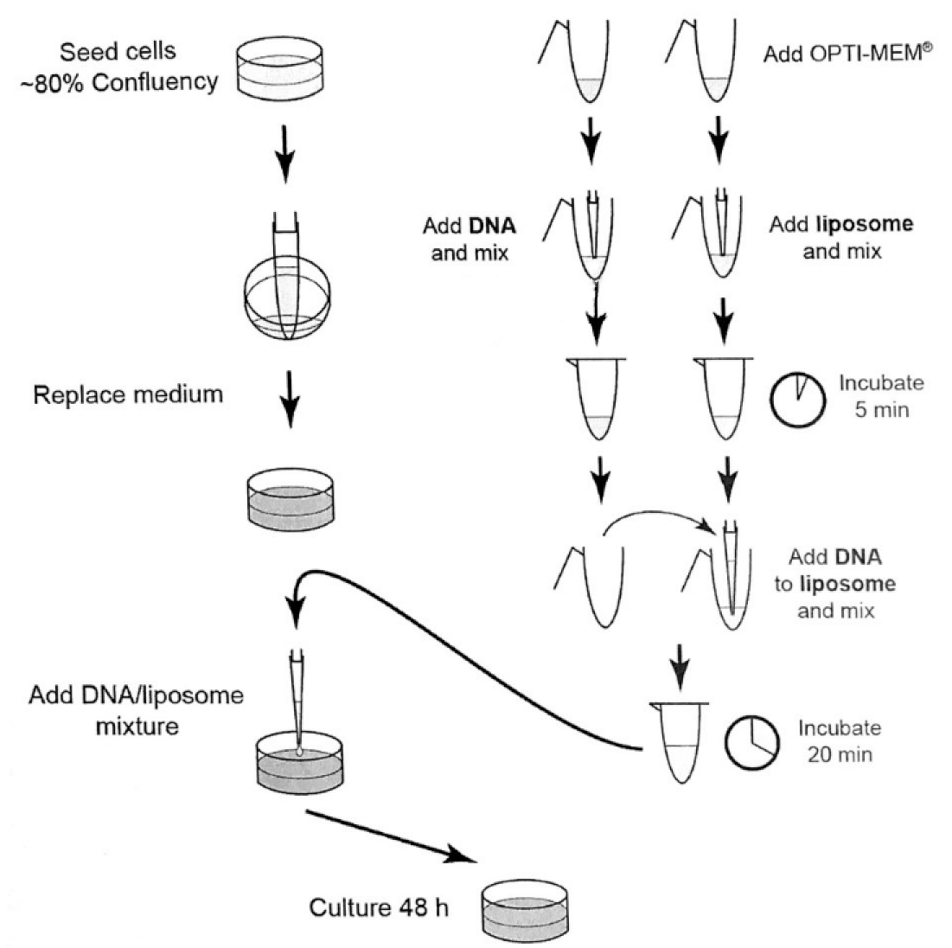
Procedures

Slide 5
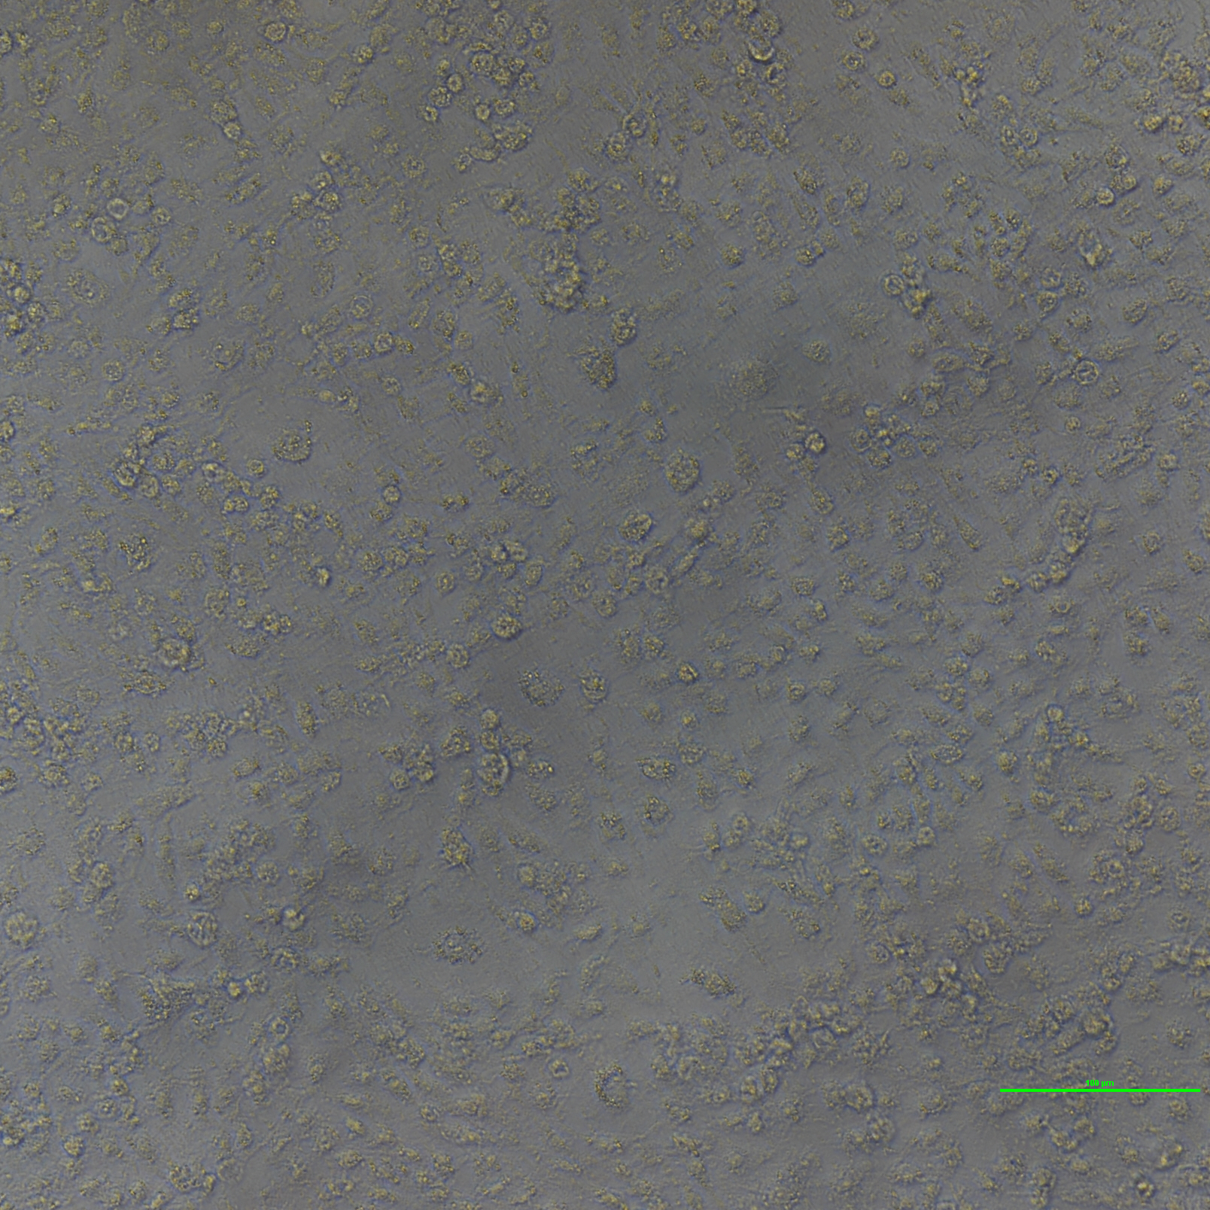
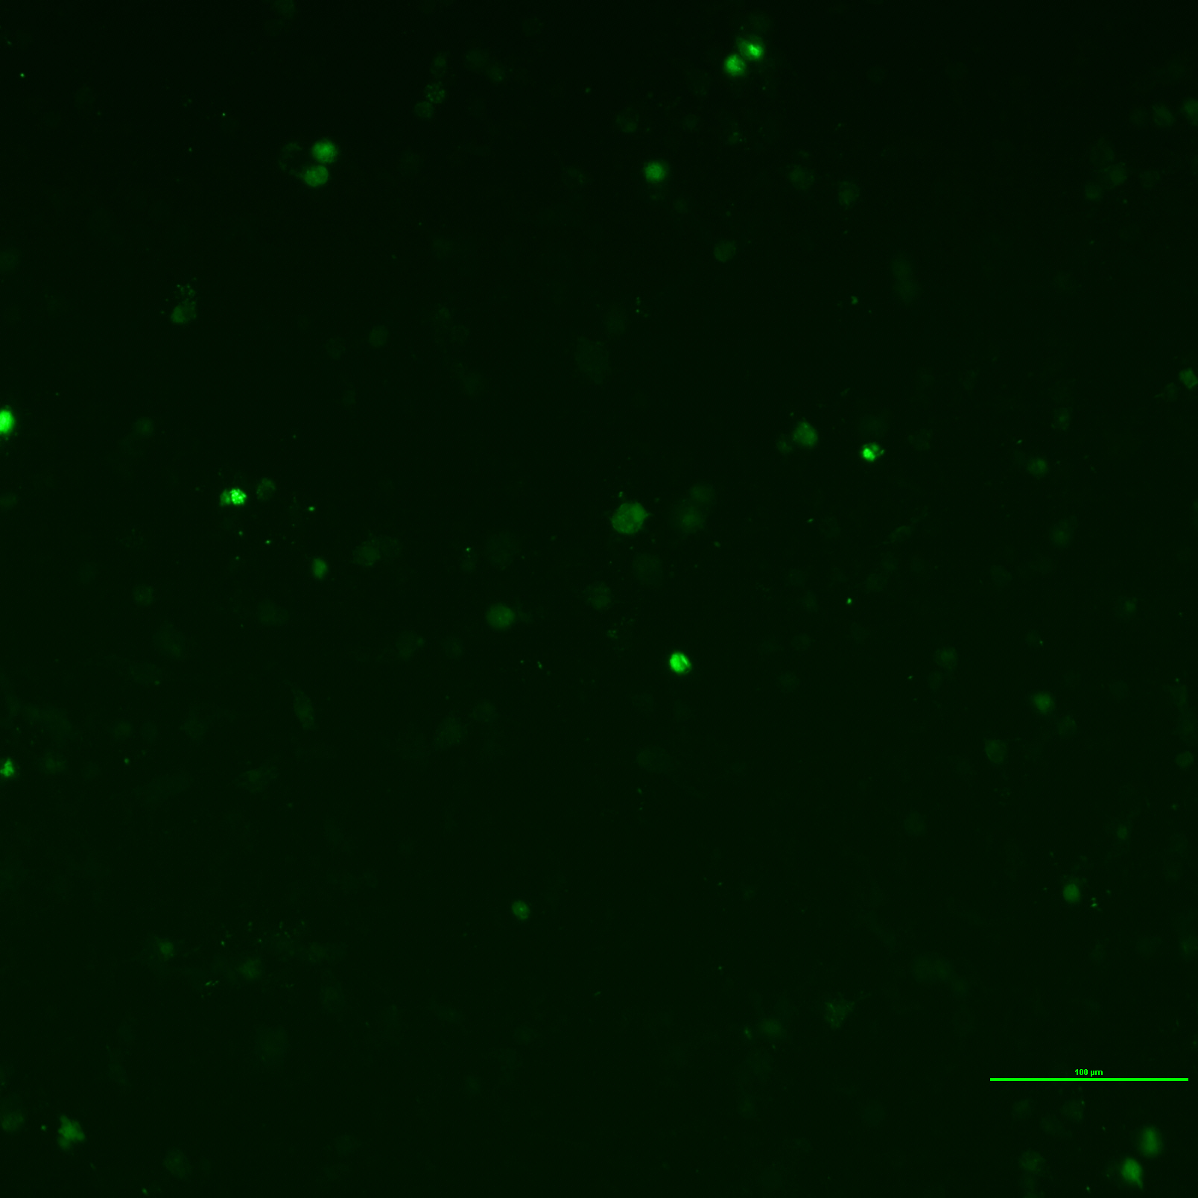
Result

Slide 6
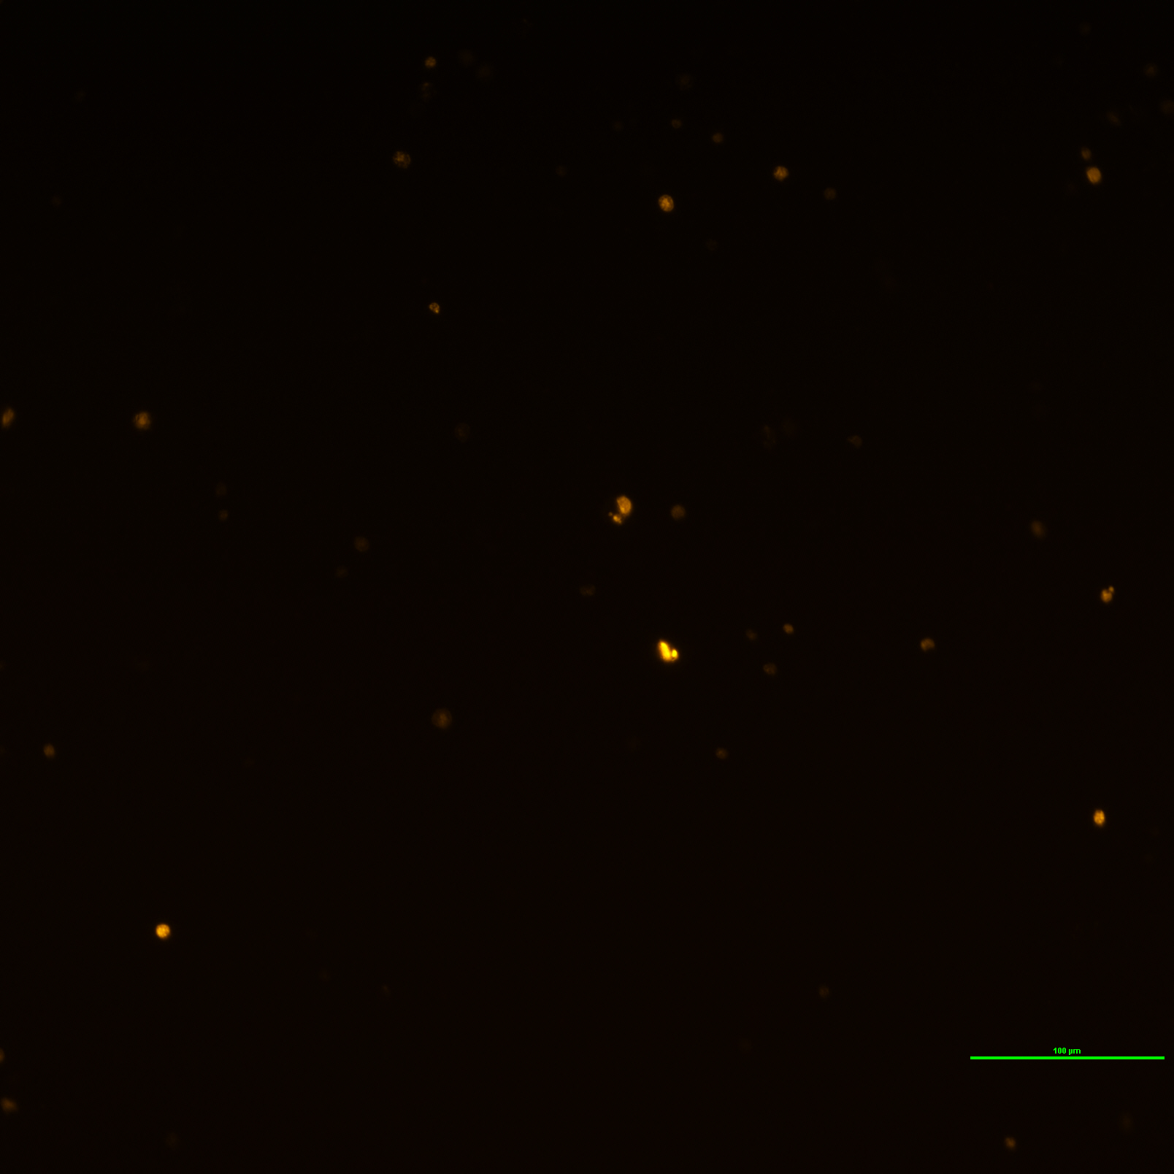
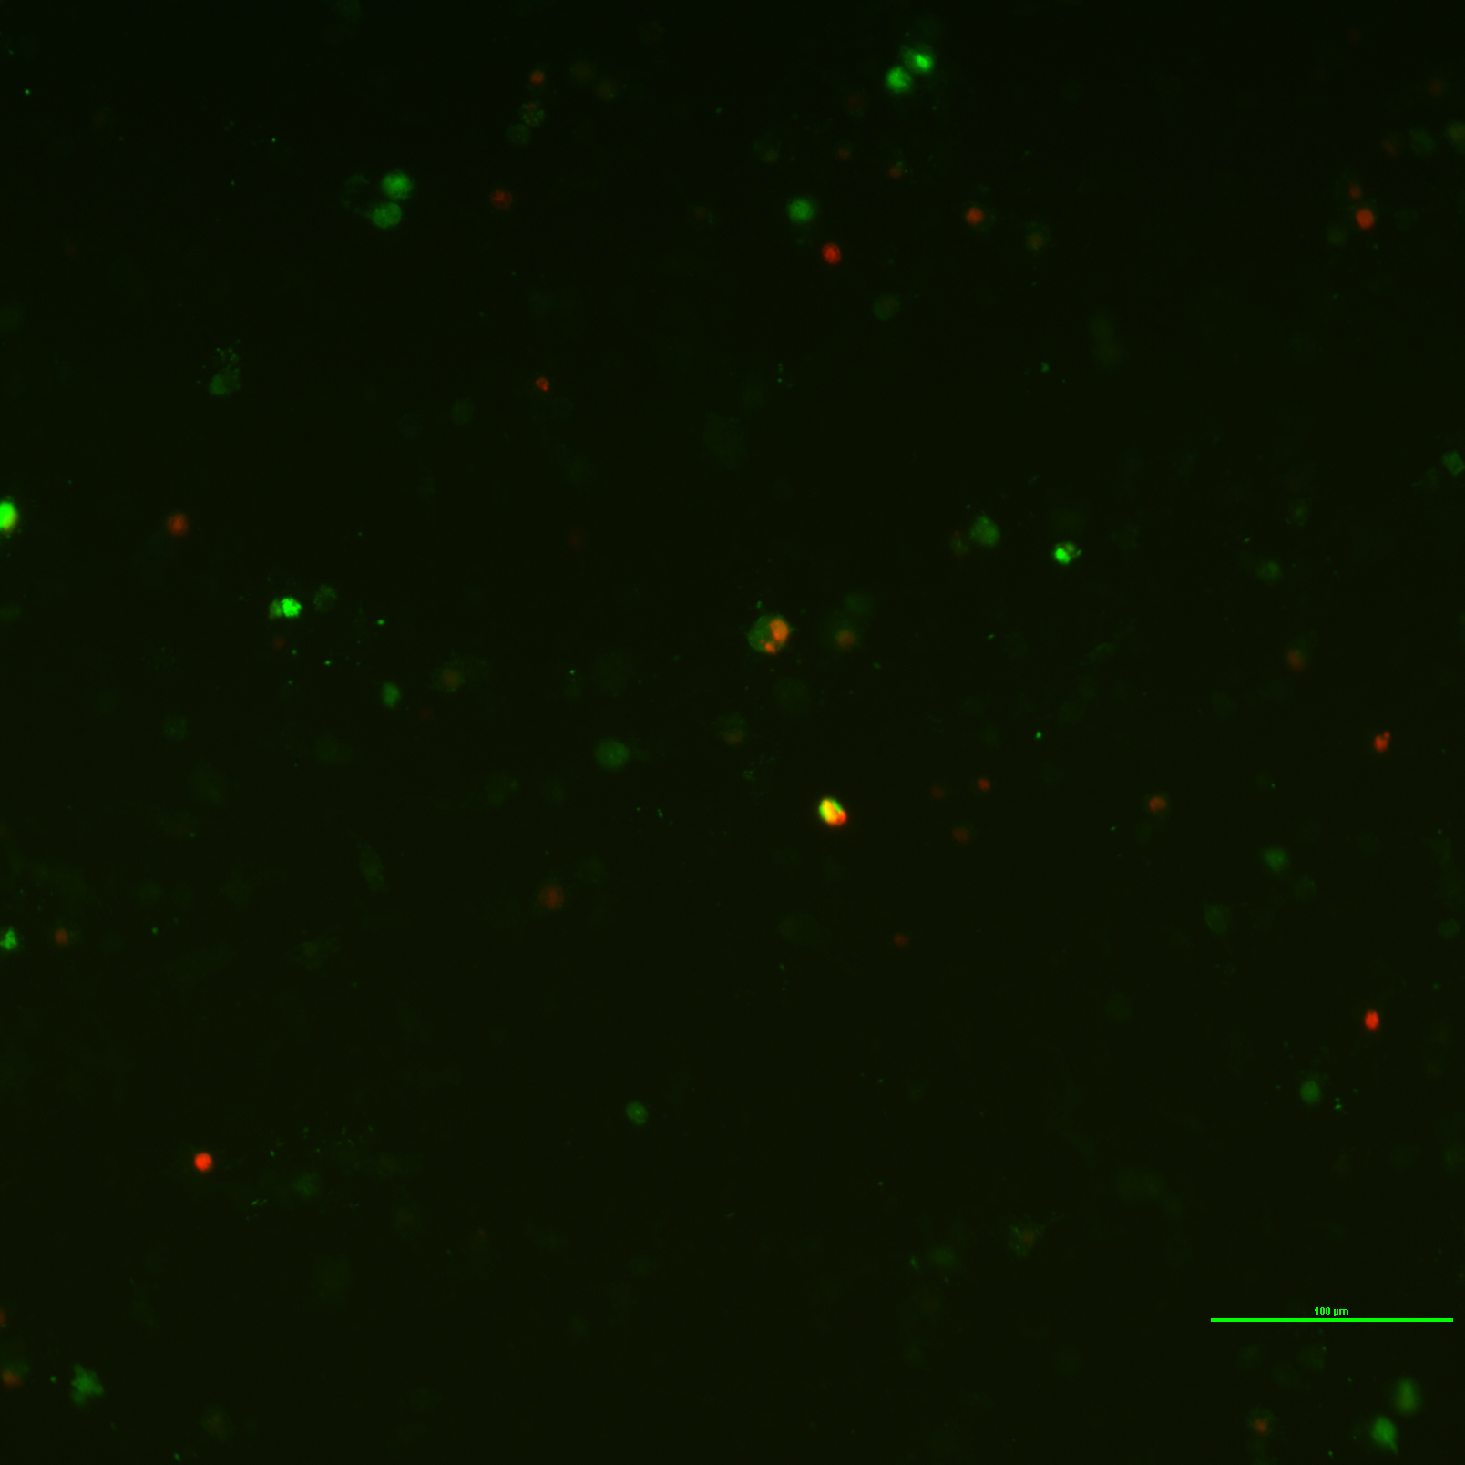
Result

Slide 7
Reference
https://blog.addgene.org/plasmids-101-what-is-a-plasmid

