Slide 1
Micro- and nano-mechanics of osteoarthritic cartilage: The effects of tonicity and disease severity
---Presented by
Wang Shiyi
Mo Yuejian
Li Yuxin
Wang Mengqi
osteoarthritic cartilage：骨性关节炎软骨
Tonicity：肌肉弹性

Slide 2
Contents
Introduction
Materials & Methods
Results
Discussion

Slide 3
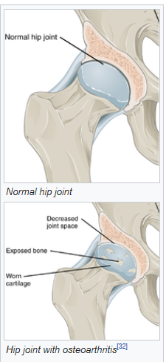
OA (osteoarthritics)
A type of joint disease that results from breakdown of joint cartilage and underlying bone.
The most common symptoms are joint pain and stiffness. Other symptoms include joint swelling, decreased range of motion.
It is characterized by the loss of proteoglycans(PGs) and hence GAG content via enzymes as well as failure of the collagen network and subsequently loss of cartilage stiffness.
Cited from : https://en.wikipedia.org/wiki/Osteoarthritis
Notes:
The water content of healthy cartilage is finely balanced by compressive force driving water out and hydrostatic and osmotic pressure drawing water in.
However, during onset of osteoarthritis, the collagen matrix becomes more disorganized and there is a decrease in proteoglycan content within cartilage. The breakdown of collagen fibers results in a net increase in water content.
1

Slide 4
Objectives
Understand the response of OA cartilage to changes in ionic strength (tonicity) and correlate it with
The mechanical properties of cartilage
measured at the micro- and nano-scale
from indentation experiment;
The severity of the disease
Notes:
The response of OA cartilage to changes in tonicity could indirectly give us information about the relationship between the structure and properties of cartilage, because the porous hydrated matrix with its negatively charged GAGs ad fibrillar collagen macromolecules is responsible for cartilage’s biomechanical behavior.
1

Slide 5
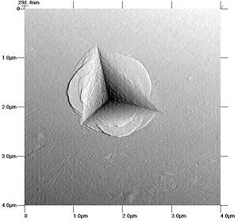
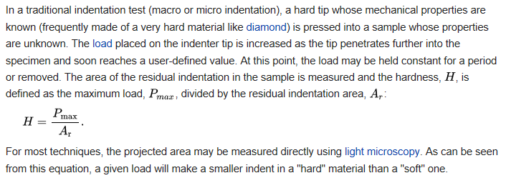
Nanoindentation(纳米压痕)
Nanoindentation is a variety of indentation hardness tests applied to small volumes. Indentation is perhaps the most commonly applied means of testing the mechanical properties of materials;
Notes:
压痕实验最早用于 硬度的测试，将一定形状和尺寸的较硬物体在一定压力的作用下压入被测材料，保持一段时间后卸载，再根据总施加载荷与所产生压痕面积或深度之间的关系，得到材料的硬度值。纳米压痕基于弹性接触力学，根据实验所测得的载荷-位移曲线，从卸载曲线开始部分的斜率求出弹性模量，并由最大加载载荷和压痕的接触投影面积的比值计算出硬度值。
1

Slide 6
Speciemens Preparation
Source: Total knee which was replaced in surgeries
5 mild OA
5 severe OA
Notes:
压痕实验最早用于 硬度的测试，将一定形状和尺寸的较硬物体在一定压力的作用下压入被测材料，保持一段时间后卸载，再根据总施加载荷与所产生压痕面积或深度之间的关系，得到材料的硬度值。纳米压痕基于弹性接触力学，根据实验所测得的载荷-位移曲线，从卸载曲线开始部分的斜率求出弹性模量，并由最大加载载荷和压痕的接触投影面积的比值计算出硬度值。
1

Slide 7
Speciemens Preparation
Source: Total knee which was replaced in surgeries
5 mild OA
5 severe OA
Isotonic PBS
Hypertonic PBS
Notes:
压痕实验最早用于 硬度的测试，将一定形状和尺寸的较硬物体在一定压力的作用下压入被测材料，保持一段时间后卸载，再根据总施加载荷与所产生压痕面积或深度之间的关系，得到材料的硬度值。纳米压痕基于弹性接触力学，根据实验所测得的载荷-位移曲线，从卸载曲线开始部分的斜率求出弹性模量，并由最大加载载荷和压痕的接触投影面积的比值计算出硬度值。
1

Slide 8
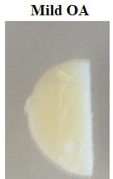
Micro-scale Indentation experiment ---Method
Creep Experment
Creep Experment
1h
Isotonic PBS
20, 40, 60, 120 min
Hypertonic PBS
Notes:
压痕实验最早用于 硬度的测试，将一定形状和尺寸的较硬物体在一定压力的作用下压入被测材料，保持一段时间后卸载，再根据总施加载荷与所产生压痕面积或深度之间的关系，得到材料的硬度值。纳米压痕基于弹性接触力学，根据实验所测得的载荷-位移曲线，从卸载曲线开始部分的斜率求出弹性模量，并由最大加载载荷和压痕的接触投影面积的比值计算出硬度值。
1

Slide 9
Micro-scale Indentation experiment ---Method
Creep Experment
Creep Experment
1h
Isotonic PBS
20, 40, 60, 120 min
Hypertonic PBS
Two or more locations each sample
Every location measure 3 times
Notes:
压痕实验最早用于 硬度的测试，将一定形状和尺寸的较硬物体在一定压力的作用下压入被测材料，保持一段时间后卸载，再根据总施加载荷与所产生压痕面积或深度之间的关系，得到材料的硬度值。纳米压痕基于弹性接触力学，根据实验所测得的载荷-位移曲线，从卸载曲线开始部分的斜率求出弹性模量，并由最大加载载荷和压痕的接触投影面积的比值计算出硬度值。
1

Slide 10
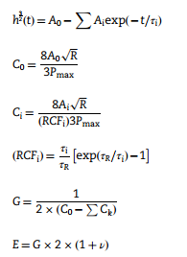
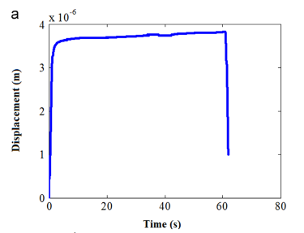
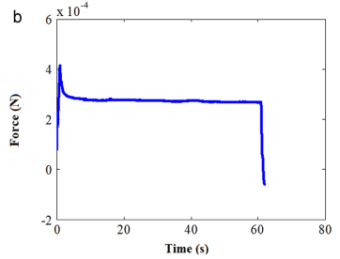
Micro-scale Indentation experiment ---Method
Assumption:
Viscoelastic creep
Poisson’s rate = 0.5
Incompressibility
Young’s Modulus
-->
Mircro-stiffness
Notes:
压痕实验最早用于 硬度的测试，将一定形状和尺寸的较硬物体在一定压力的作用下压入被测材料，保持一段时间后卸载，再根据总施加载荷与所产生压痕面积或深度之间的关系，得到材料的硬度值。纳米压痕基于弹性接触力学，根据实验所测得的载荷-位移曲线，从卸载曲线开始部分的斜率求出弹性模量，并由最大加载载荷和压痕的接触投影面积的比值计算出硬度值。
1

Slide 11
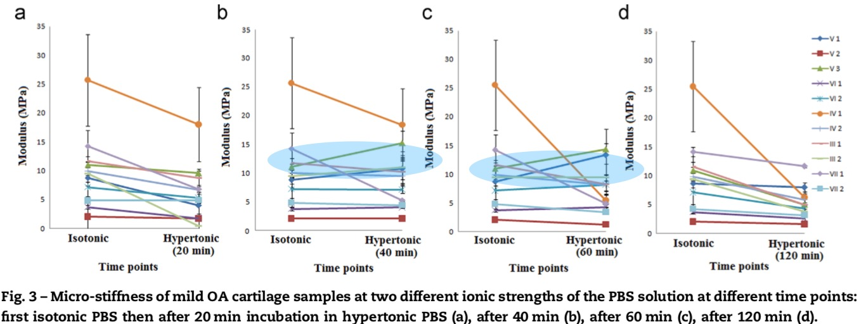
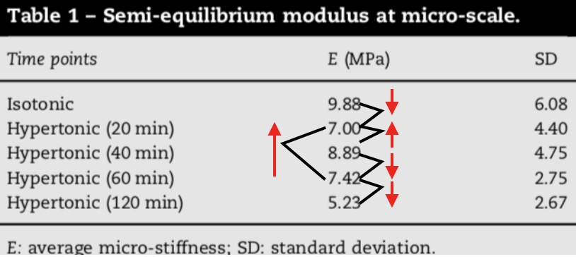
Micro-Scale Indentation experiments ---Result
tonicity dependence
micro-scale elastic modulus decrease in hypertonic solution
Each sample has its own dynamic behavior response to tonicity.
Notes:
压痕实验最早用于 硬度的测试，将一定形状和尺寸的较硬物体在一定压力的作用下压入被测材料，保持一段时间后卸载，再根据总施加载荷与所产生压痕面积或深度之间的关系，得到材料的硬度值。纳米压痕基于弹性接触力学，根据实验所测得的载荷-位移曲线，从卸载曲线开始部分的斜率求出弹性模量，并由最大加载载荷和压痕的接触投影面积的比值计算出硬度值。
1

Slide 12
Nano-scale Indentation experiment ---Method
OA Sample
2h in
Isotonic PBS
2h in
Hypertonic PBS
Notes:
压痕实验最早用于 硬度的测试，将一定形状和尺寸的较硬物体在一定压力的作用下压入被测材料，保持一段时间后卸载，再根据总施加载荷与所产生压痕面积或深度之间的关系，得到材料的硬度值。纳米压痕基于弹性接触力学，根据实验所测得的载荷-位移曲线，从卸载曲线开始部分的斜率求出弹性模量，并由最大加载载荷和压痕的接触投影面积的比值计算出硬度值。
1

Slide 13
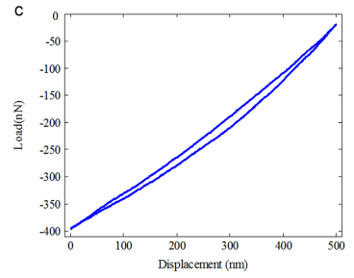
Nano-scale Indentation experiment ---Method
OA Sample
2h in
Isotonic PBS
2h in
Hypertonic PBS
Notes:
压痕实验最早用于 硬度的测试，将一定形状和尺寸的较硬物体在一定压力的作用下压入被测材料，保持一段时间后卸载，再根据总施加载荷与所产生压痕面积或深度之间的关系，得到材料的硬度值。纳米压痕基于弹性接触力学，根据实验所测得的载荷-位移曲线，从卸载曲线开始部分的斜率求出弹性模量，并由最大加载载荷和压痕的接触投影面积的比值计算出硬度值。
1

Slide 14

Nano-scale Indentation experiment ---Method
OA Sample
2h in
Isotonic PBS
2h in
Hypertonic PBS
Elastic moduli
Notes:
压痕实验最早用于 硬度的测试，将一定形状和尺寸的较硬物体在一定压力的作用下压入被测材料，保持一段时间后卸载，再根据总施加载荷与所产生压痕面积或深度之间的关系，得到材料的硬度值。纳米压痕基于弹性接触力学，根据实验所测得的载荷-位移曲线，从卸载曲线开始部分的斜率求出弹性模量，并由最大加载载荷和压痕的接触投影面积的比值计算出硬度值。
<number>

Slide 15
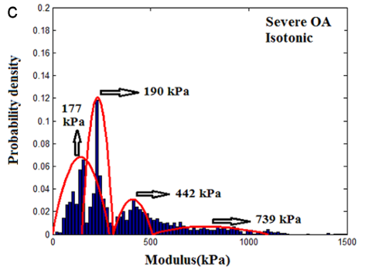

Nano-scale Indentation experiment ---Method
5000
4-Components Gaussian mixture model with Long-Likehood Criterion
Notes:
压痕实验最早用于 硬度的测试，将一定形状和尺寸的较硬物体在一定压力的作用下压入被测材料，保持一段时间后卸载，再根据总施加载荷与所产生压痕面积或深度之间的关系，得到材料的硬度值。纳米压痕基于弹性接触力学，根据实验所测得的载荷-位移曲线，从卸载曲线开始部分的斜率求出弹性模量，并由最大加载载荷和压痕的接触投影面积的比值计算出硬度值。
<number>

Slide 16
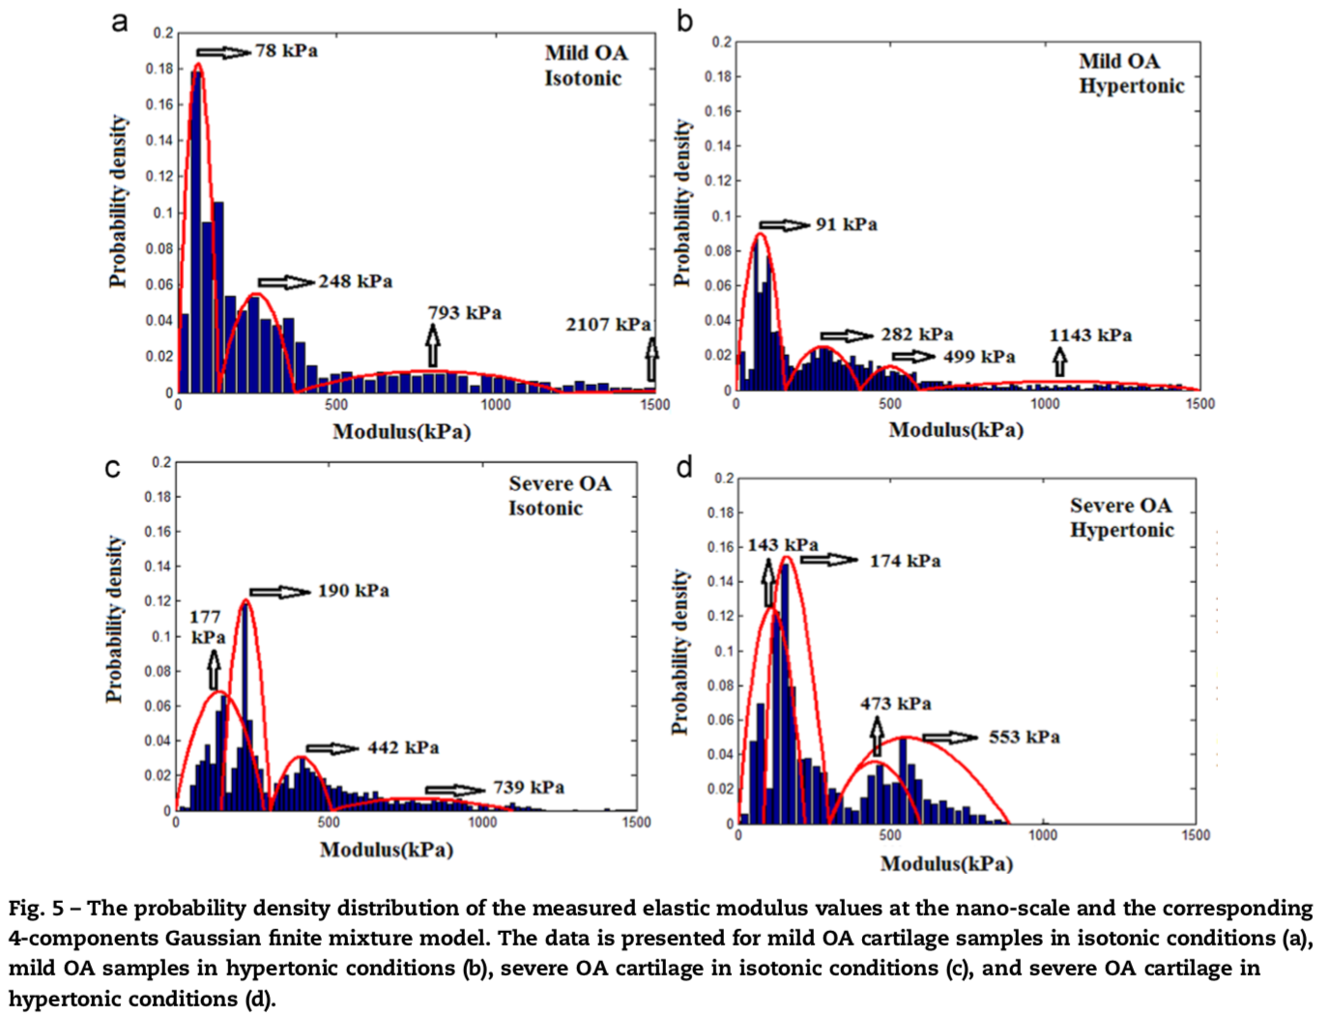
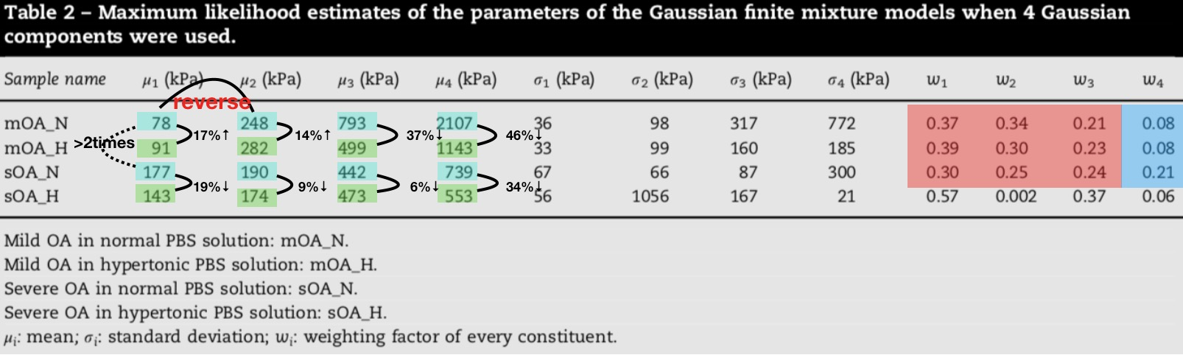
Nano-scale Indentation experiment ---Result
1st peak: associated with GAGs
3nd peak:associated with collagen network
Finite Gaussian components represent the nano-scale mechanical properties of the collagen network
no direct evidence for first mixture component represents the nano-scale mechanical properties of GAGs
Notes:
压痕实验最早用于 硬度的测试，将一定形状和尺寸的较硬物体在一定压力的作用下压入被测材料，保持一段时间后卸载，再根据总施加载荷与所产生压痕面积或深度之间的关系，得到材料的硬度值。纳米压痕基于弹性接触力学，根据实验所测得的载荷-位移曲线，从卸载曲线开始部分的斜率求出弹性模量，并由最大加载载荷和压痕的接触投影面积的比值计算出硬度值。
<number>

Slide 17

Contranst enhanced micro-CT(EPIC-μCT)---Method
Just the mean in whole CT image
Notes:
压痕实验最早用于 硬度的测试，将一定形状和尺寸的较硬物体在一定压力的作用下压入被测材料，保持一段时间后卸载，再根据总施加载荷与所产生压痕面积或深度之间的关系，得到材料的硬度值。纳米压痕基于弹性接触力学，根据实验所测得的载荷-位移曲线，从卸载曲线开始部分的斜率求出弹性模量，并由最大加载载荷和压痕的接触投影面积的比值计算出硬度值。
<number>

Slide 18
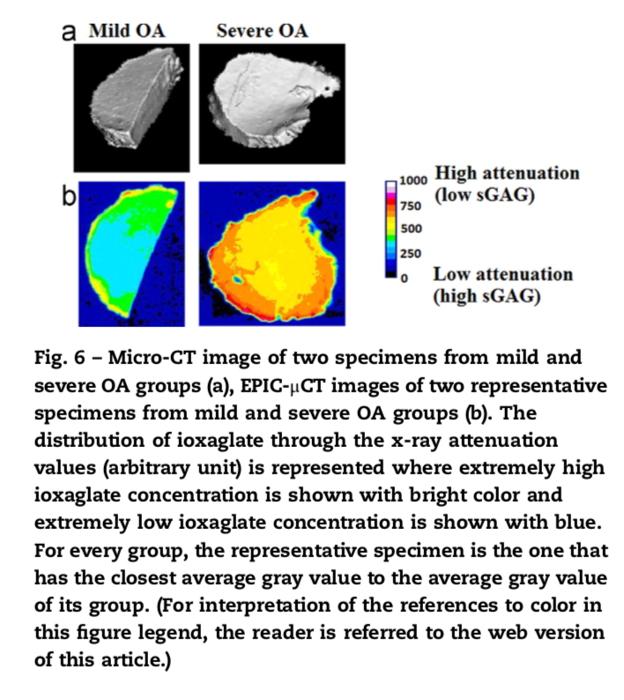
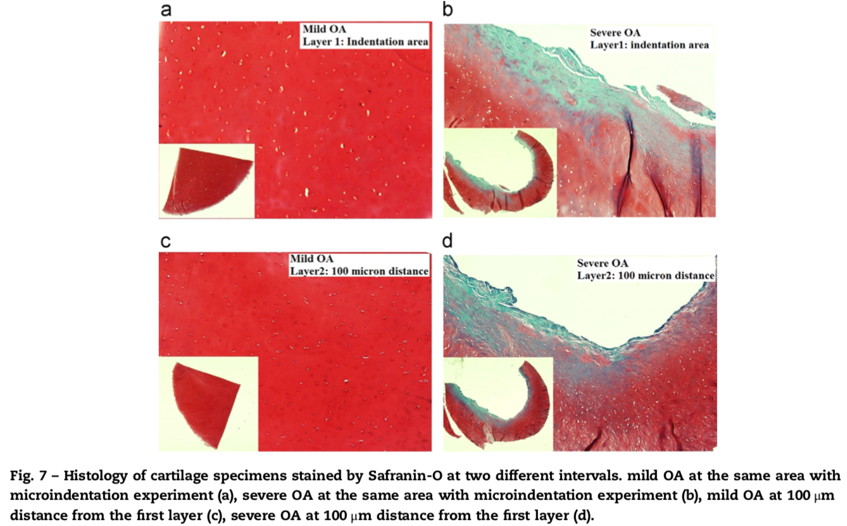
3.2 EPIC-μCT
average of mean gray values
severe OA group: 335±57>>mild OA group ：252±19
GAG: mild OA > severe OA
dependency of the indentation assay to the test location
3.3 Histology
mild OA: nicely distributed high concentration of GAG
severe OA: less GAGs content, noticeable surface fibrillation and irregularity

Slide 19
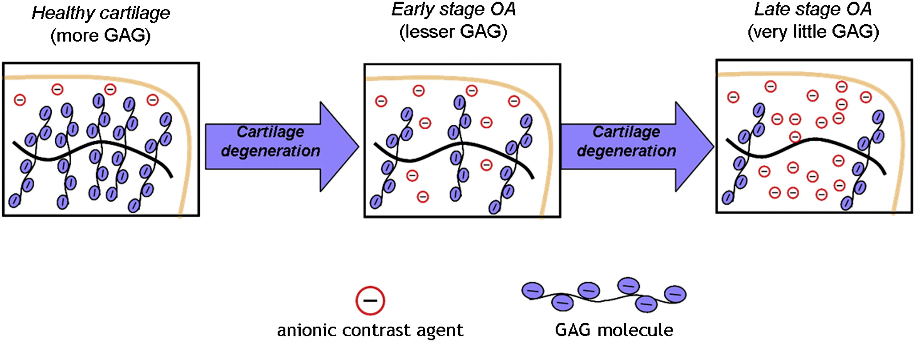
DISCUSSION
Micro-mechanics of OA cartilage
Decrease in semi-equilibrium modulus due to osmotic effects
Samples with same significant decrease
Threshold to equilibrium is different
Each sample has own dynamics in osmotic change response

Slide 20
DISCUSSION
Micro-mechanics of OA cartilage (swelling is driven by GAGs)
Explanation
Intra specimen variation due to multi-phase
Inter specimen variation

Slide 21
DISCUSSION
Micro-mechanics of OA cartilage (swelling is driven by GAGs)
Explanation (Intra specimen variation due to multi-phase)-Two transport time scales
Movement of the water to tissues
Diffusion of macromolecular: such as PGs degradation products or intact molecules freed from the swollen collagen matrix out of the tissue

Slide 22
DISCUSSION
Micro-mechanics of OA cartilage (swelling is driven by GAGs)
Explanation (Inter specimen variation)
Samples from different patients, different stages, different level of GAGs
Mechanical properties of articular cartilage sensitive to topographic location

Slide 23
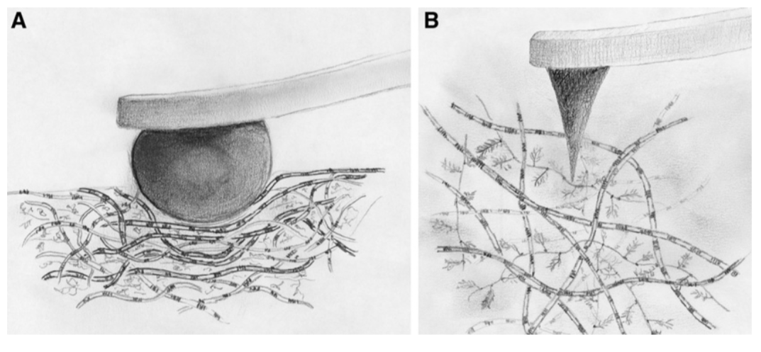
DISCUSSION
Nano Mechanics of OA cartilage: separate constituents with stimulus
Previous Atomic Force Microscopy: Two very clear peaks, associated with the nano-scale elastic modulus of GAGs and collagen.
Micro: Hard borosilicate glass spheres, were glued onto tipless rectangular cantilevers with nominal spring
Nano: Pyramidal tips with a nominal tip on V-shaped cantilevers with a nominal spring constant

Slide 24
DISCUSSION
Nano Mechanics of OA cartilage: separate constituents with stimulus
Previous Atomic Force Microscopy: Two very clear peaks, associated with the nano-scale elastic modulus of GAGs and collagen.
This paper: Several differences
Four components are needed to described, first and third peak: GAG and collagen
Additional constituent with distinct mechanical properties, make change in polymer conformation

Slide 25
DISCUSSION
Ionic: GAG chains with their negative charge can interact with positive ions from the environment and distinguish themselves in certain ways
Non-ionic: Collagen fibers not contain ionic part on their chains
Point out: nano-scale elastic modulus of cartilage depends on the ionic and non-ionic portions of the cartilage tissue

Slide 26
DISCUSSION
Neglect intrinsic interaction
Inaccurate due to nano indentation techniques themselves
Measure at surface, not represent bulk (surface are proved to be good indicators of OA )
Limitation

Slide 27
Thanks

Slide 28
Reference
https://www.hysitron.com/techniques-properties/mechanical-properties/creep

