Slide 1
Unix Text Editing and
Simple Programming

Slide 2
Text Files
Most bioinformatics work involves messing around with text files.
DNA and protein sequences, genotypes, databases, results of similarity searches and multiple alignments are all stored on the computer as ordinary ASCII text files.
To read, write, and edit these text files you must get familiar with a Text Editor program

Slide 3
What is a Text Editor?
A text editor is like a word processor on a personal computer, except that it does not apply formatting styles (bold, italics, different fonts etc.).
Unix has line editors (view and edit one line at a time) and full screen editors.
A screen editor loads an entire document into a buffer - allows you to jump to any point in the document.

Slide 4
Unix Text Editors
There are many different text editors available for Unix computers.
  You can have multiple editors on one system
    vi - old, reliable, present on every Unix machine, completely and utterly user hostile
    jed - fairly simple, identical to eve on the old VMS system
    pico - extremely simple, perhaps too simple
    emacs - a compromise between power features and ease of use

Slide 5
Emacs
The full name of the Emacs program is: "GNU emacs, the Extensible, Customizable, Self-Documenting, Real-time Display Editor.”
Emacs is free software produced by the Free Software Foundation (Boston, MA) and distributed under the GNU General Public License.
  Open source software - Linux
  GNU is an acronym for: “GNU is Not Unix”

Slide 6
Starting emacs
To start Emacs, at the > command prompt, just type: emacs
To use Emacs to edit a file, type:
  emacs filename
  (where filename is the name of your file)
When Emacs is launched, it opens either a blank text window or a window containing the text of an existing file.

Slide 7
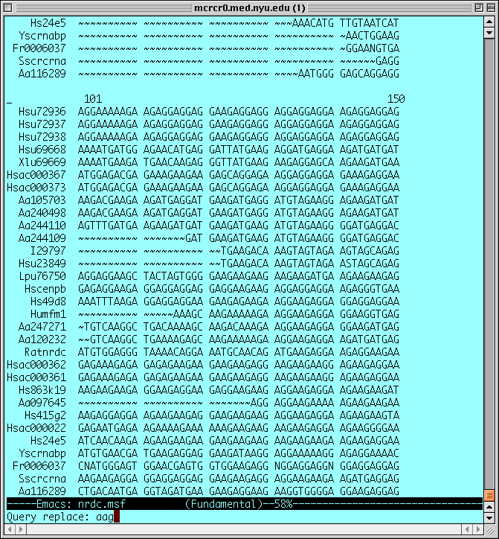

Slide 8
The Emacs Display
The display in Emacs is divided into three basic areas.
    The top area is called the text window. The text window takes up most of the screen, and is where the document being edited appears.
    Below the text window, there is a single mode line (in reverse type). The mode line gives information about the document, and about the Emacs session.
    The bottom line of the Emacs display is called the minibuffer. The minibuffer holds space for commands that you give to Emacs, and displays status information.

Slide 9
Emacs Commands
Emacs uses Control and Escape characters to distinguish editor commands from text to be inserted in the buffer.
  Ctrl -x means to hold down the control key, and type the letter x.
  (You don't need to capitalize the x, or any other control character)
  [ESC] x means to press the escape key down, release it, and then type x.

Slide 10
Save & Exit
To save a file as you are working on it, type:
Ctrl-x » Ctrl-s
To exit emacs and return to the Unix shell, type: Ctrl -x » Ctrl -c
  If you have made any changes to the file, Emacs will ask you if you want to save:
Save file /u/browns02/nrdc.msf? (y,n,!,.,q,C-r or C-h)
    Type “y” to save your changes and exit
    If you type “n”, then it will ask again:
Modified buffers exist; exit anyway? (yes or no)
    If you answer “no”, then it will return you to the file, you must answer “yes” to exit without saving changes

Slide 11
Moving Around
The arrow keys on the keyboard work for moving around one line or one character at a time.
Some navigation commands:
    Move to the Top of the file: [Esc] <
    Move to the End of the file: [Esc] >
    Next screen (page down): Ctrl-v
    Previous screen (page up): [Esc] v
    Start of the current line: Ctrl-a
    End of the current line: Ctrl-e
    Forward one word: [Esc] f
    Backward one word: [Esc] b

Slide 12
Type Text
Once you move the cursor to the location in the file where you want to do some editing, you can just start typing - just like in an ordinary word processor.
The delete key should work to remove characters and inserted text will push existing text over.

Slide 13
Cut, Copy, and Paste
You can delete or move blocks of text.
  First move the cursor to the beginning (or end) of the block of text.
  Then set a mark with: Ctrl-spacebar
  Now move to the other end of the block of text and Delete or Copy the block:
    Delete: Ctrl-w
    Copy: [Esc] w
  To Paste a copied block, move to the new location and insert with _x0008_: Ctrl-y

Slide 14
Getting Help in Emacs
Emacs has a built in help feature
  Just type: Ctrl-h
  To get help with a specific command,
  type: Ctrl-h k keys
    (where “keys” are the command keys that you type for that command)
Emacs has a built in tutorial: Ctrl-h t
    this will be an exercise for this week’s computer lab.

Slide 15
Emacs Help on the Web
Getting Started with Emacs
  http://www.cs.ucl.ac.uk/teaching/supportdocs/emacs.htm
      by Johnathon Poole,University College London, Dept. of Computer Science
LinuxCentral: Emacs Beginner's HOWTO
http://linuxcentral.com/linux/LDP/HOWTO/Emacs-Beginner-HOWTO.html
The official GNU Emacs Manual
http://www.gnu.org/manual/emacs/html_chapter/emacs_toc.html
Getting Started With the Emacs Screen Editor
http://www.leeds.ac.uk/iss/documentation/beg/beg6.pdf

Slide 16
Scripting Languages
A number of programming languages have been developed to expand the power of Unix scripts.
Perl is particularly favored by biologists
  object oriented programming
  regular expressions
  see book: “Beginning Perl for Bioinformatics”
  by James Tisdall
Other biologists favor Python or Java

Slide 17
Interact with Web Pages
These scripting languages also make it easy to automate the use of a Web page
  Submit a bunch of sequences
  Choose options, add information to various fields
  Extract the results from the html files that are returned

Slide 18
BioPerl
Why re-invent the wheel?
Lots of common bioinformatics tasks have already been programmed as “modules” in Perl.
  Grab sequences from GenBank, extract e-values and annotation from Blast results, etc.
Download them from www.bioperl.org

Slide 19
Becoming a Unix Power User
Learn more Unix commands
  http://ss64.com/bash/
Use the shell to execute simple programs
Write scripts
Download and install the latest bioinformatics software
Drive your system manager crazy… or get your own Unix machine
    (Linux on an Intel machine or Mac OS-X)

Slide 20
Resources
Notes for Lincoln Stein’s course in
“Genome Informatics”
  http://stein.cshl.org/genome_informatics/index.html
BioPerl.org http://bio.perl.org/
PERL for biologists (Kurt Stüber)
  http://caliban.mpiz-koeln.mpg.de/~stueber/perl/
“Why Biologists Want to Program Computers”
by James Tisdall: http://www.oreilly.com/news/perlbio_1001.html

Slide 21
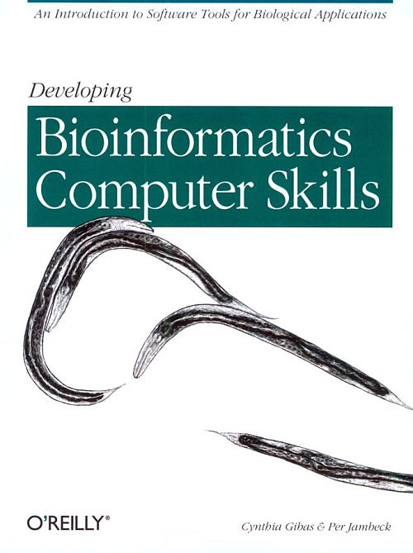
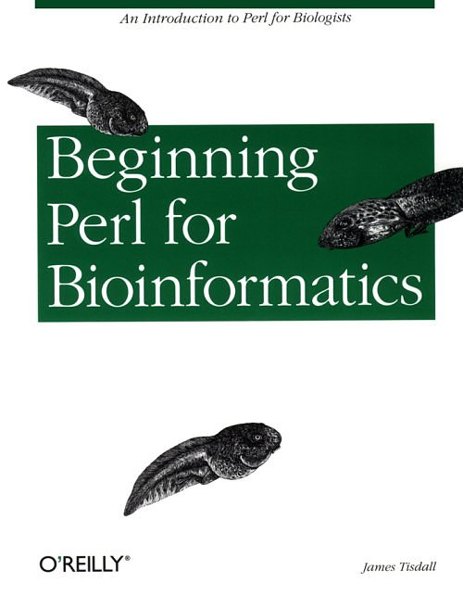
Resources for Bio-Computing

