Slide 1
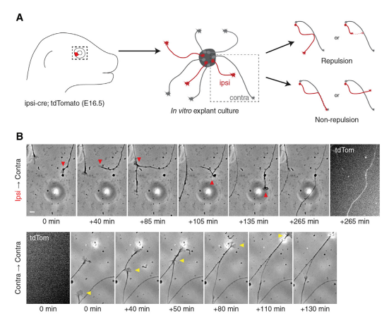
Ipsilateral RGCs Are Repelled by Contralateral RGCs
In Vitro in a Boc- and Smo-Dependent Manner

Slide 3
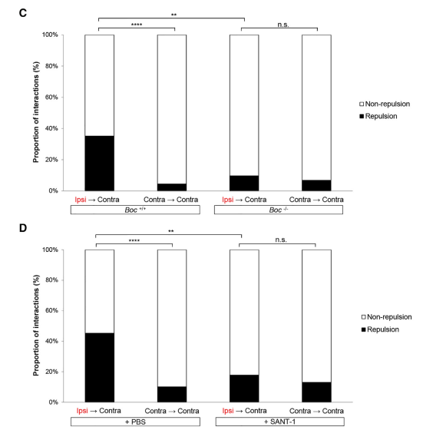
Ipsilateral RGCs Are Repelled by Contralateral RGCs
In Vitro in a Boc- and Smo-Dependent Manner

Slide 4
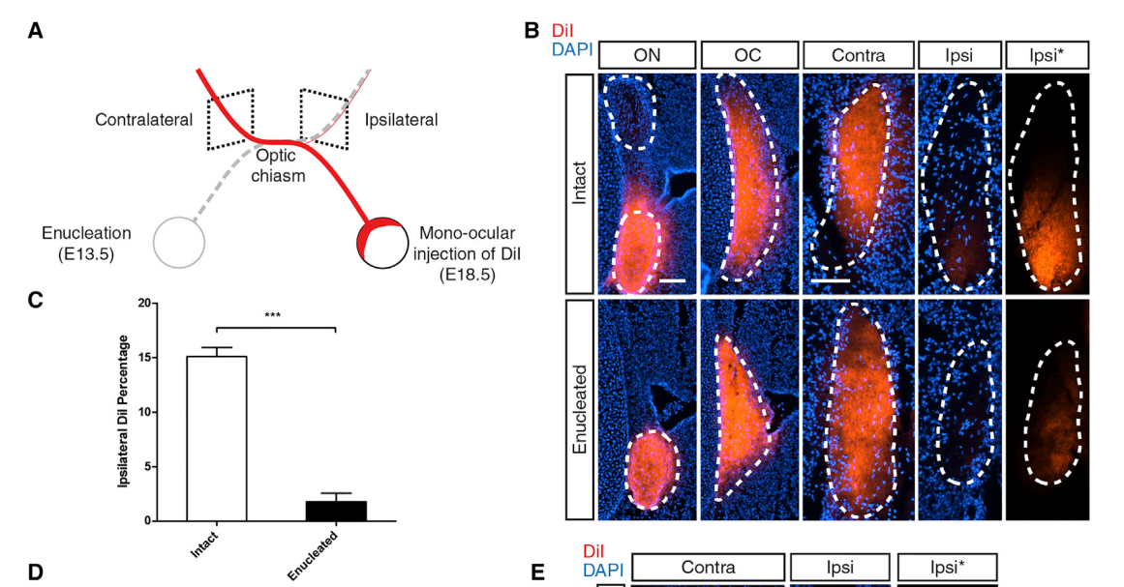
Knockdown of Shh in the Retina Reduces the Proportion of Ipsilateral Axons in a Non-cell-autonomous Manner

Slide 5
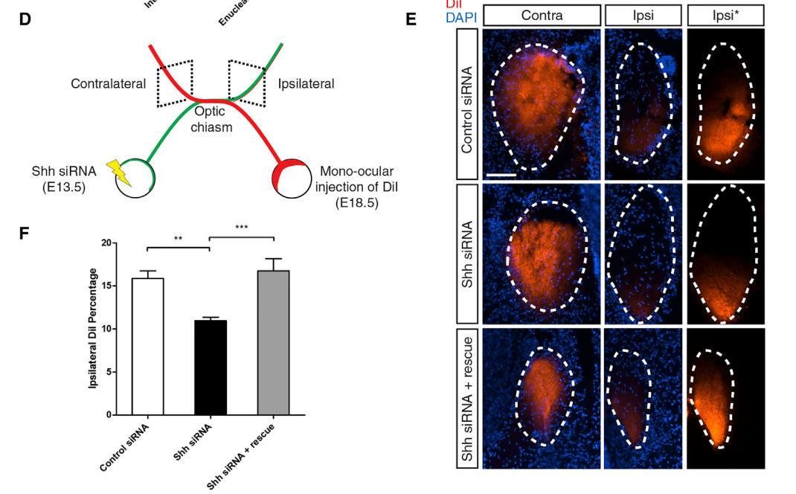
Knockdown of Shh in the Retina Reduces the Proportion of Ipsilateral Axons in a Non-cell-autonomous Manner

