Slide 1
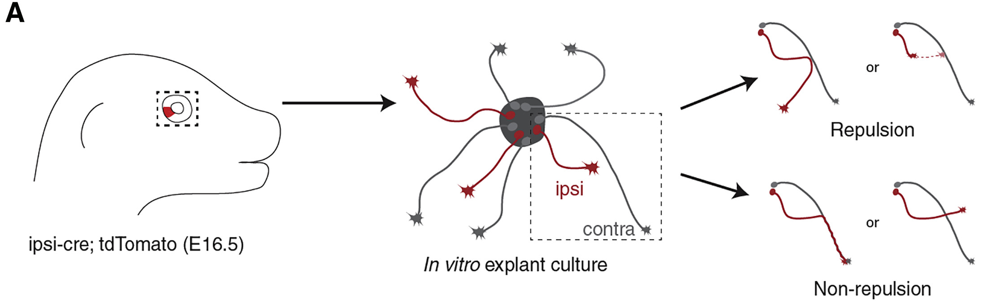
Ipsilateral RGCs Are Repelled by Contralateral RGCs
In Vitro in a Boc- and Smo-Dependent Manner
Experiment Design
Turn away
Retract
combine
pass

Slide 2
Ipsilateral RGCs Are Repelled by Contralateral RGCs
In Vitro in a Boc- and Smo-Dependent Manner
Time-lapse Exmple Result
Contra
lpsi
Retraction
Merge

Slide 3
Ipsilateral RGCs Are Repelled by Contralateral RGCs
In Vitro in a Boc- and Smo-Dependent Manner
Quantification of axon-axon interactions
Shh receptor Boc, expressed only in ipsilateral RGCs
Boc-Dependent
The signaling mediator Smo
Smo-Dependent
antagonist

Slide 4
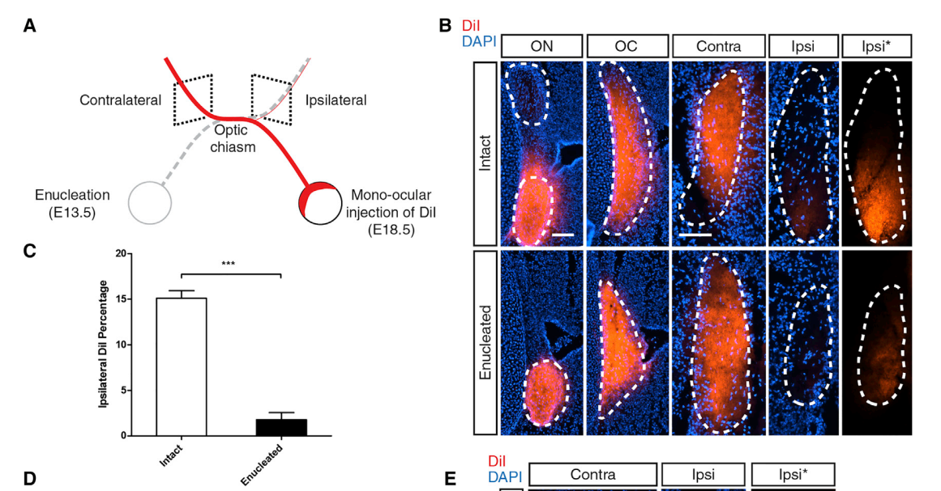
Knockdown of Shh in the Retina Reduces the Proportion
of Ipsilateral Axons in a Non-cell-autonomous Manner
Neuron 2018 97, 326-340.e4DOI:(10.1016/j.neuron.2017.12.028)

Slide 5
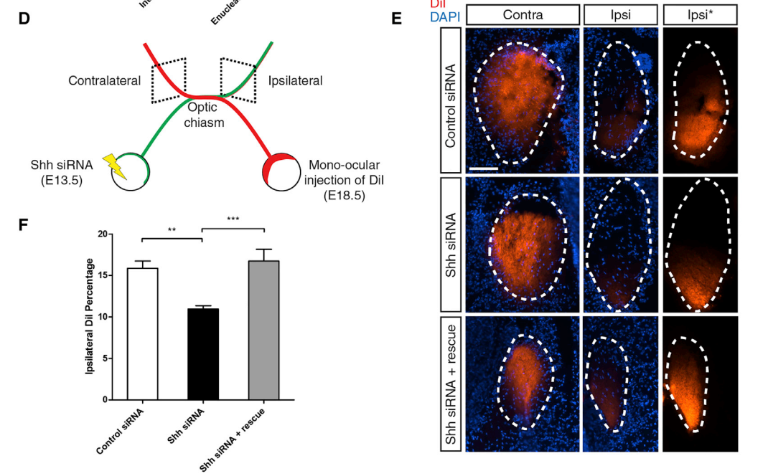
Knockdown of Shh in the Retina Reduces the Proportion
of Ipsilateral Axons in a Non-cell-autonomous Manner
Neuron 2018 97, 326-340.e4DOI:(10.1016/j.neuron.2017.12.028)

