Slide 1
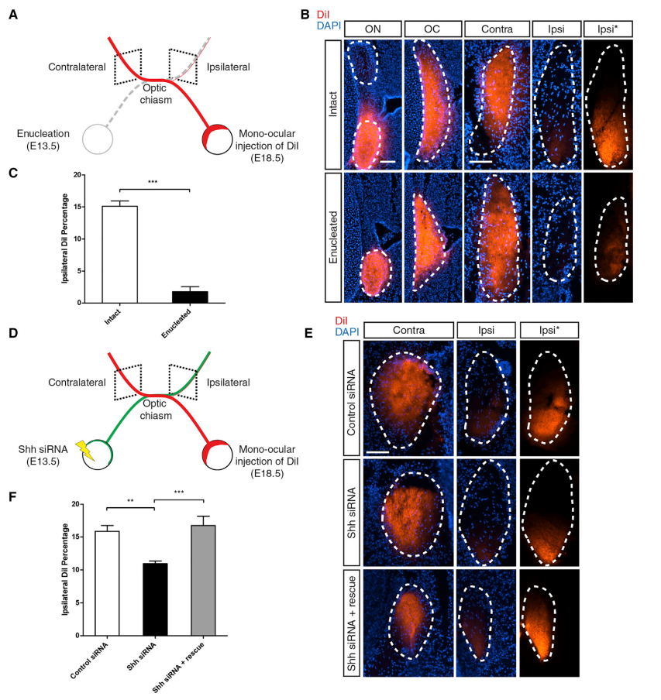
Knockdown of Shh in the Retina Reduces the Proportion of Ipsilateral Axons in a Non-cell-autonomous Manner

