Slide 1
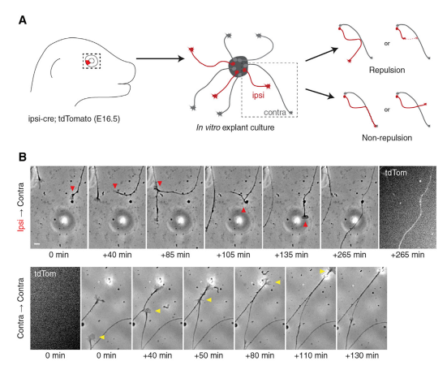
Ipsilateral RGCs Are Repelled by Contralateral RGCs
In Vitro in a Boc- and Smo-Dependent Manner

Slide 2
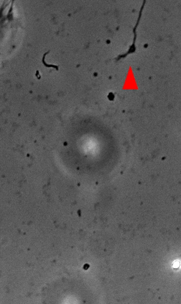
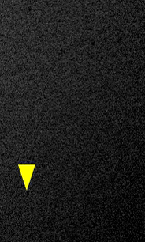

Slide 3
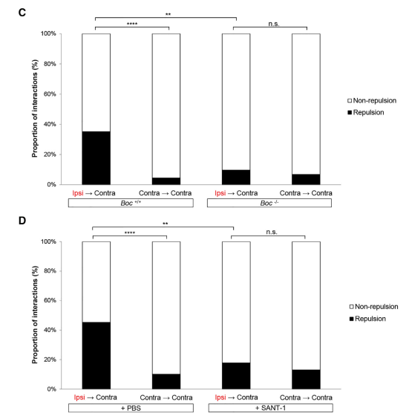
Ipsilateral RGCs Are Repelled by Contralateral RGCs
In Vitro in a Boc- and Smo-Dependent Manner

Slide 4
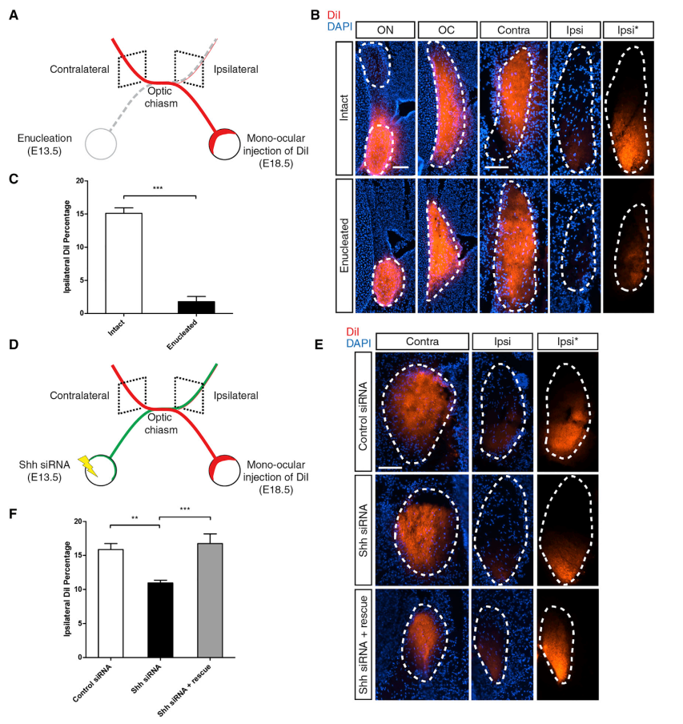
Knockdown
of Shh
in the Retina Reduces
the Proportion of Ipsilateral Axons in a Non-cell-autonomous Manner

