Slide 1
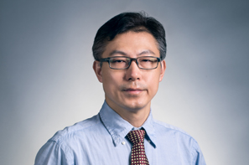
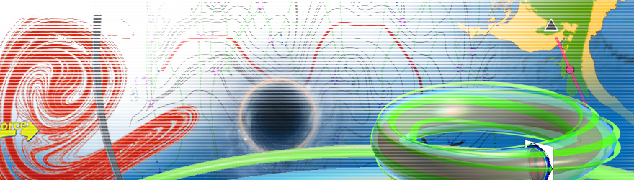
生物动力系统模拟
王冠宇 18665955633
wanggy@sustc.edu.cn

Slide 2
分子动力学模拟
系统层次动力学模拟
动力系统基本概念：状态空间、连续及离散系统、稳定性、系统
终态的分类
线性系统理论： 线性系统的解析解，脉冲响应函数， 拉普拉斯变
换，控制理论初步
生物网络：对基因调控、信号传导、蛋白相互作用的网络建模
实例分析
机体层次上的动力学模拟

Slide 3
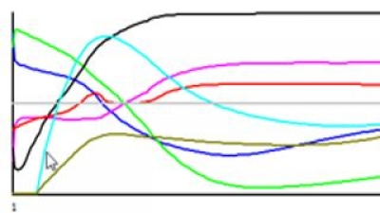
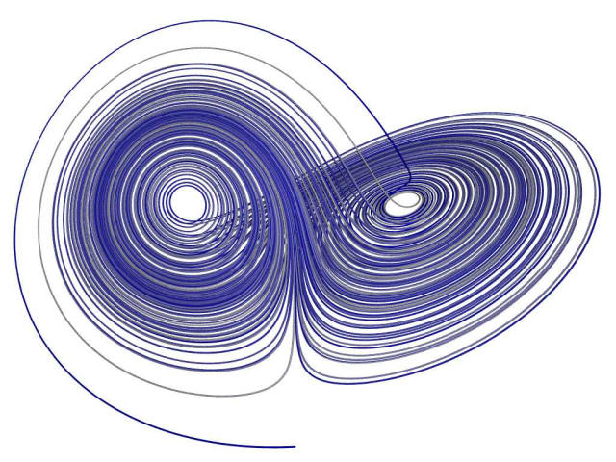

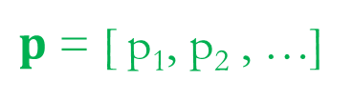

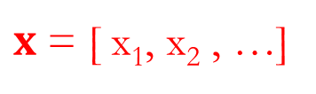
Dynamical systems theory
An area of mathematics used to describe the behavior of complex dynamical systems, usually by employing differential equations or difference equations.
x₁
Continuous
x₂
$$\frac{dx}{dt}=f(x,p,t)$$
t
$x$ = [ x₁, x₂ , …]
x₂
$p$ = [ p₁, p₂ , …]
Discrete
$$x\left(t+1\right)=f(x\left(t\right),t)$$
x₁

Slide 4
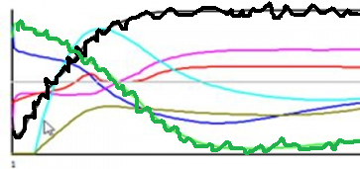


Deterministic vs stochastic systems
$$\frac{dx}{dt}=f(x,p,t)$$
$$\frac{dx}{dt}=f\left(x,p,t\right)+ξ(t)$$
noise term
Random()
Rand()

Slide 5
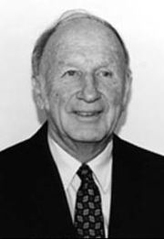
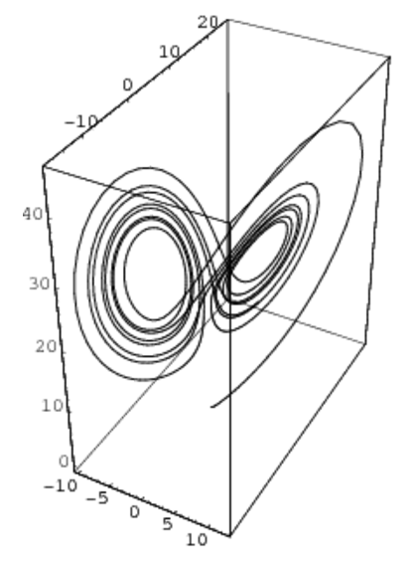
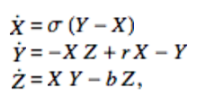
Can a deterministic system manifests stochastic behavior?
Lorenz attractor
MIT professor
Mathematician
Meteorologist
During the 1950s, Lorenz became skeptical of the appropriateness of the linear statistical models in meteorology, as most atmospheric phenomena involved in weather forecasting are non-linear
Long-term weather forecasting is impossible

Slide 6
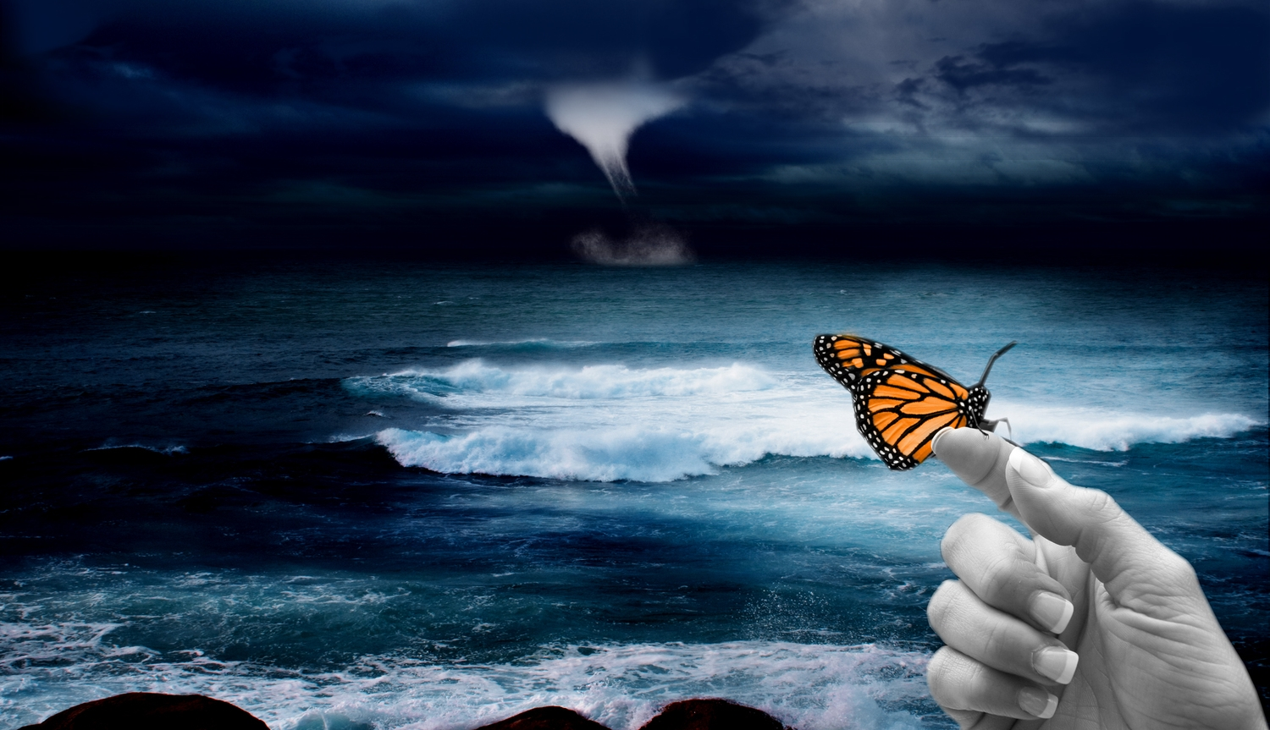
Butterfly effect
Small causes can have large effects
Sensitive dependence on initial conditions
A small change in one state of a deterministic nonlinear system can result in large differences in a later state
The butterfly effect is most familiar in terms of weather; it can easily be demonstrated in standard weather prediction models, for example. The climate scientists James Annan and William Connolley explain that chaos is important in the development of weather prediction methods; models are sensitive to initial conditions. They add the caveat: "Of course the existence of an unknown butterfly flapping its wings has no direct bearing on weather forecasts, since it will take far too long for such a small perturbation to grow to a significant size, and we have many more immediate uncertainties to worry about. So the direct impact of this phenomenon on weather prediction is often somewhat overstated
Notes:
即使大数据，也很难预测一个月的天气。

Slide 7





Sensitivity dependence on parameter values
$$\frac{dx}{dt}=f\left(x,p,t\right)$$
Example:
Duffing equation
Can anyone write it into the following form?
$$\frac{dx_{1}}{dt}=x_{2}$$
$$\frac{dx_{2}}{dt}={−δx}_{2}+x_{1}−{x_{1}^{}}^{3}+γcos⁡(t)$$

Slide 8

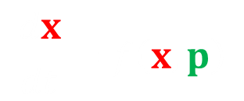


Can anyone write it into the following form?
$$\frac{dx}{dt}=f\left(x,p\right)$$
$$\frac{dx_{1}}{dt}=x_{2}$$
$$\frac{dx_{2}}{dt}={−δx}_{2}+x_{1}−{x_{1}^{}}^{3}+γcos⁡(x_{3})$$
$$\frac{dx_{3}}{dt}=1$$

Slide 9
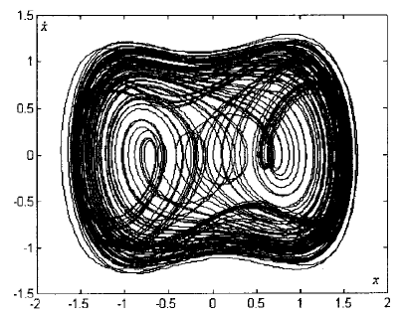
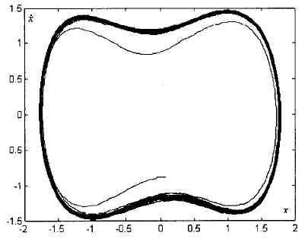


Phase diagram
$$\frac{dx_{1}}{dt}=x_{2}$$
$$\frac{dx_{2}}{dt}={−δx}_{2}+x_{1}−{x_{1}^{}}^{3}+γcos⁡(t)$$
γ < γ_{c}
γ > γ_{c}
This “sensitivity dependence on parameters” can be exploited!

Slide 10
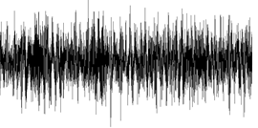




Application to weak signal detection
$$\frac{dx_{1}}{dt}=x_{2}$$
$$\frac{dx_{2}}{dt}={−δx}_{2}+x_{1}−{x_{1}^{}}^{3}+γ_{c}\cos\left(t\right)+ signal$$
$$signal=ε cos\left(t\right)+ξ(t)$$
$$signal=ξ(t)$$
Contains useful signal
Sheer noise

Slide 11
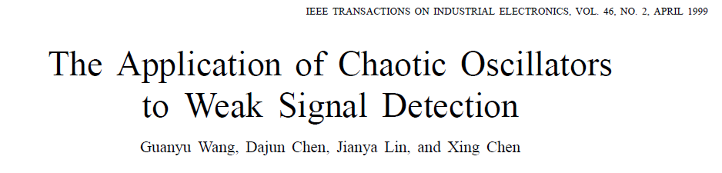
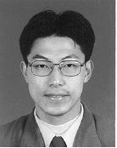
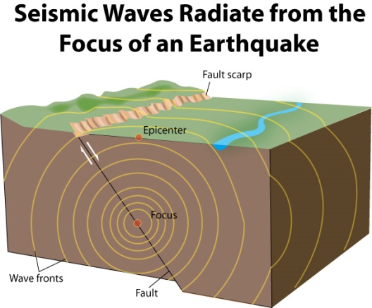
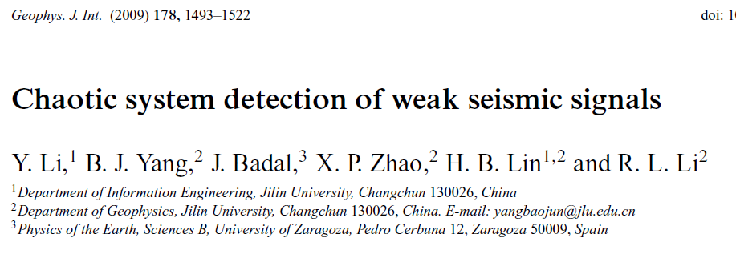
The technique was developed in last century, by …
Successfully applied to
and many other fields …

Slide 12
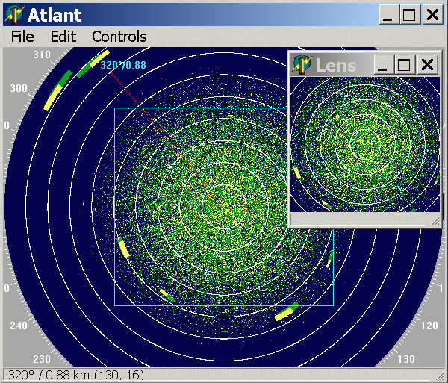
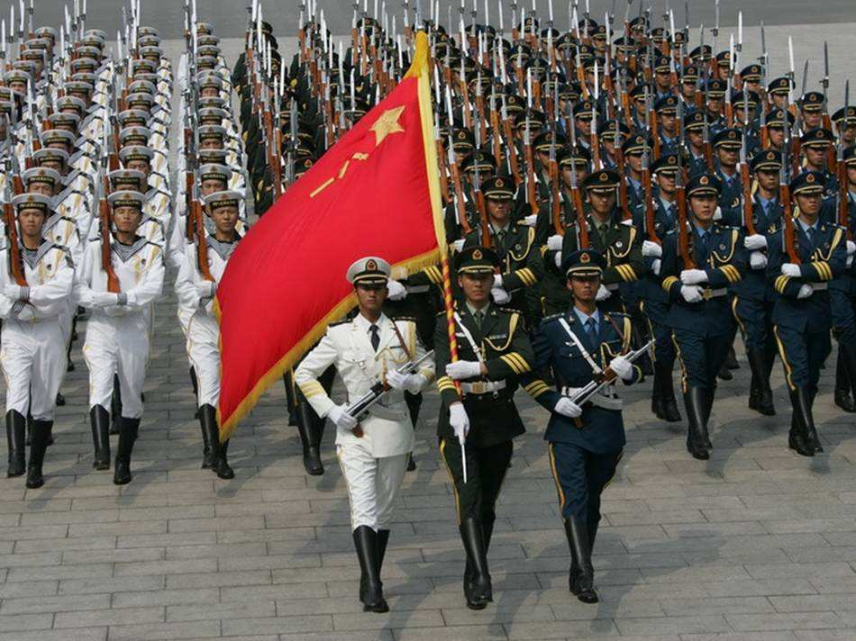

Including radar signal detection
I was invited by … to help with radar detection design

Slide 13
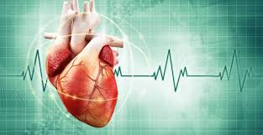
Dynamical systems theory are useful,
The application to biology would be fruitful.
Arrhythmia
Controlling chaos

Slide 14
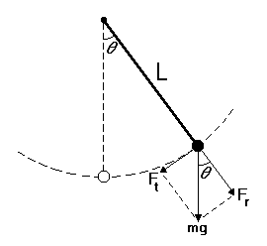


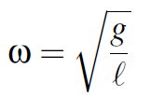

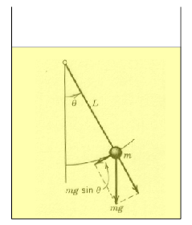

Duffing equation is related to pendulum

Slide 15


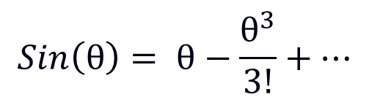
oscillator
$$Sin\left(θ\right)= θ−\frac{θ^{3}}{3!}+…$$
Can we make them closer?

Slide 16
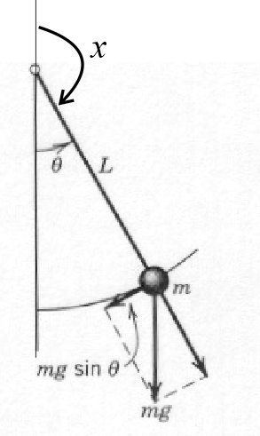


$$θ=π−x$$
We succeed in converting it
closer to the Duffing equation!

Slide 17
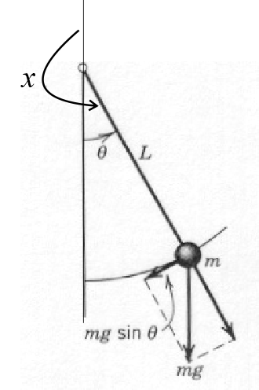


Let’s try the following
$$θ=x−π$$
It is also OK!

Slide 18
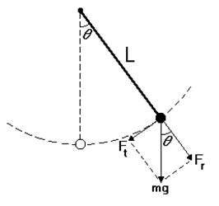
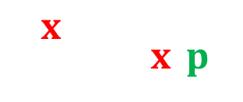



Now let’s convert
$$\frac{d^{2}θ}{dt^{2}}+sin(θ)=0$$
into
$$\frac{dx}{dt}=f\left(x,p\right)$$
$$\frac{dx}{dt}=y$$
$$\frac{dy}{dt}=−sin(x)$$

Slide 19







Steady state
$$\frac{dx}{dt}=f\left(x,p\right)=0$$
$$\frac{dx}{dt}=y$$
$$\frac{dy}{dt}=−sin(x)$$
$$x=0$$
$$x= π$$
$$y=0$$
$$y=0$$

Slide 20
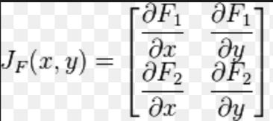



$$\frac{dx}{dt}=f\left(x,p\right)$$
Stability of
Calculate the Jacobian matrix of
$$f\left(x,p\right)$$
Then calculate the eigenvalues
$$λ=Re\left(λ\right)+Im\left(λ\right)i$$

Slide 21
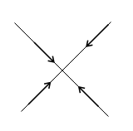
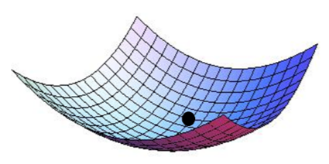
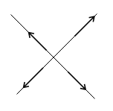
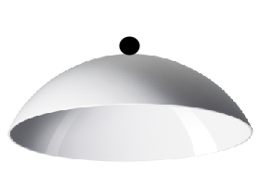
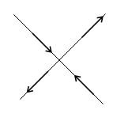
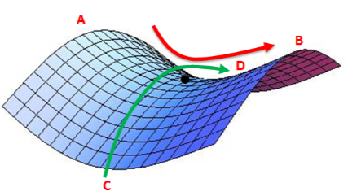




When $λ$ are real
$$λ_{1}<0$$
$$λ_{2}<0$$
sink
$$λ_{1}>0$$
$$λ_{2}>0$$
source
$$λ_{1}<0$$
$$λ_{2}>0$$
saddle

Slide 22
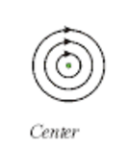
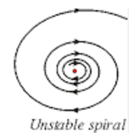
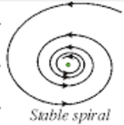




When $λ$ have imaginary part
$$Re\left(λ\right)=0$$
$$Re\left(λ\right)>0$$
$$Re\left(λ\right)<0$$

Slide 23
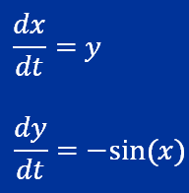
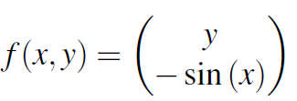
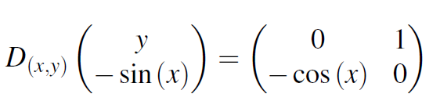
Stability of
Calculate the Jacobian matrix of

Slide 24
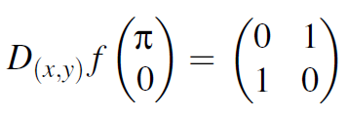



We first evaluate Jacobian at
$$x= π$$
$$y=0$$
Eigenvalues are
As long as there is a positive eigenvalue,
it is unstable.
This steady state is thus unstable

Slide 25
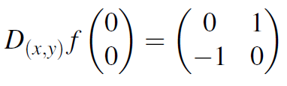



We then evaluate Jacobian at
$$x=0$$
$$y=0$$
Eigenvalues are
The real part is 0,
not positive nor negative.
This steady state is marginally stable

Slide 26
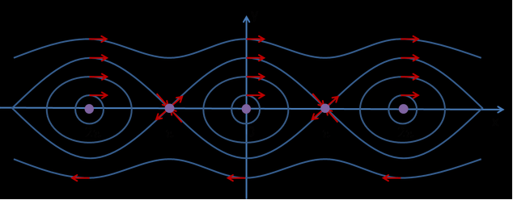
Phase portrait

Slide 27


Now let’s convert
$$\frac{d^{2}θ}{dt^{2}}+δ\frac{dθ}{dt}+sin(θ)=0$$
into
$$\frac{dx}{dt}=f\left(x,p\right)$$
$$\frac{dx}{dt}=y$$
$$\frac{dy}{dt}=−δy−sin(x)$$

Slide 28






Steady state
$$\frac{dx}{dt}=y$$
$$\frac{dy}{dt}=−δy−sin(x)$$
$$x=0$$
$$x= π$$
$$y=0$$
$$y=0$$

Slide 29
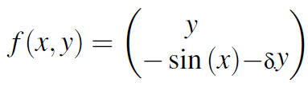
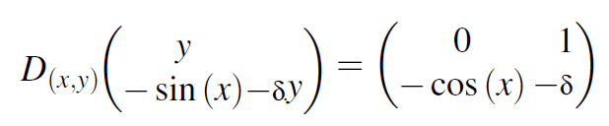
$$\frac{dx}{dt}=f\left(x,p\right)$$
Stability of
Calculate the Jacobian matrix of

Slide 30
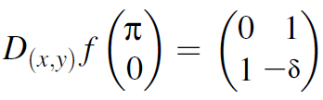
We first evaluate Jacobian at
$$x= π$$
$$y=0$$
One can check that
one eigenvalue >0
the other < 0
This steady state is thus unstable

Slide 31
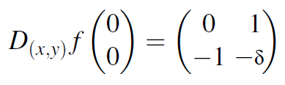
We then evaluate Jacobian at
$$x=0$$
$$y=0$$
One can check that
All the real part of eigenvalues are < 0
This steady state is stable

Slide 32

Phase portrait

