Slide 1
Fold TransposeConv2d
袁之航

Slide 2
Conv2x2 Stride=2
TransposedConv2x2 Stride=2
Conv2x2
Stride=1

Slide 3
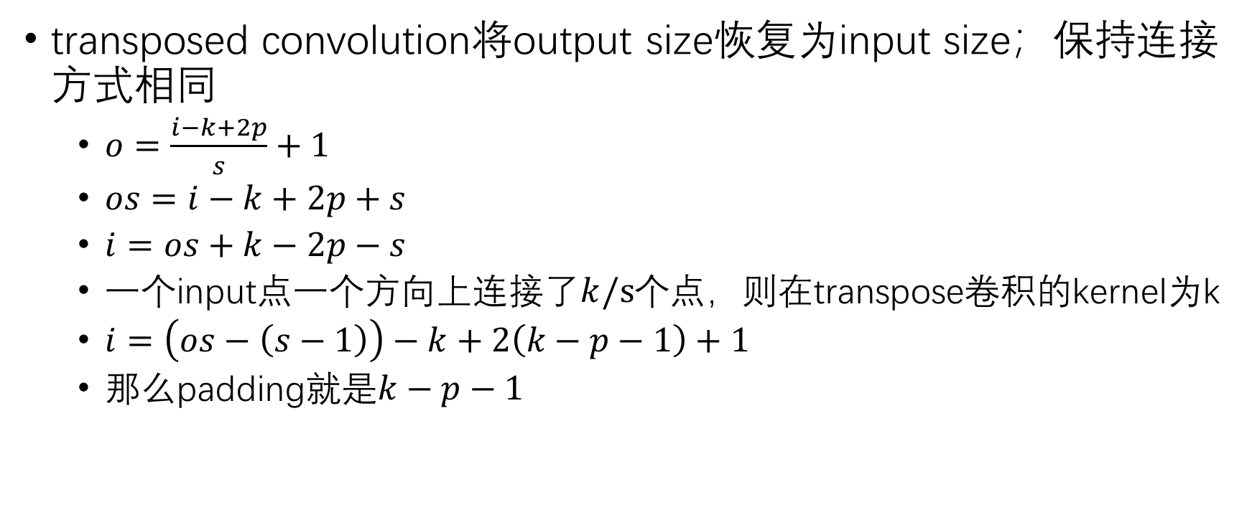
transposed convolution将output size恢复为input size；保持连接方式相同
$o=\frac{i−k+2p}{s}+1$
$os=i−k+2p+s$
$i=os+k−2p−s$
一个input点一个方向上连接了$k/s$个点，则在transpose卷积的kernel为k
$i=\left(os−\left(s−1\right)\right)−k+2\left(k−p−1\right)+1$
那么padding就是$k−p−1$

Slide 4
Conv2x2 Stride=2
TransposedConv2x2 Stride=2
Conv2x2
Stride=1
Fold TransposedConv2x2
1
2
4
3
1
Conv1x1
Stride=1
2
1
Conv2x2
Stride=1
2
3
1
2
3
3
4
4
4

Slide 5
Conv4x4 Stride=4
TransposedConv4x4 Stride=4
Conv4x4
Stride=1
Fold TransposedConv4x4
1
G
F
E
D
2
1
4
3
2
1
1
2
3
4
Conv1x1
Stride=1
Conv4x4
Stride=1
2
3
D
E
F
G
3
4
4
……
……
G
G

