Slide 1
FTX Profile
/01

Slide 2


FTX —— Fintech unicorn but just a flash in the pan
Company Orientation
FTX was a Cryptocurrency Derivatives Exchange, covered nearly the full range of secondary markets, whose products included crypto, fiat, US stocks, spot, futures, option…
FTX also had OTC services
FTX issued FTT (FTX Token), an Ethereum-based token
Company Vision
Built by traders; for traders.
Provide any products users want to trade
Business Overview
Once the second largest crypto exchange in the world
Valuation was once as high as $32 billion
FTX processed 11% of global derivatives transactions (about $2.4 trillion monthly)
FTX issued 1 billion FTT in total; Historical highest price of FTT was $85.32 ($1.39 updated on 2022.12.04)
Leave Wall Street,
Enter Crypto Chaos
Born in 1992
Graduated from MIT in 2014
Jane Street Capital ETF trader (2014.06-2017.09)
Founded Alameda Research (a quantitative trading firm) in 2017.11
Founded FTX in 2019.04
Founder & CEO
Sam Bankman-Fried
(SBF)
2022.01
Completed Series C financing
FTX Valuation was $32 billion
2022.11.02
Coindesk exposes key financial details of Alameda Research
2020
FTX average one-sided daily trading volume reached $5 billion
2019.05-07
FTX exchange launched
FTT ICO at $1.73 for 350 million shares
2022.11.11
FTX bankruptcy
2019.04
FTX founded

Slide 3






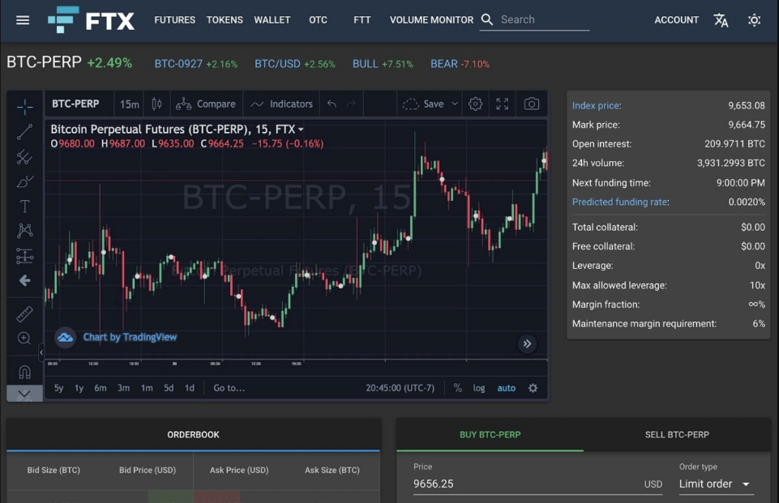
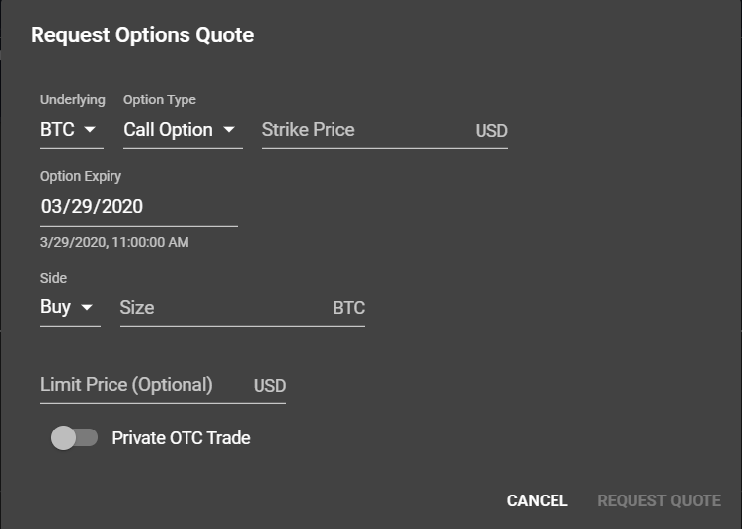
Focus on cryptos & derivatives; Serve investors & market makers
Key attractions
Products
Customers
Services
Spot trading for over 300 kinds of cryptocurrencies : BTC, ETH, DOGE, FTT, SOL, XRP…
Futures
Options
MOVE Contract (Volatility products)
Leveraged tokens
Investors:
retail investors
Institutional Investors: Sequoia Capital, SoftBank, Temasek, BlackRock …
Market makers: Almeda Research, Wintermute, Jump Crypto…
Issue/Sell FTT to investors
Provide a trading platform for investors and market makers
Data source: FTX Attorney James Bromley; Date:2022.11.24

Slide 4
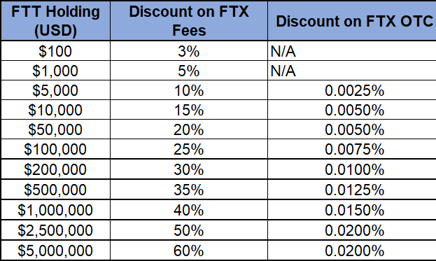
Revenue synergetic effect: FTX trading fee and FTT
Key attractions
Revenue
Cost
CNBC: FTX had revenues of $1 billion in 2021 and net income of $388 million. —— Most revenue comes from derivatives trading fee. (82% of 2021 revenue)
Revenue from trading/ transaction fee: Tiered fee structure. Discount for FTT holders.
Revenue from selling FTT: ICO and subsequent issues
Revenue from holding FTT: price goes up will bring revenue (FTT 2021 up 560%, from $5.8 to $38.3)
Employee Salary : FTX has 350 employees worldwide 2022.09—— limited payment.
Marketing Cost: Sponsor sports like Basketball, baseball and tennis ($150 million in 2021, 15% of revenue) —— huge expenditure
Acquisition Cost: acquired Good Luck Games, US exchange LedgerX, Japanese exchange Liquid…—— major expenditure
FTT Stabilizing Cost: FTX takes out 33% of transaction fee for regular FTT coin purchasing and coin burning —— large expenditure
Data source: FORTUNE; Date:2022.11
Data source: FTX Exchange; Date:2022.06
Data source: FORTUNE; Date:2022.11

