Slide 1

Bank Marketing Prediction Engine

Slide 2
Model Performance
We mainly analyzed the three models that give the highest Training and Testing Accuracy scores
XGBoost
- Parallel processing
- Regulaization
Random Forest
- Limit overfitting
- Reduce variance
Gradient Boosting
- Lots of flexibility
- Performs well with imbalanced data
Although Decision Tree has a high training accuracy, it encountered overfitting, causing its testing accuracy to drop more than the three we listed.
Model | Training Accuracy | Testing Accuracy
Decision Tree | 0.998 | 0.813
Random Forest | 0.998 | 0.868
Gradient Boosting | 0.848 | 0.859
Logistic Regression | 0.718 | 0.734
Naive Bayesian | 0.729 | 0.754
XGBoost | 0.941 | 0.876
SVC | 0.710 | 0.716

Slide 3
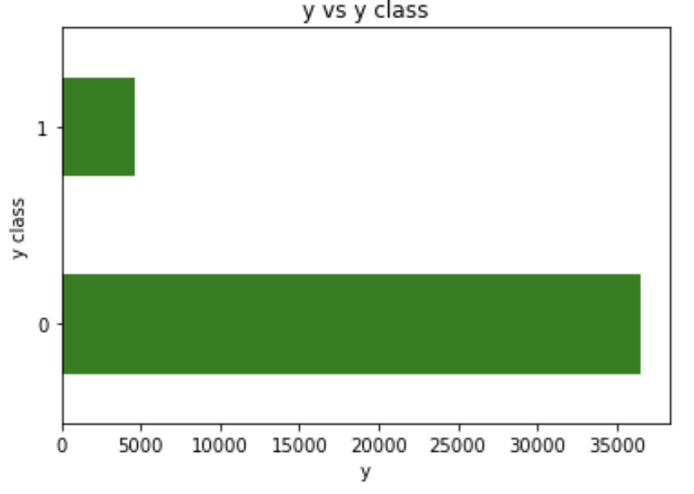
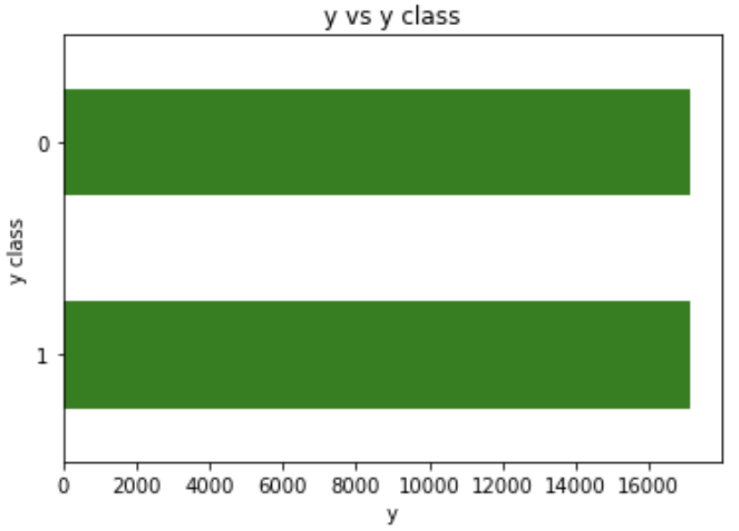
Modeling challenges: Solve unbalanced datasets using SMOTE
11.27%
88.73%

Slide 4
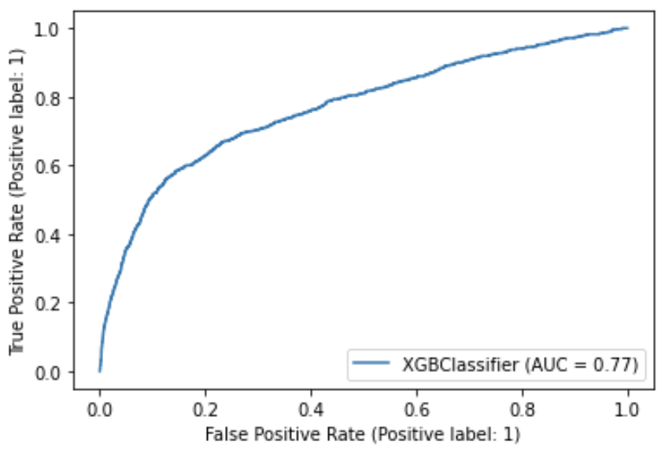
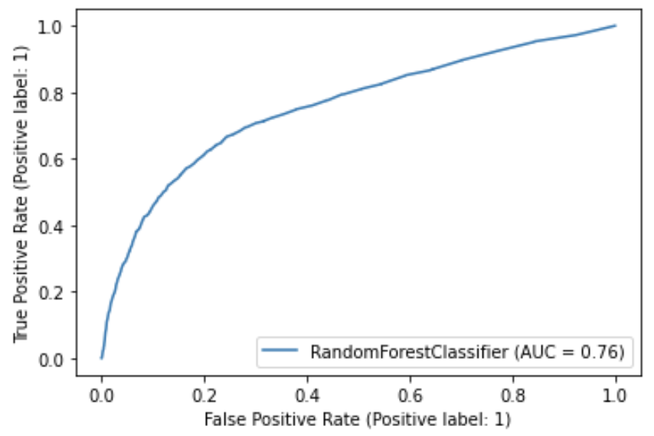
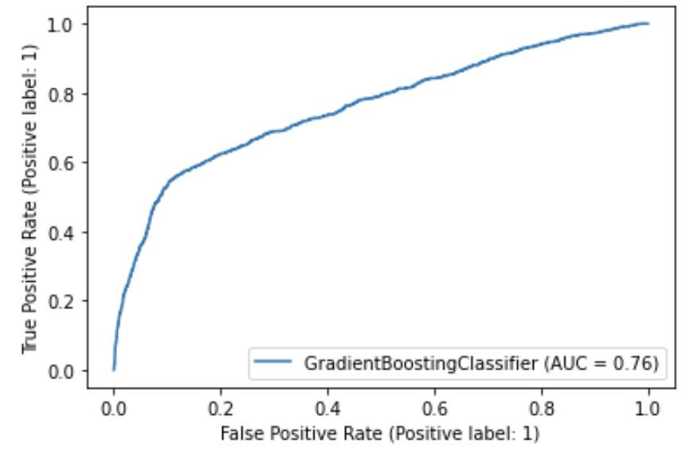
Final decisions about model
Model | Training Accuracy | Test Accuracy | CV | AUC
XGBoost | 0.941 | 0.876 | 0.896 | 0.77
Random Forest | 0.948 | 0.872 | 0.892 | 0.76
Gradient Boosting | 0.848 | 0.859 | 0.899 | 0.76

Slide 5
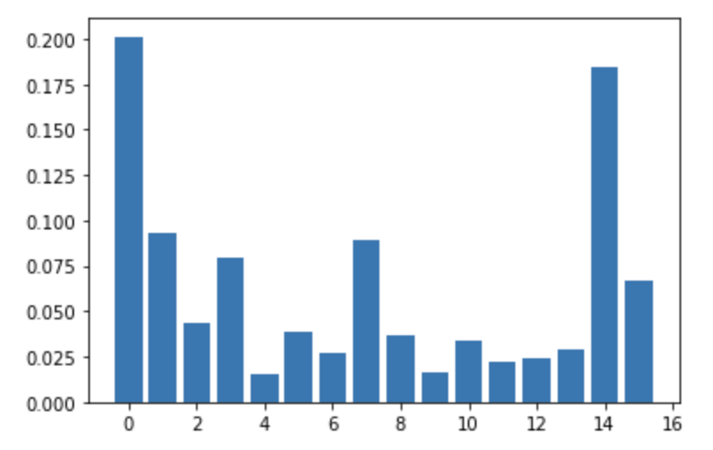
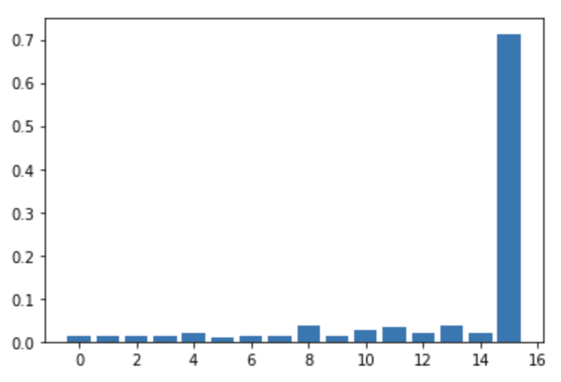
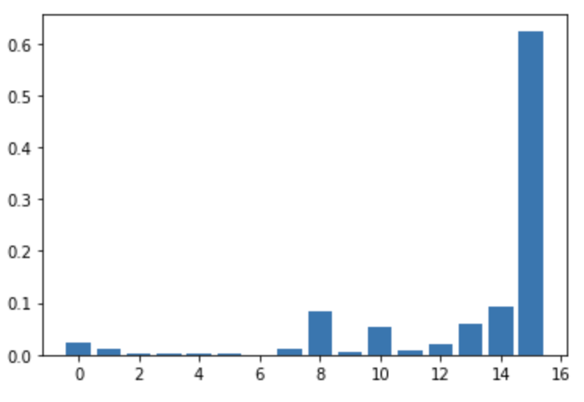
Random Forest
Model Selection: Random Forest Classifier
We decided to use Random Forest Classifier as our final model. Out of the three models that have similar evaluation scores, Random Forests is the most informative regarding all features rather than just the nr.employee feature.
Model | Train Accuracy | Test Accuracy | CV | AUC
Random Forest | 0.948 | 0.872 | 0.892 | 0.76
XGB
Gradient Boosting

Slide 6
Key Findings
Important Factors | Scores | Correlation with y | Interpretations
0: age | .20 | positive | People that are more aged might be more likely responsive to phone calls campaigns and convert. It is also possible that older people have more cash to be managed and could thus more likely enroll the term deposit.
14: euribor3m | .18 | negative | EURIBOR signals the general interest rate in present. When the interest rates are low across the more generalized financial product, the term deposit plan with an agreed rate might be more attractive, thus attracting more people to convert.
1: job | .09 | positive | With higher paid jobs, the clients would have more deposable income to enroll in term deposite
7: campaign | .09 | negative | We noticed that the number of contacts during one campaign is negatively correlated with target. Perhaps spamming the client with ads discourages them from enrolling in our project.

Slide 7
Thank You

