Slide 1
U Vid Inc. System Upgrade Project
Jianghui Li
IST 615

Slide 2


Project Overview
U Vid Inc. can no longer sustain the physical infrastructure needed due to the continued growth, so changes are needed. The goal of this project is to help U Vid to develop a plan to enable the company to run their servers from a public cloud.

Slide 3
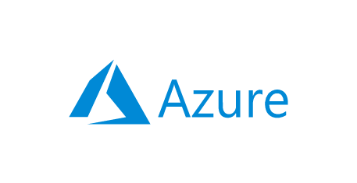
Cloud Vendor Selection
MS Azure
One requirement of the U Vid web application is that it needs .Net 5 to run. .Net is a Microsoft product, and U Vid does not want to change this requirement. Hence, to minimize the unnecessary problems after adopting the cloud solution, MS Azure is desirable in this situation since Azure functions are supported running on .Net 5.

Slide 4

architecture Change
Application Server, Wowza Streaming Engine, MS SQL server, Video Transcoder
4Servers → MS VMs
Physical servers usually need huge amount of IT spendings to acquire and maintain.
The cost of using VMs is usually flexible, and the providers would also guarantee data security and lost data recovery.

Slide 5

Expected Uptimes
We should expect clients of U Vid can have access to U Vid applications all the time. A restaurant can have its peak hours but not for video encoding services. People might need to perform video encoding at any time. Thus, the service uptimes should be twenty-four hours a day, seven days a week.

Slide 6
Backup Methodologies
Azure Backup services (full, differential, incremental) can back up data to the Microsoft Azure cloud platform.
Weekly full backup and daily differential that backs up only the files that changed since the last full backup. In this way, recovering files shouldn’t take too long. The backup should last up to one year.
Videos Files: Differential Backup
SQL Data: Differential Backup

Slide 7

TCO
4VMs with their own instances
Inbound/Outbound stream
Web app DB
Video storage
One Year TCO: $1,318,404.36

Slide 8
SLA
MS Azure guarantees that all VMs’ connectivity is more than 99.9% at all times.
The firewall will be available more than 99.9% of the time.
MS Azure guarantees at least 99.9% availability of the backup and restore functionality of the Azure Backup service.
Customers will have connectivity between their Microsoft Azure Database for MySQL Server and their Internet gateway at least 99.99% of the time.
End users will be able to create and consume information rights management documents and emails 99.9% of the time.
If downtime does happen: Providing service credits according to the downtime the customers have.

Slide 9

Advanced Features
Azure Sphere
Azure Sphere is a secured, high-level application platform with built-in communication and security features for internet-connected devices
Project Silica
Uses ultrafast laser optics to store the data. An option for some big customers who require large cloud storage space and long storage time

Slide 10

Thank you

