Slide 1
Yelp Data Analysis
Huiyu Jiang, Yanqi Huang, Xinjie Ye
Stat628, Group2

Slide 2
Main results
Model:
Use xgboost, linear regression and multilevel classification
to train models
Train set RMSE is about 0.36
Test set RMSE on Kaggle is about 0.708
Features:
Word Feature, Statistics, Others

Slide 3
Feature Engineering Review
Stratified sample 100000 reviews
Transfer words to stems
Calculate words’ and symbols’ frequencies of different stars
Select (sd > 0.15 & ∑frequency > 0.01)
Clean raw data to generate a sparse matrix

Slide 4
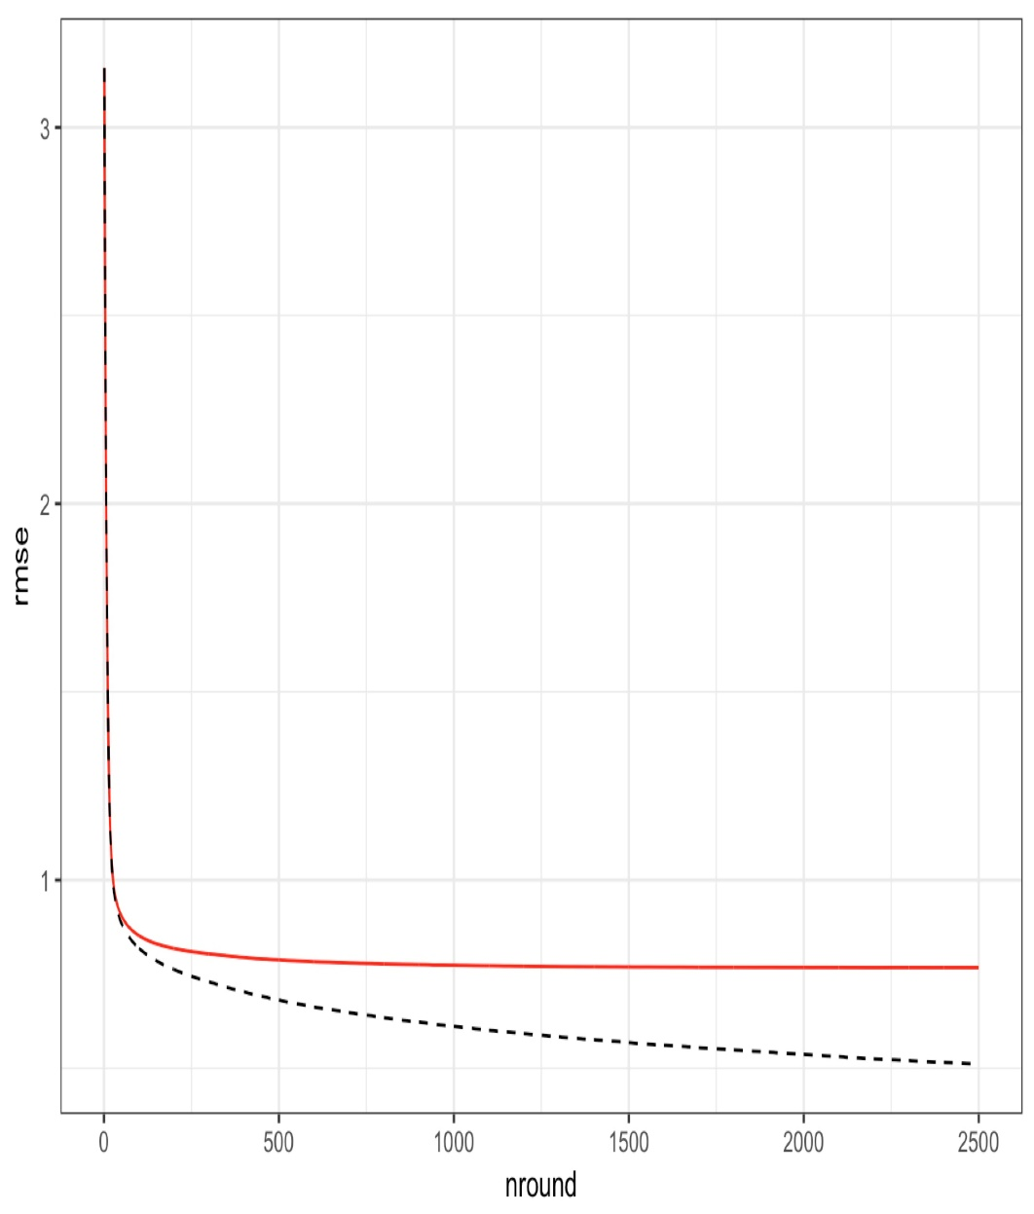
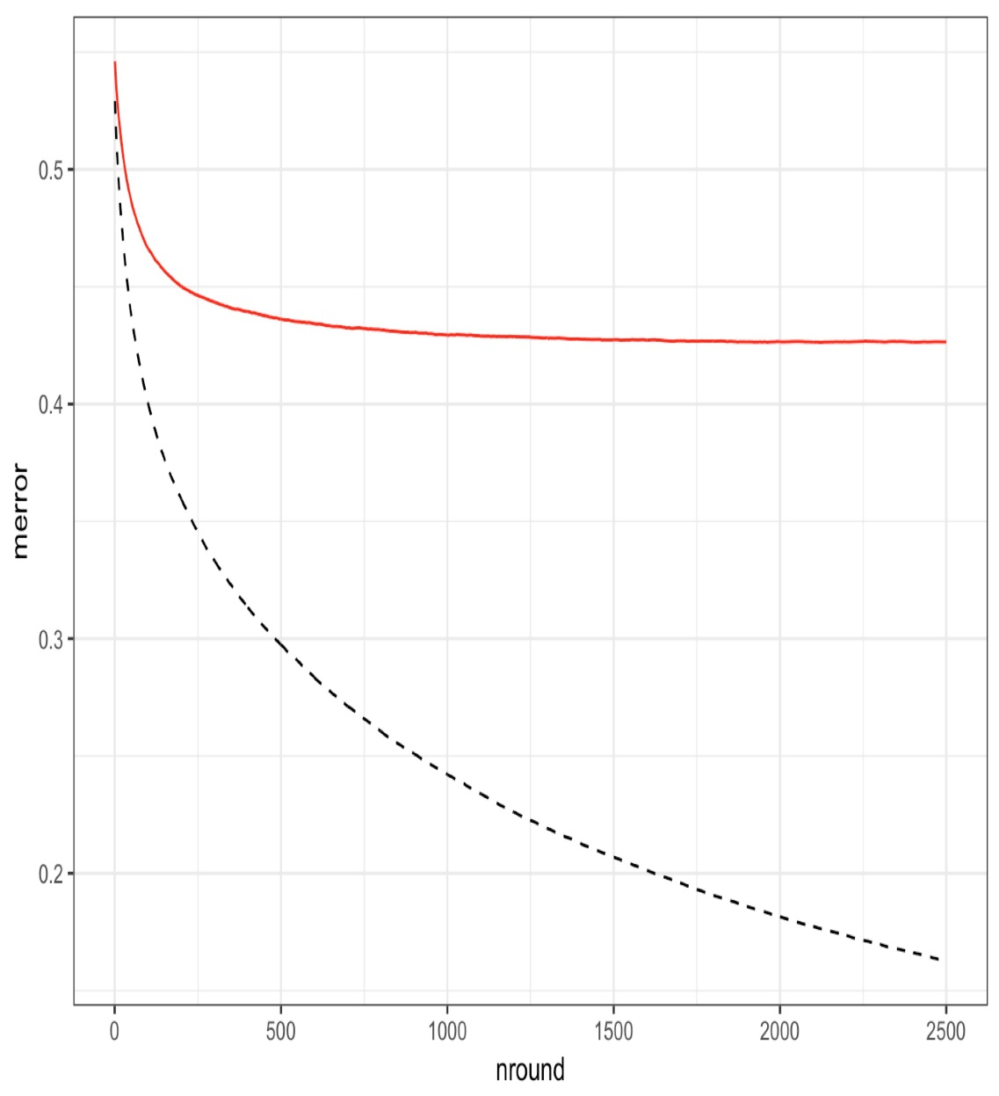

Model Training

Slide 5
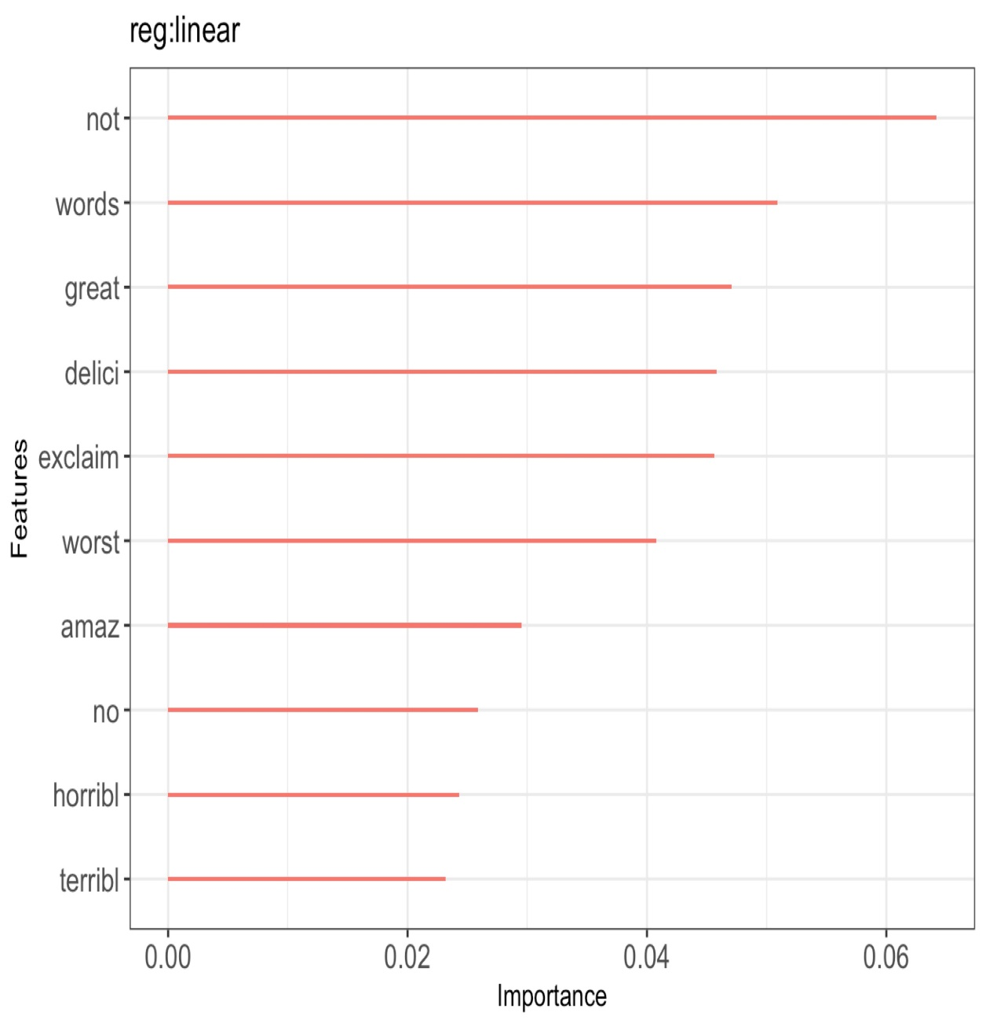
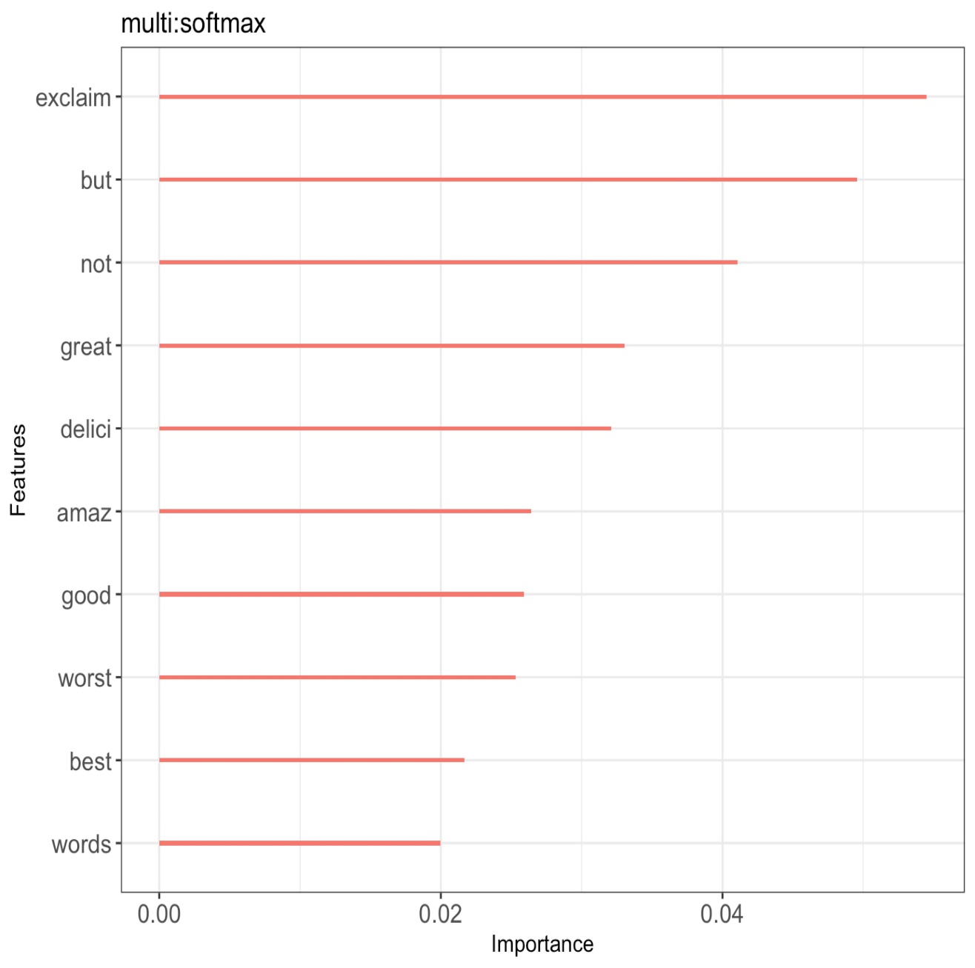
Model Comparison

Slide 6
Summary
Weakness:
Relatively few features
Long training time
A single model
Strength:
Select typical words and symbols

Slide 7
Future Work
If given a second chance, we will:
Loose our restrict to choose more useful words
Try some other methods like:
Multinomial Logistic Regression
kNN classification
Support Vector Regression
Neural Network (CNN, RNN)

