Slide 1


GEO数据挖掘实战
GBM-GSE90598
数据分析

Slide 2
作业：GSE90598数据分析

Slide 3
1. 导入并检查数据及ID转换
####jimmy老师原创获取GEO数据annoprobe####
library(AnnoProbe)
library(GEOquery)
gset <- geoChina("GSE90598")
####清洗GEO数据####
#获取表达矩阵
a=gset[[1]]
dat=exprs(a)
#----芯片间数据标准化
library(limma)
dat=normalizeBetweenArrays(dat)
#获取临床分组信息
pd=pData(a)
library(stringr)
group_list=ifelse(!grepl('Multiforme',pd$title),'healthy','patient’)
table(group_list)
####jimmy原创IDz转换函数idmap####
cg=idmap('GPL17692','soft')
ids=cg
colnames(ids)=c('probe_id','symbol') #----与GEO数据对应
ids$probe_id=as.character(ids$probe_id)
ids=ids[ids$symbol != '',]
ids=ids[ids$probe_id %in% rownames(dat),]
#---%in%判断前一个向量值是否在后一个向量中，返回布尔值
dat=dat[ids$probe_id,] #---只选取可以ID转换的基因探针
#---排序并去重
ids$median=apply(dat,1,median) #ids新建median这一列，列名为median，同时对dat这个矩阵按行操作，取每一行的中位数，将结果给到median这一列的每一行
ids=ids[order(ids$symbol,ids$median,decreasing = T),]#对ids$symbol按照ids$median中位数从大到小排列的顺序排序，将对应的行赋值为一个新的ids
ids=ids[!duplicated(ids$symbol),]#将symbol这一列取取出重复项，'!'为否，即取出不重复的项，去除重复的gene ，保留每个基因最大表达量结果s
dat=dat[ids$probe_id,] #新的ids取出probe_id这一列，将dat按照取出的这一列中的每一行组成一个新的dat
rownames(dat)=ids$symbol#把ids的symbol这一列中的每一行给dat作为dat的行名

Slide 4
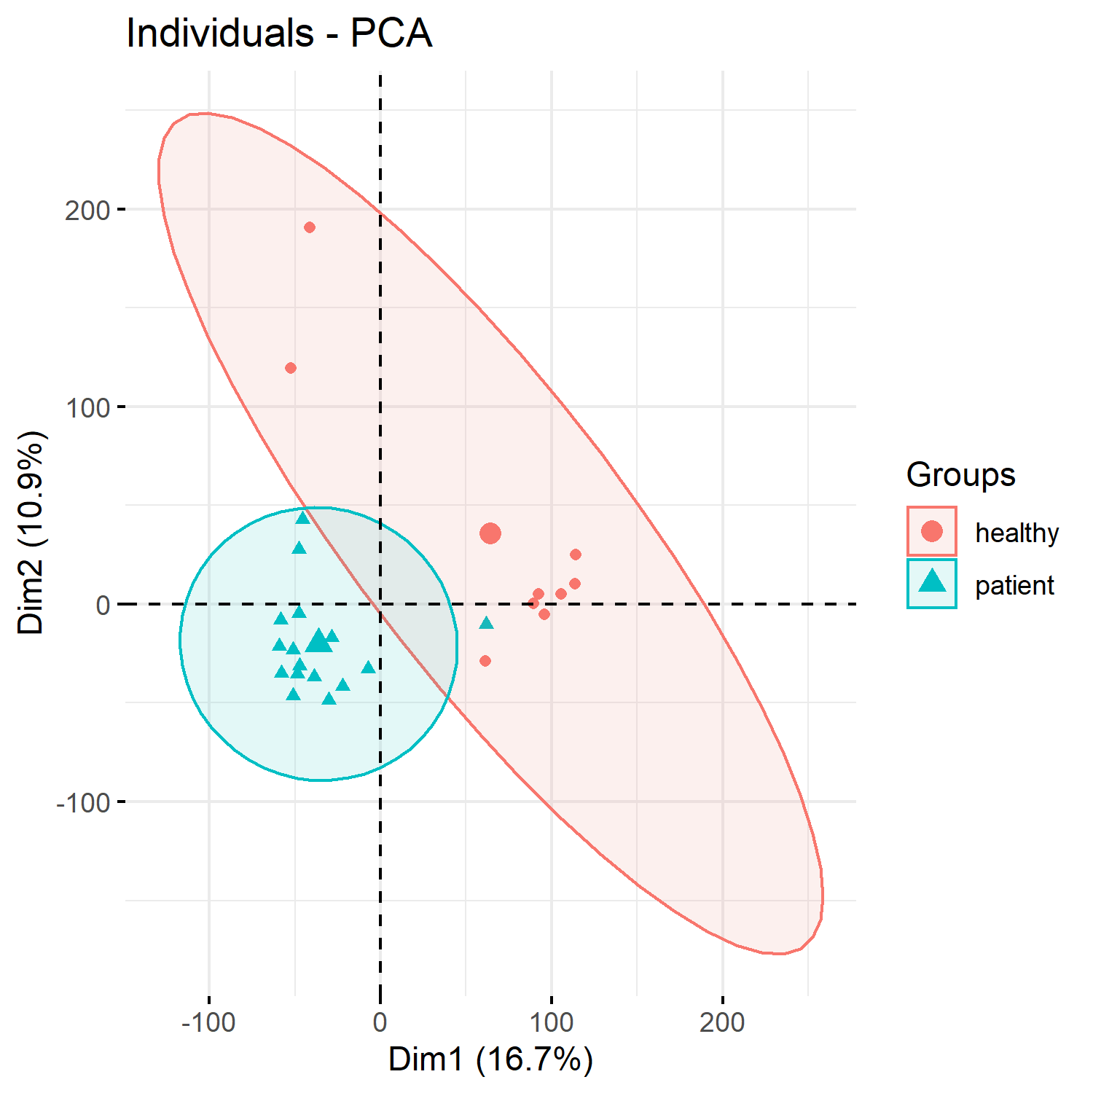
1. PCA主成分分析
####PCA主成分分析####
dat=as.data.frame(t(dat
library("FactoMineR")#画主成分分析图需要加载这两个包
library("factoextra")
#----mineR负责分析，extra负责可视化
#----为什么不需要scale标准化
?PCA
dat.pca <- PCA(dat,
graph = FALSE
)
fviz_pca_ind(dat.pca,
geom.ind = "point", # show points only (nbut not "text")
col.ind = group_list, # color by groups
addEllipses = T, #置信区间椭圆
legend.title = "Groups"
)
ggsave('all_samples_PCA.png',height = 5,width = 5)

Slide 5
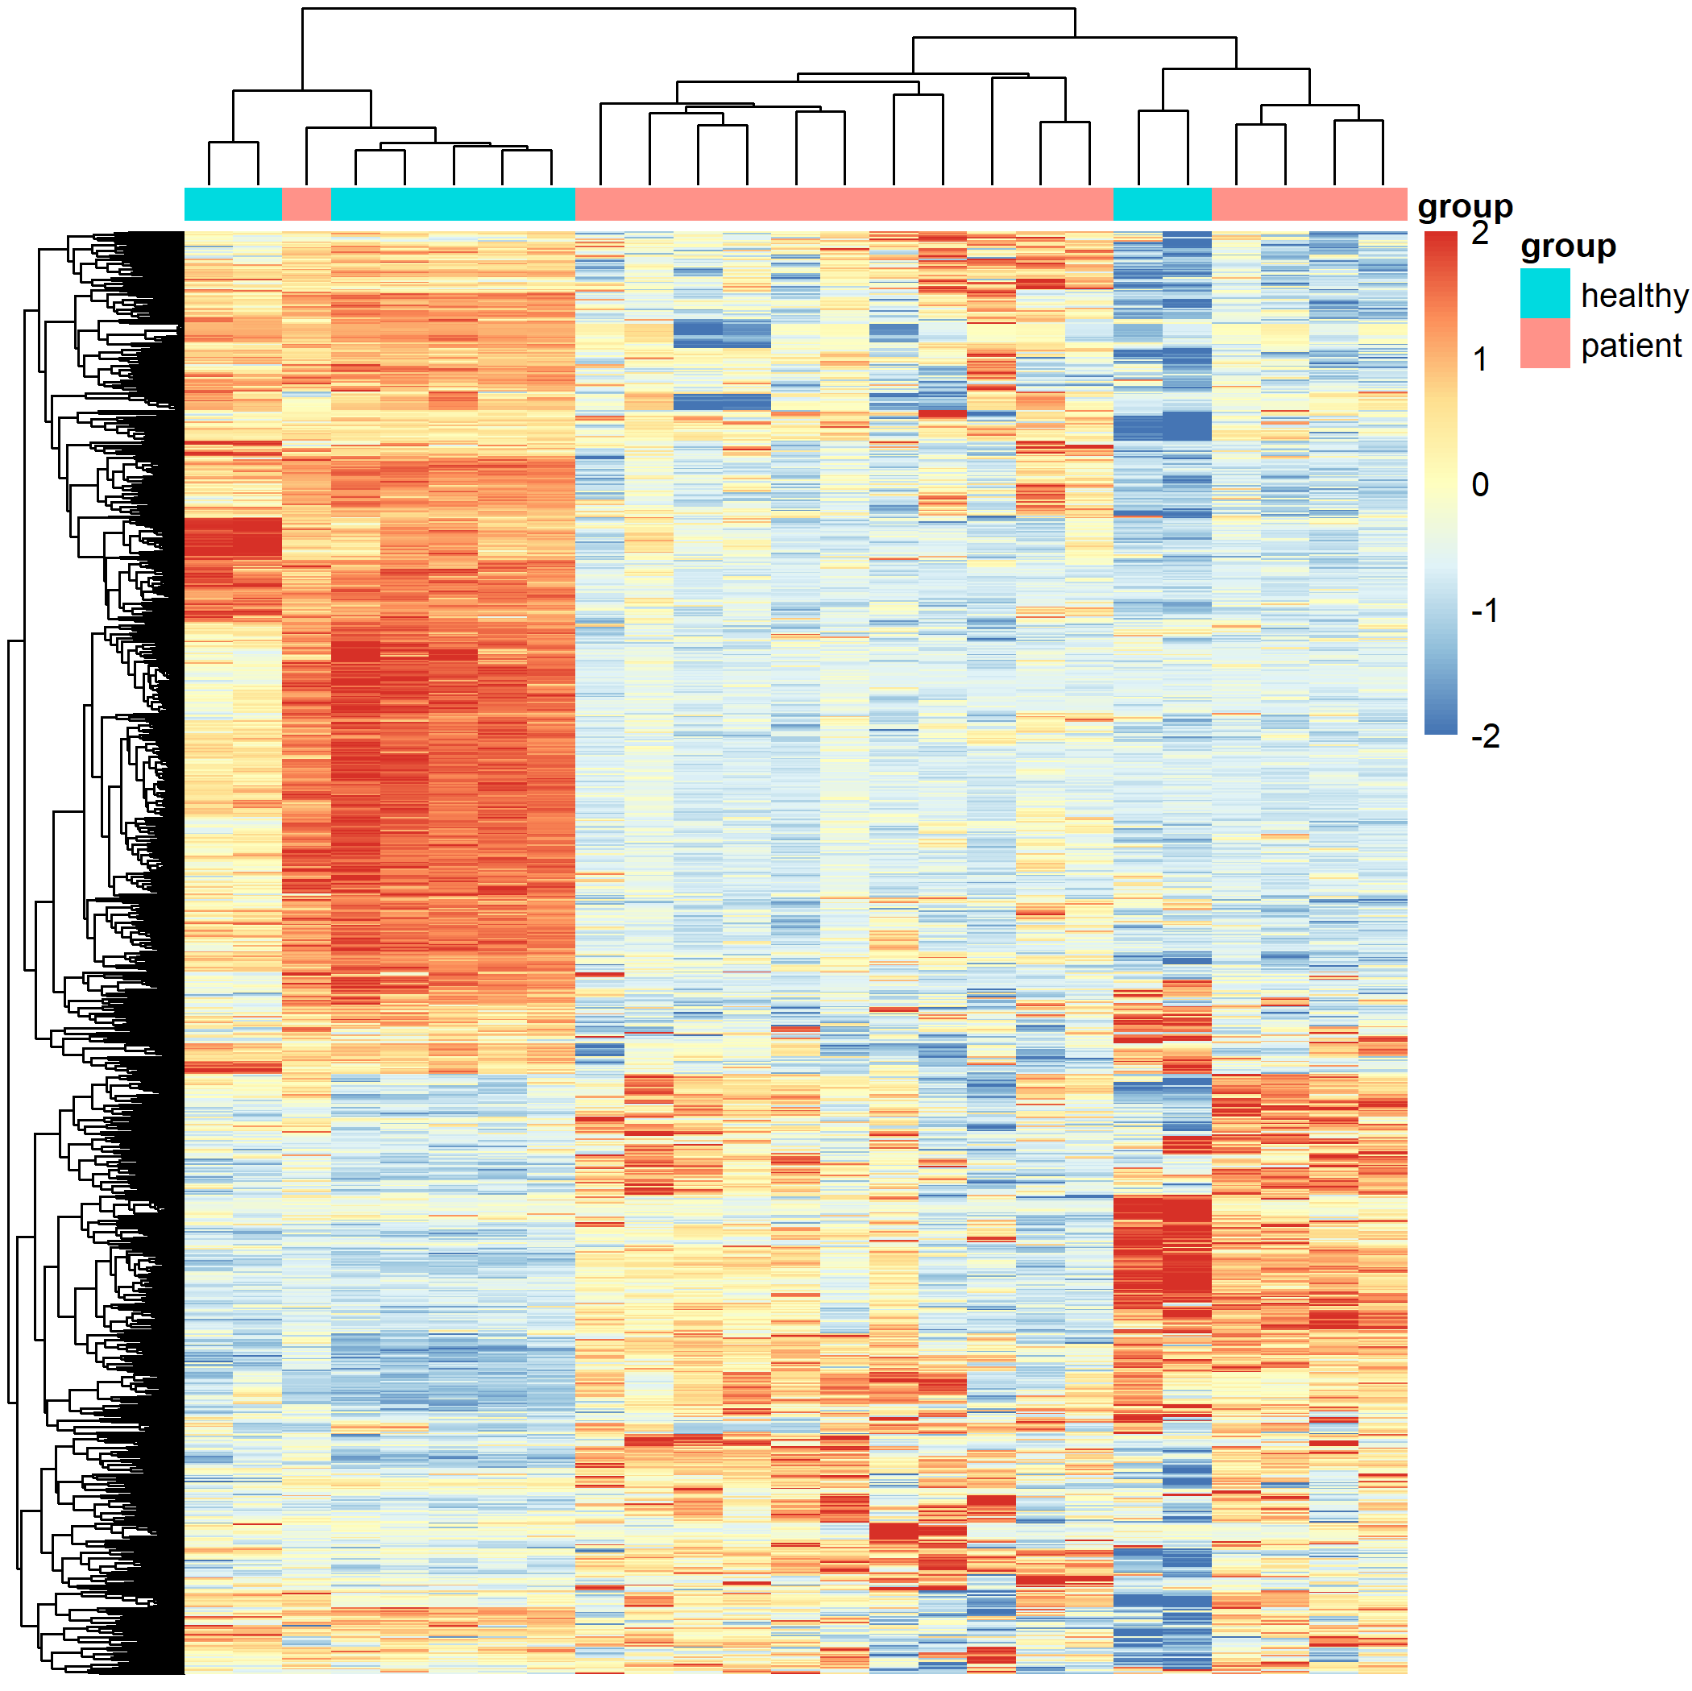
1.取1000sd差异基因做热图
每一行计算方差，从小到大排序取前1000个，形成新的矩阵，对log-ratio数值进行归一化之后画热图
####取1000sd差异基因做热图####
cg=names(tail(sort(apply(dat,1,sd)),1000)) #1000sd library(pheatmap)
pheatmap(dat[cg,],
show_colnames =F,show_rownames = F) n=t(scale(t(dat[cg,]))) # 'scale'归一化
n[n>2]=2
n[n< -2]= -2
n[1:4,1:4]
pheatmap(n,show_colnames =F,show_rownames = F)
#----制作注释信息
ac=data.frame(group=group_list)
rownames(ac)=colnames(n)
pheatmap(n,show_colnames =F,show_rownames = F, annotation_col=ac,filename ='heatmap_top1000_sd.png')
dev.off()

Slide 6
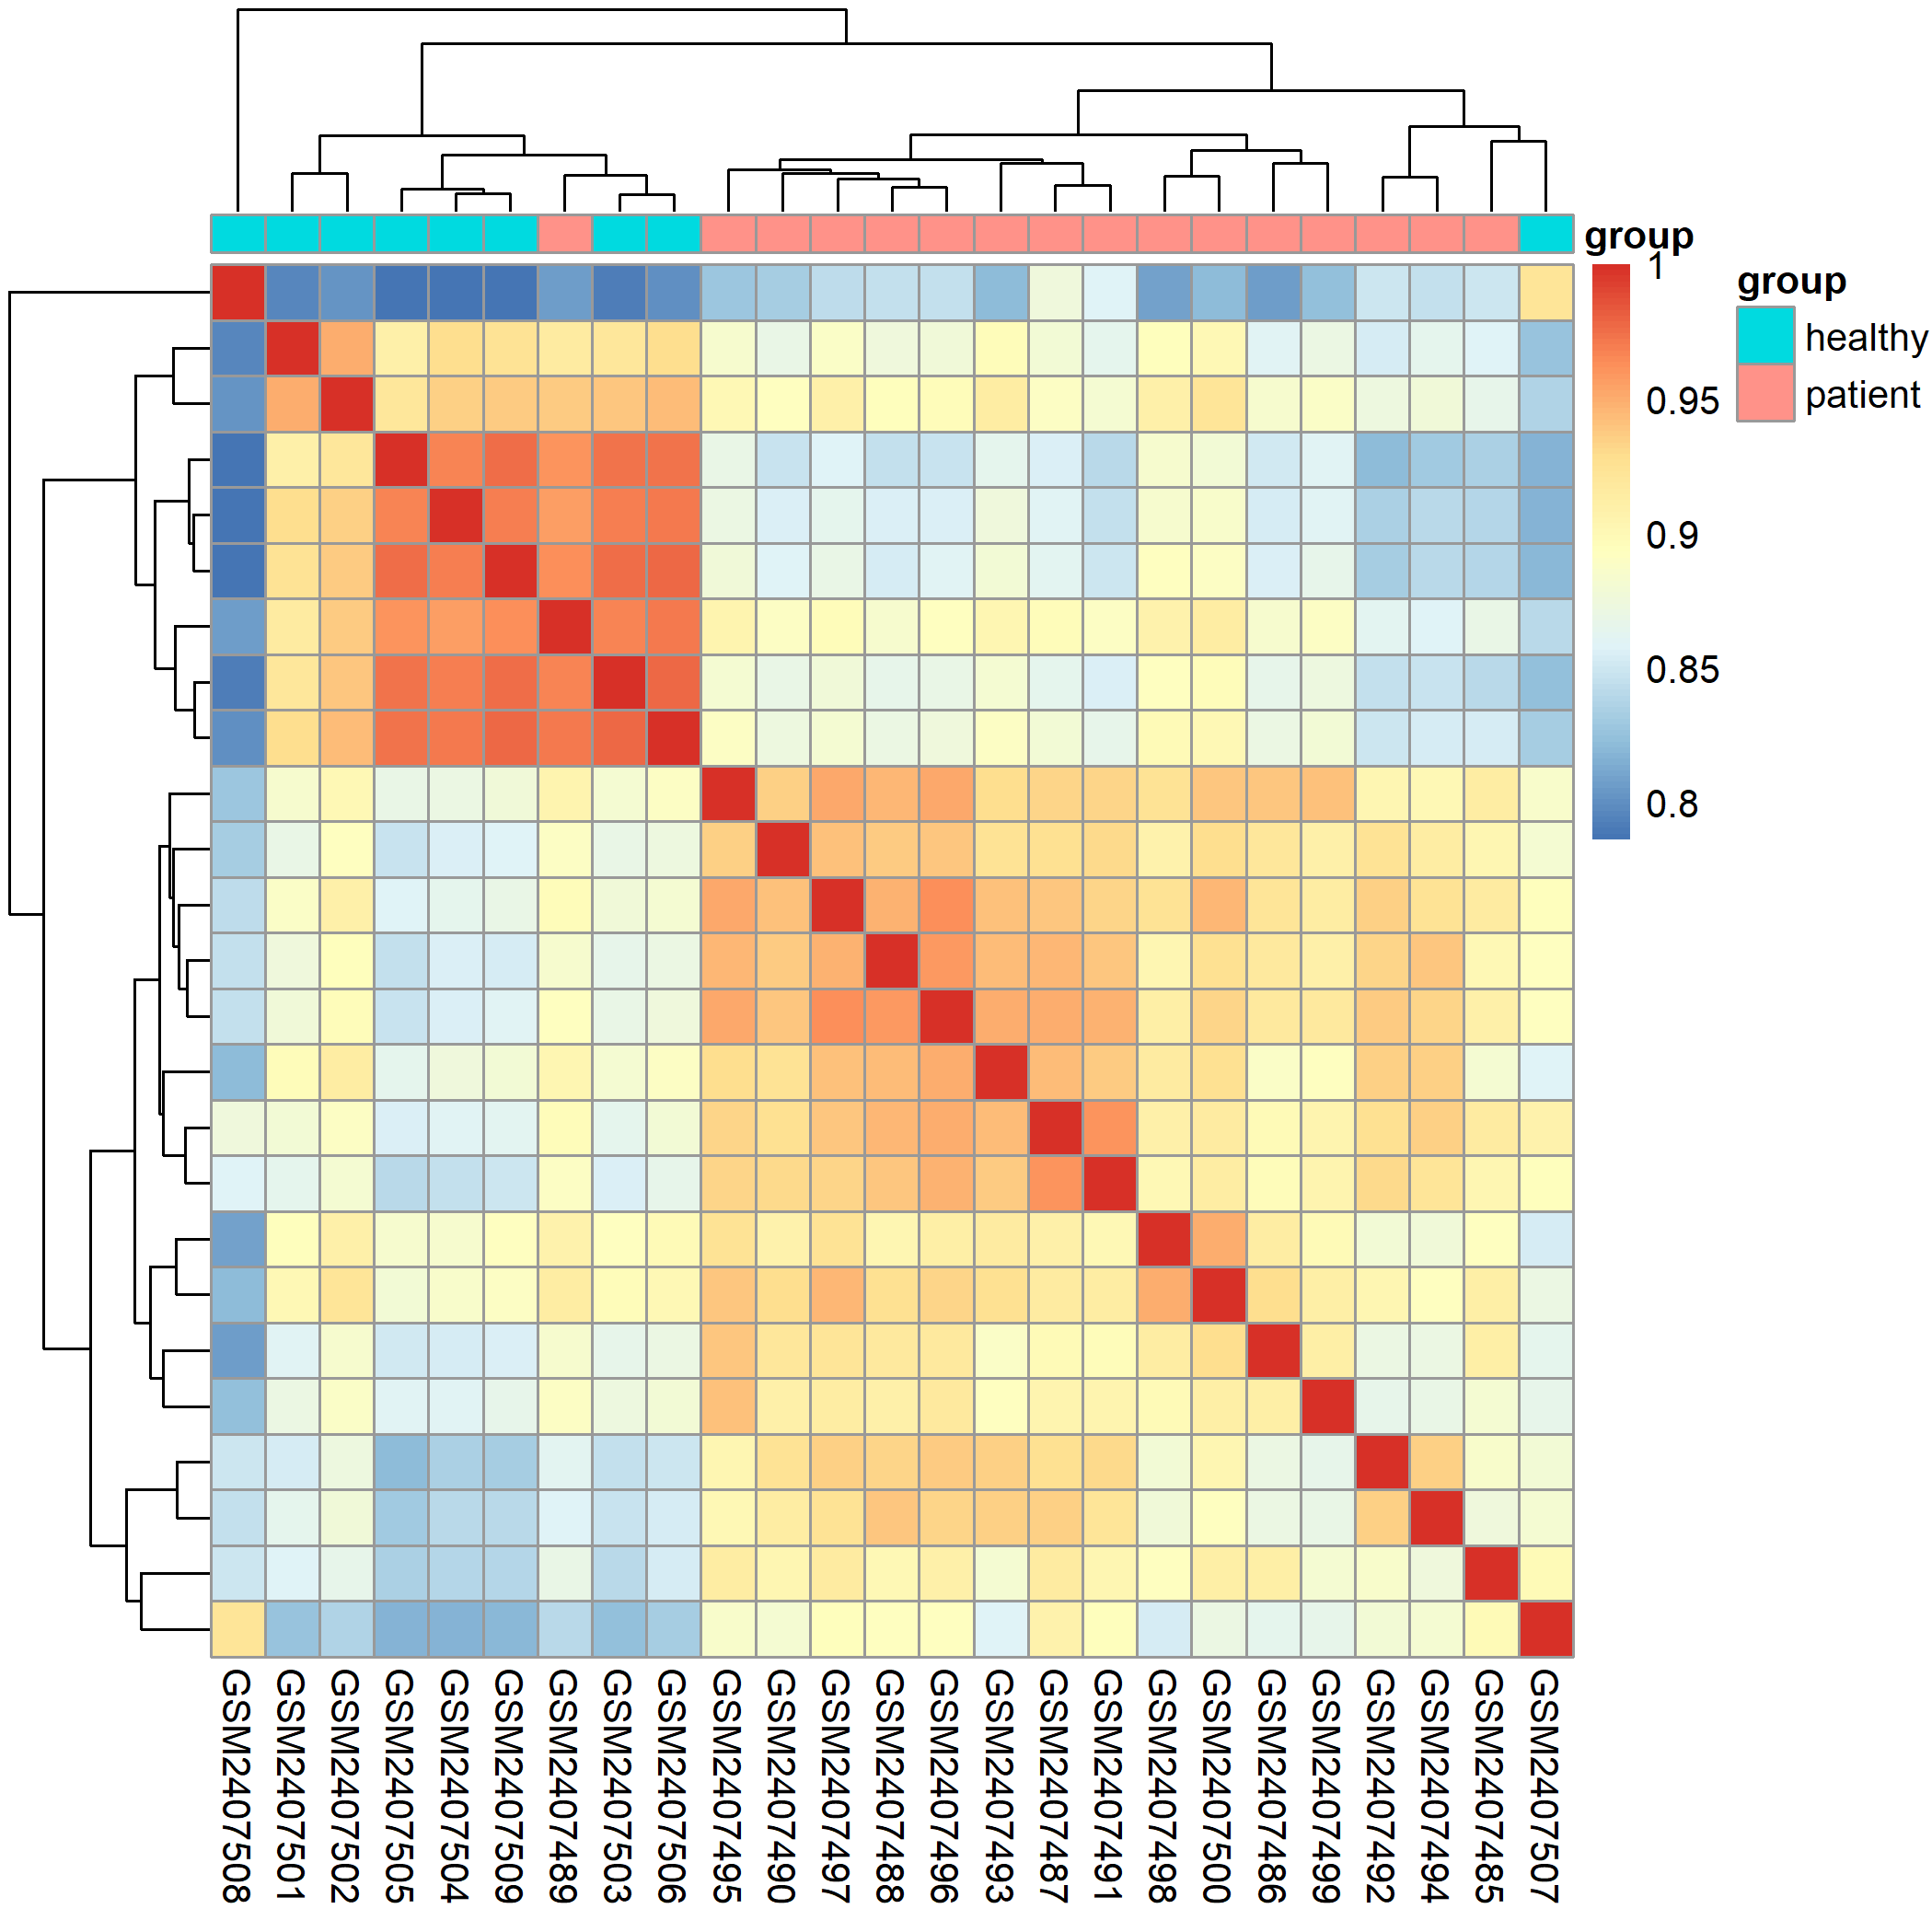
1. 导入并检查数据
对样本画相关性热图，组内的相关性是要高于组间的
####制作样本相关性热图####
rm(list = ls())
load(file = 'step1-output.Rdata')
dat[1:4,1:4]
exprSet=dat
pheatmap::pheatmap(cor(exprSet))
# 组内的样本的相似性应该是要高于组间的！
colD=data.frame(group=group_list)
rownames(colD)=colnames(exprSet) #---制作注释
pheatmap::pheatmap(cor(exprSet),
annotation_col = colD,
show_rownames = F,
filename = 'cor_all.png')
dev.off()

Slide 7
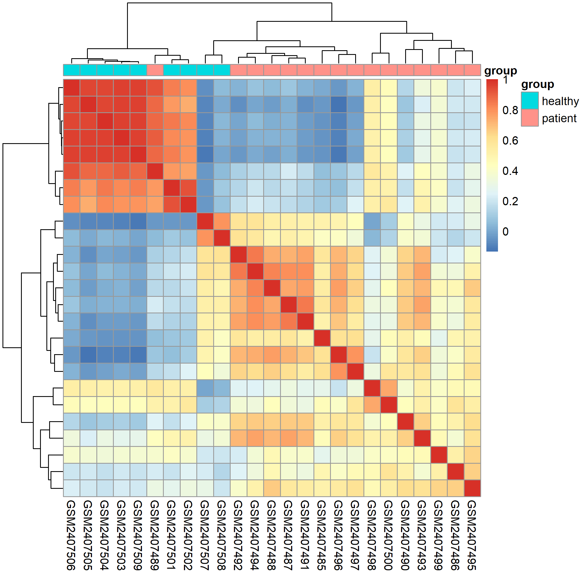
1. 导入并检查数据
取绝对中位数mad的前500个基因，来做样本相关性
exprSet=exprSet[names(sort(apply(exprSet, 1,mad),decreasing = T)[1:500]),]
dim(exprSet)
M=cor(exprSet)
pheatmap::pheatmap(M,
show_rownames = F,
annotation_col = colD, #热图注释
filename = 'cor_top500_mad.png')
dev.off()

Slide 8
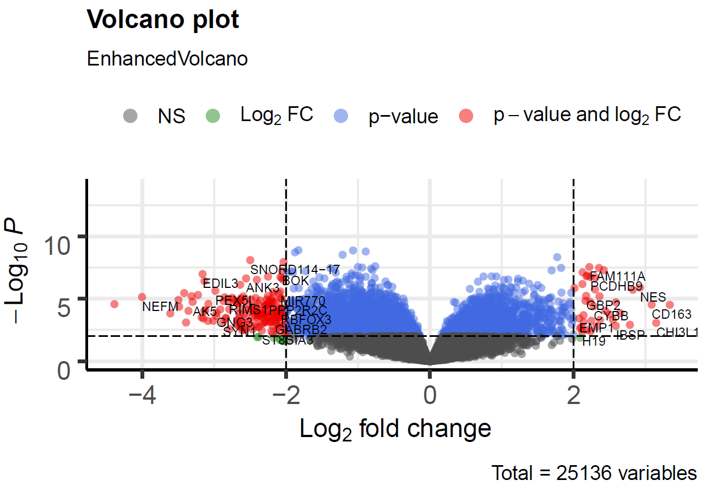
2. 差异基因分析
阈值设置为|logfc|>2, p-value <0.01
差异基因列表：
down | stable | up
172 | 24925 | 39
####利用差异基因绘制火山图####
library(EnhancedVolcano)
EnhancedVolcano(deg,
lab = rownames(deg),
x = 'logFC',
y = 'P.Value',
pCutoff=0.01, #设置p值
FCcutoff=2 #设置logFC值)
ggsave(filename = 'EnhancedVolcano_for_DEG_DEseq2.pdf')

Slide 9
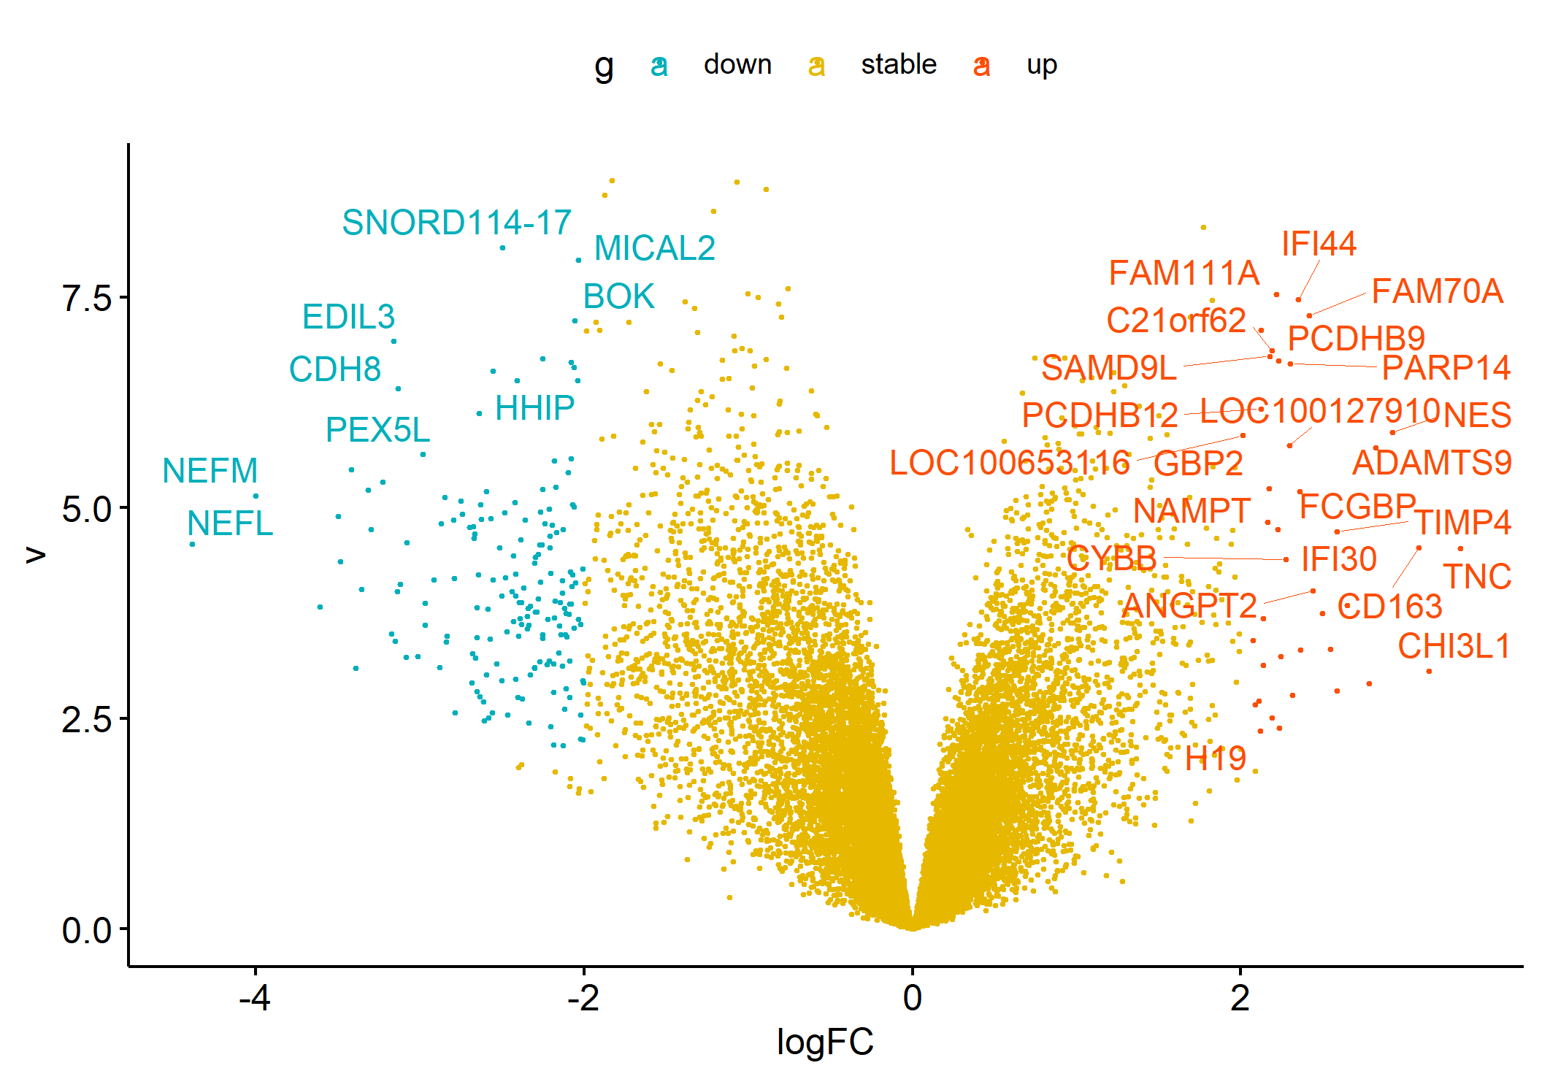
2. 差异基因分析
阈值设置为|logfc|>2, p-value <0.01
差异基因列表：
down | stable | up
172 | 24925 | 39
#---根据logFC和p用ggscatter绘火山图
ggscatter(df, x = "logFC", y = "v", color = "g",
size = 0.5, label = "name", repel = T,
#---repel:避免过度绘制标签导致重叠
label.select = rownames(df)[df$g != 'stable'] ,
palette = c("#00AFBB", "#E7B800", "#FC4E07") )
ggsave('volcano.png')

Slide 10
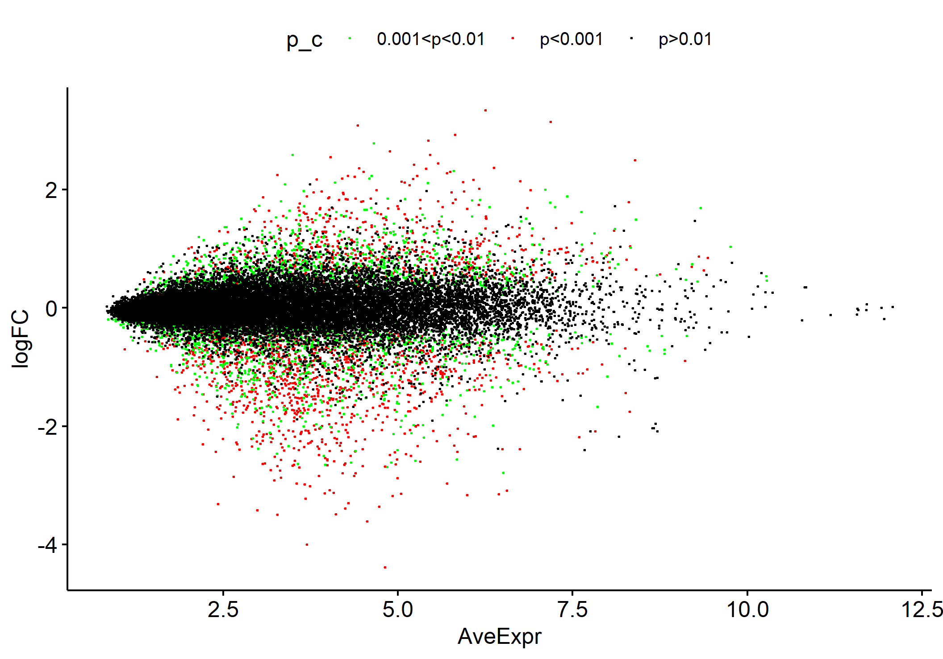
2. 差异基因分析
####绘制MA图####
#---根据基因表达和logFC
ggscatter(df, x = "AveExpr", y = "logFC",size = 0.2)
df$p_c = ifelse(df$P.Value<0.001,'p<0.001',
ifelse(df$P.Value<0.01,'0.001<p<0.01','p>0.01'))
table(df$p_c )
#根据p值(0.01，0.001)大小区分开来
ggscatter(df,x = "AveExpr", y = "logFC", color = "p_c",size=0.2,
palette = c("green", "red", "black") )
ggsave('MA.png')

Slide 11
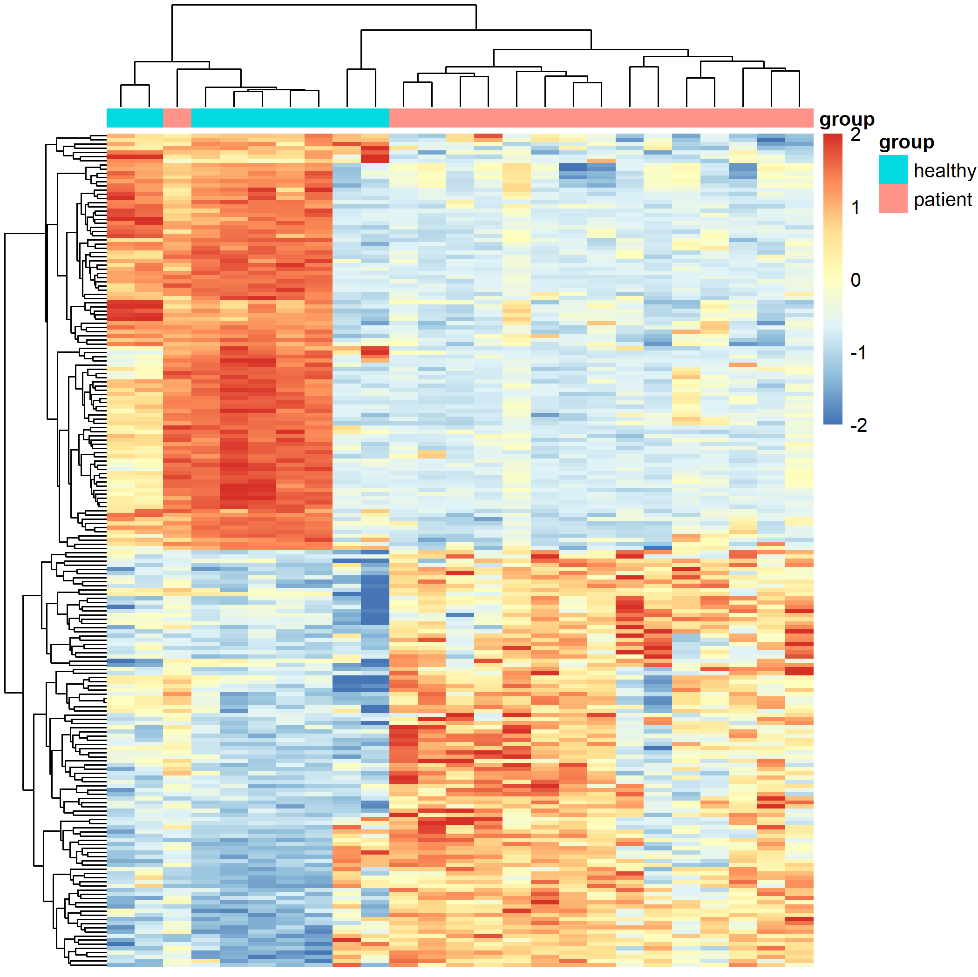
2. 差异基因分析
根据差异基因logFC值，挑取上下调值最大各100差异基因画热图
load(file = 'step1-output.Rdata’)
dat[1:4,1:4]
table(group_list)
x=deg$logFC #deg取logFC这列并将其重新赋值给x
names(x)=rownames(deg)
cg=c(names(head(sort(x),100)),names(tail(sort(x),100))) #获取上下调各100基因名字
library(pheatmap)
n=t(scale(t(dat[cg,]))) #热图极值处理
n[n>2]=2
n[n< -2]= -2
n[1:4,1:4]
pheatmap(n,show_colnames =F,
show_rownames = F,
cluster_cols = T,
annotation_col=ac,filename = 'heatmap_top200_DEG.png') #列名注释信息为ac即分组信息

Slide 12
3. 差异基因GO富集分析
####y叔的包clusterprofile基因功能富集分析####
library(ggplot2)
library(clusterProfiler)
library(DOSE)
library(org.Hs.eg.db) #---org.Hs.eg.db：人类基因组注释
df <- bitr(unique(deg$symbol), #---bitr函数进行id转换
fromType = "SYMBOL",
toType = c( "ENTREZID"),
OrgDb = org.Hs.eg.db)
DEG=merge(DEG,df,by.y='SYMBOL',by.x='symbol’)
save(DEG,file = 'anno_DEG.Rdata')
gene_up= DEG[DEG$g == 'UP','ENTREZID']
gene_down=DEG[DEG$g == 'DOWN','ENTREZID']
gene_diff=c(gene_up,gene_down)
gene_all=as.character(DEG[ ,'ENTREZID'] ) #---转换为字符串代表基因
data(geneList, package="DOSE") #---富集分析的背景基因集
head(geneList)
boxplot(geneList)
boxplot(DEG$logFC)

Slide 13
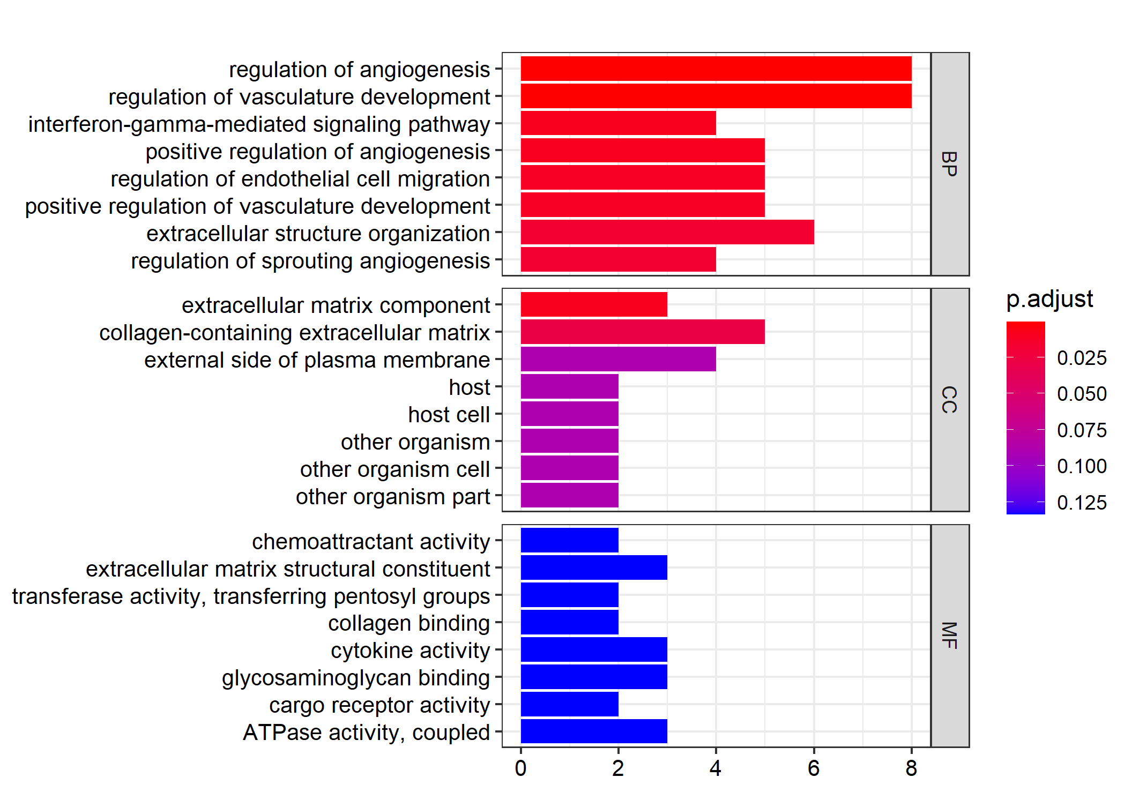
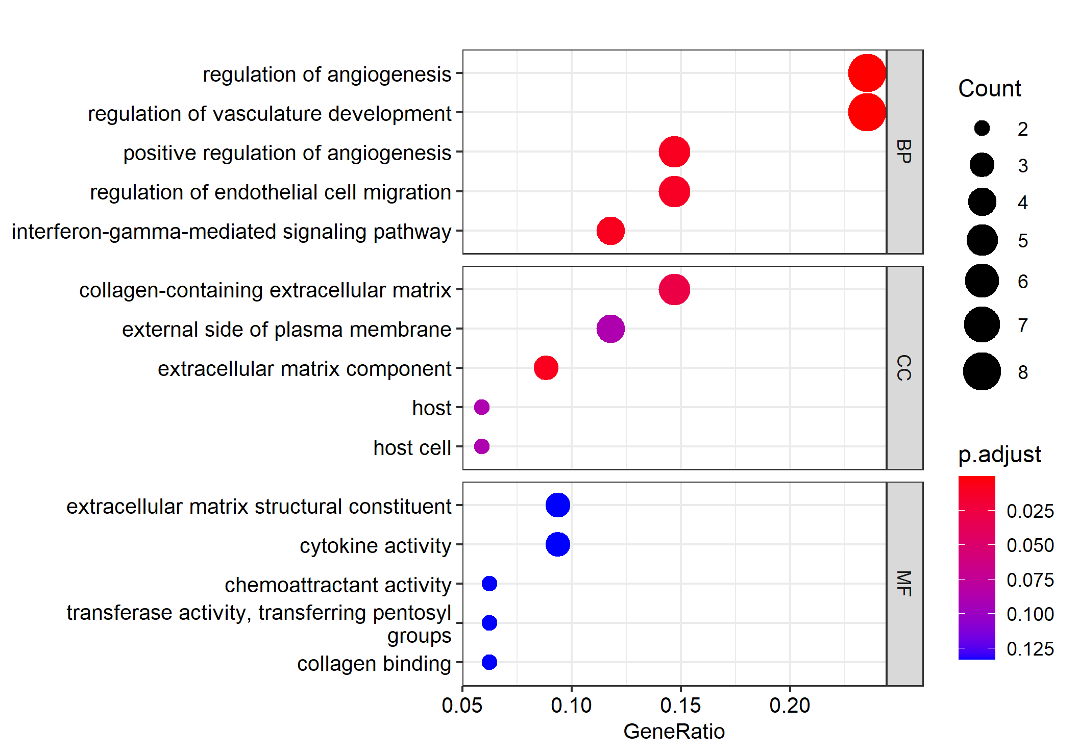
3. 差异基因GO富集分析
#---上调基因GO富集
go <- enrichGO(gene_up,
OrgDb = "org.Hs.eg.db",
ont="all",
pvalueCutoff = 0.99,
qvalueCutoff = 0.99,
readable = TRUE
)
#---ont代表GO的三大类别：BP,CC,MF，也可以是全部ALL
#---barplot富集柱形图
barplot(go, split="ONTOLOGY",font.size =10)+
facet_grid(ONTOLOGY~., scale="free")
+ scale_x_discrete(labels=function(x) str_wrap(x, width=50))
+ggsave('gene_up_GO_all_barplot.png')
#---dotplot富集柱形图
dotplot(go, split = "ONTOLOGY",
font.size = 10,
showCategory = 5) +
facet_grid(ONTOLOGY ~ ., scale = "free") +
scale_y_discrete(labels = function(x) str_wrap(x, width = 45)) +
ggsave('gene_up_GO_all_botplot.png')

Slide 14
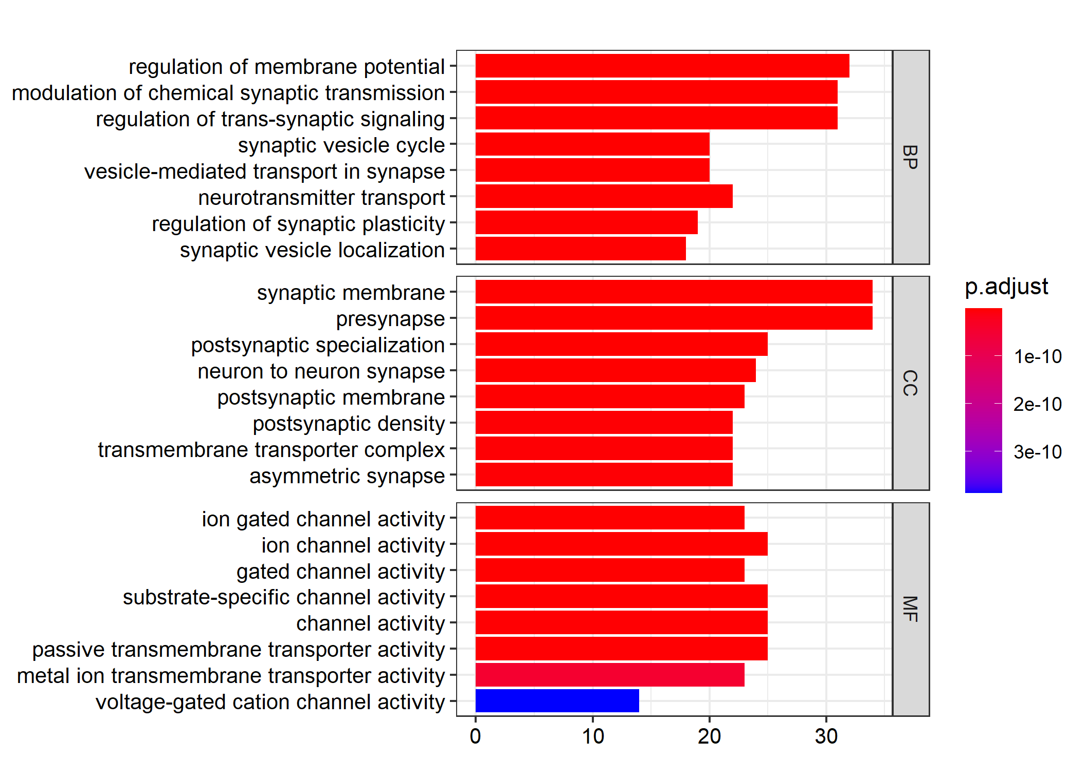
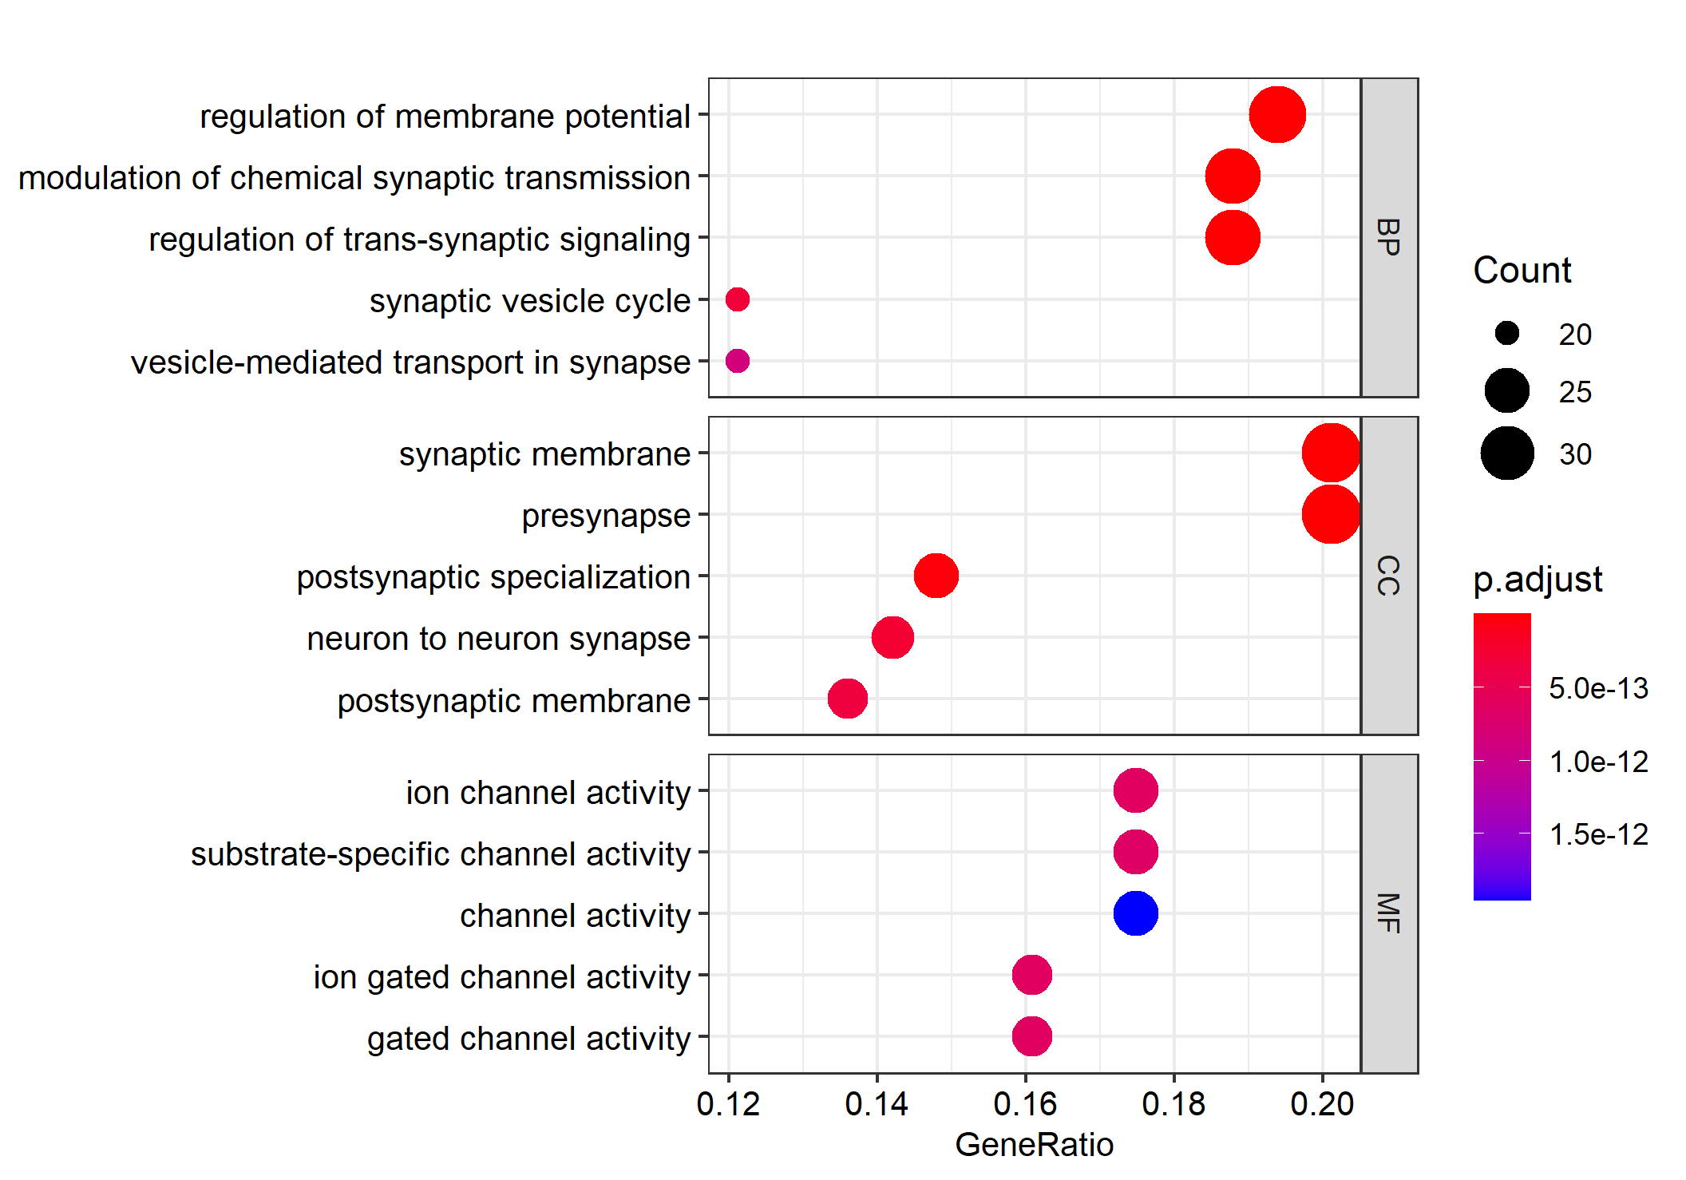
3. 差异基因GO富集分析
#---下调基因GO富集
go <- enrichGO(gene_down,
OrgDb = "org.Hs.eg.db",
ont="all"
)
#---barplot富集柱形图
barplot(go, split="ONTOLOGY",font.size =10)+
facet_grid(ONTOLOGY~., scale="free") +
scale_x_discrete(labels=function(x) str_wrap(x, width=50))+
ggsave('gene_down_GO_all_barplot.png')
#---dotplot富集柱形图
dotplot(go, split = "ONTOLOGY",
font.size = 10,
showCategory = 5) +
facet_grid(ONTOLOGY ~ ., scale = "free") +
scale_y_discrete(labels = function(x) str_wrap(x, width = 45))+
ggsave('gene_down_GO_all_botplot.png')

Slide 15
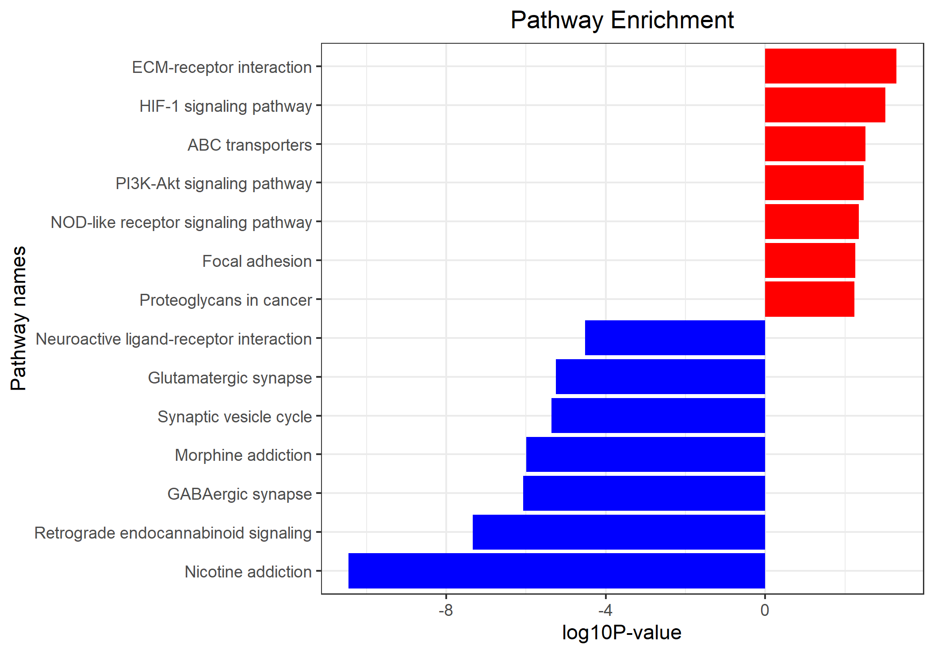
3. 差异基因KEGG富集分析
gene_up=unique(gene_up)
gene_down=unique(gene_down)
gene_diff=unique(c(gene_up,gene_down))
# 上调基因集超几何分布检验(下调，总共在此省略)
kk.up <- enrichKEGG(gene = gene_up,
organism = 'hsa',
#universe = gene_all,
pvalueCutoff = 0.9,
qvalueCutoff =0.9)
kegg_diff_dt <- as.data.frame(kk.diff)
kegg_down_dt <- as.data.frame(kk.down)
kegg_up_dt <- as.data.frame(kk.up)
#---利用group定义正负上下调
down_kegg<-kegg_down_dt[kegg_down_dt$pvalue<0.0001,];down_kegg$group=-1
up_kegg<-
kegg_up_dt[kegg_up_dt$pvalue<0.01,];up_kegg$group=1
#kegg_plot自定义画图函数
g_kegg=kegg_plot(up_kegg,down_kegg)

Slide 16
3. 差异基因GSEA富集分析
####自定义kegg_plot画图函数####
kegg_plot <- function(up_kegg,down_kegg){
dat=rbind(up_kegg,down_kegg)
colnames(dat)
dat$pvalue = -log10(dat$pvalue)
dat$pvalue=dat$pvalue*dat$group
dat=dat[order(dat$pvalue,decreasing = F),]
g_kegg<- ggplot(dat, aes(x=reorder(Description,order(pvalue, decreasing = F)), y=pvalue, fill=group)) +
geom_bar(stat="identity") +
scale_fill_gradient(low="blue",high="red",guide = FALSE) +
scale_x_discrete(name ="Pathway names") +
scale_y_continuous(name ="log10P-value") +
coord_flip() + #---翻转坐标轴
theme_bw()+theme(plot.title = element_text(hjust = 0.5))+
ggtitle("Pathway Enrichment")
}

Slide 17
3. 差异基因GSEA富集分析
####构建genelist####
geneList=DEG$logFC
names(geneList)=DEG$ENTREZID
geneList=sort(geneList,decreasing = T)
head(geneList)
####利用genelist差异表达数据进行GSEA分析####
library(clusterProfiler)
kk_gse <- gseKEGG(geneList = geneList,
organism = 'hsa',
nPerm = 1000,
minGSSize = 10,
pvalueCutoff = 0.9,
verbose = FALSE)
tmp=kk_gse@result
kk=DOSE::setReadable(kk_gse, OrgDb='org.Hs.eg.db',keyType='ENTREZID')
tmp=kk@result
pro='comp1'
write.csv(kk@result,paste0(pro,'_kegg.gsea.csv'))
save(kk,file = 'gsea_kk.Rdata')

Slide 18
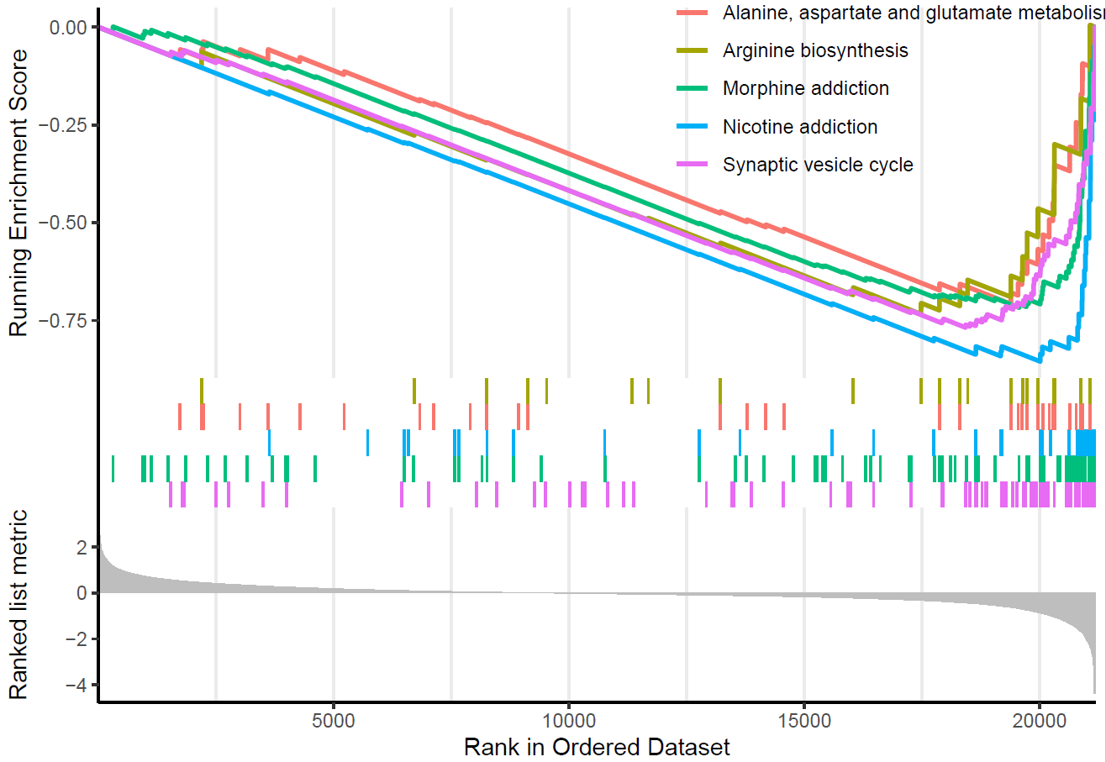
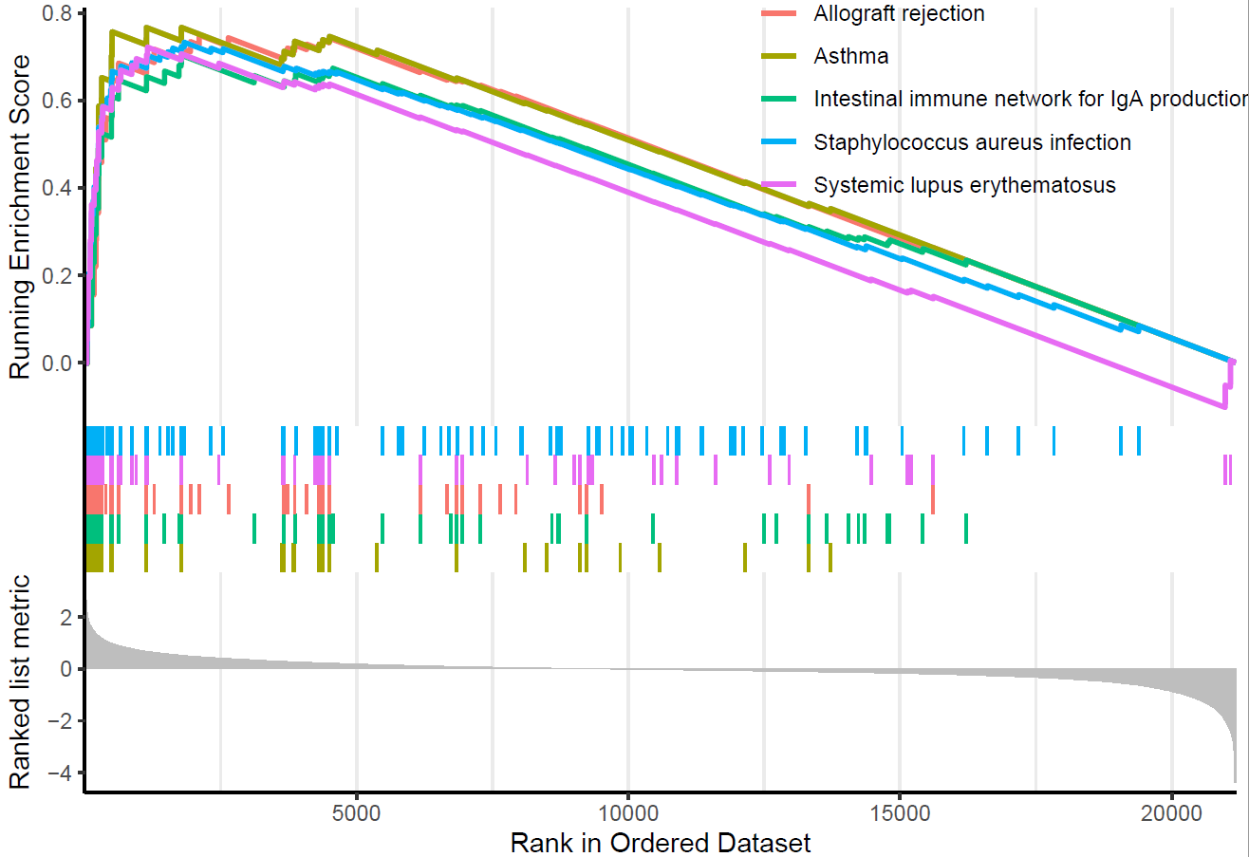
3. 差异基因GSEA富集分析
#---GSEA合并绘图
library(enrichplot)
#---下调通路gsea
gseaplot2(kk, geneSetID = down_kegg$ID[1:5])
ggsave("down_kegg.pdf")
#---上调通路gsea
gseaplot2(kk, geneSetID = up_kegg$ID
[(nrow(up_kegg)-4):nrow(up_kegg)])
ggsave("up_kegg.pdf")

