Slide 1
You Only Look Once:
Unified, Real-Time Object Detection
小组成员：何之强 赵震 赵航 王钦松
Speaker name and title
www.islide.cc
2016 IEEE Conference on Computer Vision and Pattern Recognition

Slide 2
分工
赵航：资料收集
赵震：论文研讨
王轻松：ppt制作
何之强：ppt汇报

Slide 3
abstract
We frame object detection as a regression problem to spatially separated bounding boxes and associated class probabilities. A single neural network predicts bounding boxes and class probabilities directly from full images in one evaluation.
Unified architecture is extremely fast. YOLO model processes images in real-time at 45 frames per second. A smaller version of the network, Fast YOLO, processes an astounding 155 frames per second while still achieving double the mAP of other real-time detectors.

Slide 4
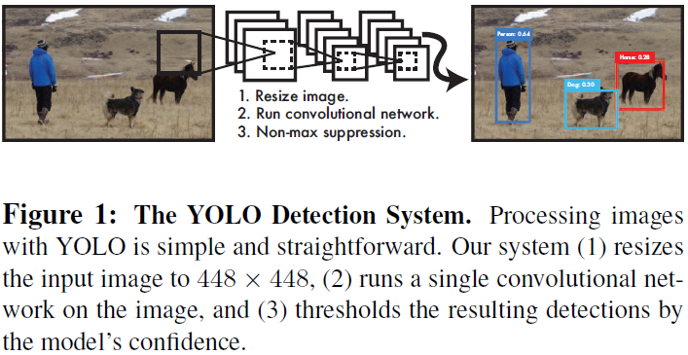

Slide 5
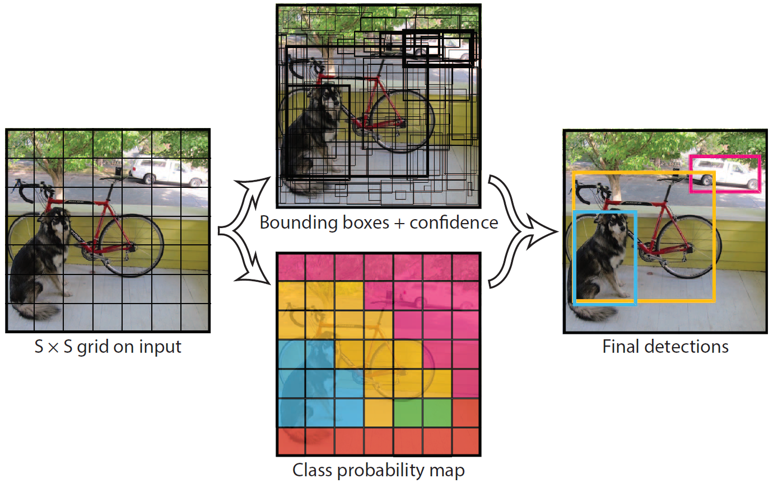



$$(x, y, w, h, confidence)$$
$$Confidence = Pr⁡⁡(Object)×IoU$$
$$S×S×(B×5+C)$$

Slide 6
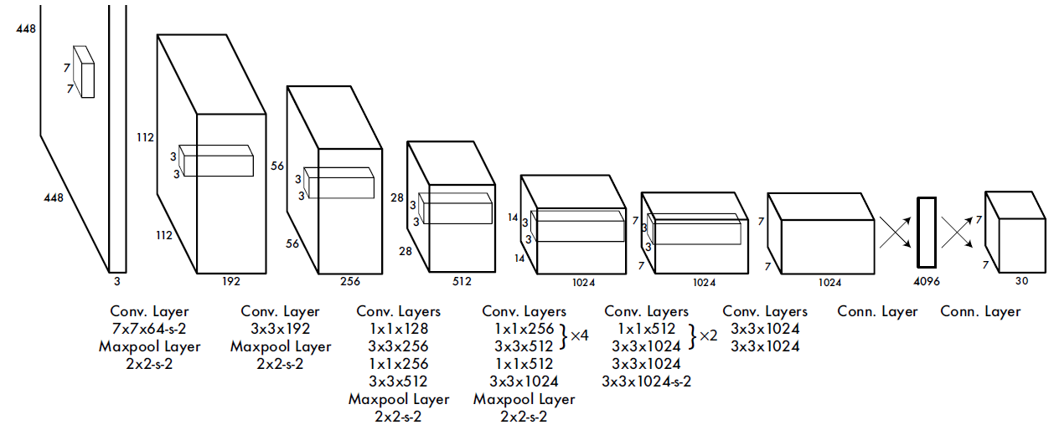
$$input=\left(448, 448, 3\right), S=7, B=2, C=20,output=(7×7×30)$$

Slide 7

Training
·Pretrain our convolutional layers on the ImageNet 1000-class competition dataset.
·Normalize the bounding box width and height by the image width and height so that they fall between 0 and 1.
·Use a linear activation function for the final layer and all other layers use the following leaky rectified linear(LeakyReLu) activation.

Slide 8
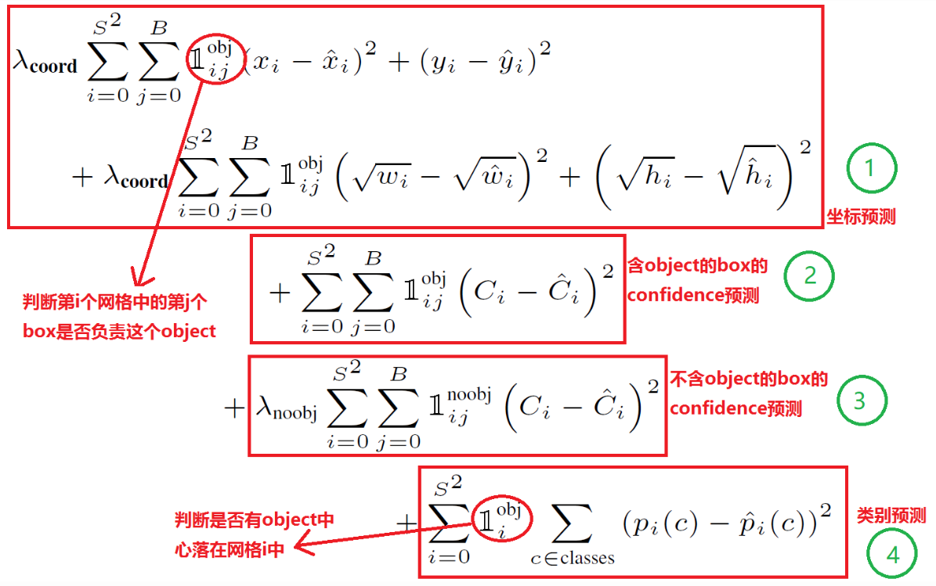
·Loss function

Slide 9
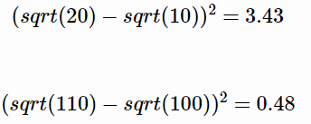




$$（h, w） (100, 100)$$
$$(110, 110)$$
将目标都预测大了10个像素
$$（h, w） (10, 10)$$
$$(20, 20)$$
不使用根号函数，那么损失相同

Slide 10
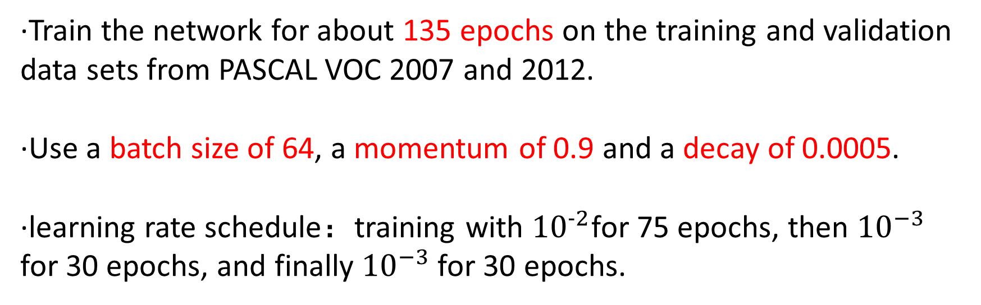
·Train the network for about 135 epochs on the training and validation data sets from PASCAL VOC 2007 and 2012.
·Use a batch size of 64, a momentum of 0.9 and a decay of 0.0005.
·learning rate schedule：training with ${10}^{−2}$for 75 epochs, then ${10}^{−3}$ for 30 epochs, and finally ${10}^{−3}$for 30 epochs.

Slide 11
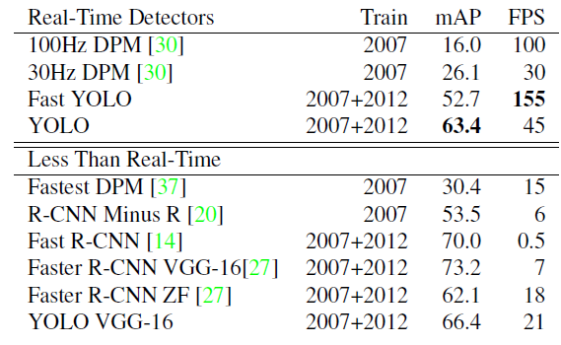
Comparison to Other Real-Time Systems

Slide 12
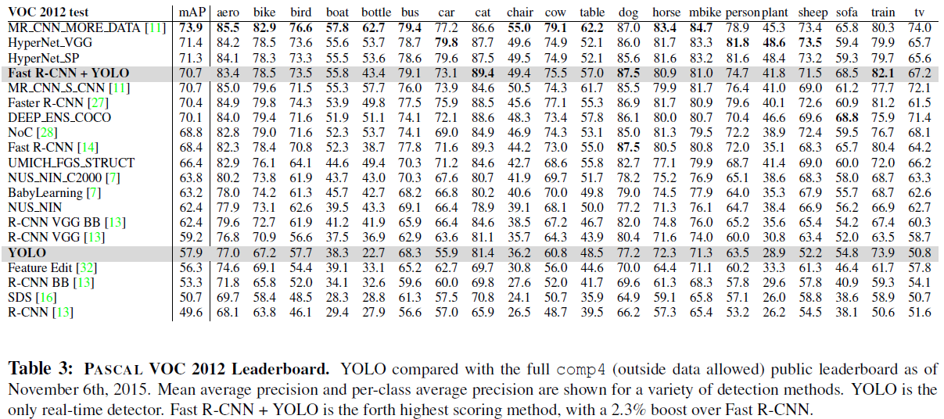

Slide 13
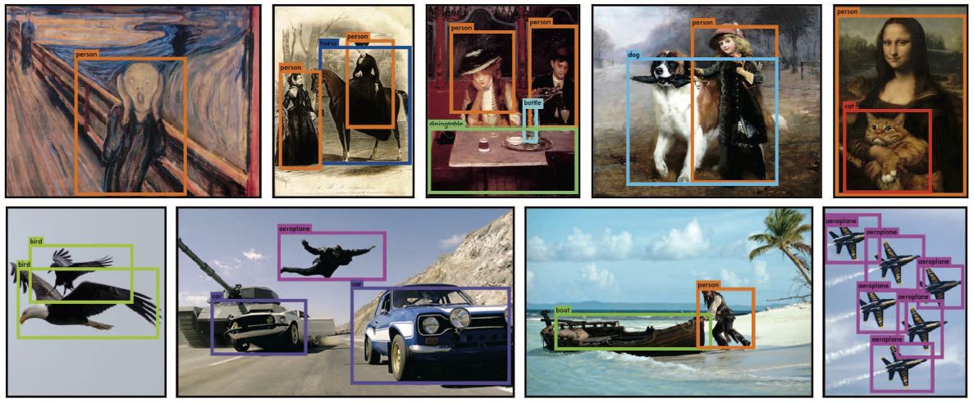

Slide 14
Thanks

