Slide 1
CE-Net: Context Encoder Network for 2D Medical Image Segmentation
汇报人：何之强
Speaker name and title
www.islide.cc
2019 IEEE Transactions on Medical Imaging(TMI)

Slide 2
Abstract
For U-net based approaches, the consecutive pooling and strided convolutional operations lead to the loss of some spatial information.
Propose a context encoder network (referred to as CE-Net) to capture more high-level information and preserve spatial information for 2D medical image segmentation.
CE-Net mainly contains three major components: a feature encoder module, a context extractor and a feature decoder module.

Slide 3
Analysis
A common limitation of the U-Net and its variations is that the consecutive pooling operations or convolution striding reduce the feature resolution to learn increasingly abstract feature representations. Although this invariance is beneficial for classification or object detection tasks, it often impedes dense prediction tasks which require detailed spatial information. Intuitively, maintaining high-resolution feature maps at the middle stages can boost segmentation performance.
Capture more high level features in the encoder and preserve more spatial information in the decoder to improve the performance of image segmentation.

Slide 4
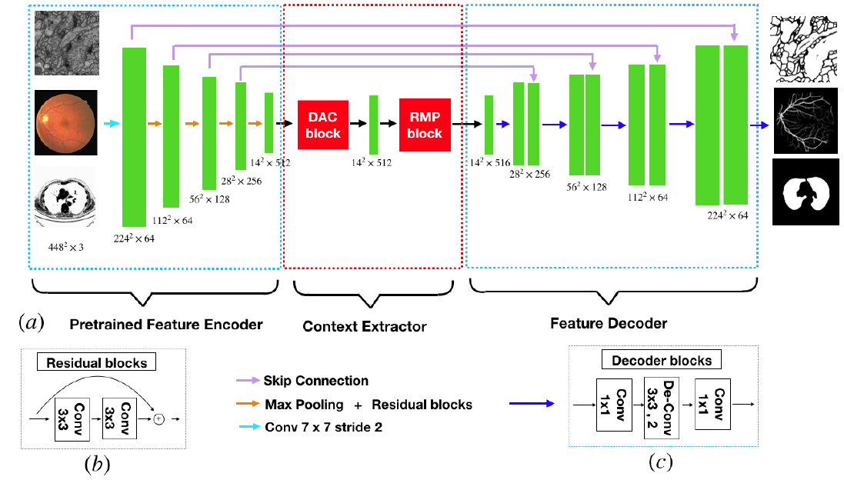
Structure

Slide 5
Feature Encoder Module
In U-Net architecture, each block of encoder contains two convolution layers and one max pooling layer.
Replace it with the pretrained ResNet-34 in the feature encoder module, which retains the first four feature extracting blocks without the average pooling layer and the fully connected layers.
Avoid the gradient vanishing and accelerate the network convergence.

Slide 6
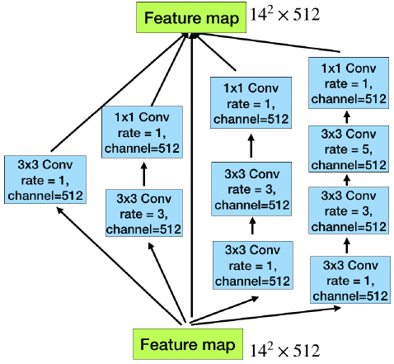
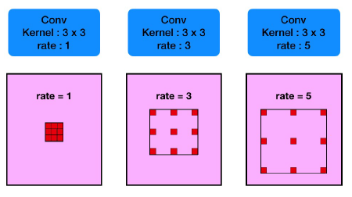
Context Extractor Module
DAC block(Dense Atrous Convolution module)

Slide 7
Context Extractor Module
It employs different receptive fields, similar to Inception structures. Very often, the convolution of large reception field could extract and generate more abstract features for large objects, while the convolution of small reception field is better
for small object.

Slide 8
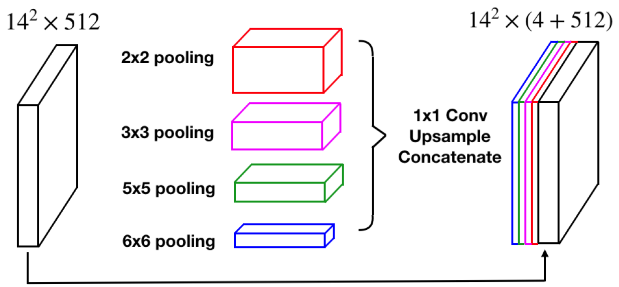
Context Extractor Module
RMP（ Residual Multi-kernel pooling ）

Slide 9
Context Extractor Module
A challenge in segmentation is the large variation of object size in medical image. For example, a tumor in middle or late stage can be much larger than that in early stage. In this paper, we propose a residual multi-kernel pooling to address the problem, which mainly relies on multiple effective field-of-views to detect objects at different sizes.

Slide 10
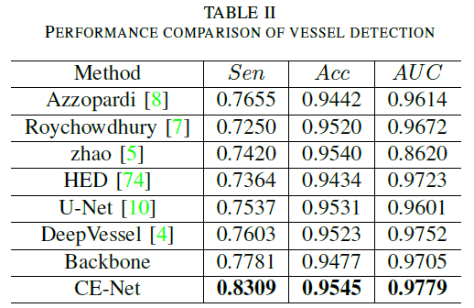
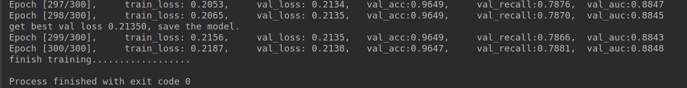
Experiment

Slide 11
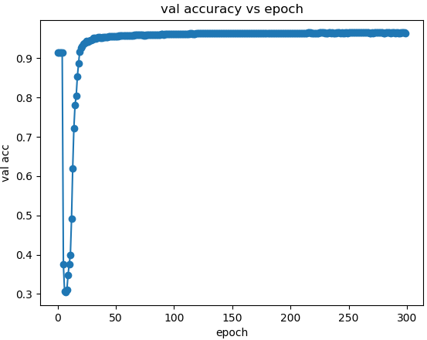
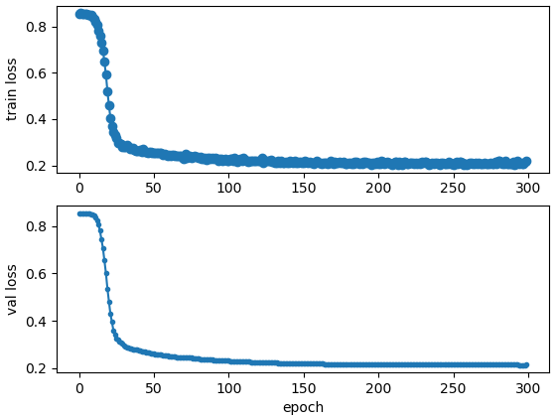
Experiment

Slide 12
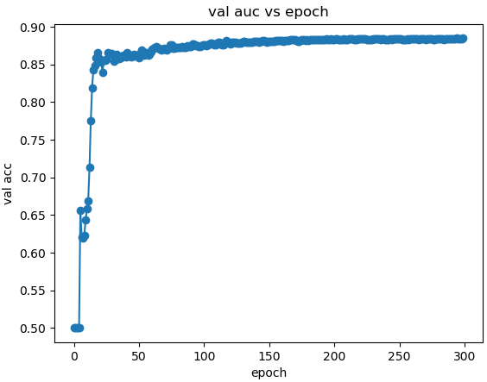
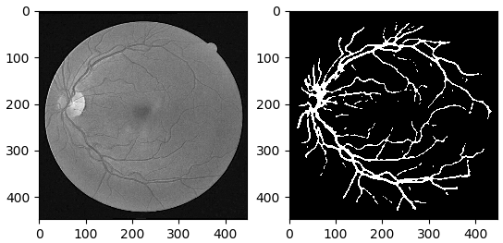
Experiment

Slide 13
Thanks

