Slide 1
SAS Regular Expression(Regex): the First Wave
Jiangtang Hu (@JiangtangHu)
d-Wise Technologies

Slide 2
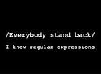
[\w\d!#$%&'*+-/=?^`{|}~]+(\.[\w\d!#$%&'*+-/=?^`{|}~]+)*~]+(\.te[w\d&'*] \\.^*+?\d&'*
Notes:
Why you should learn SAS PRX?
First, it’s cool.

Slide 3
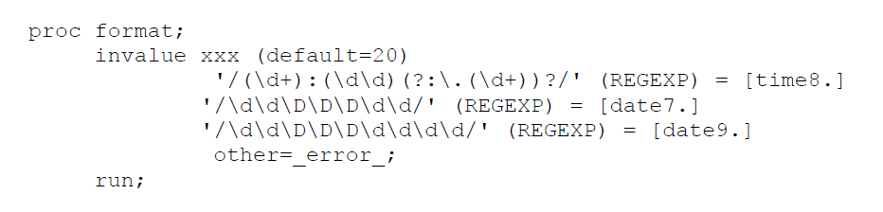
The latest news: SAS 9.3 incorporates PRX in Proc Format!

Slide 4
You can take away
The confidence to dig into Regex
Where to start?
Supporting tools
Resources
A Joke
All codes and testing data, available at
https://github.com/Jiangtang/SESUG2012

Slide 5
Agenda
No picnic! You are already using Regex
Regex with minimum efforts: a demo
Resource

Slide 6
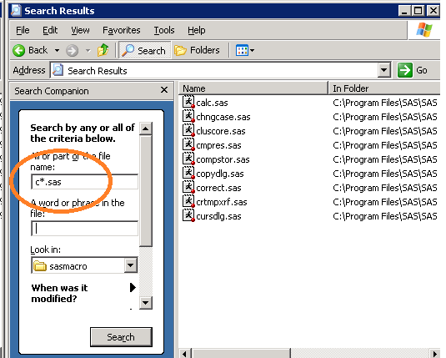
You are already using Regex!
Search all SAS files with names beginning with “c”
*: match everything!

Slide 7
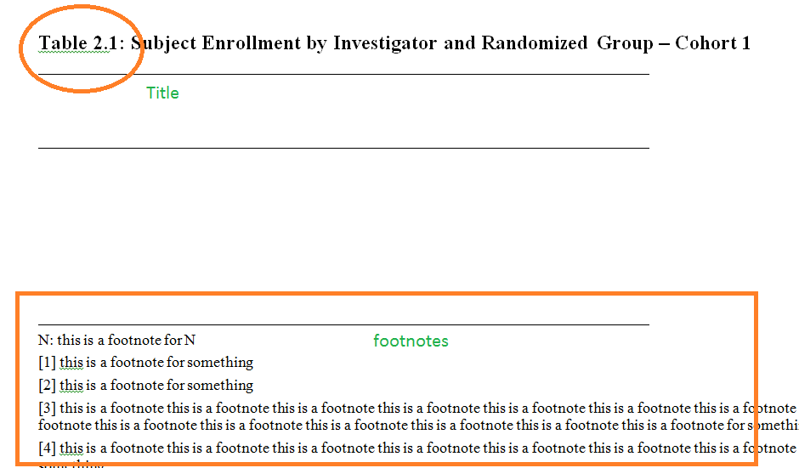
A Demo
Input: a SAP shell.doc

Slide 8
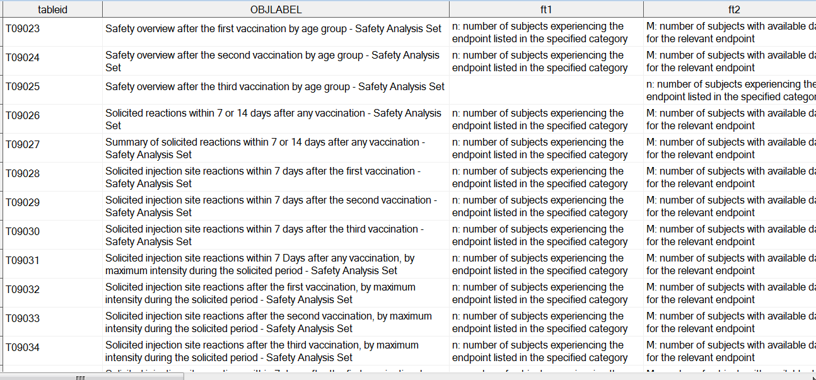
A Demo
Output: headfoot dataset for TLF programming

Slide 9
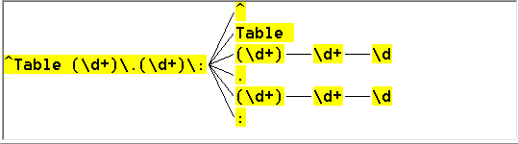
A Demo get Table
^Table (\d+)\.(\d+)\:
begin (^) with Table then space then digits(\d+) then dot (\.) then digits then colon(\:)
like Table 2.1:

Slide 10
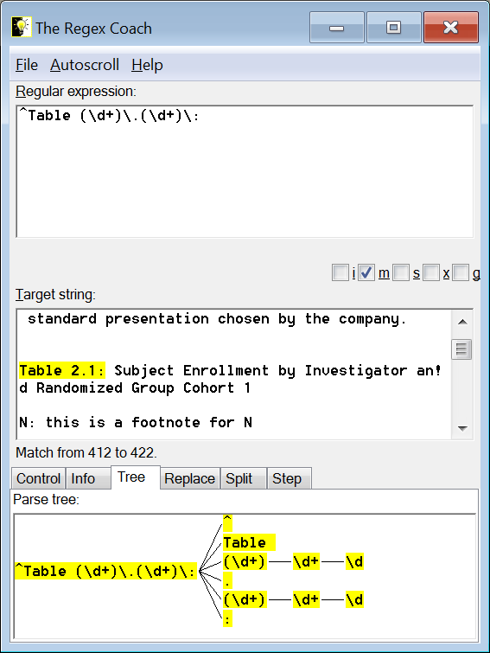
A demo
Regex Coach, a desktop tool:

Slide 11
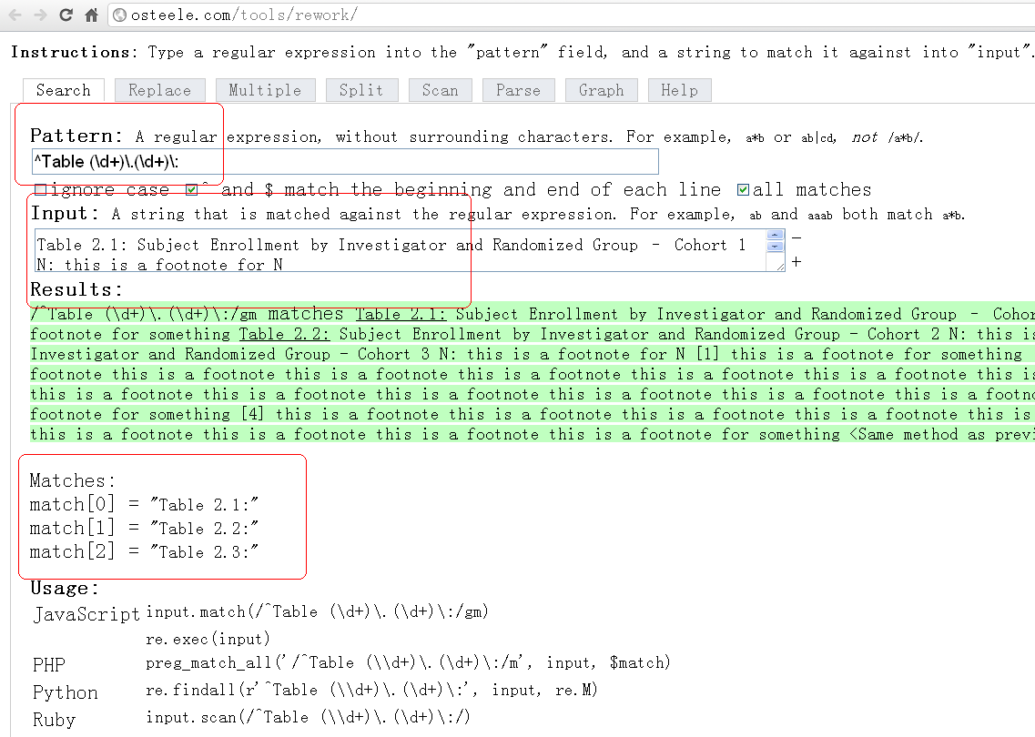
A demo
reWork: online tool

Slide 12
How can get from SAS
A demo
Catogory | Functions | Call routings
Define | PRXPARSE
Locate Patterns (position) | PRXMATCH
Locate Patterns (position and length) | CALL PRXSUBSTR
Locate Patterns (best for exact) | PRXPOSN | CALL PRXPOSN
Locate Patterns | CALL PRXNEXT
Locate Patterns | PRXPAREN
Substitute | PRXCHANGE | CALL PRXCHANGE
Memory | CALL PRXFREE
Debug | CALL PRXDEBUG

Slide 13
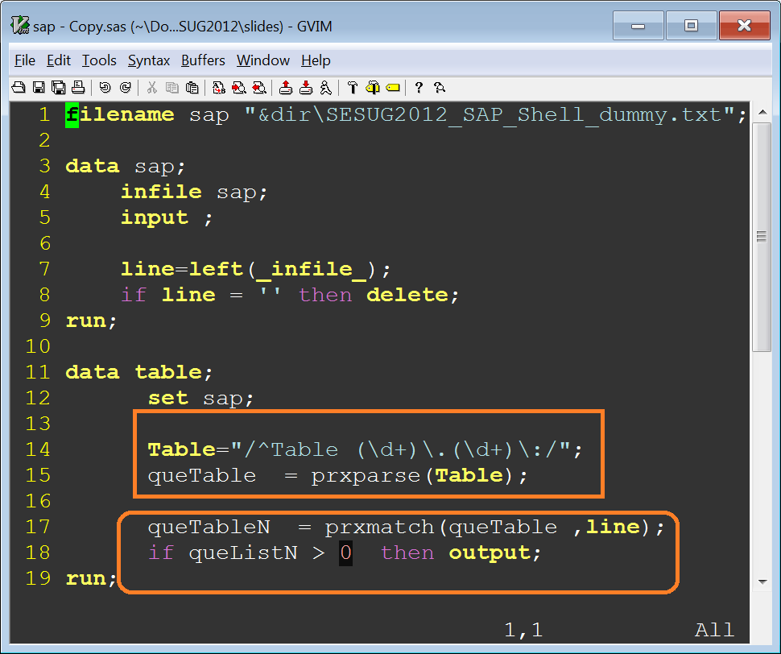
Put it to SAS
Demo codes

Slide 14
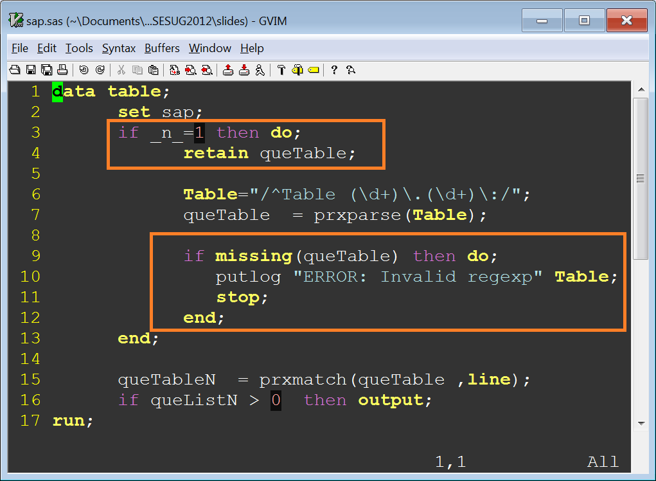
Put it to SAS
Demo codes

Slide 15
Regex with minimum efforts in SAS
scratch the patterns using meta-characters with Regex tools
validate the expression (no modification needed)
locate the patterns (no modification needed)
extract the data needed with an explicit output statement (no modification needed)

Slide 16
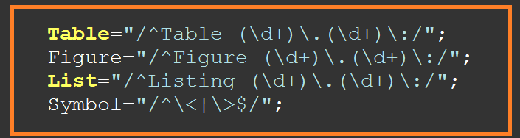
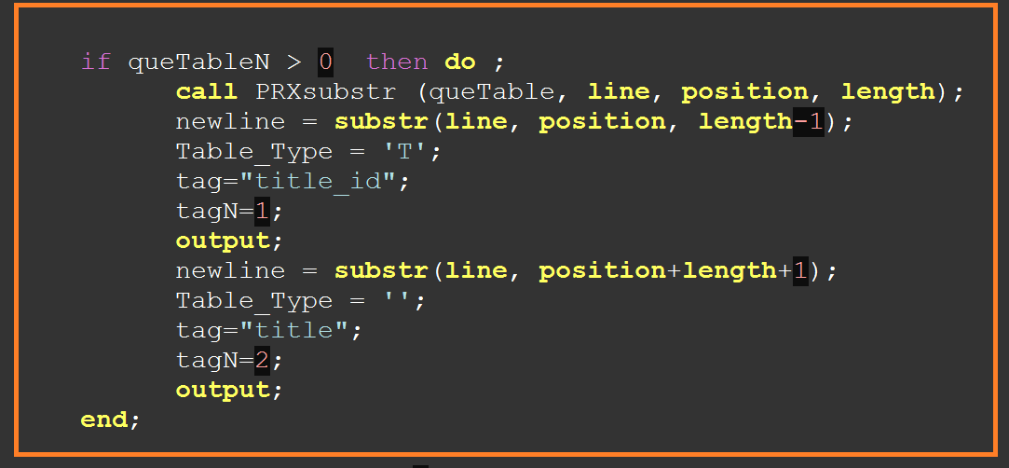
Put it to SAS
Demo codes

Slide 17
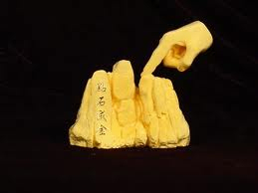
So, the only Question is: How can we get ^Table (\d+)\.(\d+)\:
The Golden Finger instead of the Golden

Slide 18
Regex is the de facto standard tool for text processing; you can get help from the whole world besides SAS
Notes:
SAS Perl Rex

Slide 19
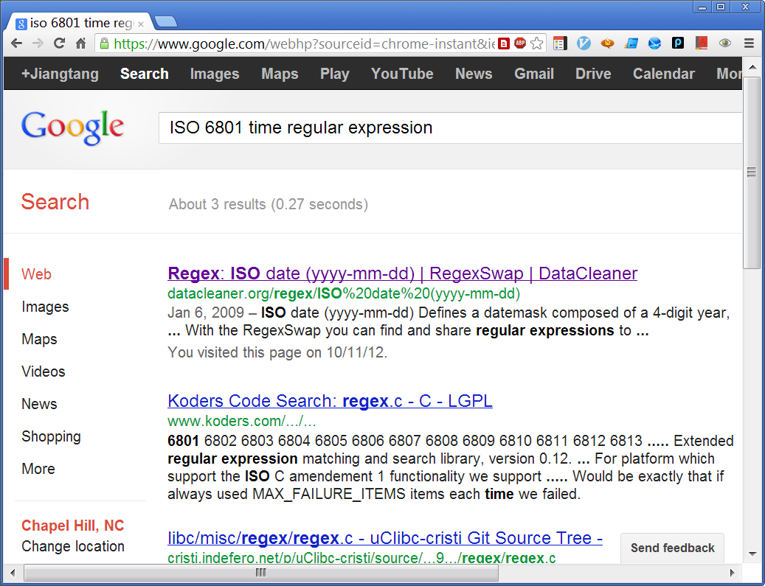
Google

Slide 20
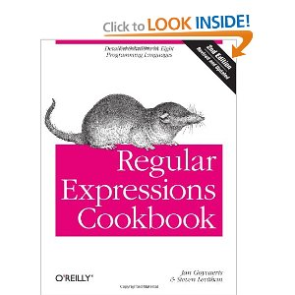

Books

Slide 21
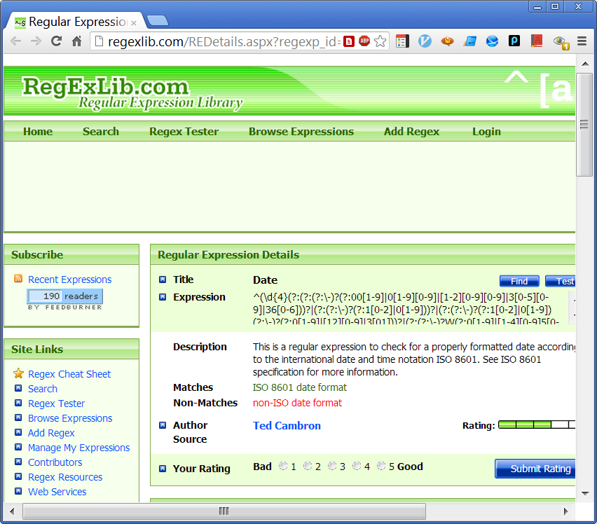
Online Repository

Slide 22
[\w\d!#$%&'*+-/=?^`{|}~]+(\.[\w\d!#$%&'*+-/=?^`{|}~]+)*~]+(\.te[w\d&'*] \\.^*+?\d&'*
Some people, when confronted with a problem, think “I know, I’ll use regular expression.”
Now they have two problems.

Slide 23
Questions?
Contact:
jhu@d-Wise.com
Jiangtanghu.com

