Slide 1

SAS Metadata Querying and Reporting
Using SAS Autocall Macros
Jiangtang(‘JT’) Hu
d-Wise
github.com/Jiangtang/SESUG
@JiangtangHu

Slide 2
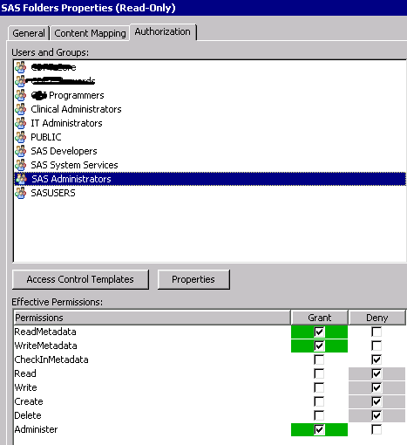
Inputs

Slide 3
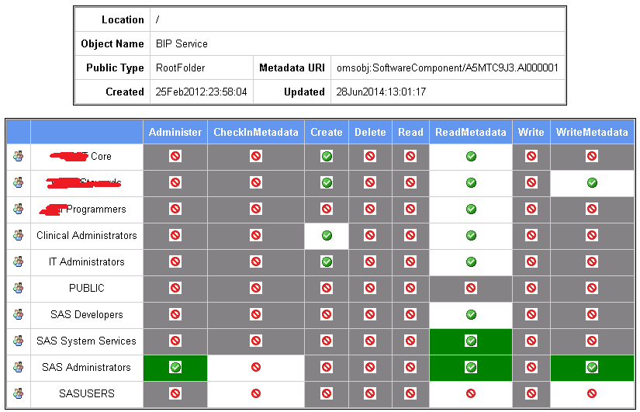
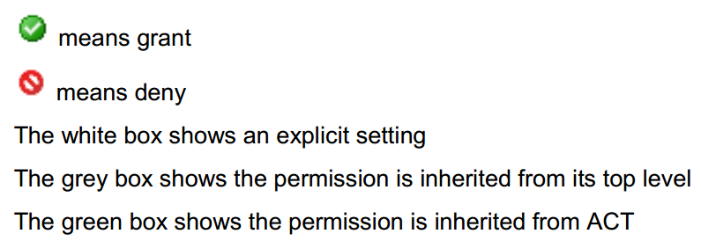
Outputs

Slide 4


Slide 5
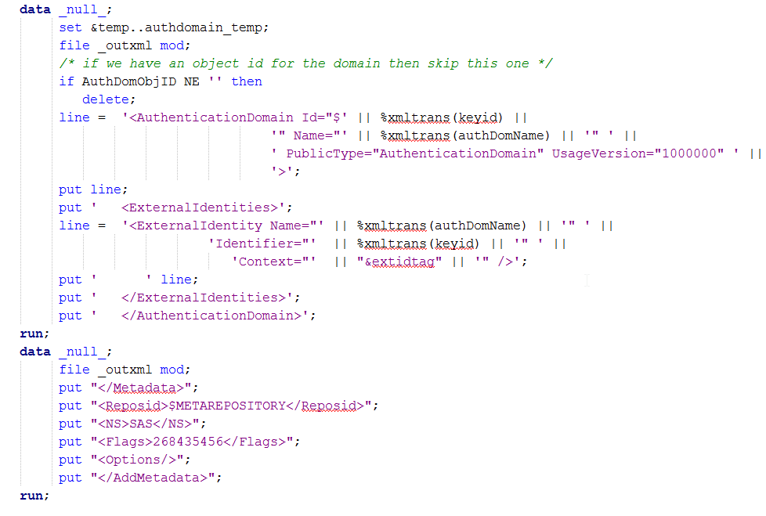
SAS Open Metadata Interface(IOMI )

Slide 6
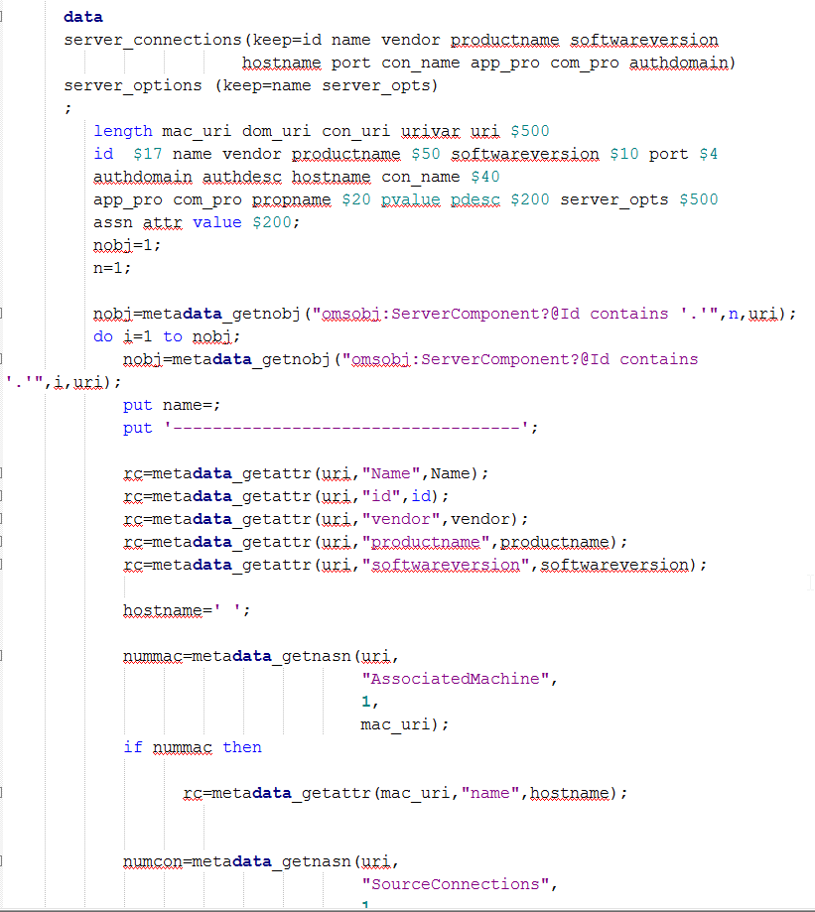
Data step functions

Slide 7

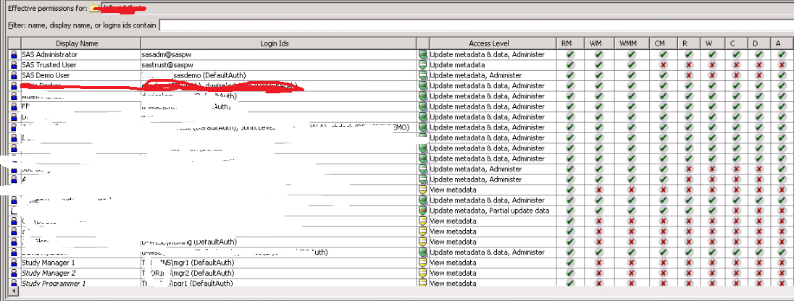

Slide 8
2-Step Approach
*step 1/2: pull the permission data; %mdsecds(folder="/",includesubfolders=YES,membertypes="Folder")
*step 2/2: reporting %secrpt(permdata=mdsecds_join, outfile=“report.html”)

Slide 9

Where to find the programs
How to make them run
How to tweak the codes
Demos

Slide 10
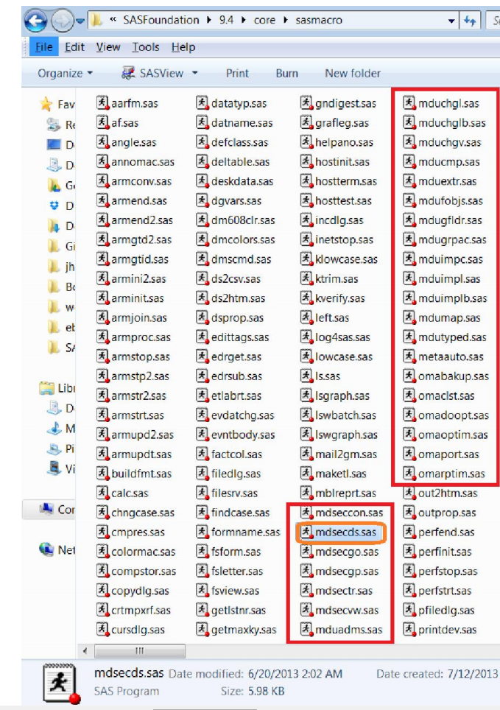
Where

Slide 11
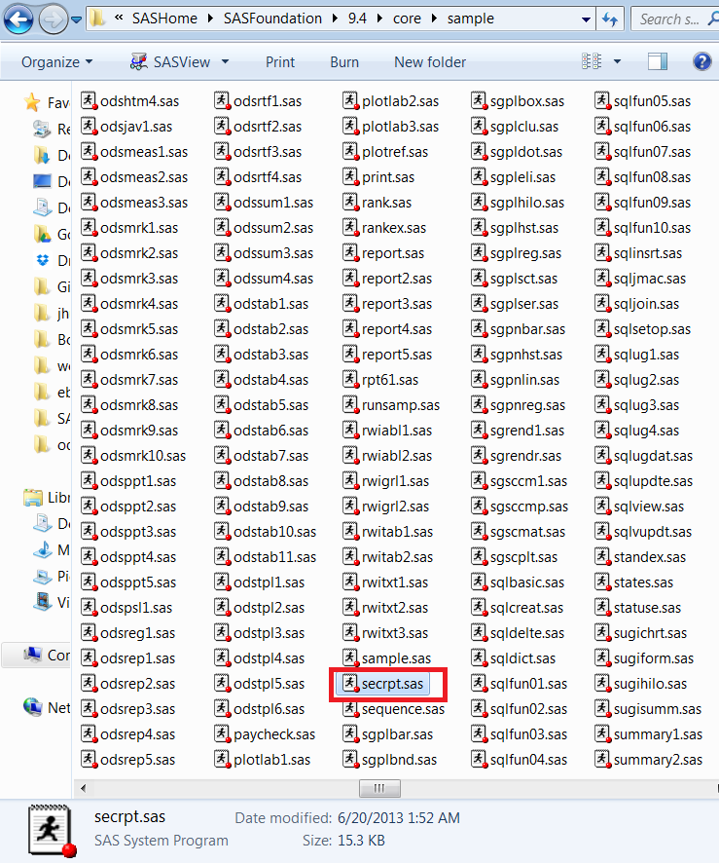
Where

Slide 12
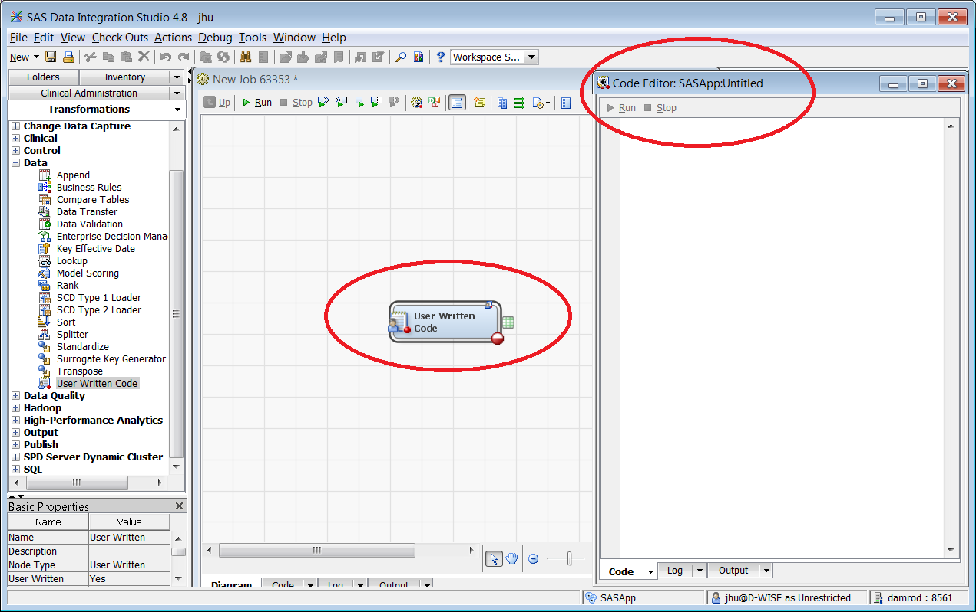
How: SAS Data Integration Studio

Slide 13
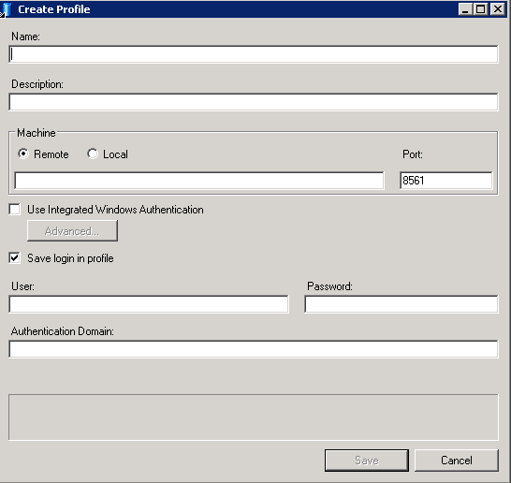
How: SAS Enterprise Guide

Slide 14
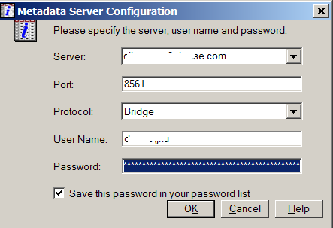
How: SAS Display Manager

Slide 15
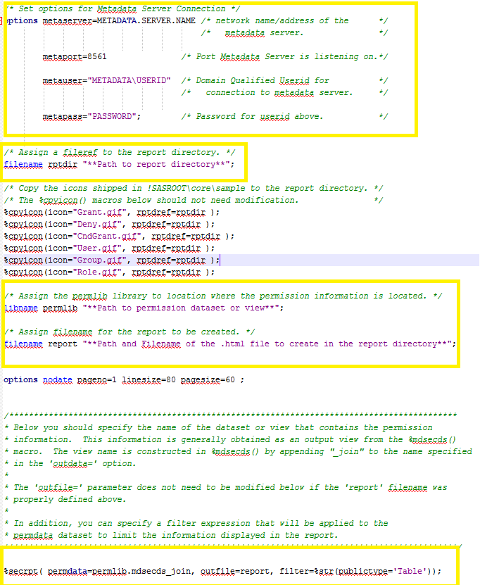
How
%secrpt

Slide 16

*step 1/2: pull the permission data; %mdsecds(folder="/",includesubfolders=YES,membertypes="Folder")
*step 2/2: reporting %secrpt(permdata=mdsecds_join, outfile=“report.html”)

Slide 17


Slide 18


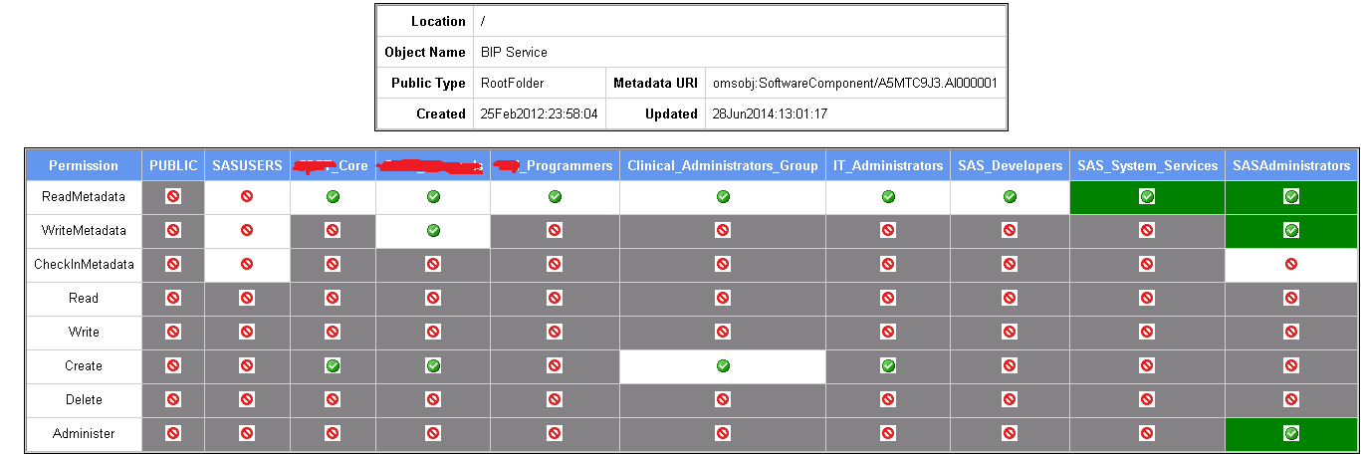
Modify

Slide 19
Additional Demos

Slide 20
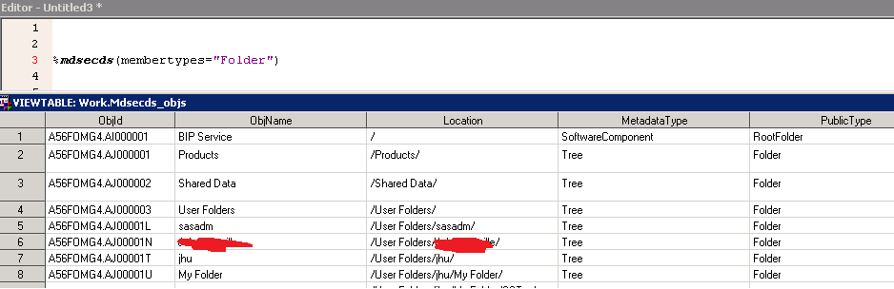
Additional Demos

Slide 21
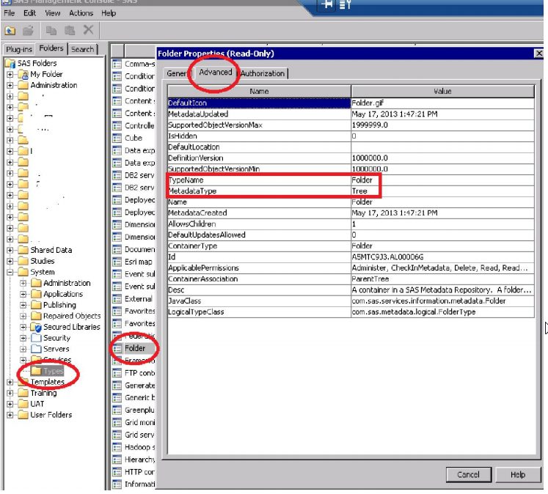
membertypes="Folder")

Slide 22
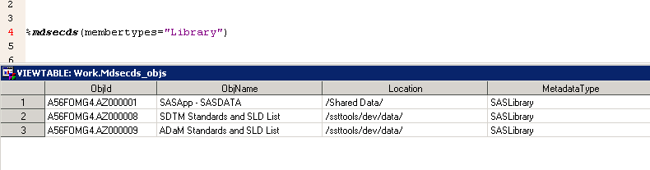
Additional Demos

Slide 23
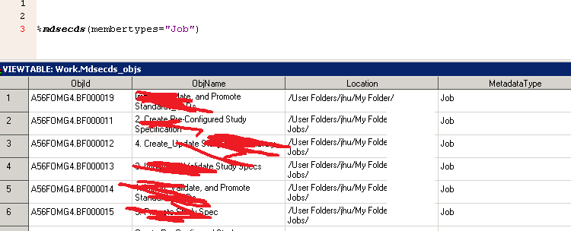
Additional Demos

Slide 24
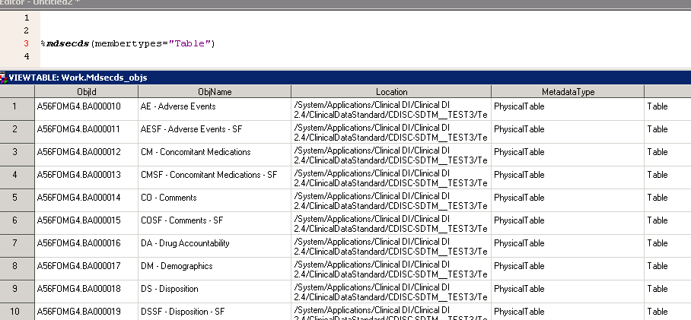
Additional Demos

Slide 25
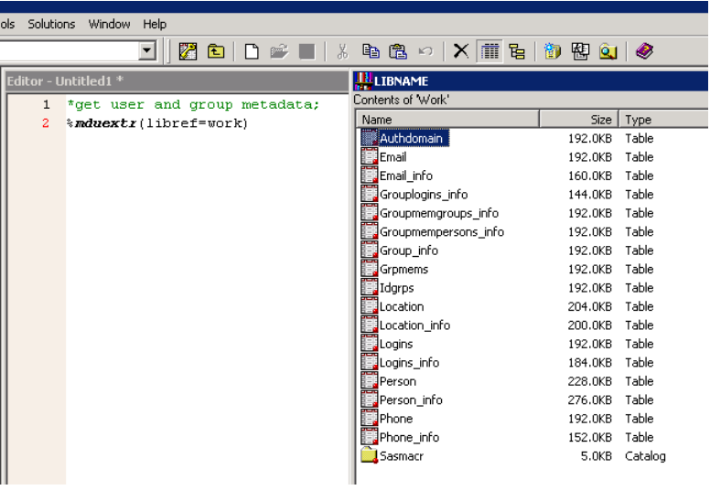
Additional Demos

Slide 26

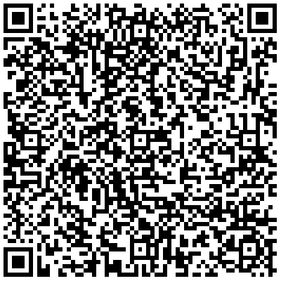
github.com/Jiangtang/SESUG

