Slide 1

Paper AD-133
New Game in Town:
SAS Proc Lua with Applicaitons
Jiangtang(‘JT’) Hu
d-wise
https://github.com/Jiangtang/SESUG

Slide 2




Slide 3

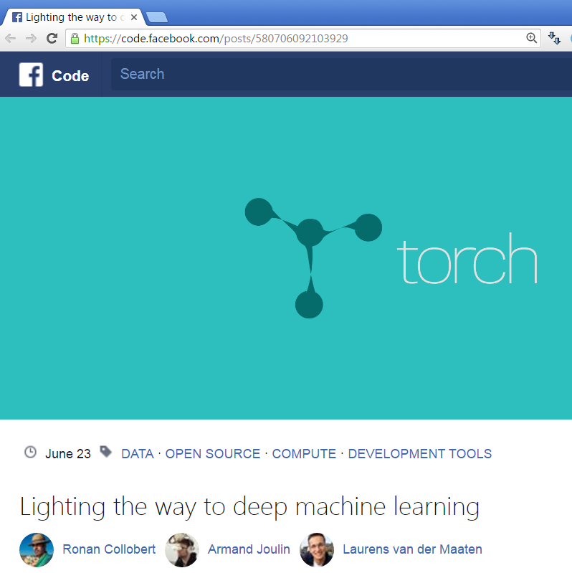

Slide 4

Lua
"Lua" (pronounced LOO-ah) means "Moon" in Portuguese.
designed, implemented, and maintained by PUC-Rio, Brazil
Lua is a powerful, efficient, lightweight, embeddable scripting language.
Available since SAS 9.4 TS1M3 by PROC LUA

Slide 5
Agenda
Lua 101
Applications
  Conditional Programming
  Dynamic Programming
  SAS Option Management
  Reading JSON file
  Machine Learning
  Object-Oriented Programming
Limitations

Slide 6
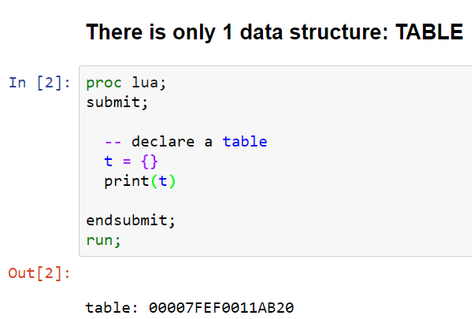
Lua 101

Slide 7
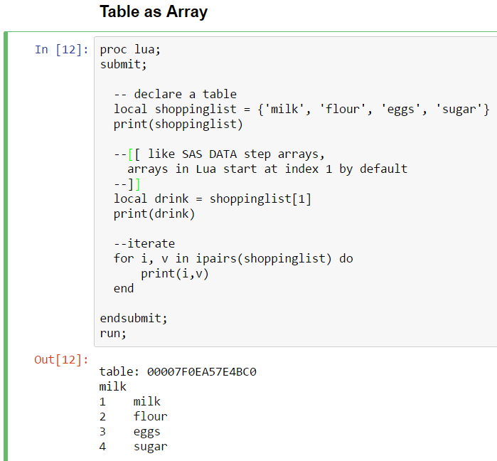

Slide 8
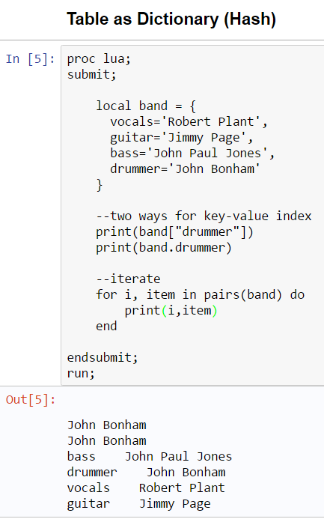

Slide 9
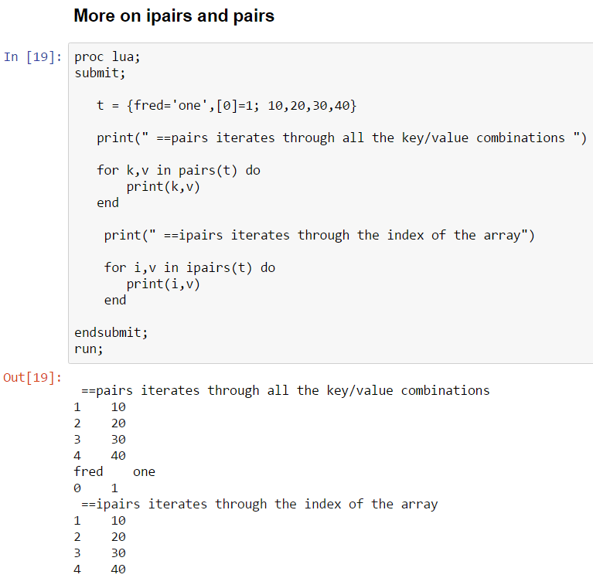

Slide 10
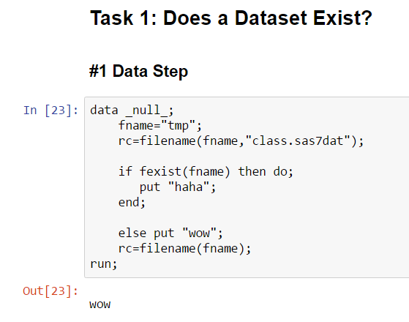
Applications

Slide 11
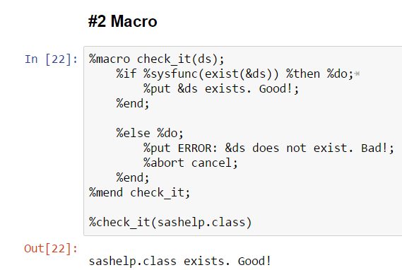

Slide 12
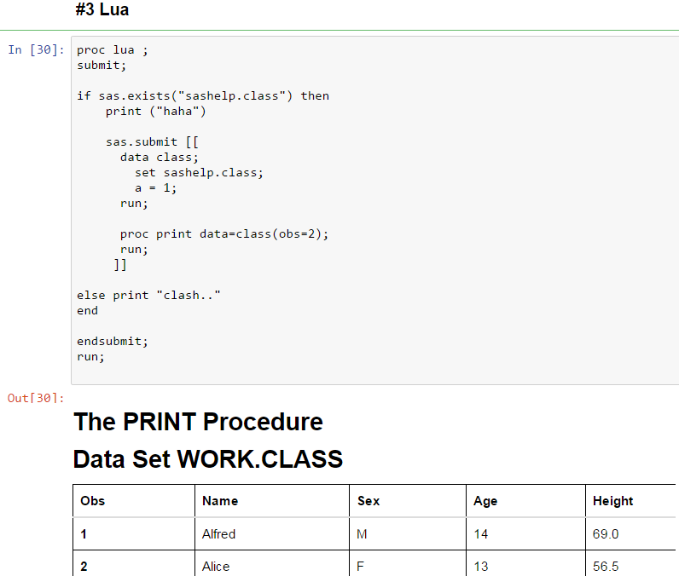

Slide 13


Slide 14
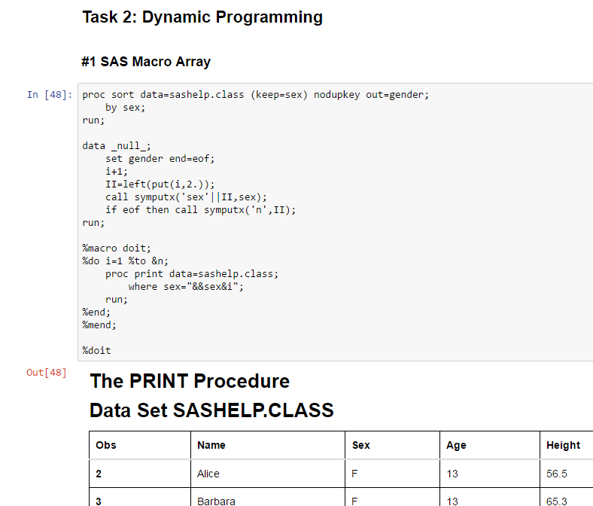

Slide 15
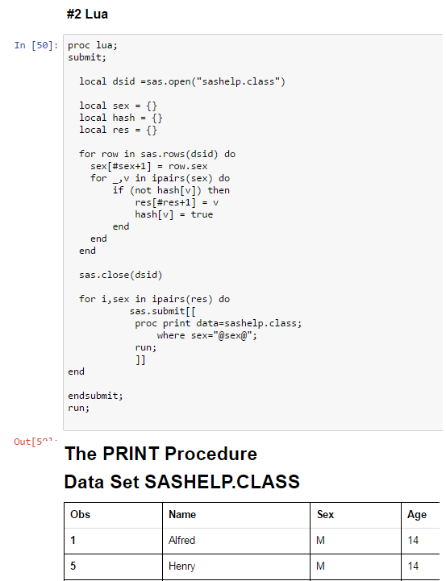

Slide 16
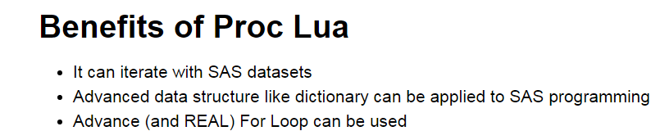

Slide 17
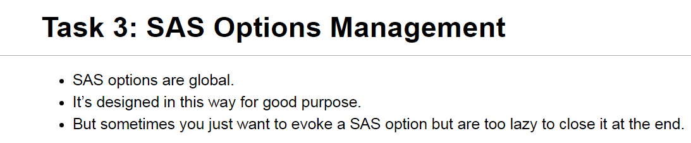

Slide 18
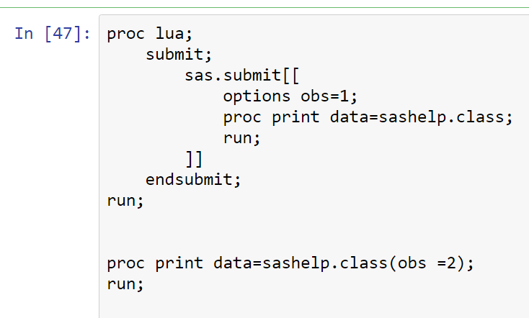

Slide 19
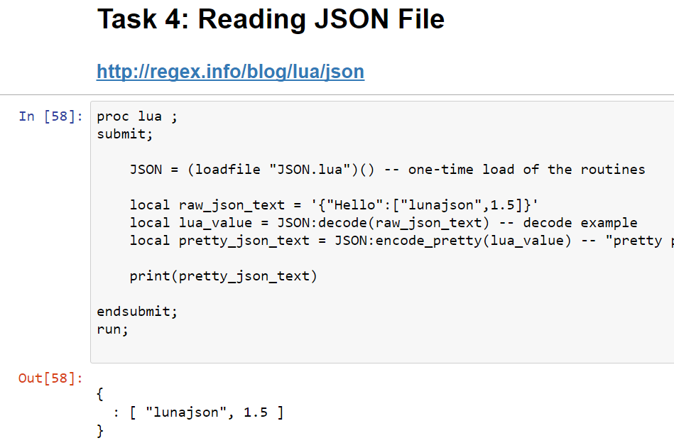

Slide 20
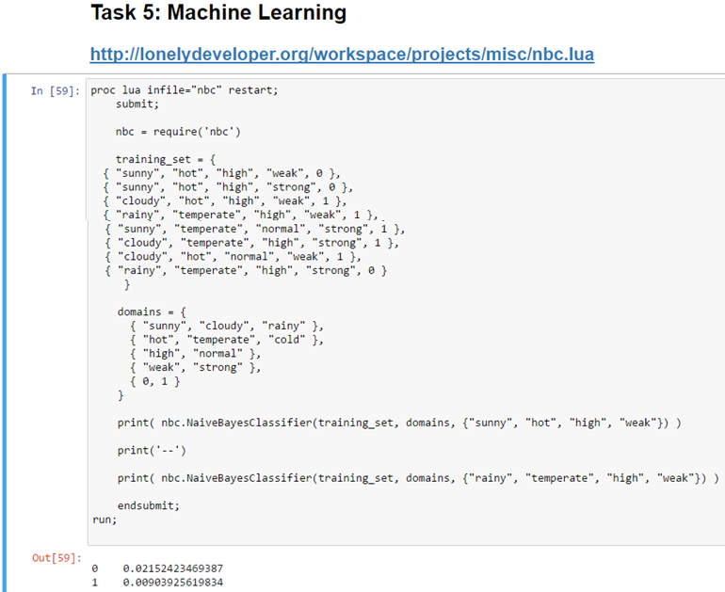

Slide 21
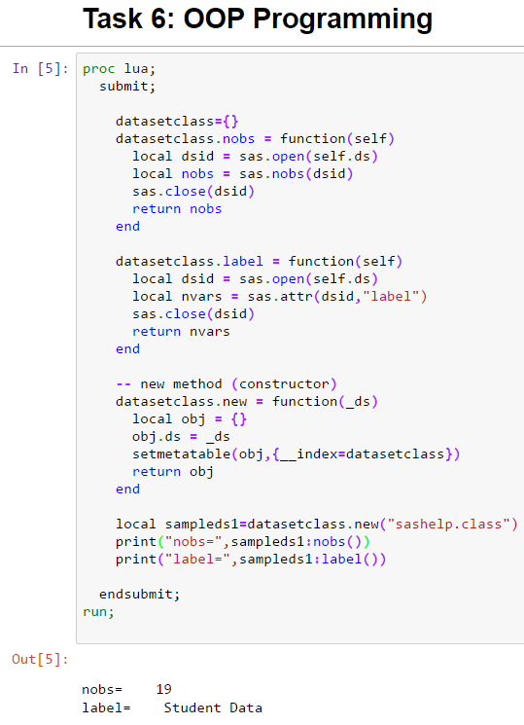

Slide 22
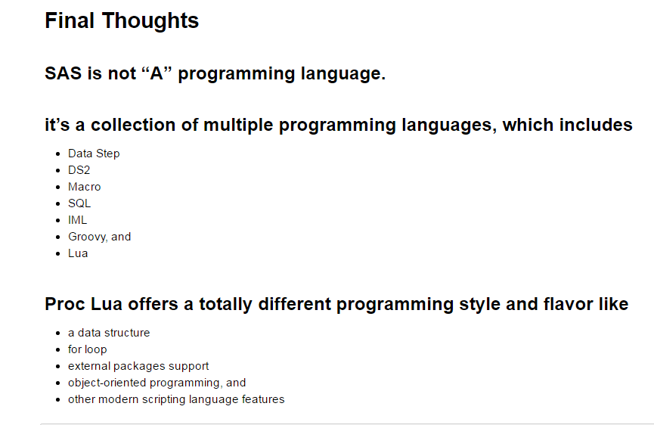

Slide 23
Limitation of Proc Lua
Currently only supporte Lua 5.1
Doesn’t support
  Lua IO module
  Multithreading
Doesn’t port any external libraries
  Can only import external libraries written by pure Lua

Slide 24
Learn More:
https://github.com/Jiangtang/SESUG/
  Notebook, codes, slides
Driving SAS® with Lua by Paul Tomas
http://stackoverflow.com/questions/tagged/lua
Google

