Slide 1

Jiangtang(‘JT’) Hu
d-Wise
https://github.com/Jiangtang/SESUG

Slide 2
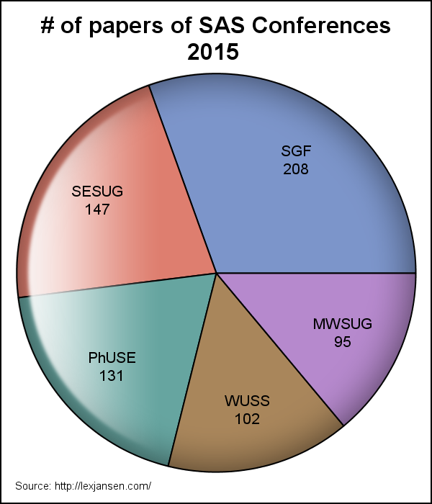
Numbers

Slide 3
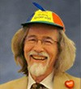

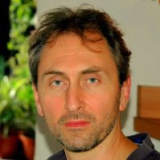

Big Names
Ronald Fehd
Paul Dorfman
Ron Cody
Kirk Paul Lafler

Slide 4
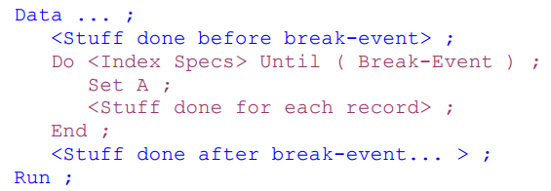
My Picks(1): Programming
Paul M. Dorfman, How to DoW

Slide 5
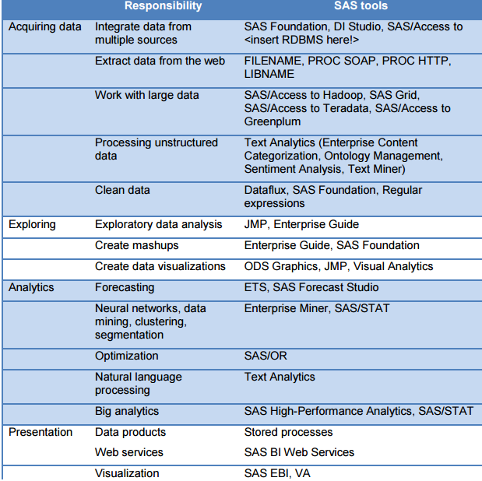
My Picks (2-1): Data Sciences
Charles Kincaid
How to be a Data Scientist Using SAS

Slide 6

My Picks (2-2): Data Sciences
Jiangtang Hu
When Bad Things Happen to Good SAS Programmers

Slide 7
My Picks (3-1): Statistics
John Castelloe, Power and Sample Size Computations

Slide 8
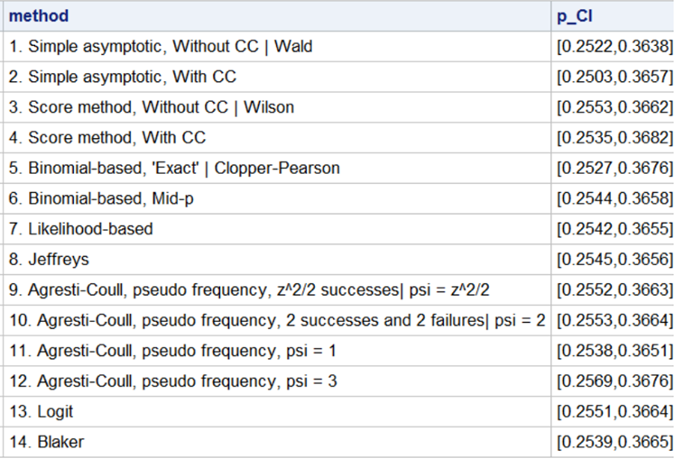
My Picks (3-2): Statistics
Jiangtang Hu
Confidence Intervals for Binomial Proportion Using SAS: The All You Need to Know and No More

Slide 9
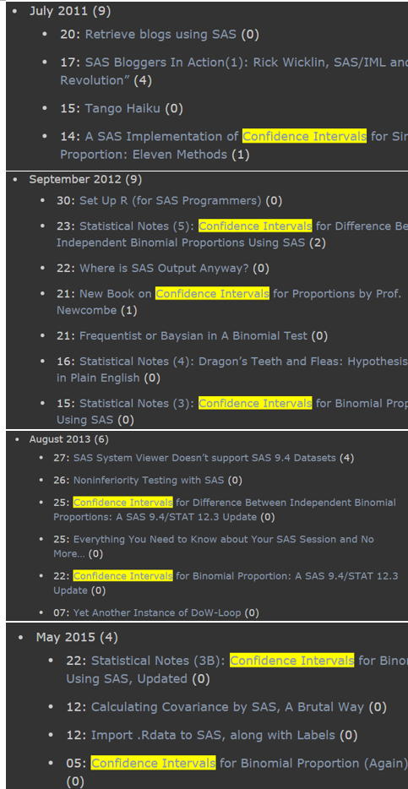
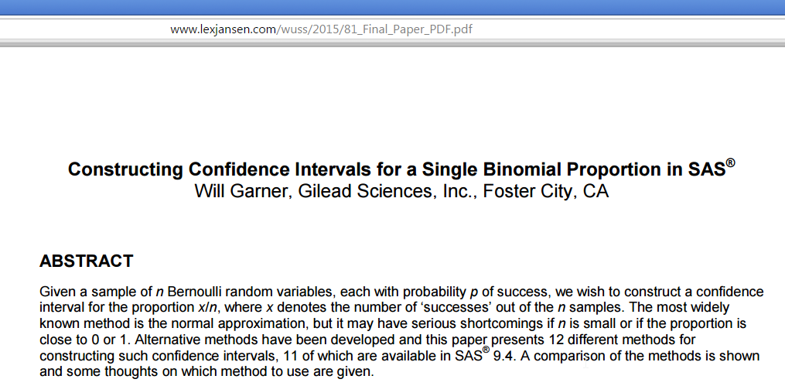
My Picks (3-2): Statistics

