Slide 1
List Processing with SAS: A Comprehensive Survey
Jiangtang(‘JT’) Hu
d-Wise Technologies
https://github.com/Jiangtang/SAS_ListProcessing
@JiangtangHu

Slide 2
From William Shakespeare
To List, or not to List,
That is the question.

Slide 3
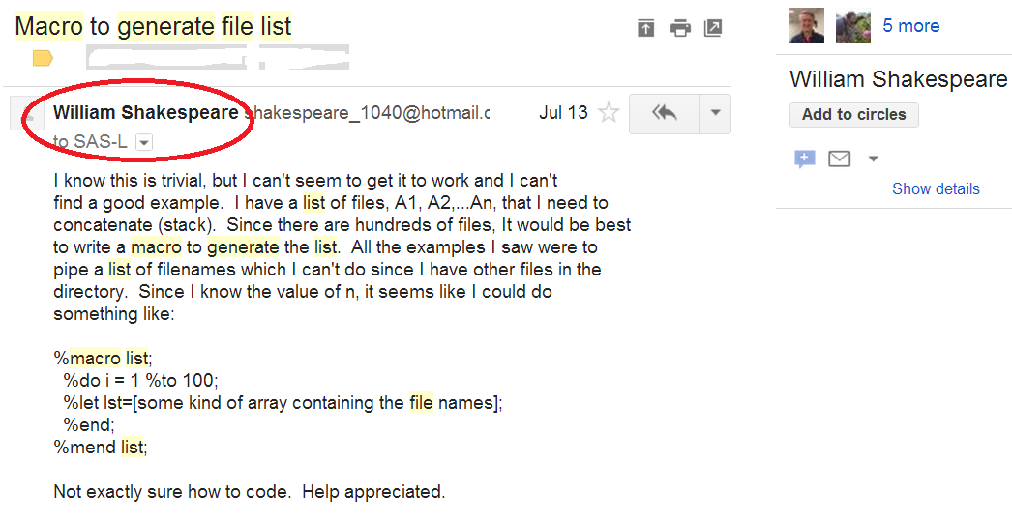
From SAS-L

Slide 4
Agenda
?
A Story
A Collection
Build Your Own

Slide 5
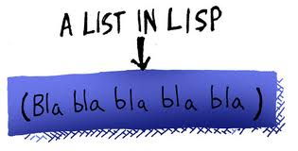
What is a List (1/2): In General Programming Languages
A data structure to hold sequence of values

Slide 6
What is a List (2/2): In SAS
A list is a list is a list is a list…
data combine;
set a1 a2 a3 a4 a5;
run;
%let group=red yellow pink;

Slide 7
A Story: My Question
data combine;
set a1-a3;
run;
proc sql;
create table sqlA as
select *
from a1-a3
;
quit;
data combine;
set a1:;
run;

Slide 8
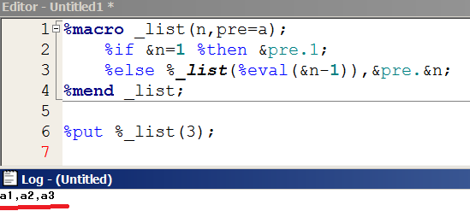
A Story: My Solution (2011)

Slide 9
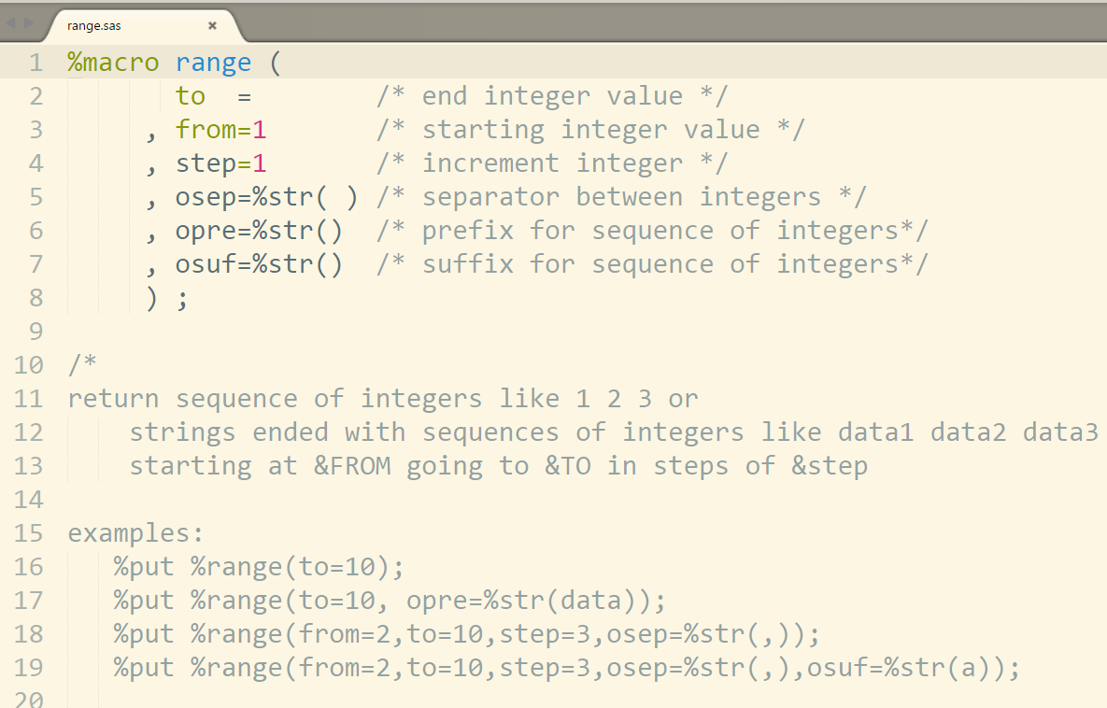
A Story: then I read Ian Whitlock (2007)

Slide 10
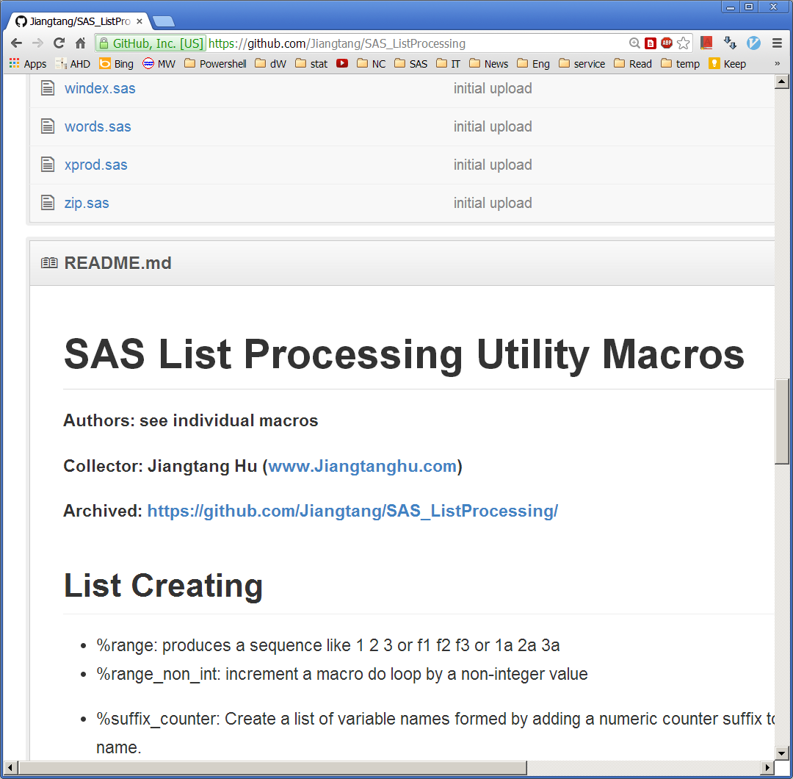
A Collection (1/6): the Host
https://github.com/Jiangtang/SAS_ListProcessing

Slide 11
A Collection (2/6): the Usage
filename list url "https://raw.github.com/Jiangtang/SAS_ListProcessing/master/_ListProcessing";
%inc list;

Slide 12
A Collection (3/6): the Categories
Creating
Formatting
Quoting
Counting
Sorting
Slicing
Zipping
Join
Adding
Appending
Replacing
Renaming
Editing
Dropping
Matching
Reversing
#45

Slide 13
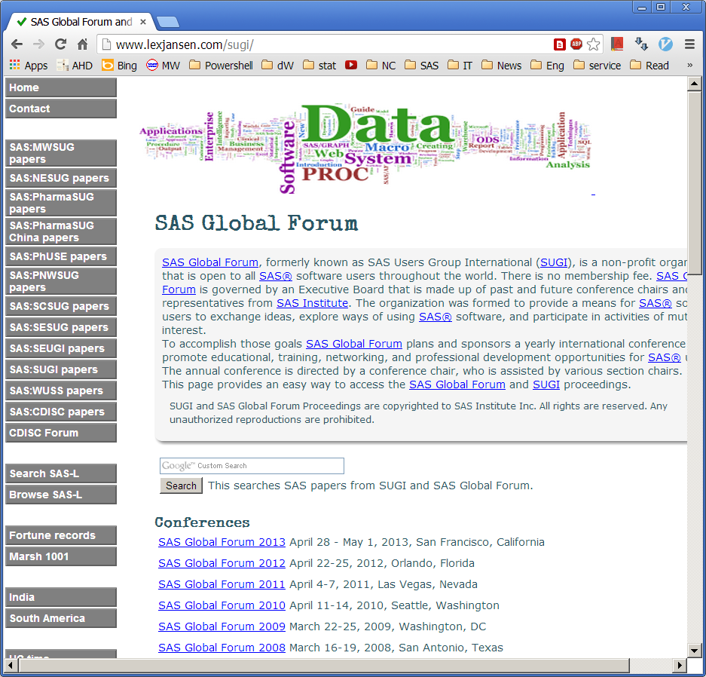
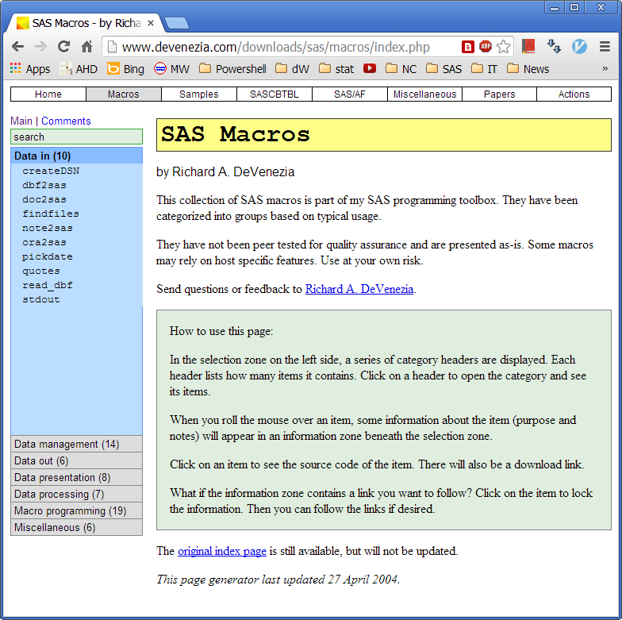
A Collection (4/6): the Source

Slide 14
A Collection (5/6): the Credits
Roland Rashleigh-Berry
Ian Whitlock
Robert J. Morris
Richard A. DeVenezia
Chang Chung
Paul Dorfman
…

Slide 15
A Collection (6/6): the Criterion
Only function-like macros
%let ds= %range(to=3, opre=a);
proc sql;
create table sqlA as
select *
from %range(to=3,opre=a,sosep=%str(,))
;
quit;

Slide 16

Build Your Own
Review the repository of all macros available
Learn the basic program style by existing macros
Have and only have return value in your macros
Be careful for the SAS macro quoting!

Slide 17

Take Home
https://github.com/Jiangtang/SAS_ListProcessing

