Slide 1
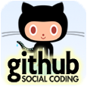
The Hitchhiker’s Guide to Github: SAS Programming Goes Social
Jiangtang(‘JT’) Hu
d-Wise Technologies
https://github.com/Jiangtang
@JiangtangHu

Slide 2

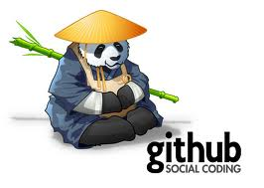

Slide 3

Agenda
What
Who
Why
How

Slide 4
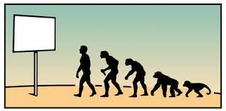
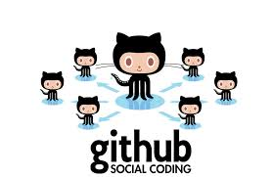
What is Github
 | Version Control System | GUI Clients | Mobile Apps | Website
Github | Git | Github for Windows/Mac | Github for iOS, Android | https://github.com/Jiangtang
 | CVS | TortoiseCVS
 | SVN | TortoiseSVN
Notes:
Report01_20130902_Tom_DONOT_DELETE.sas
CVS: Concurrent Versions System
SVN: Subversion
Git
Github:
A web-based hosting services, for
Software development, using
Git reversion control system
Distributed vs Centralized : clone, checkout

Slide 5


Why Version Control

Slide 6
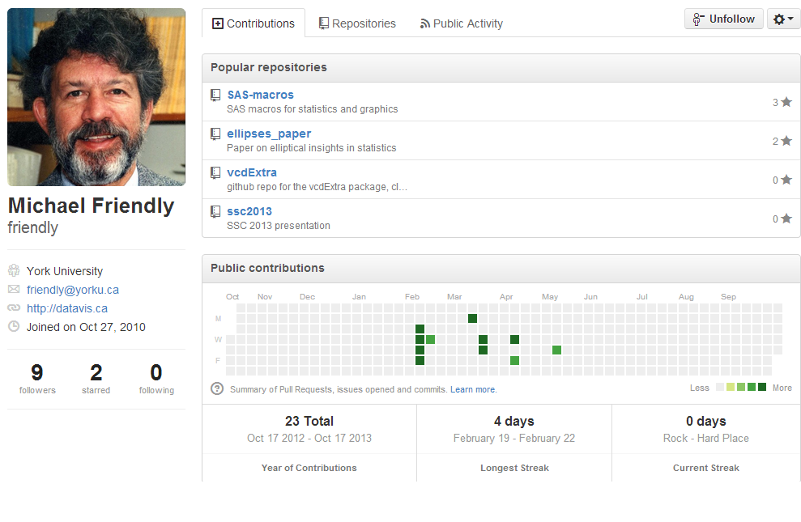
SAS Programmers in Github (1/4)

Slide 7
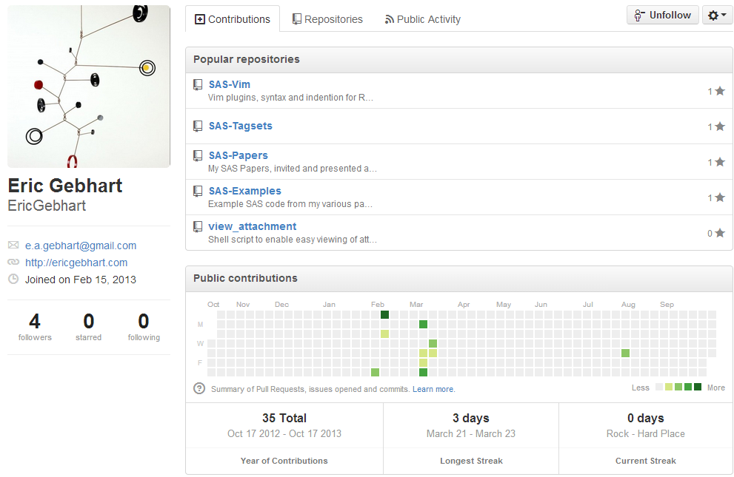
SAS Programmers in Github (2/4)

Slide 8
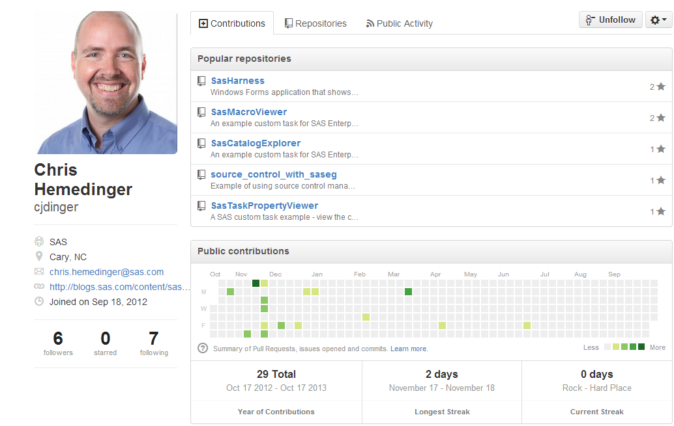
SAS Programmers in Github (3/4)

Slide 9
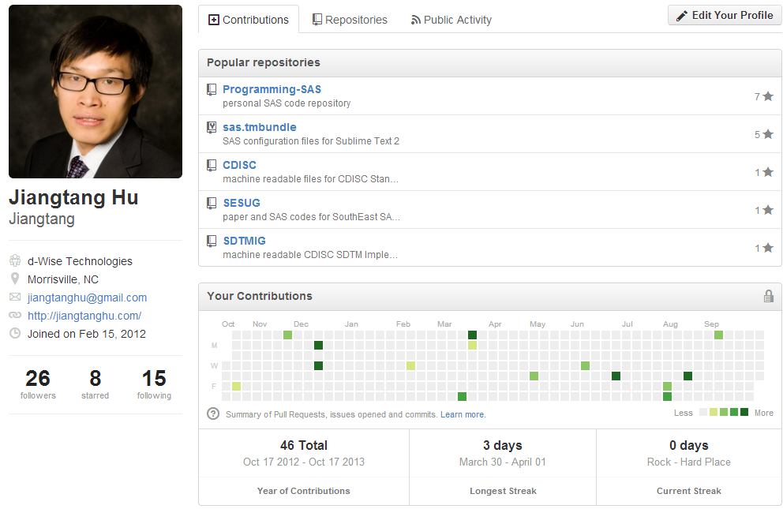
SAS Programmers in Github (4/4)

Slide 10
Why Github (1/3)
It’s based on Git
You don’t need to know Git
Huge community
Cool

Slide 11
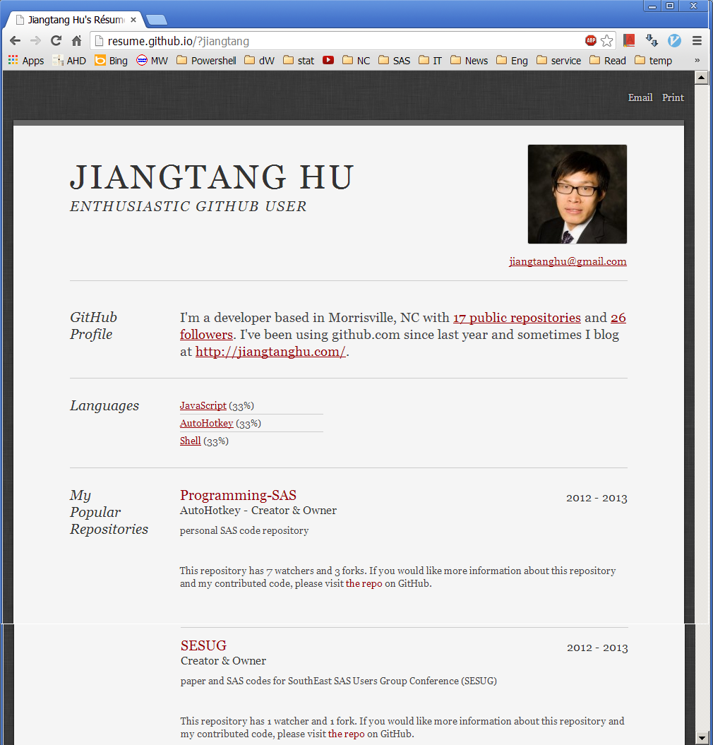
Why Github (2/3): Help you to find a Job!

Slide 12
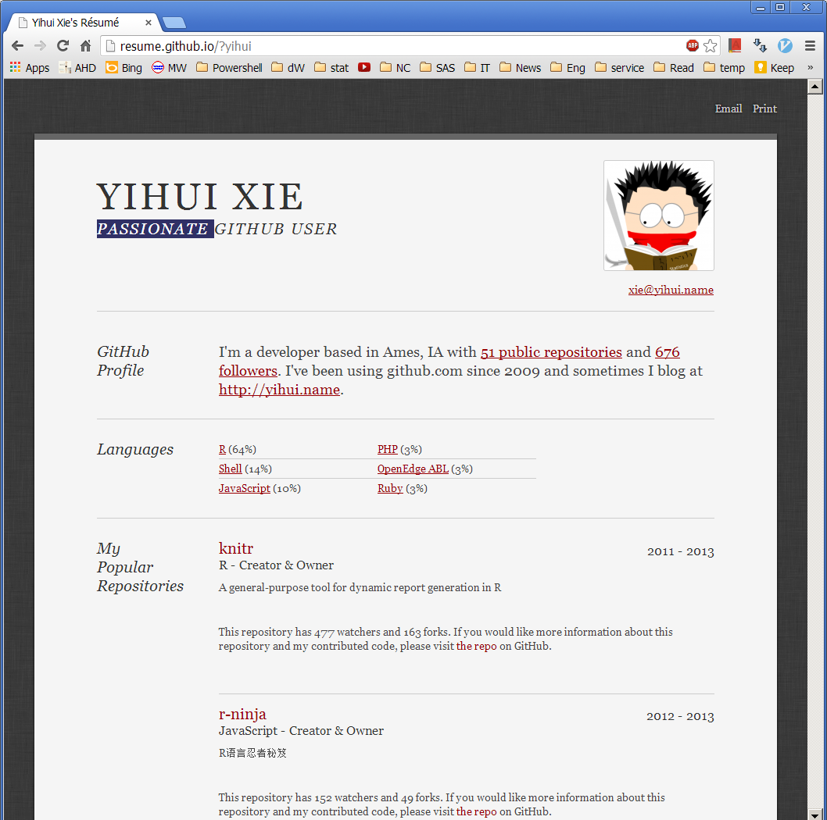
Why Github (3/3) : Help you to find a Job!

Slide 13
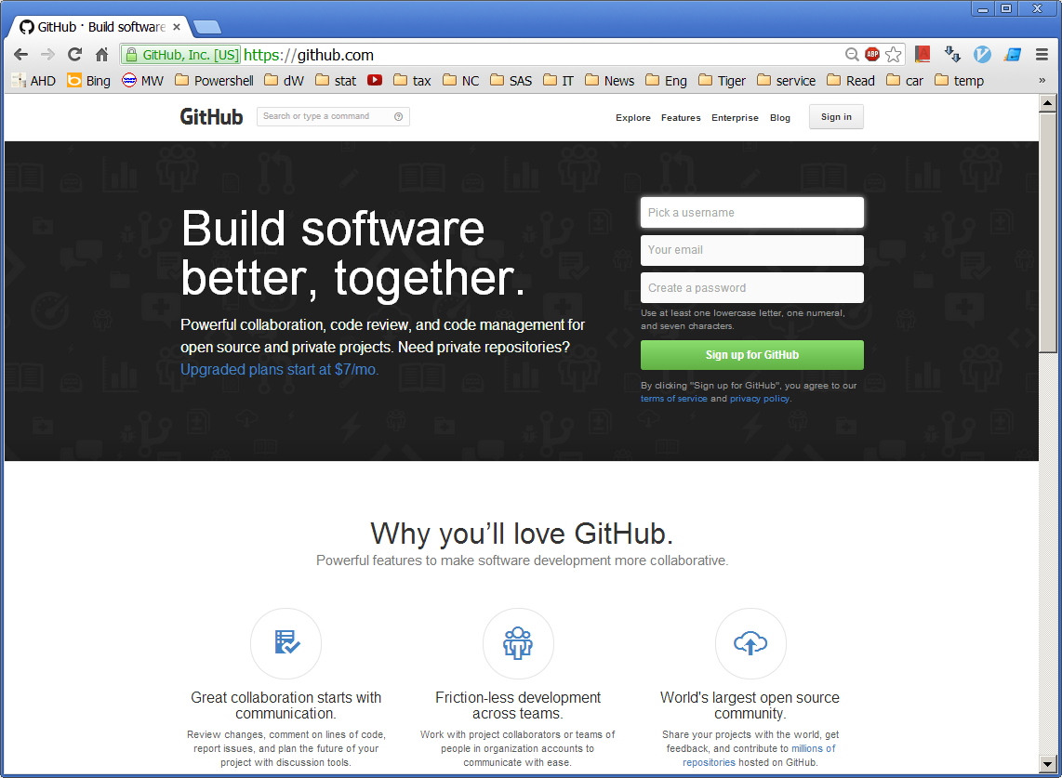
Get Started (1/2): Create an Account

Slide 14
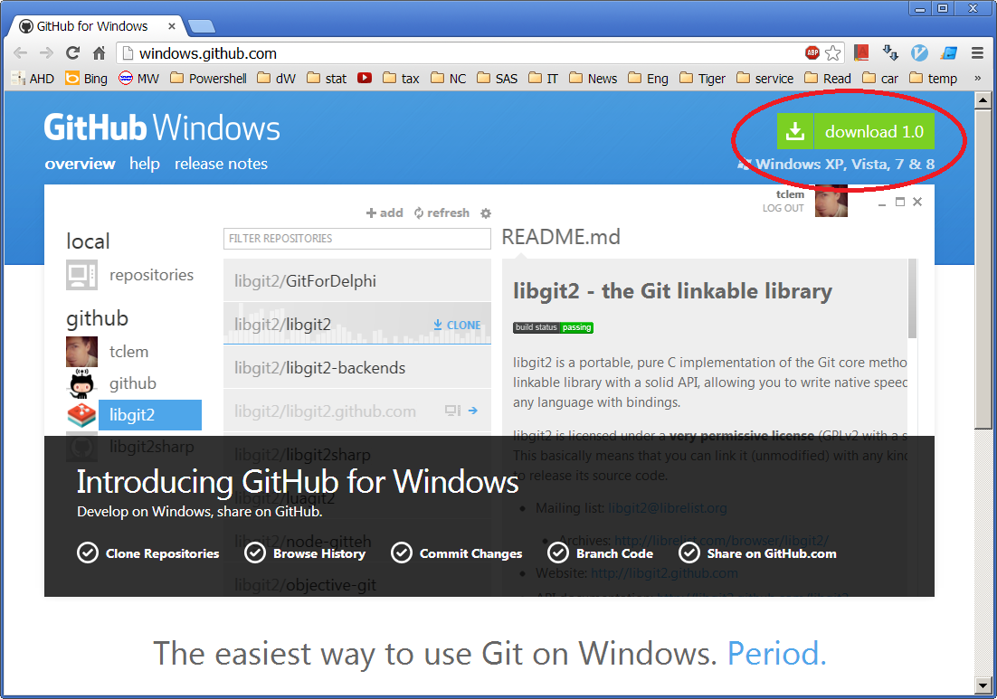
Get Started (2/2): Download the Client

Slide 15
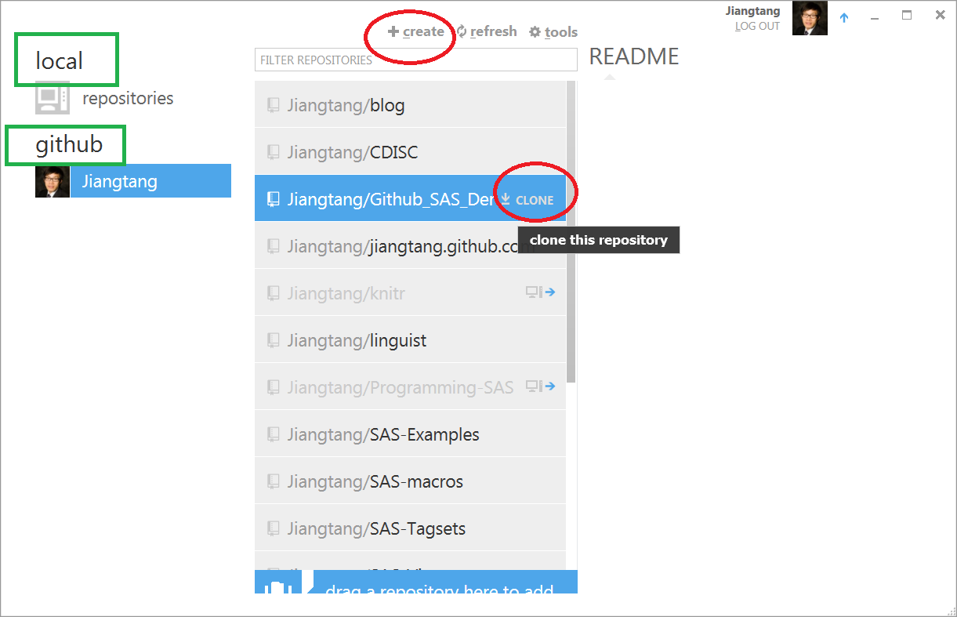
Just Play Around (1/3): Create or Clone Repositories

Slide 16
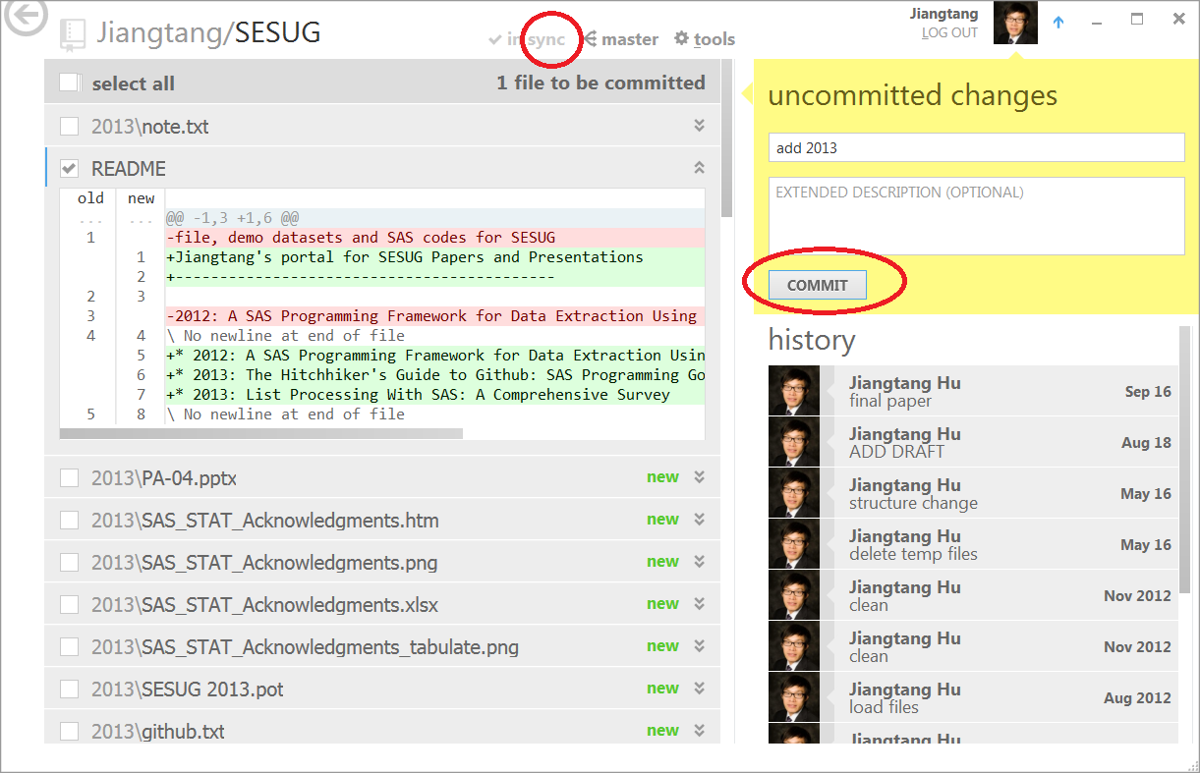
Just Play Around (2/3): Commit and Sync

Slide 17
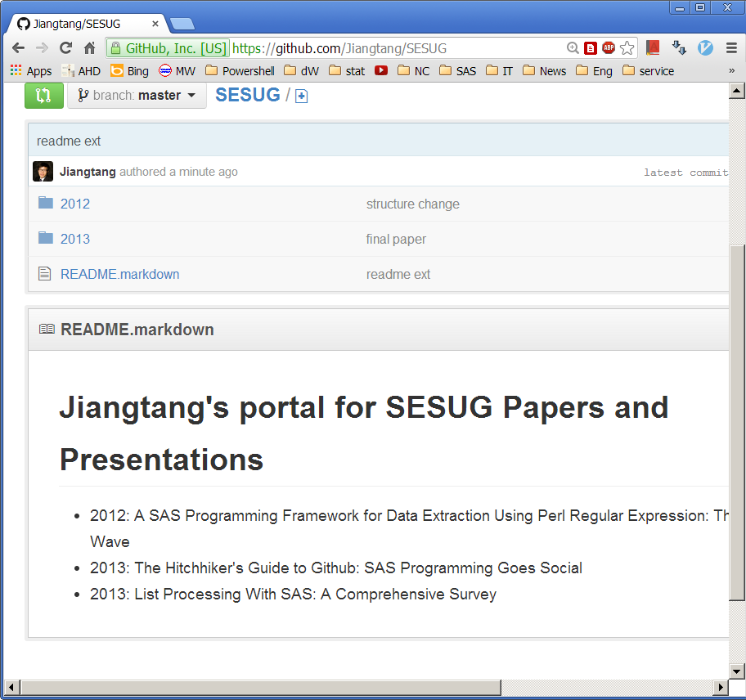
Just Play Around (3/3): Check Online!

Slide 18
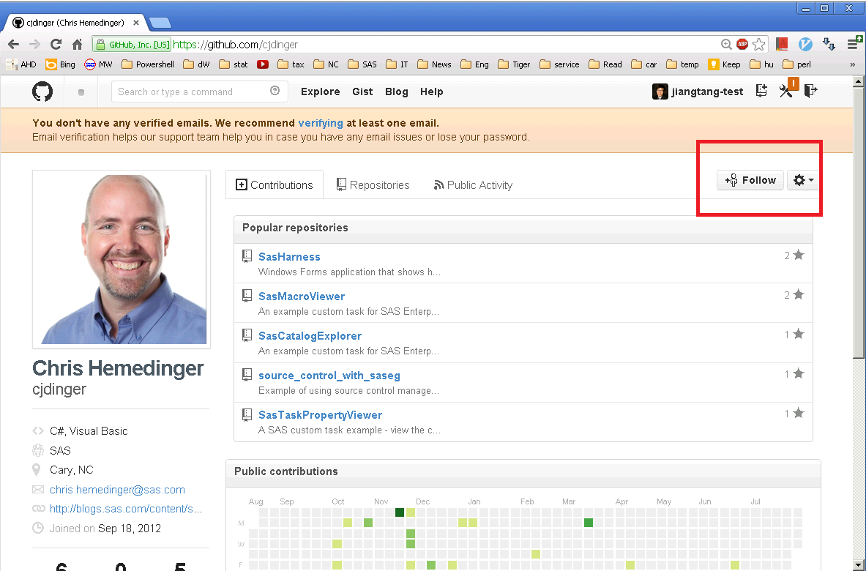
Be Social (1/5): Follow a User

Slide 19
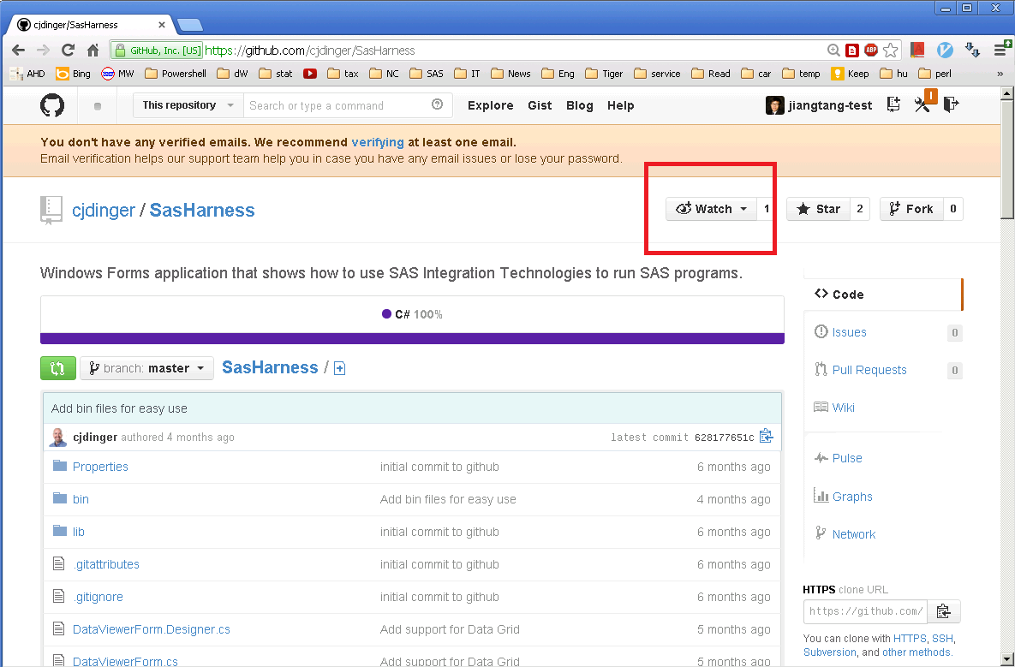
Be Social (2/5): Watch A Repository

Slide 20
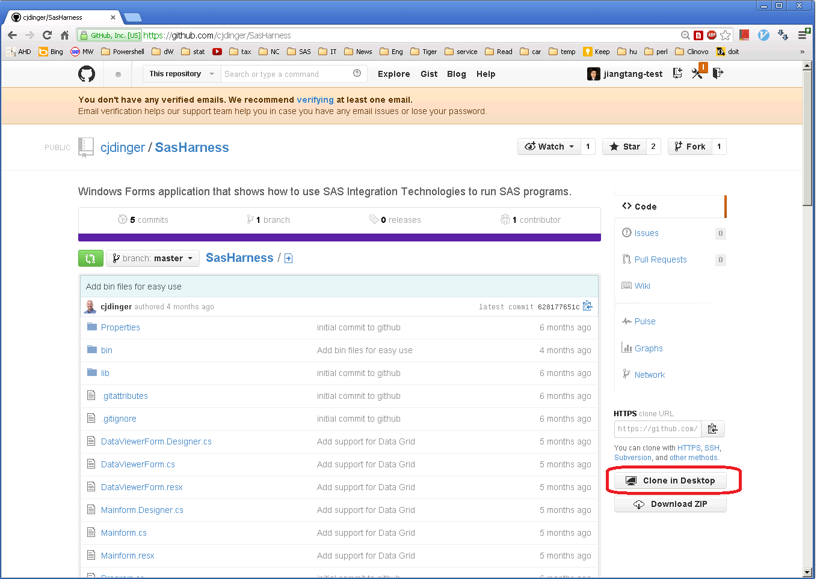
Be Social (3/5): Clone A Repository

Slide 21
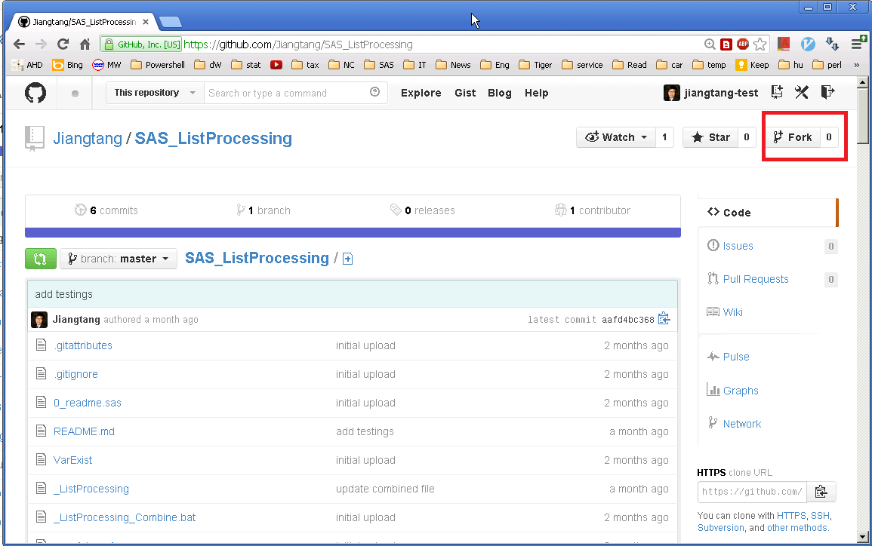
Be Social (4/5): Fork A Repository

Slide 22
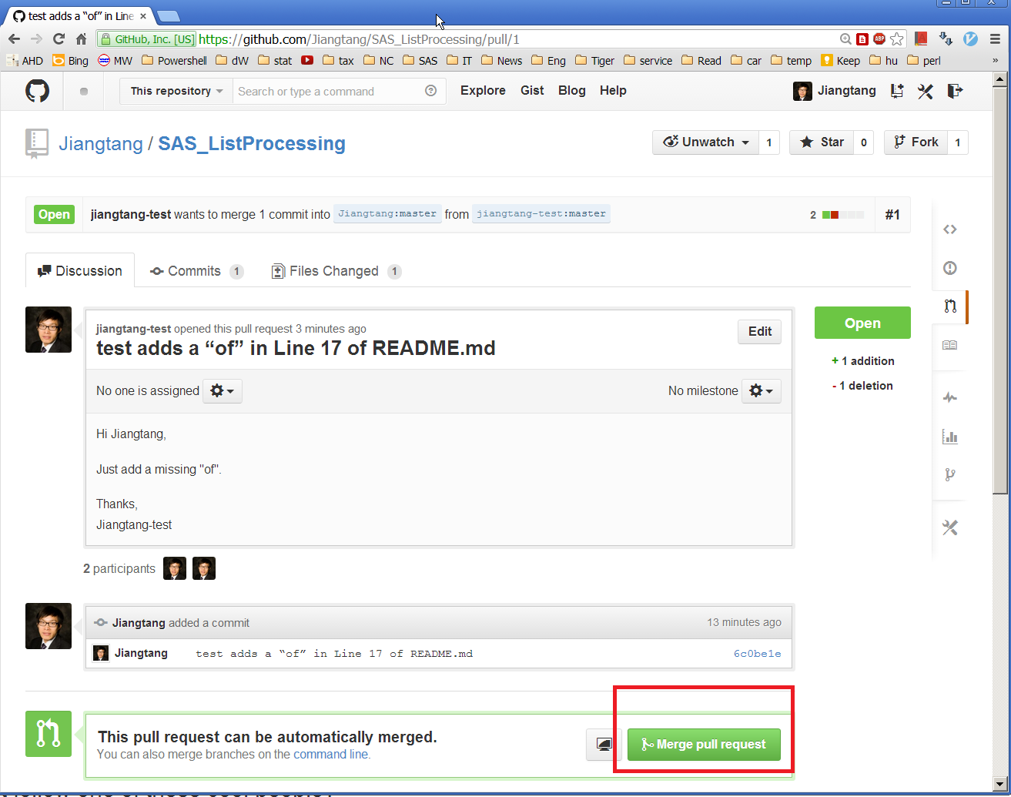
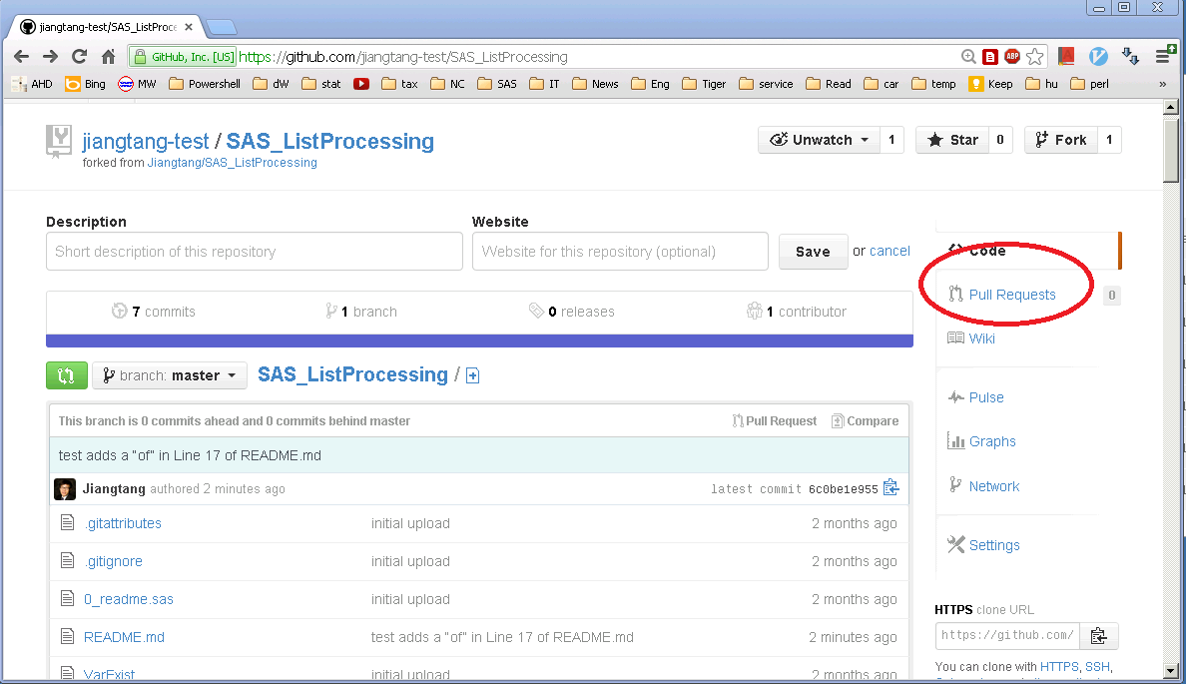
Be Social (5/5): Pull a Request

Slide 23

Take Home
https://github.com/Jiangtang

