Slide 1

When Bad Things Happen to Good SAS® Programmers
Jiangtang(‘JT’) Hu
d-Wise
https://github.com/Jiangtang/SESUG

Slide 2
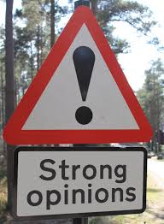
Disclaimer

Slide 3
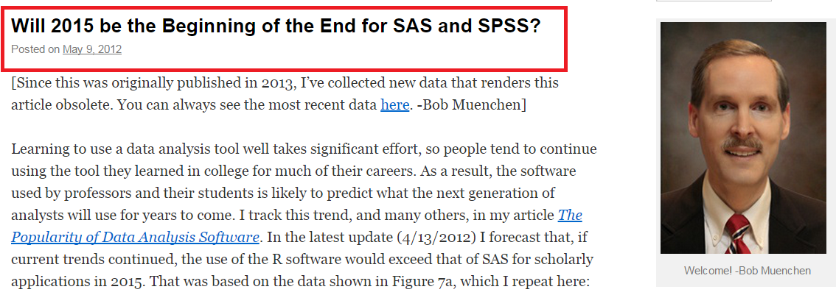
The Question

Slide 4
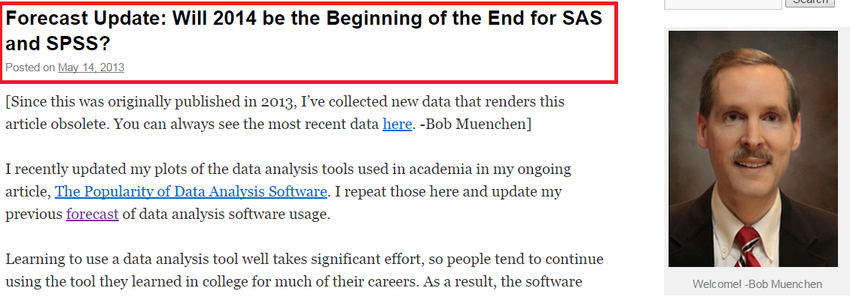
The Question

Slide 5
Agenda
The challenges
How
Next

Slide 6



Internal Challenges: IT
Your favorite text editors were not installed/available in the new computing system

Slide 7

Internal Challenges: IT
Ask IT
Green version
Explore advance editing features in SAS
Display Manager even can do Column selection, parentheses matching, etc
Enterprise Guide is a better IDE

Slide 8


Internal Challenges: IT
You can’t use the traditional SAS Display Manager anymore to write, interactively debug your SAS codes and check temporary output datasets
The new and only interface to write SAS codes is now SAS Enterprise Guide, or SAS Studio

Slide 9
Internal Challenges: IT
Change…
Enterprise Guide is a better IDE
SAS Studio also has some advantages
Pain…
customized configurations

Slide 10
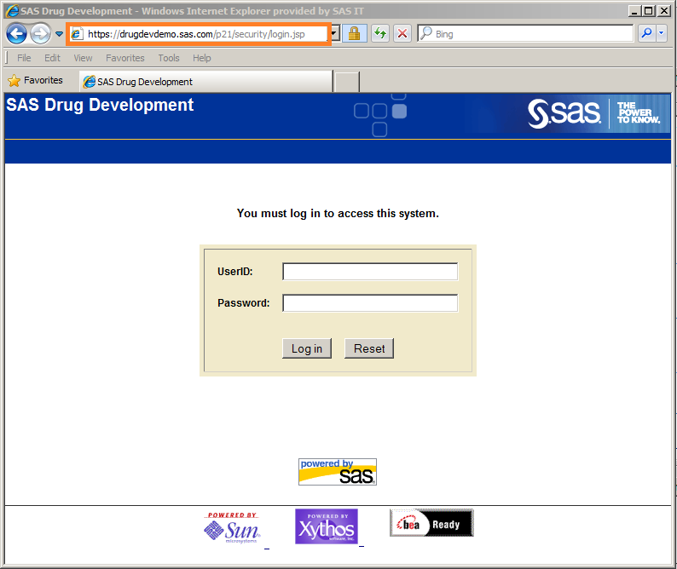
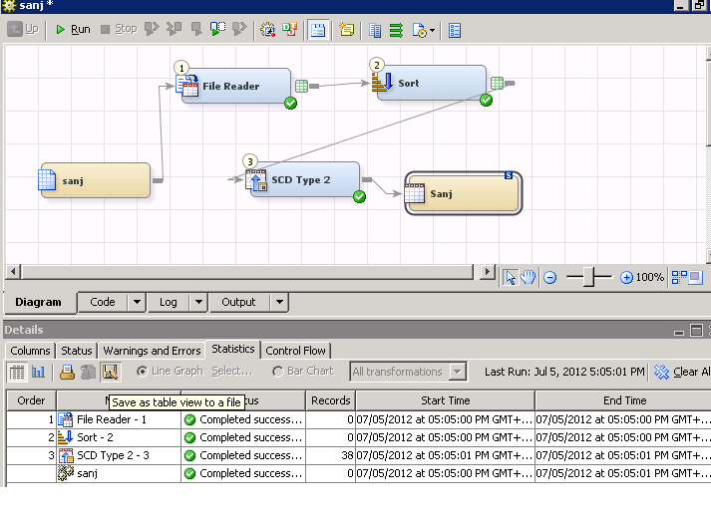
Internal Challenges: IT
the only SAS editor available for you to complete your SAS job is SAS Drug Development, or SAS Data Integration Studio

Slide 11
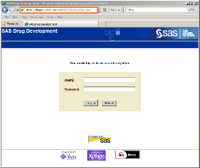
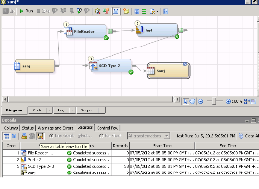
Internal Challenges: IT
This is real BAD…
What we can do
Utilize your local favorite text editors or even SAS editors
Modularize your codes/jobs

Slide 12
Internal Challenges: Outsourcing
if you can’t get it here,
you can get it somewhere

Slide 13
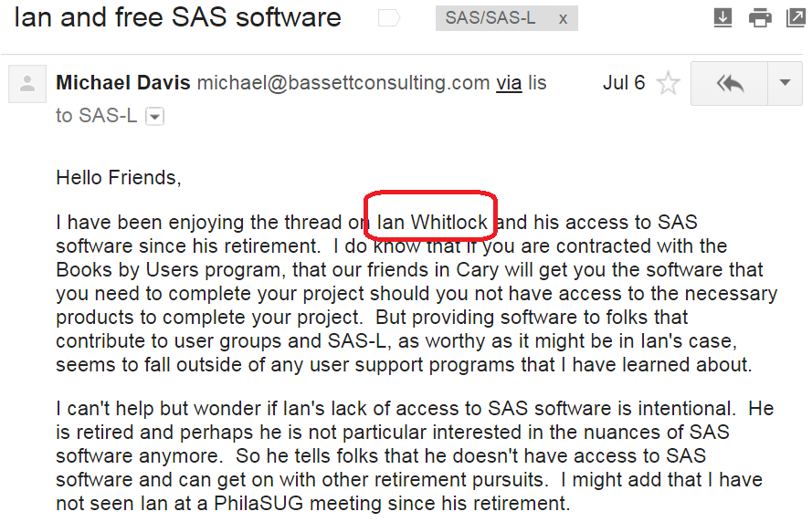
External Challenges: SAS
SAS is a proprietary software

Slide 14

External Challenges: SAS

Slide 15
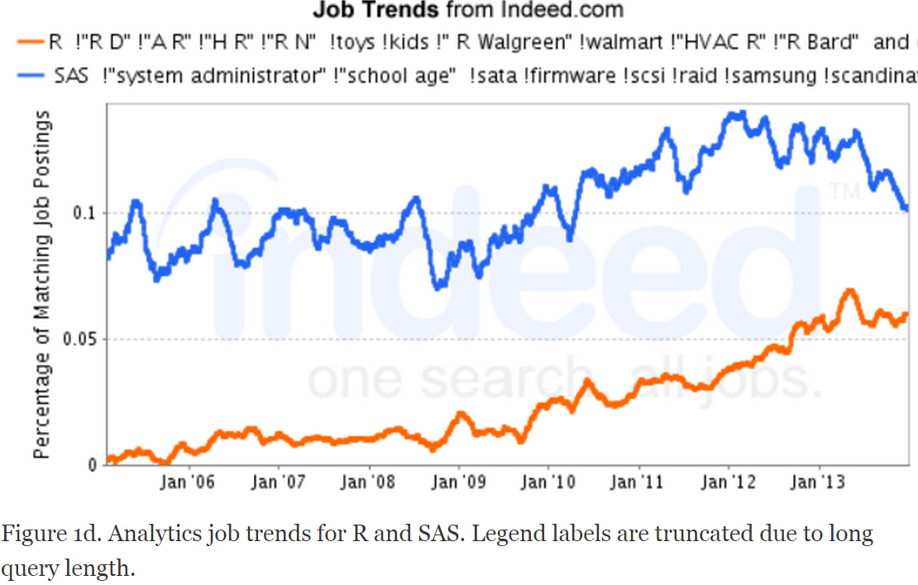
External Challenges: R

Slide 16


External Challenges: R

Slide 17
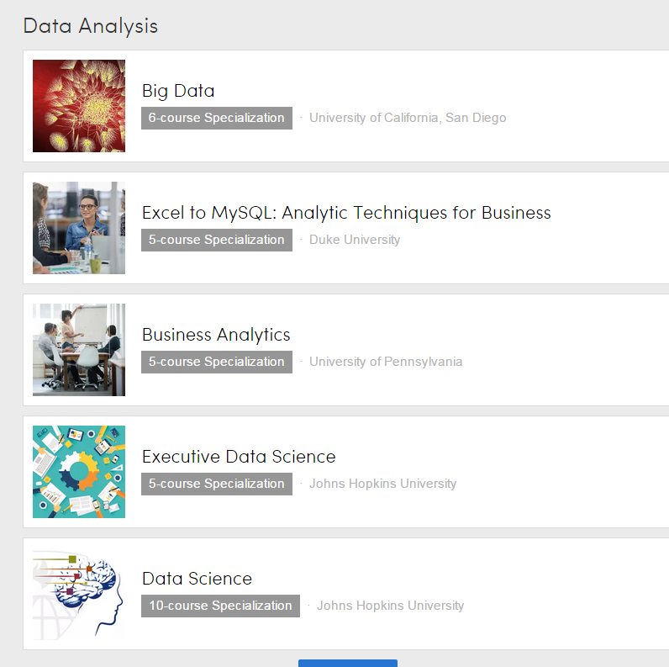
External Challenges: Big Data

Slide 18
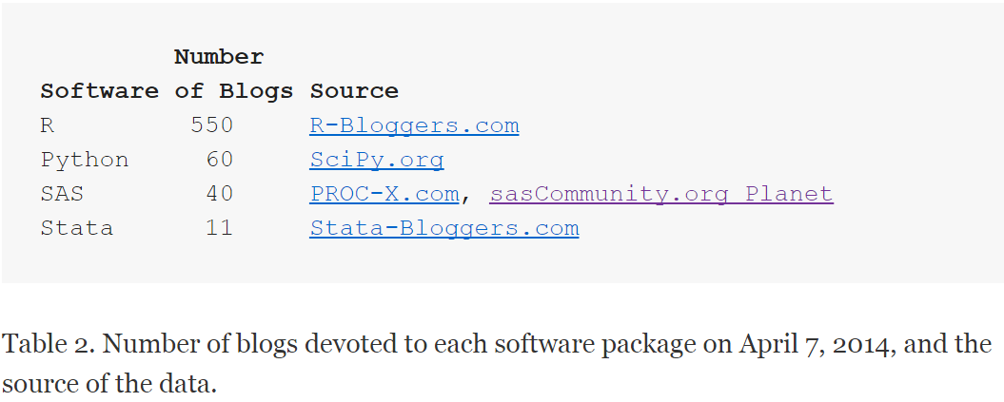
External Challenges: Pool of new SAS Programmers

Slide 19
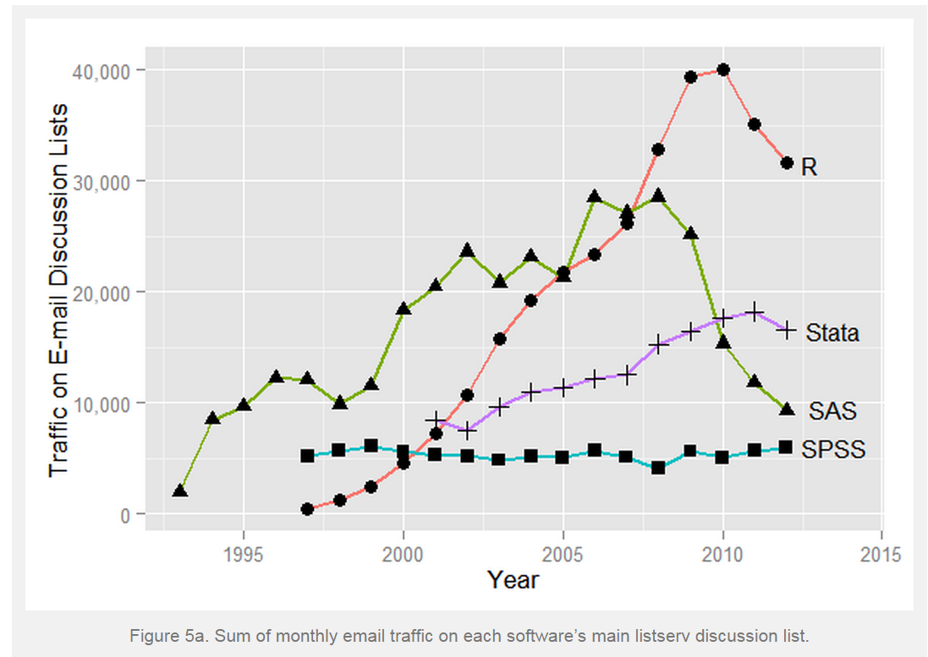
External Challenges: Pool of new SAS Programmers

Slide 20
External Challenges: Pool of new SAS Programmers
Post your question to SAS-L, instead send emails to a single SAS helper
Answer questions if possible
Stackoverflow is another good place to post and answer SAS questions
Start a SAS blog
Spread the news

Slide 21

When Bad Things Happen to Good SAS® Programmers
Jiangtang(‘JT’) Hu
d-Wise
https://github.com/Jiangtang/SESUG

