Slide 1

Confidence Intervals for Binomial Proportion Using SAS®: The All You Need to Know and No More…
Jiangtang(‘JT’) Hu
d-Wise
https://github.com/Jiangtang/SESUG

Slide 2

Disclaimer

Slide 3
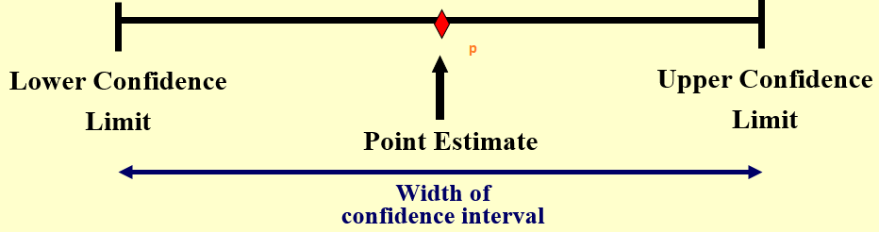
The Question
n: Sample size
r: Number of count of interested outcome
p = r/n: binomial proportion (sample proportion)
CI: Confidence Interval

Slide 4
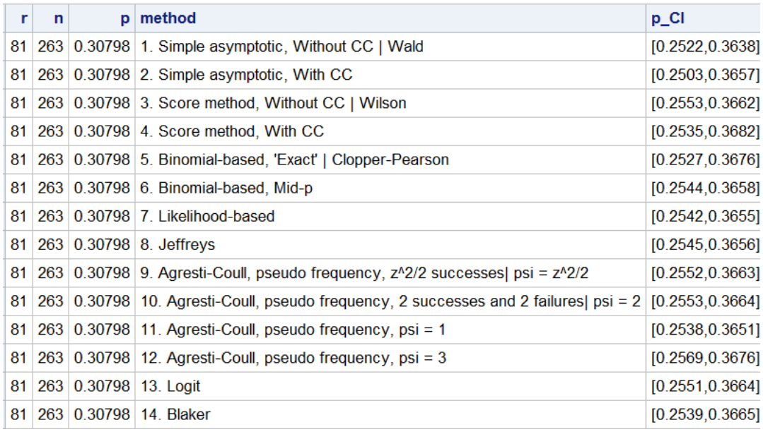
What you can take away (1/3)
One line of macro call
%CI_Single_Proportion(r=81,n=263)

Slide 5
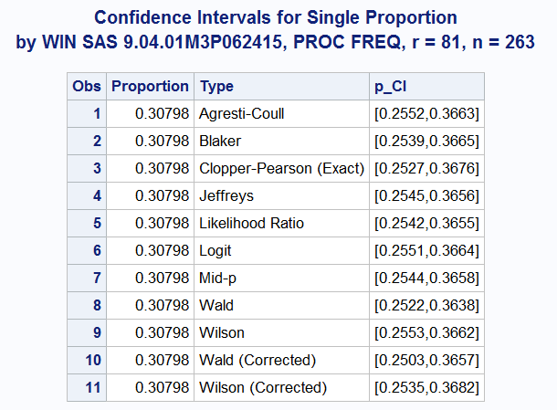
What you can take away (2/3)
Use PROC FREQ
%CI_freq(r=81,n=263)

Slide 6
What you can take away (3/3)
Some statistical vocabularies
Some comments

Slide 7
Agenda
The Story
What
How
Next

Slide 8
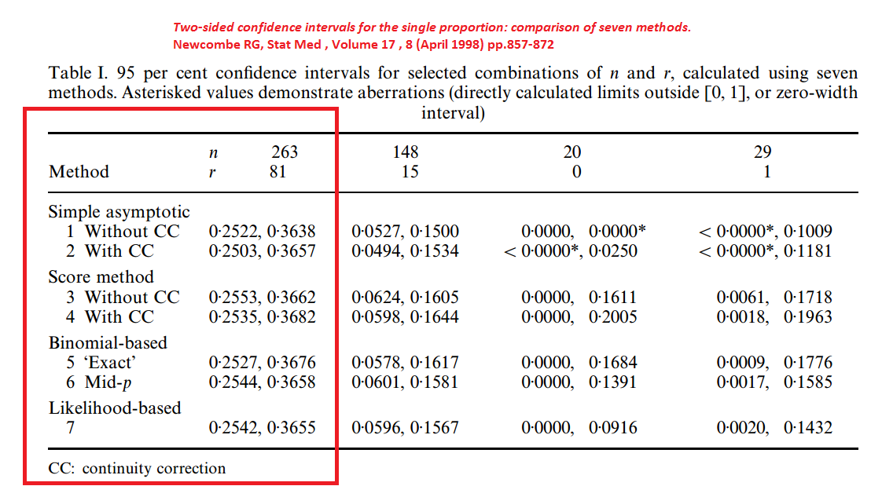
A Programmer’s Exercise (1/4)
A Paper: Robert Newcombe (1998)

Slide 9
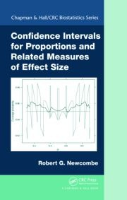
A Programmer’s Exercise (2/4)
A book: Robert Newcombe (2012)

Slide 10
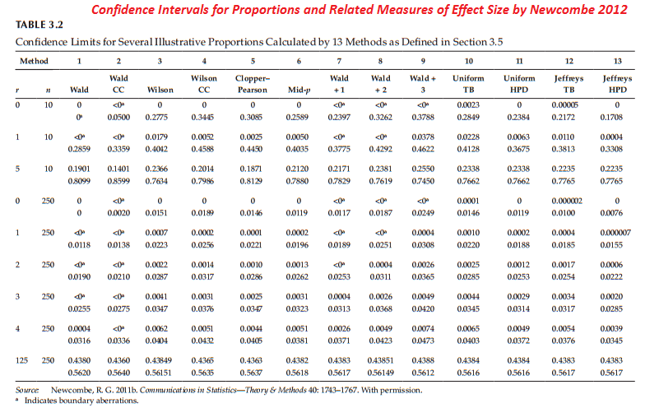
A Programmer’s Exercise (3/4)
A book: Robert Newcombe (2012)

Slide 11
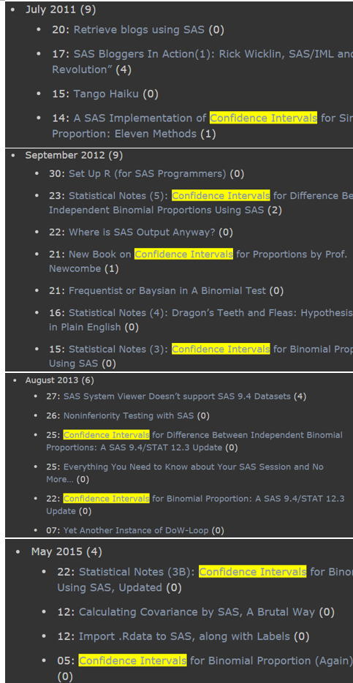
A Programmer’s Exercise (4/4)

Slide 12
What is CI
Inputs: n, r
derived: p = r/n, q = 1- p)
CI: Confidence Interval, a range of values, computed from the sample, which is with probability of 95% to cover the population proportion

Slide 13
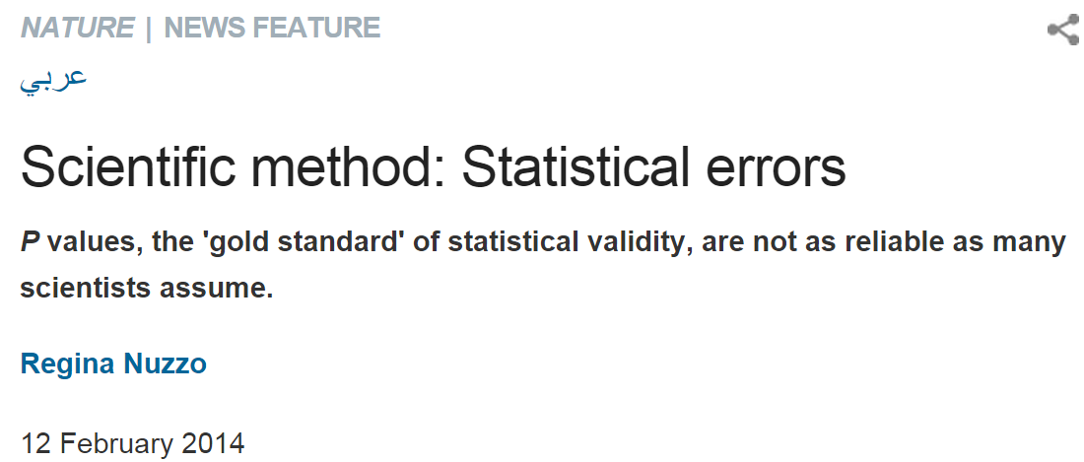
Why CI is important
From statistical point of view, confidence intervals are generally more informative than p-value

Slide 14
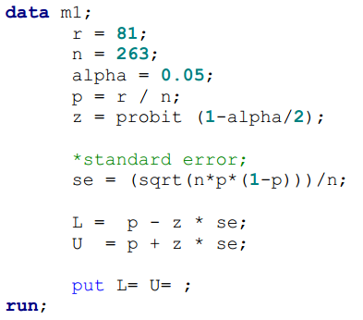
#1: Wald
p ± z × SE
p is the empirical estimate of the proportion, r / n,
SE, standard error = √(p(1-p)/n)
z, the quantile of the standard normal distribution (1.96 for the usual two-sided 95% interval)

Slide 15
#1: Wald
Pros
very popular
Easy to understand
Cons
not boundary-respecting (beyond 0 or 1)
Degeneracy: When p = 0 or 1, #1 will get a zero width interval [0, 0]

Slide 16


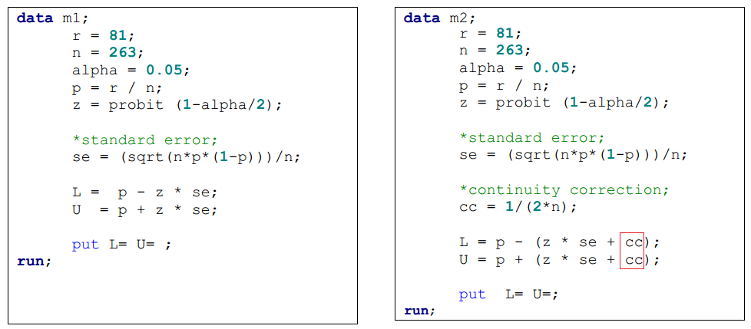
#2: Wald with CC
CC: continuity correction, 1 / (2n)

Slide 17
#2: Wald with CC
Pros:
Avoiding degeneracy
Cons
Overshoot (wider than #1)

Slide 18
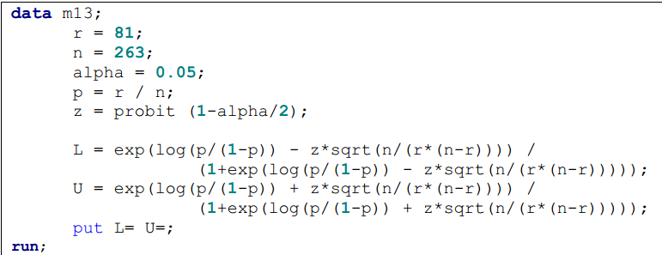
#13: Logit
Similar to #1, Wald (p = r / n)
logit transformation: log (p / (1-p))

Slide 19
#13: Logit
Pros
often used for odds ratios
Cons
not guaranteed satisfactory when n is small or p is close to 0 or 1 (like #1 ‘Wald’)

Slide 20

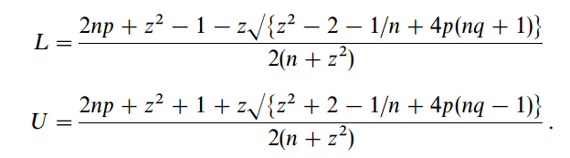
#3 & 4: Wilson Score w/o CC
#3 Score method, without CC, ‘Wilson’
#4 Score method, with CC

Slide 21
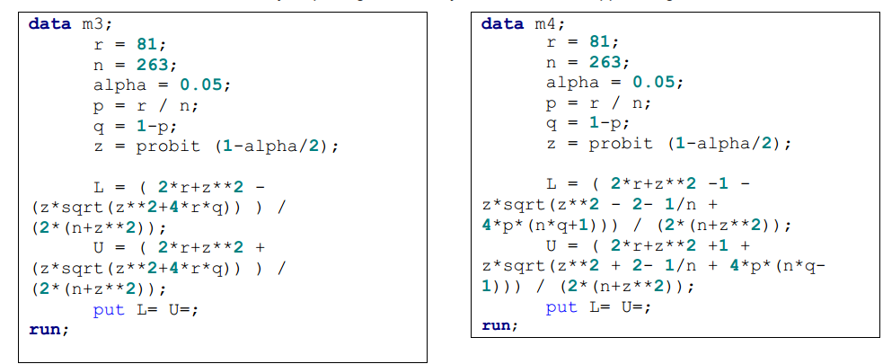
#3 & 4: Wilson Score w/o CC

Slide 22
#3 & 4: Wilson Score w/o CC
Wilson score method (#3)
Pros
is considered the simplest acceptable alternative to the Wald approach
It gets better performance when n is small and when p is close to 0 or 1
Cons
not boundary-respecting

Slide 23
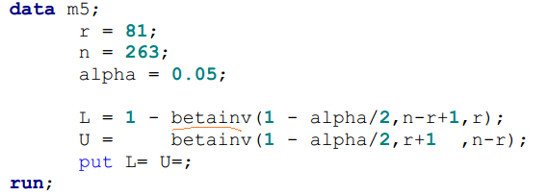
#5 Binomial based: Clopper-Pearson ‘exact’
computationally convenient
Not symmetrical (as #1 - #4)
Based on exact binomial distribution (vs #1 - #4: normal approximation)

Slide 24
#5 Binomial based: Clopper-Pearson ‘exact’
Conservative
Needs large sample size for precision
recommended for the case of very rare or common events

Slide 25
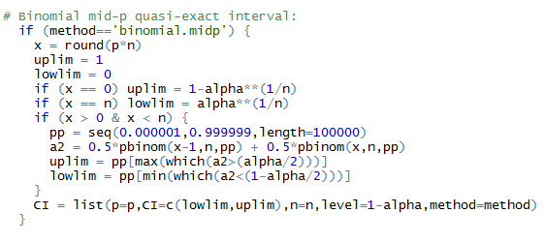
#6 Binomial based: Mid-p
used to reduce the conservatism of #5
https://raw.githubusercontent.com/Jiangtang/Programming-SAS/master/CI_Single_Proportion.sas

Slide 26
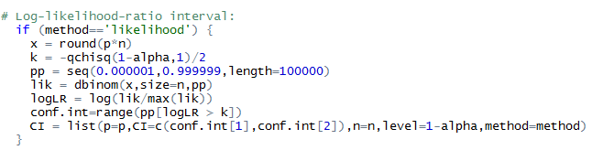
#7 Likehood
is said to be theoretically appealing☺
https://raw.githubusercontent.com/Jiangtang/Programming-SAS/master/CI_Single_Proportion.sas

Slide 27
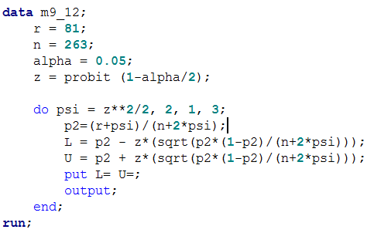
Agresti-Coull, #9-12
Instead of using p = r / n, 4 methods are developed when ψ gets values z2/2, 2, 1, 3
pψ = (r + ψ)/(n + 2ψ)

Slide 28
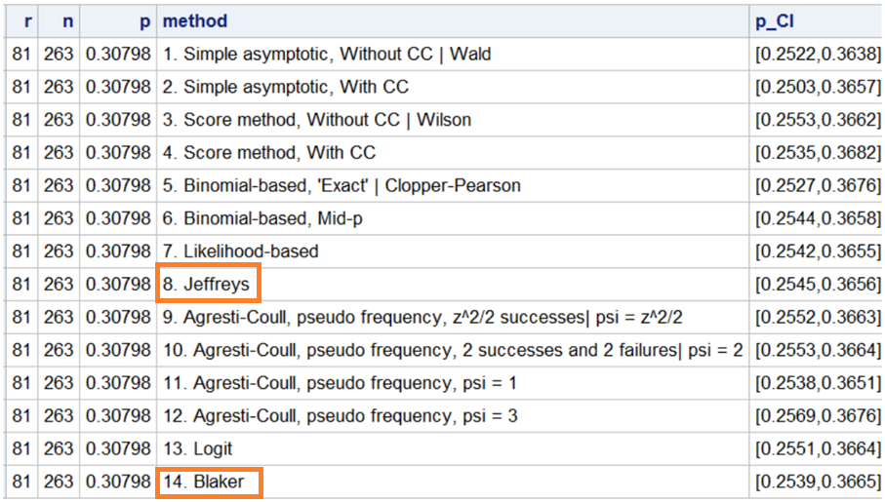
Bayesian Begins

Slide 29
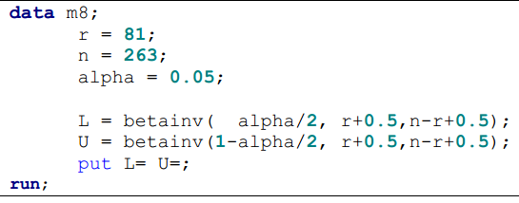
#8 Bayesian: Jeffreys

Slide 30
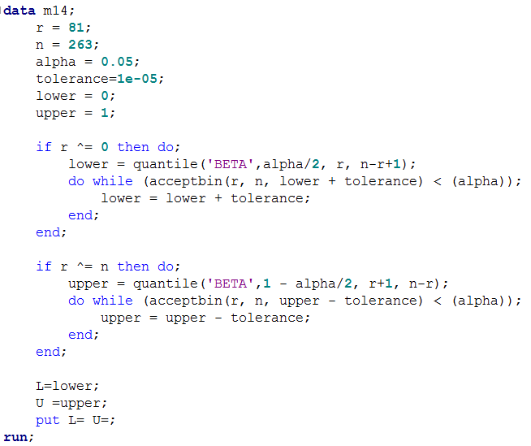
#14 Bayesian: Blaker

Slide 31
Get All!
filename CI url 'https://raw.github.com/Jiangtang/ProgrammingSAS/master/CI_Single_Proportion.sas'; %include CI; %CI_Single_Proportion(r=81,n=263);

Slide 32
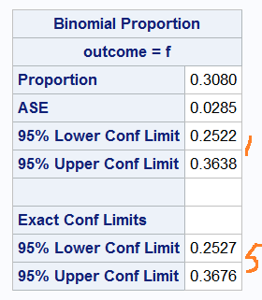
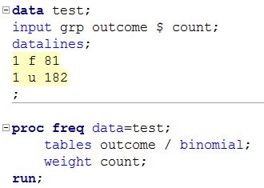
Using PROC FREQ (1/4)

Slide 33
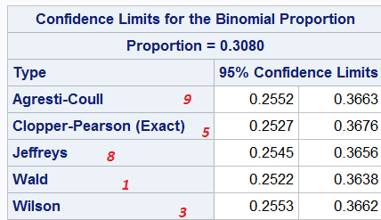
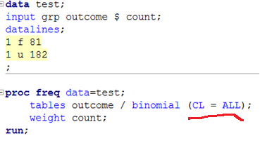
Using PROC FREQ (2/4)

Slide 34
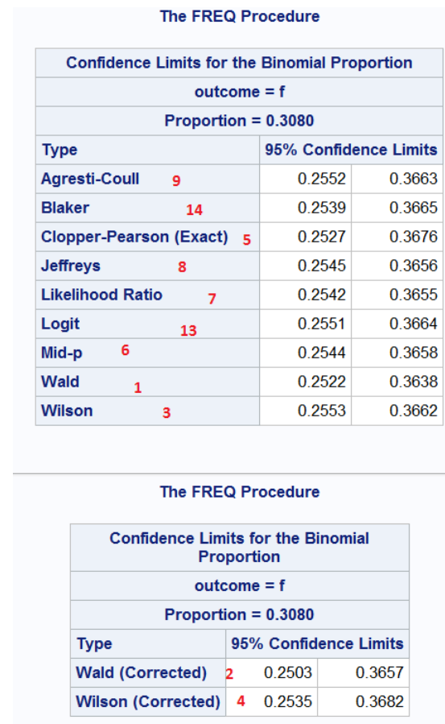
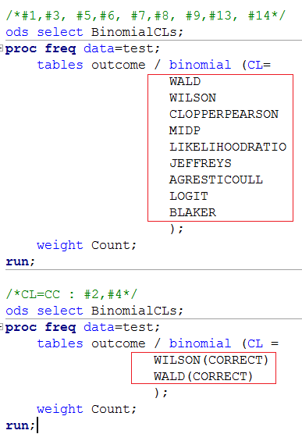
Using PROC FREQ (3/4)

Slide 35
Using PROC FREQ (4/4)
%CI_freq(r=81,n=263)

Slide 36
What’s next
PROC MCMC
Put macros to functions
CI for difference between independent proportions
Interval estimation for the difference between independent proportions: comparison of eleven methods. Newcombe RG, Stat Med , Volume 17 , 8 (April 1998) pp.873-890

