Slide 1
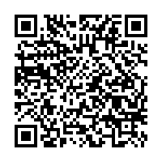
When Bad Things Happen to Good SAS® Programmers
Jiangtang(‘JT’) Hu
d-Wise
https://github.com/Jiangtang/SESUG

Slide 2

Disclaimer

Slide 3
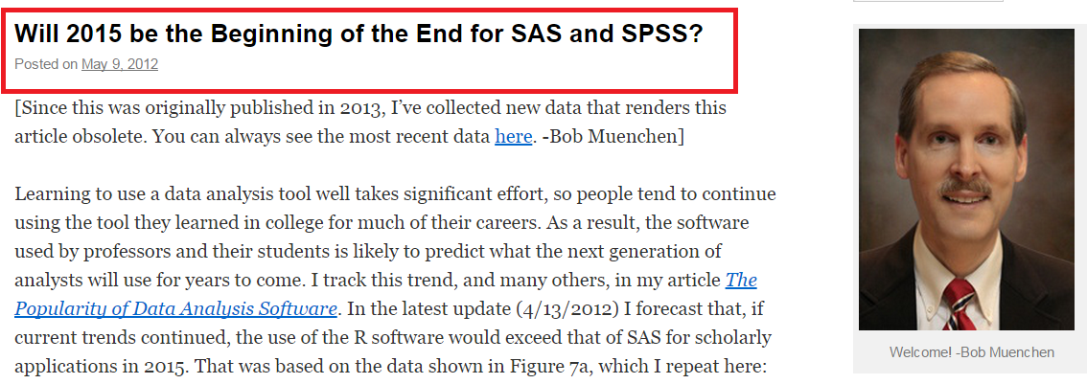
The Question

Slide 4
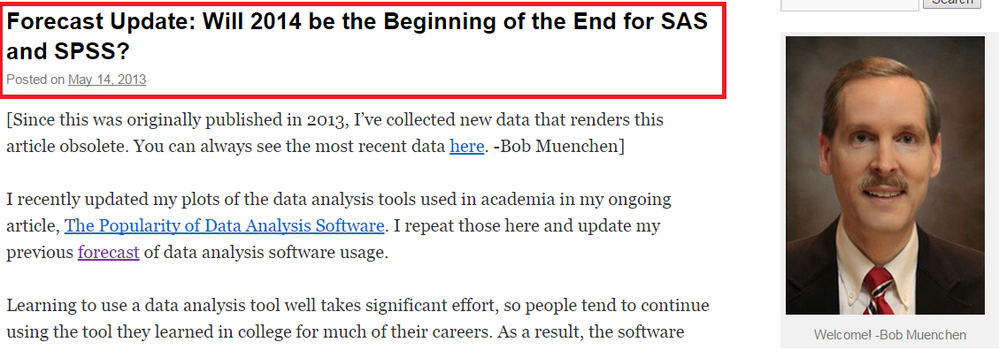
The Question

Slide 5
Agenda
The challenges
The Goal
What
How
Next

Slide 6
Internal Challenges: IT
Your favorite text editors were not installed/available in the new computing system

Slide 7
Internal Challenges: IT
You can’t use the traditional SAS Display Manager anymore to write, interactively debug your SAS codes and check temporary output datasets
The new and only interface to write SAS codes is now SAS Enterprise Guide, or SAS Studio

Slide 8
Internal Challenges: IT
the only SAS editor available for you to complete your SAS job is SAS Drug Development, or SAS Data Integration Studio

Slide 9
Internal Challenges: Outsourcing

Slide 10
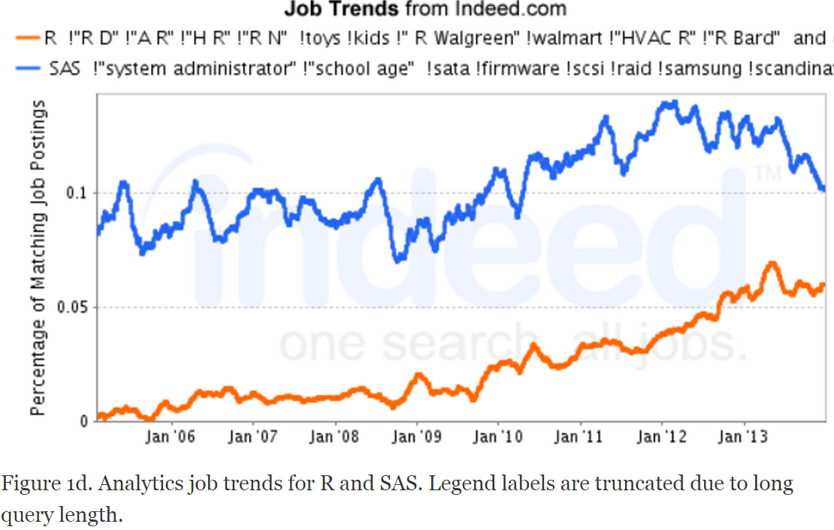
External Challenges: R

Slide 11
External Challenges: Big Data

Slide 12
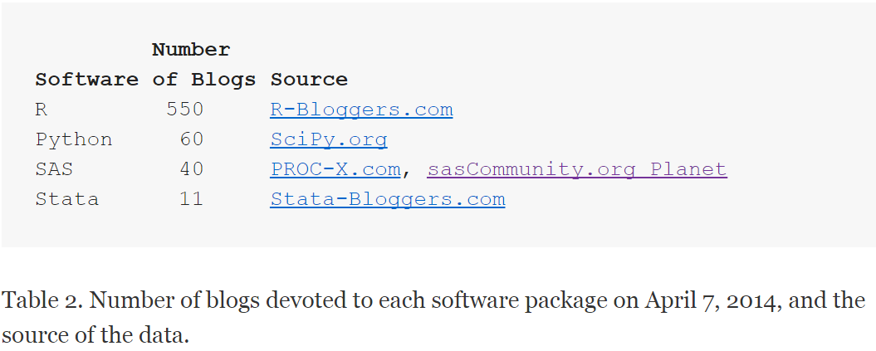
External Challenges: Pool of new SAS Programmers

Slide 13
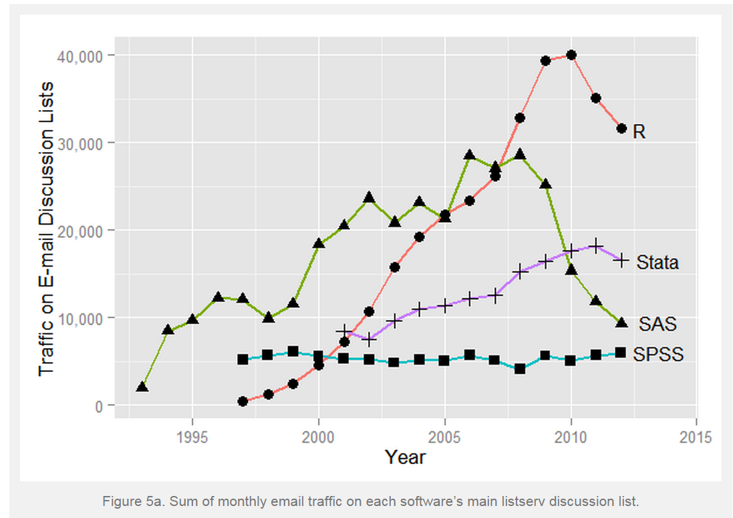
External Challenges: Pool of new SAS Programmers

Slide 14
External Challenges: Pool of new SAS Programmers
Post your question to SAS-L, instead send emails to a single SAS helper
Answer questions if possible
Stackoverflow is another good place to post and answer SAS questions
Start a SAS blog
Spread the news

