Slide 1
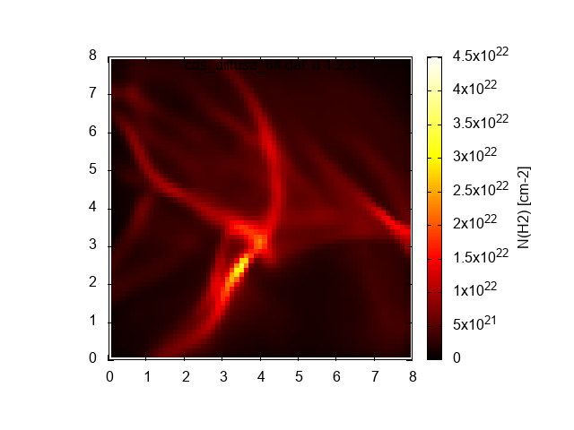
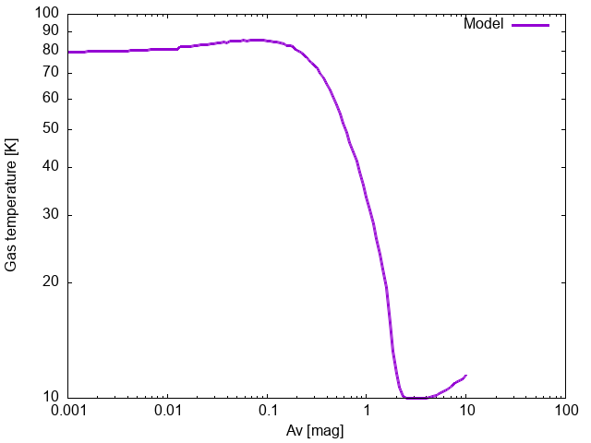
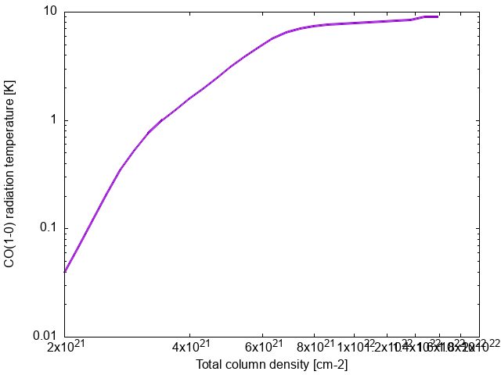
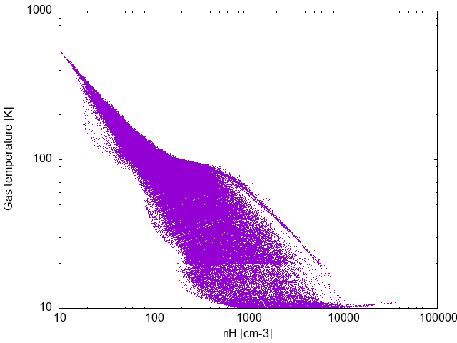
3D-PDR Agent
A1 portrait poster
Astrophysics / ISM
X. Jiang et al.
A Codex skill/plugin workflow for reproducible ISM post-processing
from simulation snapshots to synthetic observables
Agent Workflow
Transparent, file-based reproducibility
1
INPUT/RAW
2
INPUT/SELECTED
3
sims_*
4
3D-PDR
5
RT-synth
6
Products
source snapshots
curated links + DAT
short run paths
chemistry + thermal state
synthetic observables
preserved hierarchy
Operational knowledge becomes explicit: path conventions, skip/force behavior, local parameter rewriting, helper scripts, and HPC submission templates.
Why an Agent?
Proposed Skill Names
3D-PDR and RT-synth post-processing is rich but operationally brittle:
- raw snapshot placement
- HDF5 -> density DAT
- velocity grids for RT-synth
- local parameter rewriting
- HPC sync + SLURM submission
- synthetic map rendering
import-raw
place incoming HDF5 snapshots under INPUT/RAW
prep-dat
prepare SELECTED links, density DAT, and velocity DAT
run-pdr
create snapshot-local sims_* folders and run 3DPDR
Design goal: make the notebook-to-HPC-to-products path repeatable and inspectable without hiding the astrophysics.
sync-hpc-run
rsync sources and submit sbatch jobs
run-rtsynth
produce multi-angle synthetic maps
The agent reduces operational friction while preserving transparent files and commands.
render-rt
convert RT output tables to PNG diagnostics
Verb-first names read better in posters, talks, and user-facing docs.
Science Products
Bundled 3D-PDR benchmark outputs
H2 column density
Gas temperature
CO 1-0 tracer
3D thermal structure
Robust post-processing bridges simulations and observable ISM diagnostics.
Repository Architecture
Conference message
Canonical paths: INPUT/RAW, INPUT/SELECTED, 3D-PDR-dev, RT-synth, Products/RTsynth, plugins/3d-pdr-agent
Agentic infrastructure reduces friction while preserving transparent scientific workflows.
3D-PDR Agent | INPUT -> DAT -> 3D-PDR -> RT-synth -> Products
Edit author, affiliation, QR code, and captions before printing.

