Slide 1

R语言环境简介及基本语法(3)
王志恒
Zhiheng.wang@pku.edu.cn
2021.09.15 @ PKU, China
Department of Ecology
College of Urban & Environmental Sciences
Peking University

Slide 2
Outline
What’s R?
Getting help in R
Variable names
Symbols & basic built-in functions
Data types and structures
Import/export data
Functions for basic statistics
Conditional statements
Loop and apply functions
Make a barplot
Writing scripts

Slide 3
Conditional statements
ifelse (test, yes, no)
简洁
只能返回一个值
> a <- 1:10
> x <- sample(x=a, size=1, replace=F)
> b <- x %% 2
> y <- ifelse (b == 0, yes="even", no="odd")
> y

Slide 4
Conditional statements
if (condition) {
statements
}
else if (condition) {
statements
}
else {
statements
}

Slide 5
Conditional statements
目标：随机取一个数x，根据x的不同，建立频度分布不同的数组y，长度均为10。如果x是偶数，y ~ N(μ = 0，σ² = 1)；如果x是奇数，y ~ N(μ = 10，σ² = 1)
> a <- 1:10
> x <- sample(x=a, size=1, replace=F)
> b <- x %% 2
> if (b == 0) y <- rnorm(n = 10, mean = 0, sd = 1) else y <- rnorm(n = 10, mean = 10, sd = 1)

Slide 6
Conditional statements
目标：随机取一个数x，根据x的不同，建立频度分布不同的数组y，长度均为10。如果x是偶数，y ~ N(μ = 0，σ² = 1)；如果x是奇数，y ~ N(μ = 10，σ² = 1)
错误写法：
> if (b == 0) y <- rnorm(n = 10, mean = 0, sd = 1)
> else y <- rnorm(n = 10, mean = 10, sd = 1)
Error: unexpected 'else' in "else"
正确写法：
> {
> if (b == 0) y <- rnorm(n = 10, mean = 0, sd = 1)
> else y <- rnorm(n = 10, mean = 10, sd = 1)
> }

Slide 7
Conditional statements
目标：随机取一个数x ，根据x的不同，建立频度分布不同的数组y，长度均为10 。如果x是3的整数倍，y ~ N(μ = 0，σ² = 1)；如果x除3余1，y ~ N(μ = 10，σ² = 1)；如果x除3余2，y ~ N(μ = 20，σ² = 1)
> a <- 1:10
> x <- sample(x=a, size=1, replace=F)
> b <- x %% 3
> {
> if (b == 1) y <- rnorm(n = 10, mean = 10, sd = 1)
> else if (b == 2) y <- rnorm(n = 10, mean = 20, sd = 1)
> else y <- rnorm(n = 10, mean = 0, sd = 1)
> }

Slide 8
Conditional statements
目标：随机取一个数x ，根据x的不同，建立频度分布不同的数组y，长度均为10。如果x <=3，y ~ N(μ = 0，σ² = 1)；如果3 < x <= 6，y ~ N(μ = 10，σ² = 1)；如果6 < x <= 10 ，y ~ N(μ = 20，σ² = 1)
## 条件判断的先后
> a <- 1:10
> x <- sample(x=a, size=1, replace=F)
> {
> if (x <= 3) y <- rnorm(n = 10, mean = 0, sd = 1)
> else if (x <= 6) y <- rnorm(n = 10, mean = 10, sd = 1)
> else y <- rnorm(n = 10, mean = 20, sd = 1)
> }

Slide 9
Conditional statements: Multiple Options
The switch structure provides an efficient way to select among multiple options:
switch(EXPR,
"opt1" = action1,
"opt2" = action2,
...)
Note:
EXPR is a single character string or number that indicates which option to use.
"opt1" is the indicator for the 1st option.
"opt2" is the indicator for the 2nd option.
switch is used for a fixed list of options.

Slide 10
循环语句( Loop)
for (i in …) {
statements
}
while (condition is true) {
statements
break() ## 非必需
}
repeat {
statements
break() ## 必需
}

Slide 11
循环语句( Loop)
目标：循环若干次，每次在屏幕上显示一个值
for (i in 1:100) {
m <- i*2
print(m)
}
for (i in c("a", "b", "c")) print(i)

Slide 12
循环语句( Loop)
目标：循环若干次，每次在屏幕上显示一个值
i <- 1
j <- 10
while (i <= 10) {
j <- i + 1
print(j)
i <- i + 1
if (j > 8) break()
}
i <- 1
j <- 10
while (i <= 10) {
j <- i + 1
print(j)
i <- i + 1
}

Slide 13
循环语句( Loop)
目标：循环若干次，每次在屏幕上显示一个值
## 危险案例
i <- 1
j <- 10
while (i <= 10) {
j <- i + 1
print(j)
}

Slide 14
循环语句( Loop)
目标：循环若干次，每次在屏幕上显示一个值
i <- 1
j <- 10
repeat {
print(i)
i <- i + 1
if (i > 8) break
}

Slide 15
apply functions
Function | Description
apply | Apply a function to rows or columns of a matrix or data frame.
lapply | Apply a function to the components of a list. Returns a list.
sapply | Apply a function to the components of a list. Returns the simplest structure, which may be a vector, a matrix, or a list.
tapply | Apply a function to a vector, subject to one or more grouping variables.

Slide 16
apply functions
function | Definition | Input Obj. | Return Obj.
apply | (X, MARGIN, FUN, ...) | must have dim | vector / array dim dependent
lapply | (X, FUN, ...) | any object | list
sapply | (X, FUN, ... , simplify=T, USE.NAMES = T) | any object | vector, matrix or list
tapply | (X, INDEX, FUN, ... , simplify=T) | Vector | vector / array depends on Indices
by | (X, INDECES, FUN, ...) | Data Frame | by (an array of mode list)

Slide 17
apply functions
apply(data,1, mean)
apply(data,2, summary)
apply(data,3, sum)
MAR = 3
MAR = 2
MAR = 1

Slide 18
apply functions
For each element of a list:
lapply(X, FUN, …)
分类汇总
tapply(X, INDEX, FUN, …)
aggregate(x, index, FUN)
For a matrix or a data frame:
apply(X, MARGIN, FUN, …)

Slide 19
Using apply functions
## calculate the mean species diversity of butterflies on north and south slopes
mean.num.sp <- tapply(X=data[,2], INDEX=data[,1], FUN=mean)
std.sp <- tapply(X=data[,2], INDEX=data[,1], FUN=sd)
mean.num.sp <- aggregate(x=data[,2], by=data[1], FUN=mean)
std.sp <- aggregate(x=data[,2], by=data[1], FUN=sd)

Slide 20
Vectorization
Vectorized functions are usually quicker than iteration, and often are orders of magnitude quicker.
Vectorization involves using functions and operators that take vector arguments rather than iterating over values.
Vectorization frequently requires thinking about the problem differently:
Think of vectors as single object rather than as collections of items.
Get to know functions that facilitate vectorization.
Use matrix operations whenever possible.

Slide 21
tempE <- rnorm(1000000)
# Use a for() loop to calculate cumulative sums of one million values:
tempE.csum <- tempE
system.time(
for( i in seq(along = tempE)[-1] )
tempE.csum[i] <- tempE.csum[i-1] + tempE[i]
)
# Use cumsum() to calculate cumulative sums of one million values:
system.time( cumsum(tempE) )
# Both return the same result:
all.equal( tempE.csum, cumsum(tempE) )
tempE.diffs <- rep( 0., times = length(tempE) - 1 )
system.time(
for( i in seq( along = tempE.diffs ) )
tempE.diffs[i] <- tempE[i+1] - tempE[i]
)
system.time( diff(tempE) )

Slide 22
Write your own functions
name <- function(arguments) {
statements
return()
}
Arguments: 参数
Arguments:“…”
参数赋值： 可有默认值，也可没有
返回值

Slide 23
Write your own functions
Myfunction1 <- function(x = 1, y = 2) {
z <- x + y
return(z)
}
Myfunction2 <- function(mean, sd) {
x <- rnorm(n=10, mean=mean, sd=sd)
return(x)
}

Slide 24
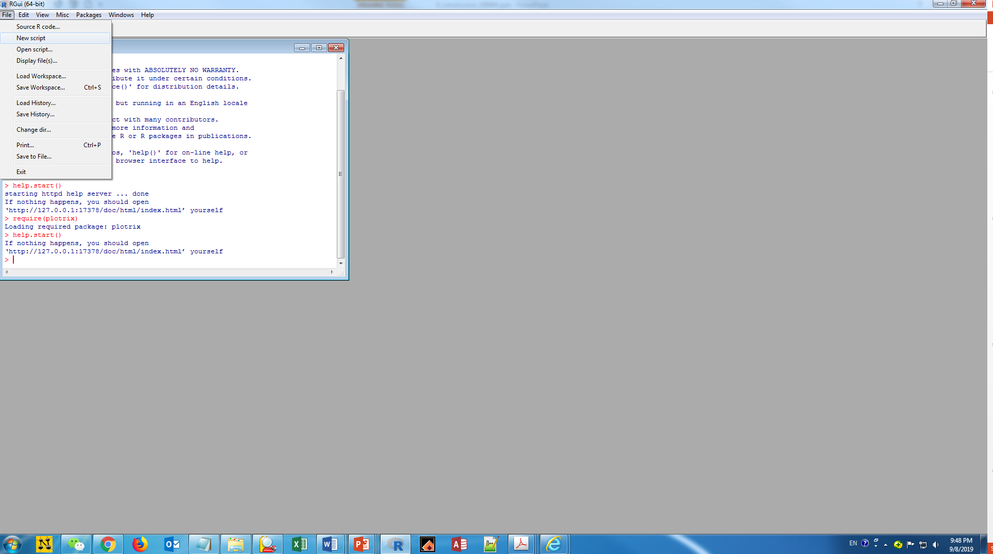
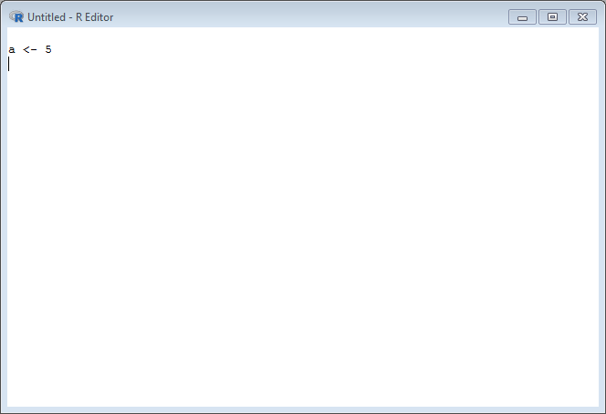
Let’s staRt!
Start a new script:
Run the code:
Ctrl + Enter (Ctrl + R for some versions)
Hide a line: #
Save the script: *.R, *.rmd

Slide 25
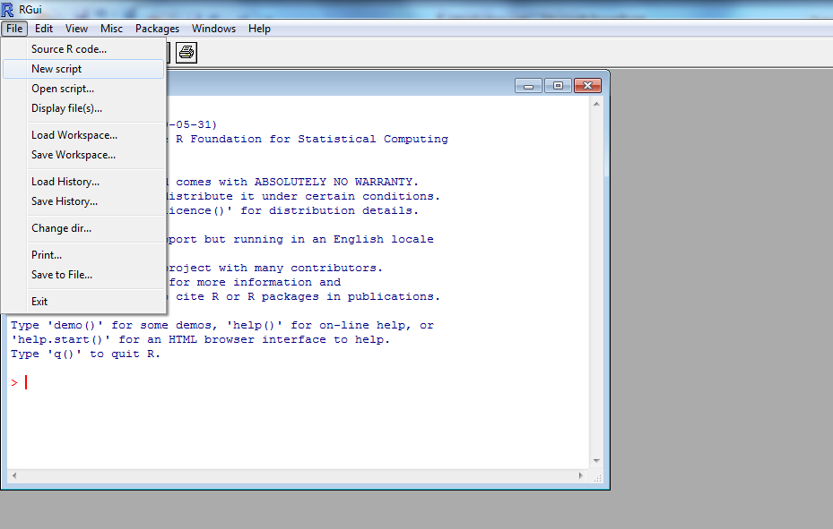
Write scripts in R
Scripts remember what you have done
Short script can conduct many analyses by using loops and conditions
You can re-run the scripts, given some updates of the data
- Build a new script
File -> New script
Save the script
Open the script

Slide 26
Write scripts in R
## set up the working directory
setwd("E:/R_Cal/R_Group")
## read the data into R
d <- read.csv(file = "ClimateChina.csv", header=T)
str(d)
## show the histograms of each variable
windows(width=8,height=10)
par(mar=c(3,3,1,0.5),mfrow=c(5,4), mgp=c(1.4,0.6,0))
## explore the correlations between climate variables
## define a matrix to put the correlation coefficients
n.var <- 19
cli.cor <- matrix(NA,nrow = n.var,ncol = n.var)
rownames(cli.cor) <- colnames(cli.cor) <- colnames(d)[3+(1:n.var)]
for (i in 1:n.var)
{
x <- d[,i+3]
hist(x, ylab="", xlab="", main=colnames(d)[i+3])
for (j in i:n.var)
{
y <- d[,j+3]
xy.cor <- cor.test(x=x,y=y) ## return a list
cli.cor[i,j] <- xy.cor$estimate
}
}
## export the result
write.csv(cli.cor,file="ClimateCorrelation.csv”)

Slide 27
谢谢！

