Slide 1
Curriculum sampling halves the compute needed to reach baseline accuracy
Example Conference 2026 · Session 4B
A loss-driven schedule for noisy, long-tailed training sets
Presenter Name, Co-author One, Co-author Two
Department of Example Studies · Example University

Slide 2
Can we stop spending compute on examples the model has already learned?
The question

Slide 3
Uniform sampling wastes most of its steps
01
Where the compute goes in a standard training run

Slide 4
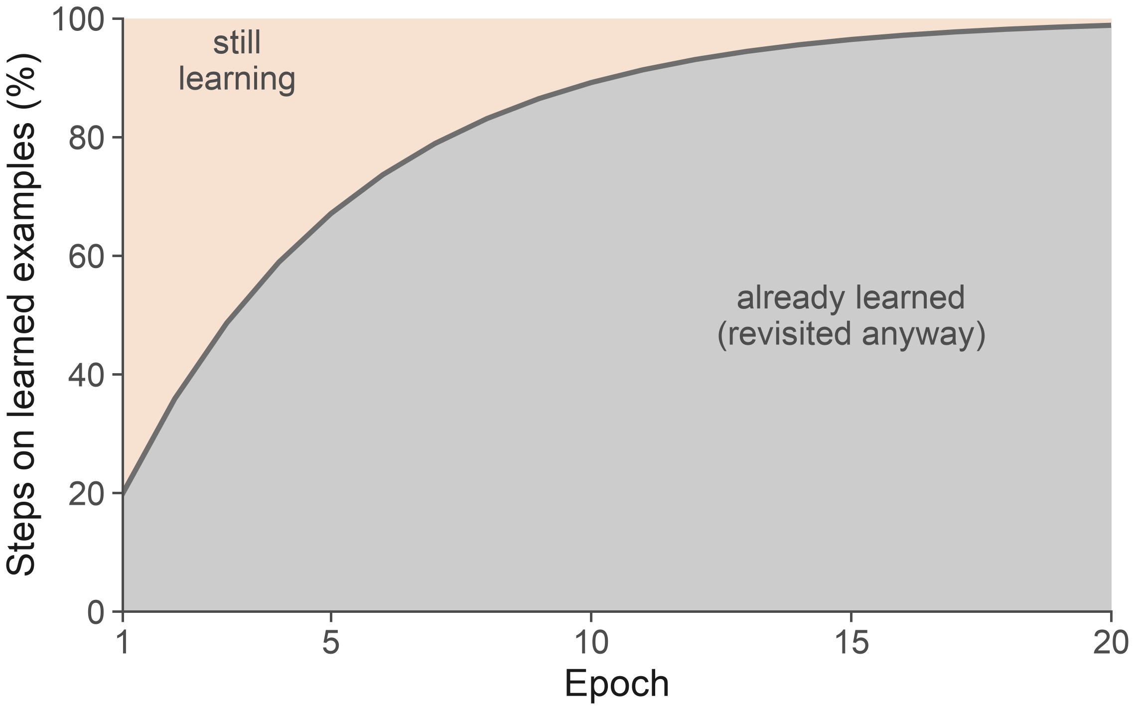
By epoch 10, nine in ten training steps revisit examples the model already gets right
Grey = steps on learned examples
The share grows every epoch
  Hard examples get rarer
These steps add almost no gradient signal
Synthetic data for illustration. Learned = correct on 3 consecutive visits.

Slide 5
Curriculum sampling
02
Reweight each example by its recent loss

Slide 6
Curriculum sampling reweights examples by recent loss, not by a fixed schedule
Uniform (baseline)
Curriculum (ours)
Every example drawn with equal probability
Cost grows with dataset size
No notion of difficulty
Weight ∝ exponential moving average of loss
Floor weight keeps easy examples in play
One extra hyperparameter, τ = 0.9

Slide 7
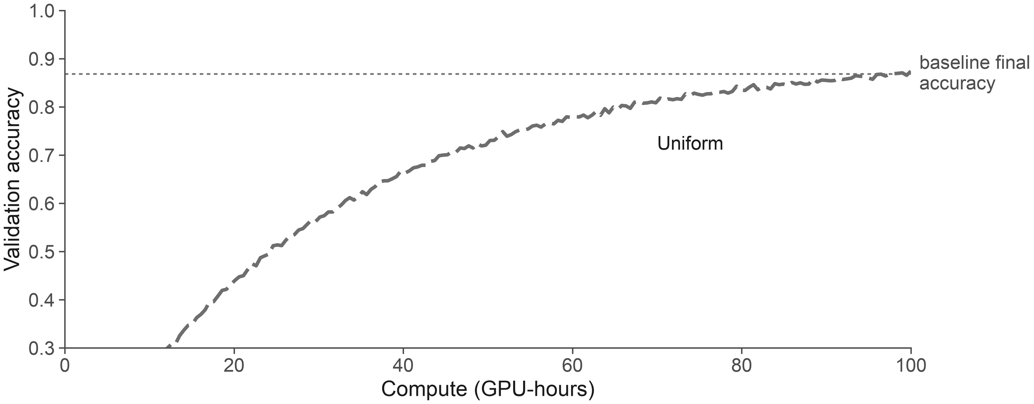
Curriculum sampling reaches the baseline's final accuracy with 2× less compute
Mean of 5 seeds; shaded bands omitted for clarity (s.d. < 0.01).

Slide 8
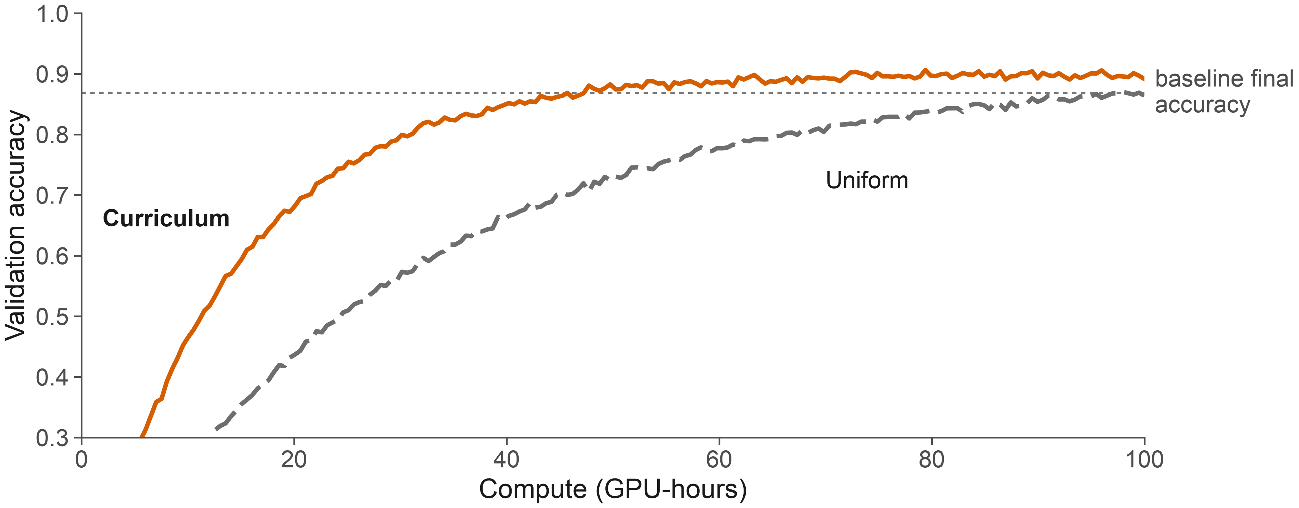
Curriculum sampling reaches the baseline's final accuracy with 2× less compute
47 vs 100 GPU-hours
Mean of 5 seeds; shaded bands omitted for clarity (s.d. < 0.01).

Slide 9
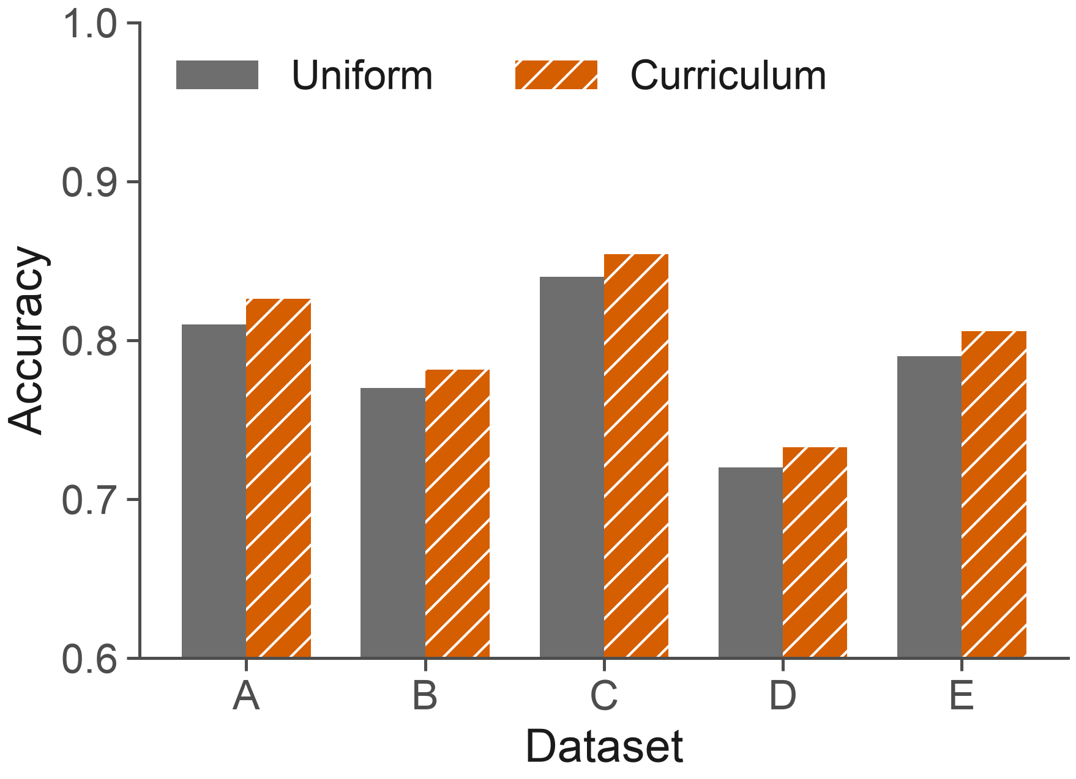
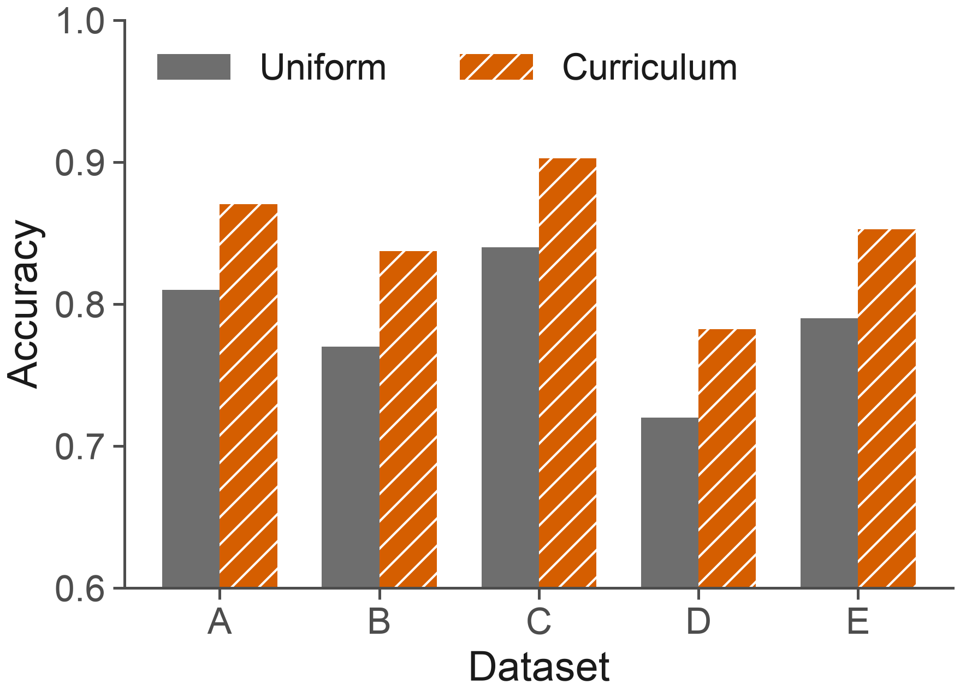
The gain is large under label noise and small on clean data
Clean labels
20% label noise
Five benchmark datasets (A–E). Accuracy after 50 GPU-hours.

Slide 10
Gains hold across all five datasets at equal compute
Dataset | Uniform | Curriculum | Δ
A · images | 0.812 | 0.861 | +0.049
B · text | 0.771 | 0.818 | +0.047
C · audio | 0.843 | 0.872 | +0.029
D · tabular | 0.724 | 0.781 | +0.057
E · graphs | 0.790 | 0.836 | +0.046
Mean | 0.788 | 0.834 | +0.046
Accuracy at 50 GPU-hours, mean of 5 seeds. Δ = Curriculum − Uniform.

Slide 11
Three caveats limit how far this result generalises
Tested only up to 1B parameters

Slide 12
Three caveats limit how far this result generalises
Tested only up to 1B parameters
Needs per-example loss, which costs memory
  About 4 bytes per example

Slide 13
Three caveats limit how far this result generalises
Tested only up to 1B parameters
Needs per-example loss, which costs memory
  About 4 bytes per example
Gains shrink when labels are clean

Slide 14
Take-home messages
Uniform sampling spends most of its steps on learned examples
Loss-based curriculum sampling reaches baseline accuracy with 2× less compute
The gain is largest under label noise
Thanks to the Example Lab and the Example Compute Cluster. Funded by grant EX-0000.
presenter@example.edu · github.com/example/curriculum · arXiv:0000.00000

Slide 15
Backup slides
B

Slide 16
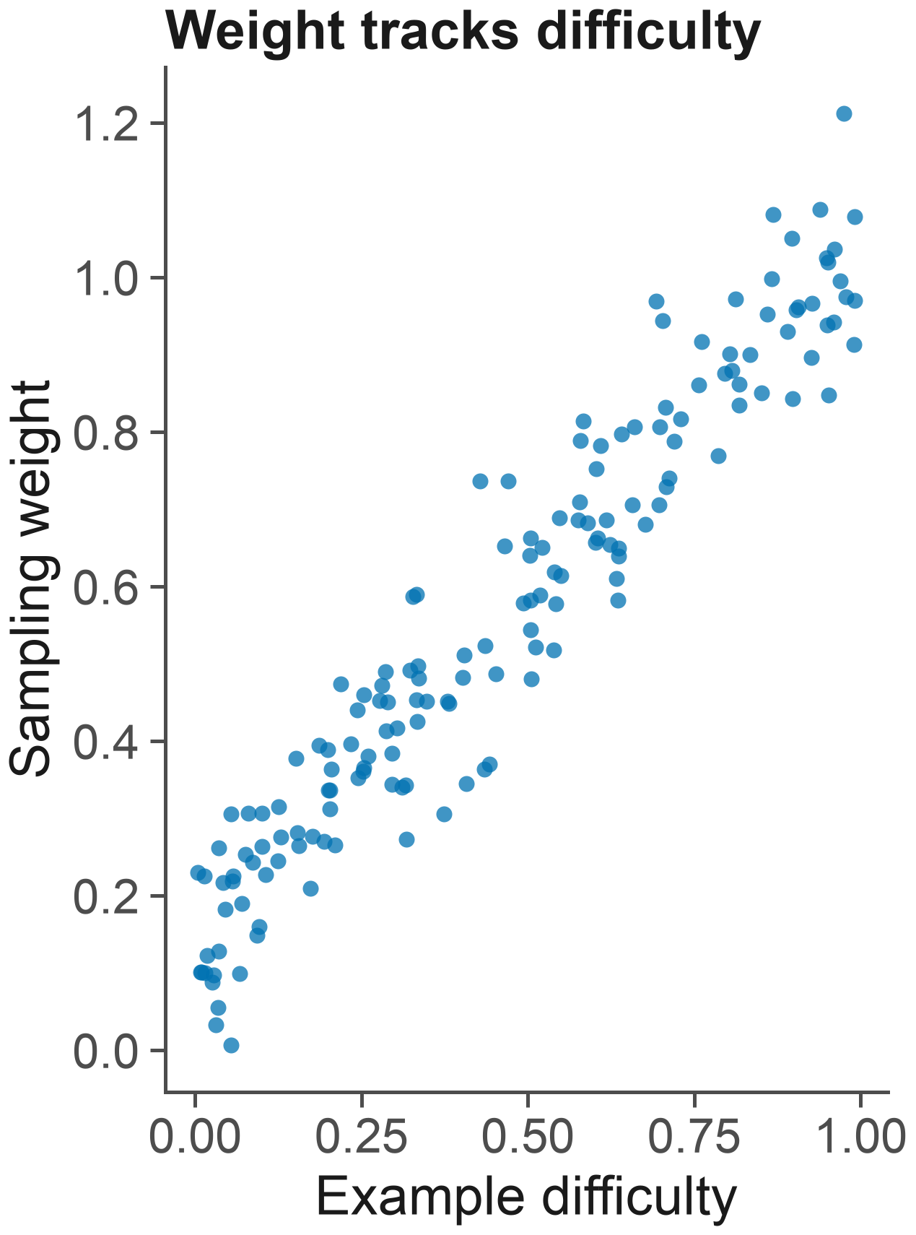
Prioritised sampling by loss: a short history
Background paper
First Author, Second Author, Last Author
Example Journal · 2025 · doi:10.0000/example
Discussed in journal club, March 2026

