Slide 1
Beta coronavirus gene datasets updates
5-28-2020

Slide 2
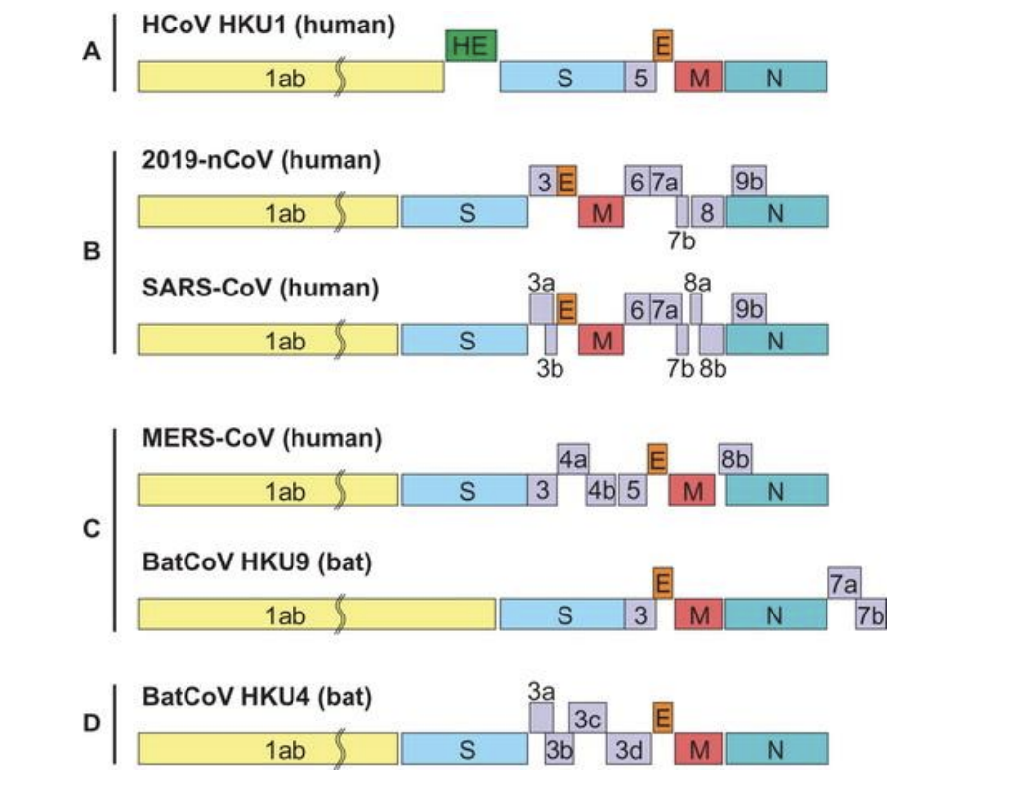
Gene structure of Beta Coronavirus
Species:
Murine coronavirus Betacoronavirus 1 Hedgehog coronavirus 1 Human coronavirus HKU1 Middle East respiratory syndrome-related coronavirus Pipistrellus bat coronavirus HKU5 Rousettus bat coronavirus HKU9 SARS coronavirus 2 Severe acute respiratory syndrome-related coronavirus Tylonycteris bat coronavirus HKU4
Bat Hp-betacoronavirus Zhejiang2013
https://rega.kuleuven.be/if/pdf_corona
Notes:
here are four main sub-groupings of coronaviruses, known as alpha, beta, gamma, and delta.
The spike protein (S) forms a prominent projection from the virus envelope and gives CoVs their characteristic appearance. S is glycosylated and is the attachment and fusion protein
The viruses of lineage A differ from all others in the genus in that they have an additional shorter spike-like protein called hemagglutinin esterase (HE) It is believed to be acquired from influenza C virus.

Slide 3
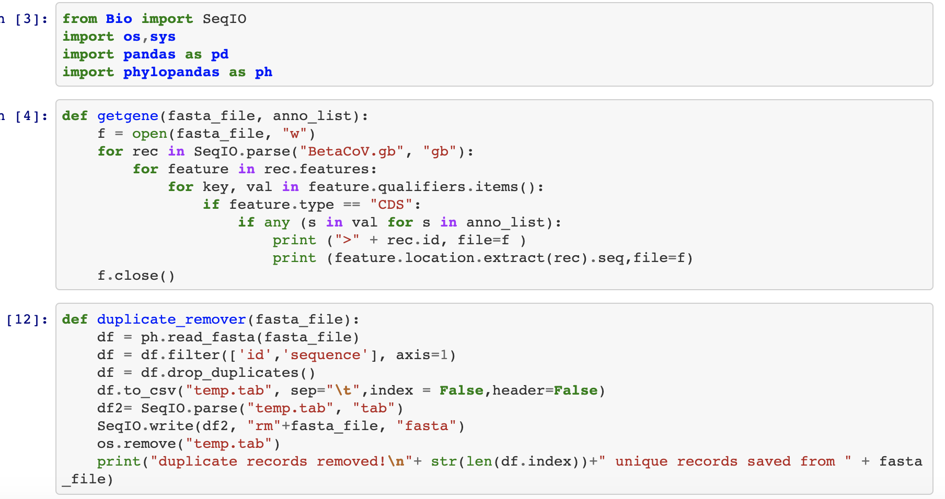
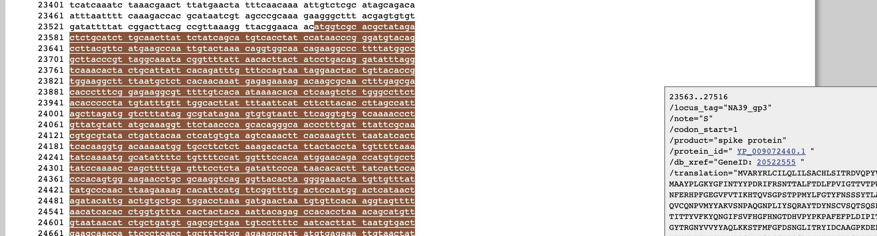
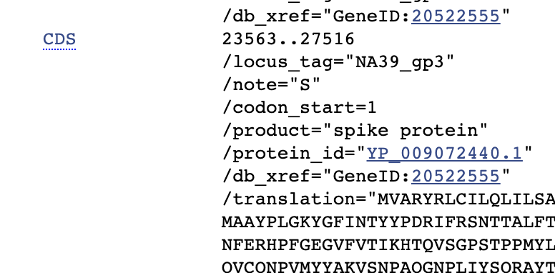
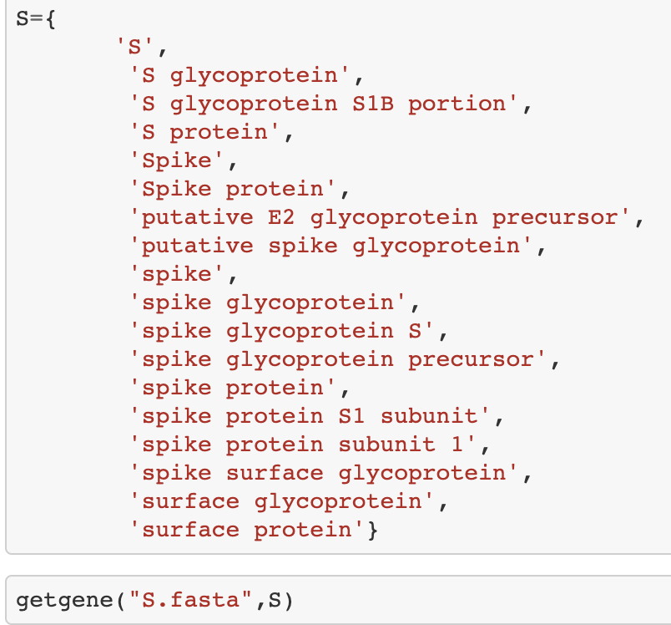
Beta Coronavirus Gene Extraction Pipeline
Get gene sequences form GenBank file using “CDS”

Slide 4
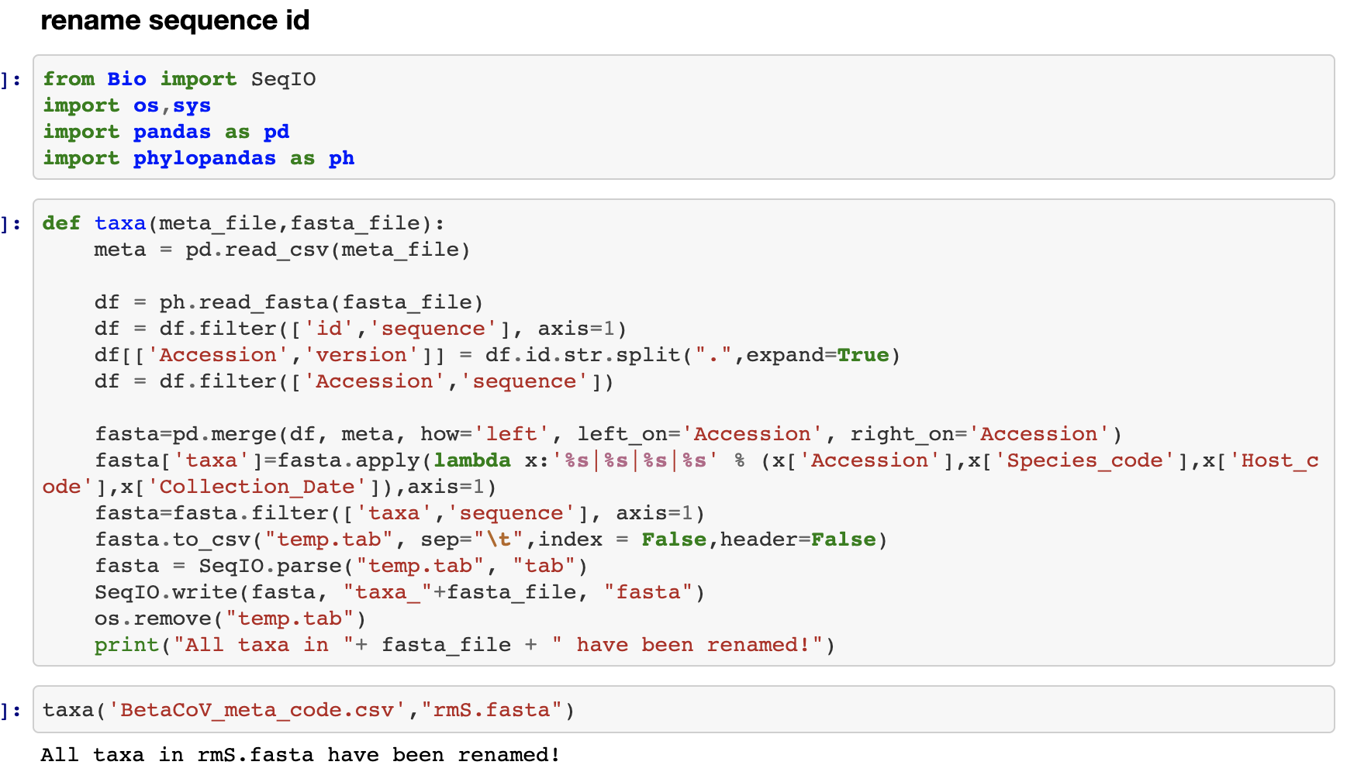
Beta Coronavirus Gene Extraction Pipeline
Get gene sequences form GenBank file using “CDS”
Rename sequence taxa with metadata ( from NCBI Virus)

Slide 5
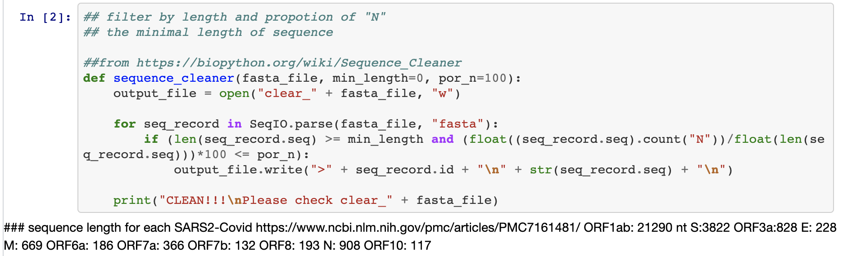
Beta Coronavirus Gene Extraction Pipeline
Get gene sequences form GenBank file using “CDS”
Rename sequence taxa with metadata ( from NCBI Virus)
Sequence cleaner ( > 50% full length of SARS-CoV2 ref, < 50 % ”N”
Alignment?

Slide 6
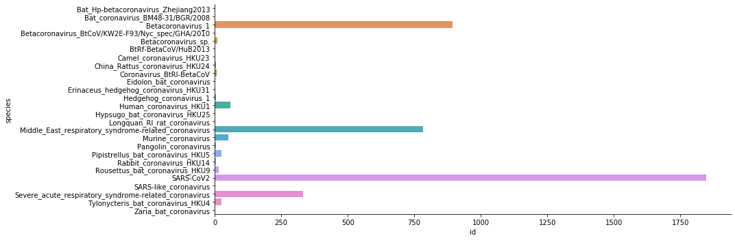
Distribution of Gene Dataset
Gene name | ORFab1 | S | ORF3a | E | M | ORF6a | ORF7a | ORF7b | ORF8 | N | ORF10
Sequence number | 3114 | 4101 | 1890 | 3190 | 3235 | 1862 | 1857 | 1722 | 1815 | 3663 | 1907
Species distribution of BetaCoV S gene

