Slide 1
CS 412 Intro. to Data Mining
Chapter 4. Data Warehousing and On-line Analytical Processing
Jiawei Han, Computer Science, Univ. Illinois at Urbana-Champaign, 2106

Slide 2

Notes:
TEMPLE OF OLYMPIAN ZEUS, Athens, Greece

Slide 3
Chapter 4: Data Warehousing and On-line Analytical Processing
Data Warehouse: Basic Concepts
Data Warehouse Modeling: Data Cube and OLAP
Data Warehouse Design and Usage
Data Warehouse Implementation
Summary

Slide 4
What is a Data Warehouse?
Defined in many different ways, but not rigorously
A decision support database that is maintained separately from the organization’s operational database
Support information processing by providing a solid platform of consolidated, historical data for analysis
“A data warehouse is a subject-oriented, integrated, time-variant, and nonvolatile collection of data in support of management’s decision-making process.”—W. H. Inmon
Data warehousing:
The process of constructing and using data warehouses

Slide 5
Data Warehouse—Subject-Oriented
Organized around major subjects, such as customer, product, sales
Focusing on the modeling and analysis of data for decision makers, not on daily operations or transaction processing
Provide a simple and concise view around particular subject issues by excluding data that are not useful in the decision support process

Slide 6
Data Warehouse—Integrated
Constructed by integrating multiple, heterogeneous data sources
relational databases, flat files, on-line transaction records
Data cleaning and data integration techniques are applied.
Ensure consistency in naming conventions, encoding structures, attribute measures, etc. among different data sources
Ex. Hotel price: differences on currency, tax, breakfast covered, and parking
When data is moved to the warehouse, it is converted

Slide 7
Data Warehouse—Time Variant
The time horizon for the data warehouse is significantly longer than that of operational systems
Operational database: current value data
Data warehouse data: provide information from a historical perspective (e.g., past 5-10 years)
Every key structure in the data warehouse
Contains an element of time, explicitly or implicitly
But the key of operational data may or may not contain “time element”

Slide 8
Data Warehouse—Nonvolatile
Independence
A physically separate store of data transformed from the operational environment
Static: Operational update of data does not occur in the data warehouse environment
Does not require transaction processing, recovery, and concurrency control mechanisms
Requires only two operations in data accessing:
initial loading of data and access of data

Slide 9
OLTP vs. OLAP
OLTP: Online transactional processing
DBMS operations
Query and transactional processing
OLAP: Online analytical processing
Data warehouse operations
Drilling, slicing, dicing, etc.

Slide 10
Why a Separate Data Warehouse?
High performance for both systems
DBMS— tuned for OLTP: access methods, indexing, concurrency control, recovery
Warehouse—tuned for OLAP: complex OLAP queries, multidimensional view, consolidation
Different functions and different data:
missing data: Decision support requires historical data which operational DBs do not typically maintain
data consolidation: DS requires consolidation (aggregation, summarization) of data from heterogeneous sources
data quality: different sources typically use inconsistent data representations, codes and formats which have to be reconciled
Note: There are more and more systems which perform OLAP analysis directly on relational databases

Slide 11
Data Warehouse: A Multi-Tiered Architecture
Top Tier: Front-End Tools
Middle Tier: OLAP Server
Bottom Tier: Data Warehouse Server
Data

Slide 12
Three Data Warehouse Models
Enterprise warehouse
Collects all of the information about subjects spanning the entire organization
Data Mart
A subset of corporate-wide data that is of value to a specific groups of users
Its scope is confined to specific, selected groups, such as marketing data mart
Independent vs. dependent (directly from warehouse) data mart
Virtual warehouse
A set of views over operational databases
Only some of the possible summary views may be materialized

Slide 13
Extraction, Transformation, and Loading (ETL)
Data extraction
get data from multiple, heterogeneous, and external sources
Data cleaning
detect errors in the data and rectify them when possible
Data transformation
convert data from legacy or host format to warehouse format
Load
sort, summarize, consolidate, compute views, check integrity, and build indicies and partitions
Refresh
propagate the updates from the data sources to the warehouse
Notes:
MK 08.11.09 Former title: Data Warehouse Back-End Tools and Utilities

Slide 14
Metadata Repository
Meta data is the data defining warehouse objects. It stores:
Description of the structure of the data warehouse
schema, view, dimensions, hierarchies, derived data defn, data mart locations and contents
Operational meta-data
data lineage (history of migrated data and transformation path), currency of data (active, archived, or purged), monitoring information (warehouse usage statistics, error reports, audit trails)
The algorithms used for summarization
The mapping from operational environment to the data warehouse
Data related to system performance
warehouse schema, view and derived data definitions
Business data
business terms and definitions, ownership of data, charging policies

Slide 15
Chapter 4: Data Warehousing and On-line Analytical Processing
Data Warehouse: Basic Concepts
Data Warehouse Modeling: Data Cube and OLAP
Data Warehouse Design and Usage
Data Warehouse Implementation
Summary

Slide 16
From Tables and Spreadsheets to Data Cubes
A data warehouse is based on a multidimensional data model which views data in the form of a data cube
A data cube, such as sales, allows data to be modeled and viewed in multiple dimensions
Dimension tables, such as item (item_name, brand, type), or time(day, week, month, quarter, year)
Fact table contains measures (such as dollars_sold) and keys to each of the related dimension tables
Data cube: A lattice of cuboids
In data warehousing literature, an n-D base cube is called a base cuboid
The top most 0-D cuboid, which holds the highest-level of summarization, is called the apex cuboid
The lattice of cuboids forms a data cube.

Slide 17
Data Cube: A Lattice of Cuboids
all
0-D (apex) cuboid
time
item
location
supplier
1-D cuboids
time,location
item,location
location,supplier
time,item
2-D cuboids
time,supplier
item,supplier
time,location,supplier
3-D cuboids
time,item,location
time,item,supplier
item,location,supplier
4-D (base) cuboid
time, item, location, supplier

Slide 18
Conceptual Modeling of Data Warehouses
Modeling data warehouses: dimensions & measures
Star schema: A fact table in the middle connected to a set of dimension tables
Snowflake schema: A refinement of star schema where some dimensional hierarchy is normalized into a set of smaller dimension tables, forming a shape similar to snowflake
Fact constellations: Multiple fact tables share dimension tables, viewed as a collection of stars, therefore called galaxy schema or fact constellation

Slide 19
Star Schema: An Example
time
time_key
day
day_of_the_week
month
quarter
year
item
item_key
item_name
brand
type
supplier_type
Sales Fact Table
time_key
item_key
branch_key
branch
location
location_key
branch_key
branch_name
branch_type
location_key
street
city
state_or_province
country
units_sold
dollars_sold
avg_sales
Measures

Slide 20
Snowflake Schema: An Example
time
item
time_key
day
day_of_the_week
month
quarter
year
item_key
item_name
brand
type
supplier_key
supplier
Sales Fact Table
supplier_key
supplier_type
time_key
item_key
branch_key
branch
location
location_key
location_key
street
city_key
branch_key
branch_name
branch_type
units_sold
dollars_sold
city
city_key
city
state_or_province
country
avg_sales
Measures

Slide 21
Fact Constellation: An Example
time
time_key
day
day_of_the_week
month
quarter
year
item
Shipping Fact Table
item_key
item_name
brand
type
supplier_type
Sales Fact Table
time_key
time_key
item_key
shipper_key
item_key
branch_key
from_location
branch
location_key
location
to_location
branch_key
branch_name
branch_type
units_sold
location_key
street
city
province_or_state
country
dollars_cost
dollars_sold
units_shipped
avg_sales
shipper
Measures
shipper_key
shipper_name
location_key
shipper_type

Slide 22
A Concept Hierarchy for a Dimension (location)
all
all
region
Europe
...
North_America
country
Germany
...
Spain
Canada
...
Mexico
city
Frankfurt
...
Vancouver
...
Toronto
office
L. Chan
...
M. Wind

Slide 23
Data Cube Measures: Three Categories
Distributive: if the result derived by applying the function to n aggregate values is the same as that derived by applying the function on all the data without partitioning
E.g., count(), sum(), min(), max()
Algebraic: if it can be computed by an algebraic function with M arguments (where M is a bounded integer), each of which is obtained by applying a distributive aggregate function
avg(x) = sum(x) / count(x)
Is min_N() an algebraic measure? How about standard_deviation()?
Holistic: if there is no constant bound on the storage size needed to describe a subaggregate.
E.g., median(), mode(), rank()

Slide 24
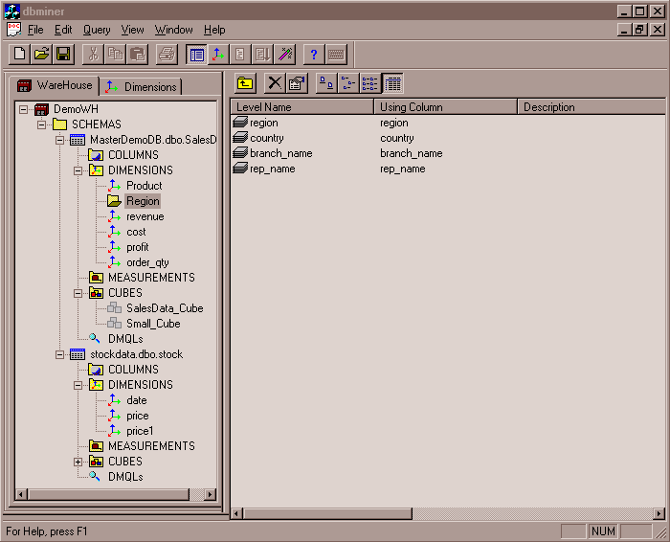
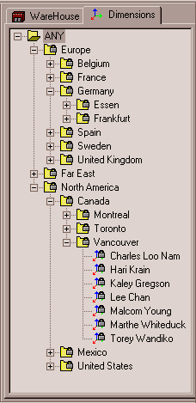
View of Warehouses and Hierarchies
Specification of hierarchies
Schema hierarchy
day < {month < quarter; week} < year
Set_grouping hierarchy
{1..10} < inexpensive

Slide 25
Multidimensional Data
Sales volume as a function of product, month, and region
Dimensions: Product, Location, Time
Hierarchical summarization paths
Region
Industry Region Year
Category Country Quarter
Product City Month Week
Office Day
Product
Month

Slide 26
A Sample Data Cube
Date
Total annual sales
of TVs in U.S.A.
1Qtr
2Qtr
3Qtr
4Qtr
sum
Product
TV
PC
U.S.A
VCR
sum
Canada
Country
Mexico
sum
All, All, All

Slide 27
Cuboids Corresponding to the Cube
all
0-D (apex) cuboid
product
date
country
1-D cuboids
product,date
product,country
date, country
2-D cuboids
3-D (base) cuboid
product, date, country

Slide 28
Typical OLAP Operations
Roll up (drill-up): summarize data
by climbing up hierarchy or by dimension reduction
Drill down (roll down): reverse of roll-up
from higher level summary to lower level summary or detailed data, or introducing new dimensions
Slice and dice: project and select
Pivot (rotate):
reorient the cube, visualization, 3D to series of 2D planes
Other operations
Drill across: involving (across) more than one fact table
Drill through: through the bottom level of the cube to its back-end relational tables (using SQL)

Slide 29
Typical OLAP Operations

Slide 30
A Star-Net Query Model
Customer Orders
Shipping Method
Customer
CONTRACTS
AIR-EXPRESS
ORDER
TRUCK
PRODUCT LINE
Time
Product
ANNUALY
QTRLY
DAILY
PRODUCT ITEM
PRODUCT GROUP
CITY
SALES PERSON
COUNTRY
DISTRICT
REGION
DIVISION
Location
Each circle is called a footprint
Promotion
Organization

Slide 31
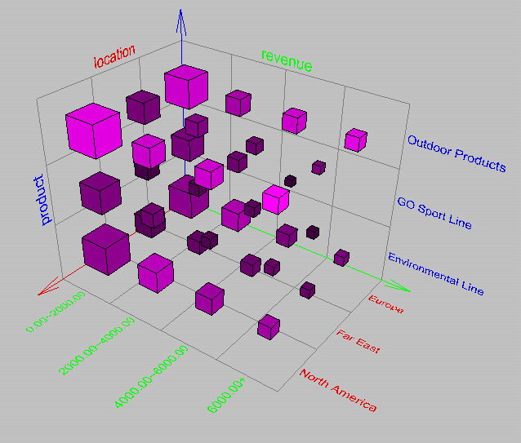
Browsing a Data Cube
Visualization
OLAP capabilities
Interactive manipulation

Slide 32
Chapter 4: Data Warehousing and On-line Analytical Processing
Data Warehouse: Basic Concepts
Data Warehouse Modeling: Data Cube and OLAP
Data Warehouse Design and Usage
Data Warehouse Implementation
Summary

Slide 33
Design of Data Warehouse: A Business Analysis Framework
Four views regarding the design of a data warehouse
Top-down view
allows selection of the relevant information necessary for the data warehouse
Data source view
exposes the information being captured, stored, and managed by operational systems
Data warehouse view
consists of fact tables and dimension tables
Business query view
sees the perspectives of data in the warehouse from the view of end-user

Slide 34
Data Warehouse Design Process
Top-down, bottom-up approaches or a combination of both
Top-down: Starts with overall design and planning (mature)
Bottom-up: Starts with experiments and prototypes (rapid)
From software engineering point of view
Waterfall: structured and systematic analysis at each step before proceeding to the next
Spiral: rapid generation of increasingly functional systems, short turn around time, quick turn around
Typical data warehouse design process
Choose a business process to model, e.g., orders, invoices, etc.
Choose the grain (atomic level of data) of the business process
Choose the dimensions that will apply to each fact table record
Choose the measure that will populate each fact table record

Slide 35
Data Warehouse Usage
Three kinds of data warehouse applications
Information processing
supports querying, basic statistical analysis, and reporting using crosstabs, tables, charts and graphs
Analytical processing
multidimensional analysis of data warehouse data
supports basic OLAP operations, slice-dice, drilling, pivoting
Data mining
knowledge discovery from hidden patterns
supports associations, constructing analytical models, performing classification and prediction, and presenting the mining results using visualization tools

Slide 36
From On-Line Analytical Processing (OLAP) to On Line Analytical Mining (OLAM)
Why online analytical mining?
High quality of data in data warehouses
DW contains integrated, consistent, cleaned data
Available information processing structure surrounding data warehouses
ODBC, OLEDB, Web accessing, service facilities, reporting and OLAP tools
OLAP-based exploratory data analysis
Mining with drilling, dicing, pivoting, etc.
On-line selection of data mining functions
Integration and swapping of multiple mining functions, algorithms, and tasks

Slide 37
Chapter 4: Data Warehousing and On-line Analytical Processing
Data Warehouse: Basic Concepts
Data Warehouse Modeling: Data Cube and OLAP
Data Warehouse Design and Usage
Data Warehouse Implementation
Summary

Slide 38
Efficient Data Cube Computation
Data cube can be viewed as a lattice of cuboids
The bottom-most cuboid is the base cuboid
The top-most cuboid (apex) contains only one cell
How many cuboids in an n-dimensional cube with L levels?
Materialization of data cube
Full materialization: Materialize every (cuboid)
No materialization: Materialize none (cuboid)
Partial materialization: Materialize some cuboids
Which cuboids to materialize?
Selection based on size, sharing, access frequency, etc.
Why this formula?
Industry Region Year
Category Country Quarter
Product City Month Week
Office Day

Slide 39
The “Compute Cube” Operator
Cube definition and computation in DMQL
define cube sales [item, city, year]: sum (sales_in_dollars)
compute cube sales
Transform it into a SQL-like language (with a new operator cube by, introduced by Gray et al.’96)
SELECT item, city, year, SUM (amount)
FROM SALES
CUBE BY item, city, year
Need compute the following Group-Bys
(date, product, customer),
(date, product),(date, customer), (product, customer),
(date), (product), (customer)
()
()
(city)
(item)
(year)
(city, item)
(city, year)
(item, year)
(city, item, year)

Slide 40
Indexing OLAP Data: Bitmap Index
Index on a particular column
Each value in the column has a bit vector: bit-op is fast
The length of the bit vector: # of records in the base table
The i-th bit is set if the i-th row of the base table has the value for the indexed column
not suitable for high cardinality domains
A recent bit compression technique, Word-Aligned Hybrid (WAH), makes it work for high cardinality domain as well [Wu, et al. TODS’06]
Base table
Index on Region
Index on Type
Notes:
Bit-map index compression methods should be introduced -JH

Slide 41
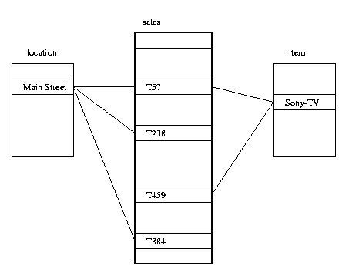
Indexing OLAP Data: Join Indices
Join index: JI(R-id, S-id) where R (R-id, …)  S (S-id, …)
Traditional indices map the values to a list of record ids
It materializes relational join in JI file and speeds up relational join
In data warehouses, join index relates the values of the dimensions of a start schema to rows in the fact table.
E.g., fact table: Sales and two dimensions city and product
A join index on city maintains for each distinct city a list of R-IDs of the tuples recording the Sales in the city
Join indices can span multiple dimensions

Slide 42
Efficient Processing OLAP Queries
Determine which operations should be performed on the available cuboids
Transform drill, roll, etc. into corresponding SQL and/or OLAP operations, e.g., dice = selection + projection
Determine which materialized cuboid(s) should be selected for OLAP op.
Let the query to be processed be on {brand, province_or_state} with the condition “year = 2004”, and there are 4 materialized cuboids available:
1) {year, item_name, city}
2) {year, brand, country}
3) {year, brand, province_or_state}
4) {item_name, province_or_state} where year = 2004
Which should be selected to process the query?
Explore indexing structures and compressed vs. dense array structs in MOLAP

Slide 43
OLAP Server Architectures
Relational OLAP (ROLAP)
Use relational or extended-relational DBMS to store and manage warehouse data and OLAP middle ware
Include optimization of DBMS backend, implementation of aggregation navigation logic, and additional tools and services
Greater scalability
Multidimensional OLAP (MOLAP)
Sparse array-based multidimensional storage engine
Fast indexing to pre-computed summarized data
Hybrid OLAP (HOLAP) (e.g., Microsoft SQLServer)
Flexibility, e.g., low level: relational, high-level: array
Specialized SQL servers (e.g., Redbricks)
Specialized support for SQL queries over star/snowflake schemas

Slide 44
Chapter 4: Data Warehousing and On-line Analytical Processing
Data Warehouse: Basic Concepts
Data Warehouse Modeling: Data Cube and OLAP
Data Warehouse Design and Usage
Data Warehouse Implementation
Summary

Slide 45
Summary
Data warehousing: A multi-dimensional model of a data warehouse
A data cube consists of dimensions & measures
Star schema, snowflake schema, fact constellations
OLAP operations: drilling, rolling, slicing, dicing and pivoting
Data Warehouse Architecture, Design, and Usage
Multi-tiered architecture
Business analysis design framework
Information processing, analytical processing, data mining, OLAM
Implementation: Efficient computation of data cubes
Partial vs. full vs. no materialization
Indexing OALP data: Bitmap index and join index
OLAP query processing
OLAP servers: ROLAP, MOLAP, HOLAP

Slide 46
References (I)
S. Agarwal, R. Agrawal, P. M. Deshpande, A. Gupta, J. F. Naughton, R. Ramakrishnan, and S. Sarawagi. On the computation of multidimensional aggregates. VLDB’96
D. Agrawal, A. E. Abbadi, A. Singh, and T. Yurek. Efficient view maintenance in data warehouses. SIGMOD’97
R. Agrawal, A. Gupta, and S. Sarawagi. Modeling multidimensional databases. ICDE’97
S. Chaudhuri and U. Dayal. An overview of data warehousing and OLAP technology. ACM SIGMOD Record, 26:65-74, 1997
J. Gray, et al. Data cube: A relational aggregation operator generalizing group-by, cross-tab and sub-totals. Data Mining and Knowledge Discovery, 1:29-54, 1997.
A. Gupta and I. S. Mumick. Materialized Views: Techniques, Implementations, and Applications. MIT Press, 1999
J. Han. Towards on-line analytical mining in large databases. SIGMOD Record, 1998
V. Harinarayan, A. Rajaraman, and J. D. Ullman. Implementing data cubes efficiently. SIGMOD’96

Slide 47
References (II)
C. Imhoff, N. Galemmo, and J. G. Geiger. Mastering Data Warehouse Design: Relational and Dimensional Techniques. John Wiley, 2003
W. H. Inmon. Building the Data Warehouse. John Wiley, 1996
R. Kimball and M. Ross. The Data Warehouse Toolkit: The Complete Guide to Dimensional Modeling. 2ed. John Wiley, 2002
P. O'Neil and D. Quass. Improved query performance with variant indexes. SIGMOD'97
S. Sarawagi and M. Stonebraker. Efficient organization of large multidimensional arrays. ICDE'94
P. Valduriez. Join indices. ACM Trans. Database Systems, 12:218-246, 1987.
J. Widom. Research problems in data warehousing. CIKM’95.
K. Wu, E. Otoo, and A. Shoshani, Optimal Bitmap Indices with Efficient Compression, ACM Trans. on Database Systems (TODS), 31(1), 2006, pp. 1-38.

Slide 48


