Slide 1
Interactive Computer Graphics CS 418 – Fall 2016
TA: Apollo Ellis, Ryan Freedman,
Mary Pietrowicz
Originally created by Mahsa Kamali

Slide 2
Agenda for today
Communication Channels & Resources
Demo code for basic animation

Slide 3
Piazza
Post questions that might be beneficial to everyone
www.piazza.com
Don’t wait until the night before the MP/HW is due
Send your questions and ask for help soon!

Slide 4
TA Info
TAs:
Apollo Ellis. Office Hour: TBD
Email: aiellis2 at illinois.edu
Mary Pietrowicz. Ofc. Hour: Friday 2:00-3:00 SC 0207
Email: mpietro2 at illinois.edu
Ryan Freedman. Office Hour: Thurs 3-4pm SC 0207
Email: rtfreed2 at illinois.edu

Slide 5
Resources
Google, StackOverflow, Lighthouse 3D……
Tutorials
http://www.tutorialspoint.com/webgl/
http://learningwebgl.com/blog/?page_id=1217

Slide 6
Student Graphics @ Illinois
UIUC Student Chapter of ACM SIGGRAPH
http://www.acm.uiuc.edu/siggraph/
Short Films, Video Games, Graphics Research
GameBuilders
http://www.acm.uiuc.edu/gamebuilders/
Video Games

Slide 7
Demo - HelloAnimation

Slide 8
Brackets
Useful Editor for WebGL
http://brackets.io
File->Open Folder points Brackets to your code
Click on a file to edit it, File->Save to save it
To run a WebGL program, click on its html file, then click the lightening bolt

Slide 9
Chrome Development Tools - 1
Recommended Development Environment
http://www.google.com/chrome
Built-in debugging environment within Google Chrome browser
Use this to set breakpoints, examine variables, etc. (the usual debugging functions)

Slide 10
Chrome Development Tools - 2
Point Chrome at the directory which contains your code
Go to Chrome browser menu. View->Developer->Developer Tools
Right click on any file to inspect it

Slide 11
Chrome Development Tools - 3
Shortcuts:
Ctrl+Shift+I (Cmd+Opt+I on the Mac) to open DevTools
Ctrl+Shift+J(Cmd+Opt+J on the Mac) to open console
Ctrl+Shift+C(Cmd+Shift+C on the Mac) to open DevTools in Inspect Element mode.

Slide 12
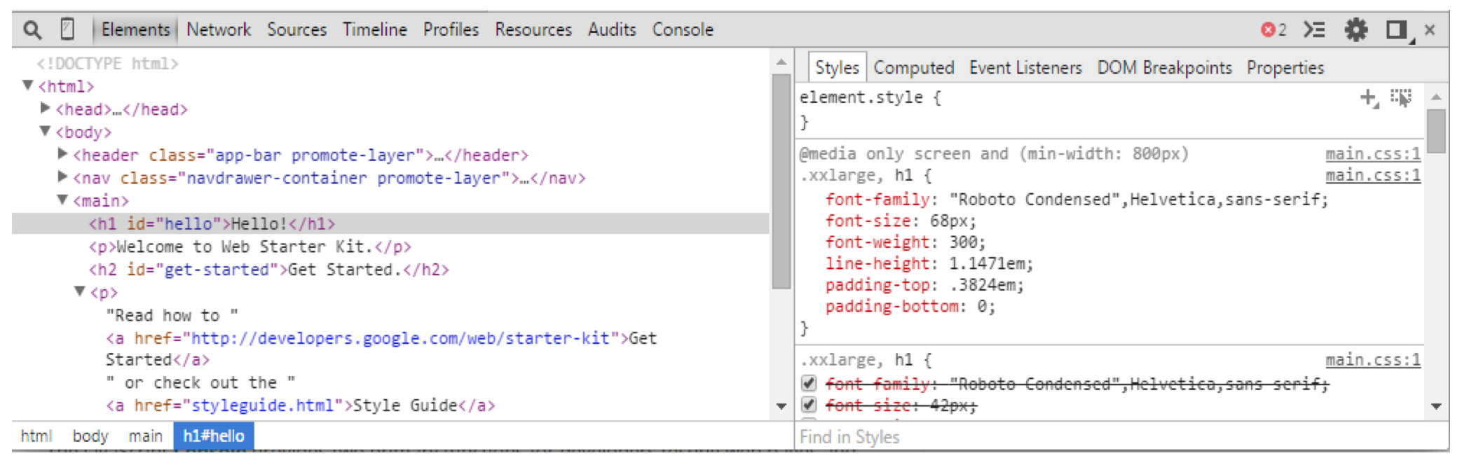
Chrome Development Tools - 4
Elements Panel: Inspect and live-edit the HTML and CSS of the webpage.

Slide 13
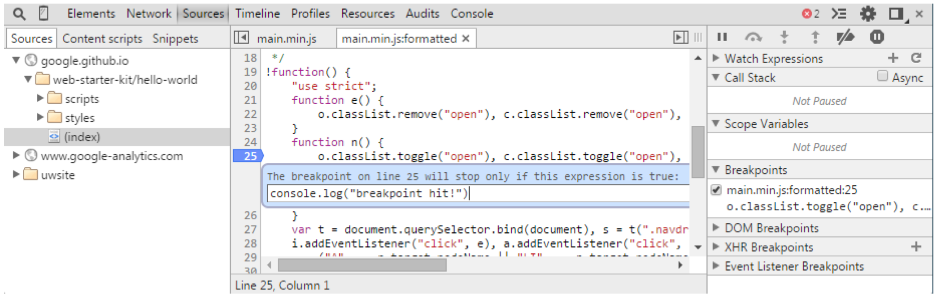
Chrome Development Tools - 5
Sources Panel: Used to debug your JavaScript code using breakpoints

Slide 14
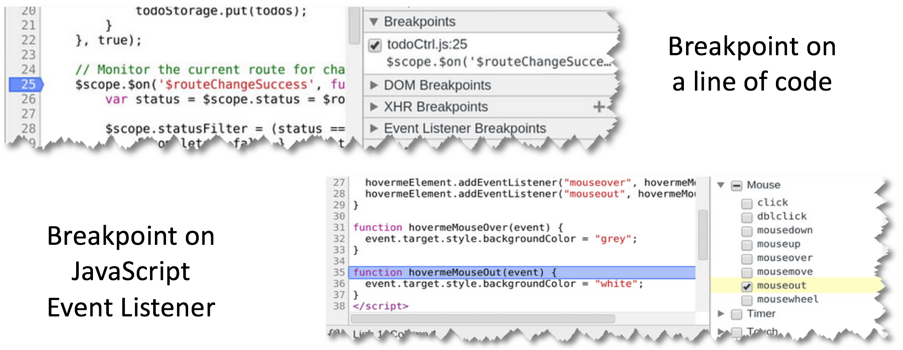
Chrome Development Tools - 6
Setting a breakpoint:

Slide 15
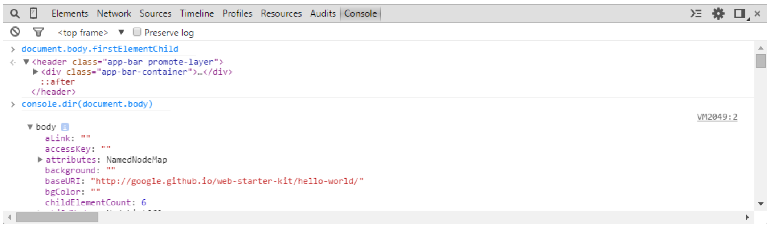
Chrome Development Tools - 7
Console Panel: Used to log diagnostic information in the development process and provide shell prompt which can be used to interact with the document and DevTools.

Slide 16
Exercise
Download Brackets if you need an editor
Download HelloAnimation demo code
Available on course website:
https://courses.engr.illinois.edu/cs418/discussion.html
Your Mission:
Modify the code to display a capital block I instead of an L
Color it in a gradient from orange to blue

Slide 17
Exercise Walk-Through

Slide 18
Tips for success
Start Early
Write modular code (test progressively)
Compile often
Ask questions early (if it bugs you ask)
Avoid long (all night) debug sessions
Take breaks during debugging (sleep)
Start Early

