Slide 1
Interactive Computer Graphics CS 418 – Fall 2016 Mesh Rendering and Transformation in WebGL
TAs: Mary Pietrowicz
Ryan Freedman
Apollo Ellis
Background Imagery:
http://www.cs.cmu.edu/~kmcrane/Projects/ModelRepository/yeahright.png

Slide 2
Agenda
Mesh Structure
Drawing with WebGL
Matrix transformation
Animation Demo

Slide 3
Mesh Structure (Indexed Face Set)
Stores vertex attributes in one array and face indices in another array
Here is what we’ve seen, drawing two triangles
vertexPositionBuffer = gl.createBuffer();
var triangleVertices = new Float32Array([
0.50, 0.75, 0.0,
-0.5, 0.75, 0.0,
-0.5, -0.75, 0.0,
-0.5, -0.75, 0.0,
0.50, -0.75, 0.0,
0.50, 0.75, 0.0
]);

Slide 4
Mesh Structure
Here is what’s possible with indexing
vertexPositionBuffer = gl.createBuffer();
indexBuffer = gl.createBuffer();
var vertices = new Float32Array([
0.50, 0.75, 0.0,
-0.50, 0.75, 0.0,
-0.50, -0.75, 0.0,
0.50, -0.75, 0.0
]);
var indices = new Int32Array([
0,1,2,
2,3,0
]);

Slide 5
Display Your Mesh
Assuming you’ve set up the view/projection transformation.
gl.bindBuffer(gl.ARRAY_BUFFER, vertexPositionBuffer);
gl.bufferData(gl.ARRAY_BUFFER, vertices ,gl.STATIC_DRAW);
vertexPositionBuffer.itemSize = 3;
vertexPositionBuffer.numberOfItems = 4;
gl.bindBuffer(gl.ELEMENT_ARRAY_BUFFER, indexBuffer);
gl.bufferData(gl.ELEMENT_ARRAY_BUFFER, indices ,gl.STATIC_DRAW);
indexBuffer.itemSize = 1;
indexBuffer.numberOfItems = 6;
gl.drawElements(gl.TRIANGLES, 2, gl.UNSIGNED_INT, 0);

Slide 6
Color Your Mesh
colors = new Float32Array([
1.0, 0.0, 0.0, 1.0, //red
0.0, 1.0, 0.0, 1.0, //green
0.0, 0.0, 1.0, 1.0, //blue
0.0, 0.0, 0.0, 1.0 //black
]);
gl.bindBuffer(gl.ARRAY_BUFFER, vertexColorBuffer);
gl.bufferData(gl.ARRAY_BUFFER, colors ,gl.STATIC_DRAW);
vertexColorBuffer.itemSize = 4; vertexColorBuffer.numberOfItems = 4;

Slide 7
Shade Your Mesh
Bind the program
Get the variable location
Enable that shader variable
Do all the buffer setup we just saw
Finally point the shader variable to the buffers we created earlier
gl.useProgram(exampleShaderProgram);
shaderProgram.vertexPositionAttribute = gl.getAttribLocation(shaderProgram, "aVertexPosition");
gl.enableVertexAttribArray(shaderProgram.vertexPositionAttribute);
…
gl.vertexAttribPointer(shaderProgram.vertexPositionAttribute,
vertexPositionBuffer.itemSize, gl.FLOAT, false, 0, 0);

Slide 8
In a Nut Shell
gl.bindBuffer(gl.ARRAY_BUFFER, vertexPositionBuffer);
gl.bufferData(gl.ARRAY_BUFFER, vertices ,gl.STATIC_DRAW);
vertexPositionBuffer.itemSize = 3;
vertexPositionBuffer.numberOfItems = 4;
gl.vertexAttribPointer(shaderProgram.vertexPositionAttribute,
vertexPositionBuffer.itemSize, gl.FLOAT, false, 0, 0);
gl.bindBuffer(gl.ARRAY_BUFFER, vertexColorBuffer);
gl.bufferData(gl.ARRAY_BUFFER, colors ,gl.STATIC_DRAW);
vertexColorBuffer.itemSize = 4;
vertexColorBuffer.numberOfItems = 4;
gl.vertexAttribPointer(shaderProgram.vertexColorAttribute,
vertexColorBuffer.itemSize, gl.FLOAT, false, 0, 0);
gl.bindBuffer(gl.ELEMENT_ARRAY_BUFFER, indexBuffer);
gl.bufferData(gl.ELEMENT_ARRAY_BUFFER, indices ,gl.STATIC_DRAW);
indexBuffer.itemSize = 1;
indexBuffer.numberOfItems = 6;
gl.bindBuffer(gl.ELEMENT_ARRAY_BUFFER, indexBuffer);
gl.drawElements(gl.TRIANGLES, indexBuffer.numberOfItems, gl.UNSIGNED_SHORT, 0);

Slide 9
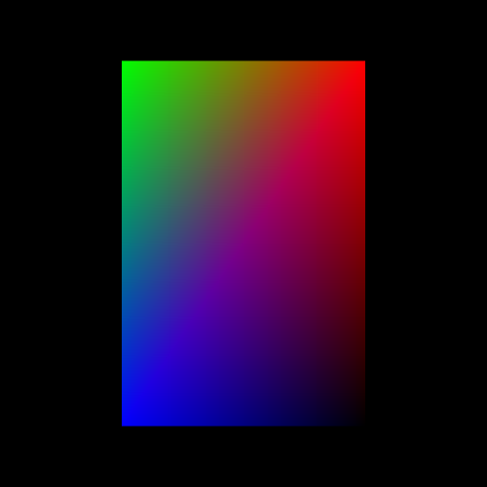
Result

Slide 10
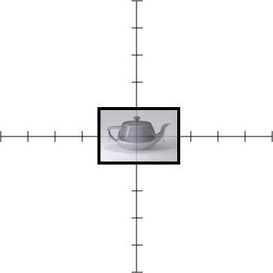
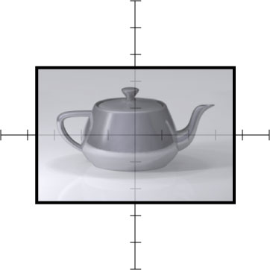
Review of Matrix Ops.
Scale
Notes:
10

Slide 11
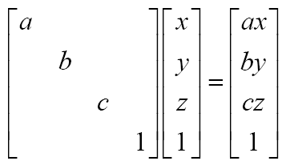
Scaling
Notes:
11

Slide 12
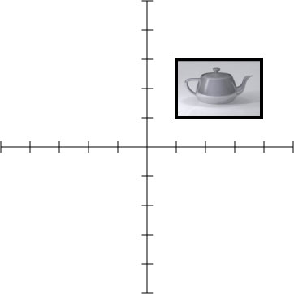
Translation
Notes:
12

Slide 13
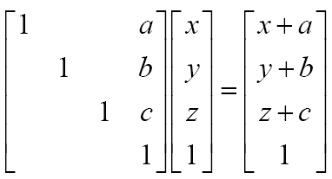
Translation
Notes:
13

Slide 14
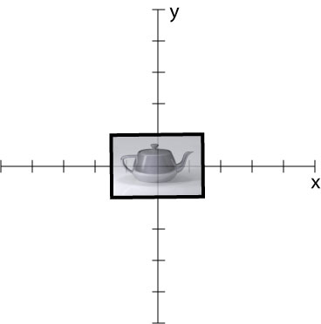
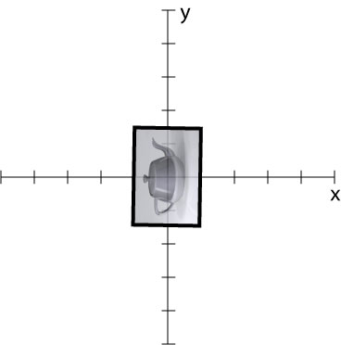
Rotation
Notes:
14

Slide 15
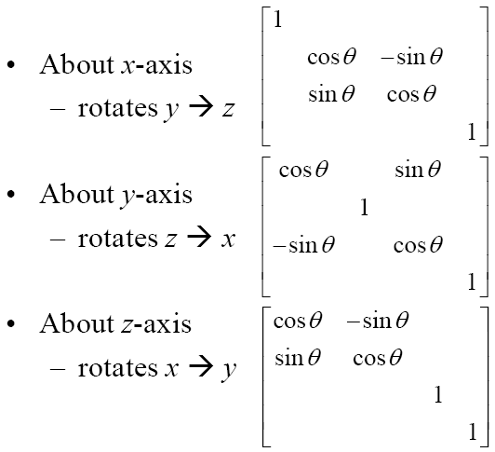
Rotation
You may also specify rotation about an arbitrary axis.
Notes:
15

Slide 16
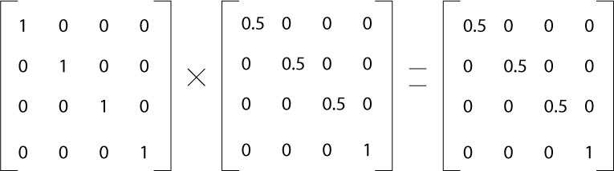
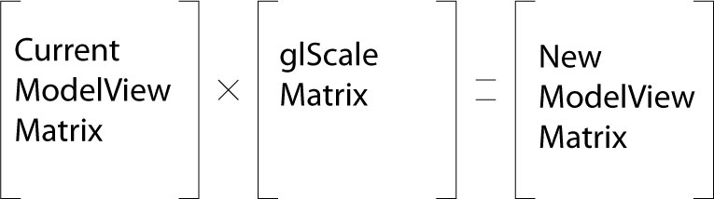
Last Transform Applied First
var mvMatrix = mat4.create();
var mvMatrix = mat4.create();
mat4.rotateX(mvMatrix…)
mat4.translate(mvMatrix…)
mat4.translate(mvMatrix…)
mat4.rotateX(mvMatrix…)
M=I
R
T
M=I
T
R

Slide 17
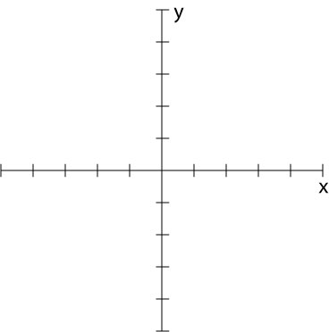
Exercise
Draw the result of the following OpenGL transformation code.
var mvMatrix = mat4.create();
mat4.scale(mvMatrix,mvMatrix,vec3.fromValues(1.5, 1.0, 1.0));
mat4.rotateZ(mvMatrix, mvMatrix, degToRad(90));
mat4.translate(mvMatrix, mvMatrix,vec3.fromValues(2.0, 2.0, 0.0));
draw_teapot_image();

Slide 18
Exercise
var mvMatrix = mat4.create();
mat4.scale(mvMatrix,mvMatrix,vec3.fromValues(1.5, 1.0, 1.0));
mat4.rotateZ(mvMatrix, mvMatrix, degToRad(90));
mat4.translate(mvMatrix, mvMatrix,vec3.fromValues(2.0, 2.0, 0.0));
draw_teapot_image();

Slide 19
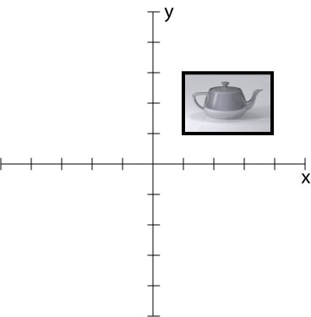
Exercise
var mvMatrix = mat4.create();
mat4.scale(mvMatrix,mvMatrix,vec3.fromValues(1.5, 1.0, 1.0));
mat4.rotateZ(mvMatrix, mvMatrix, degToRad(90));
mat4.translate(mvMatrix, mvMatrix,vec3.fromValues(2.0, 2.0, 0.0));
draw_teapot_image();

Slide 20
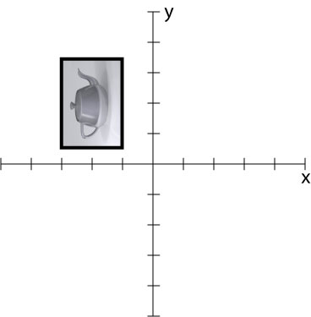
Exercise
var mvMatrix = mat4.create();
mat4.scale(mvMatrix,mvMatrix,vec3.fromValues(1.5, 1.0, 1.0));
mat4.rotateZ(mvMatrix, mvMatrix, degToRad(90));
mat4.translate(mvMatrix, mvMatrix,vec3.fromValues(2.0, 2.0, 0.0));
draw_teapot_image();

Slide 21
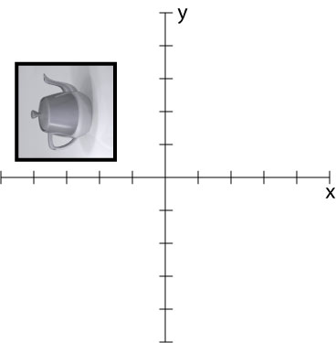
Exercise
var mvMatrix = mat4.create();
mat4.scale(mvMatrix,mvMatrix,vec3.fromValues(1.5, 1.0, 1.0));
mat4.rotateZ(mvMatrix, mvMatrix, degToRad(90));
mat4.translate(mvMatrix, mvMatrix,vec3.fromValues(2.0, 2.0, 0.0));
draw_teapot_image();

Slide 22
Column Major (i.e. We Must Transpose)
Given a 1D array of 16 floats:
1 | 2 | 3 | 4 | 5 | 6 | 7 | 8 | 9 | 10 | 11 | 12 | 13 | 14 | 15 | 16
Matrix in WebGL :
1 | 5 | 9 | 13
2 | 6 | 10 | 14
3 | 7 | 11 | 15
4 | 8 | 12 | 16

Slide 23
Animation Demo

Slide 24
Q&A

