Slide 1
CS 418: Normal Mapping

Slide 2
Normal Textures vs Basic Textures
We store XYZ normal values as ranging from -1 to +1 in each texel of a normal texture
We can store these values in an RGB texture by converting:
Color.rgb = Normal.xyz / 2.0 + 0.5;
We can extract these normal values from RGB as well:
NormalMap = texture2D(NormalMapTex, TexCoord); Normal.xyz = NormalMap.rgb * 2.0 - 1.0;

Slide 3
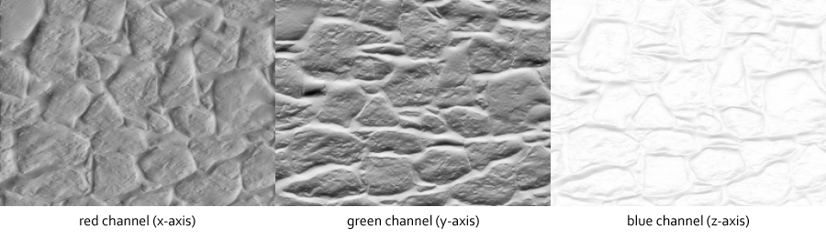
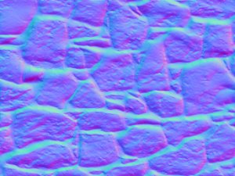
Normal Map
Normal values loaded as a texture and dictate how light will behave
Lambertian example (from lwjgl basics):
N = normalize(Normal.xyz) L = normalize(LightDir.xyz) Diffuse = LightColor * max(dot(N, L), 0.0) Ambient = AmbientColor * AmbientIntensity Attenuation = 1.0 / (ConstantAtt + (LinearAtt * Distance) + (QuadraticAtt * Distance * Distance)) Intensity = Ambient + Diffuse * Attenuation FinalColor = DiffuseColor.rgb * Intensity.rgb

Slide 4
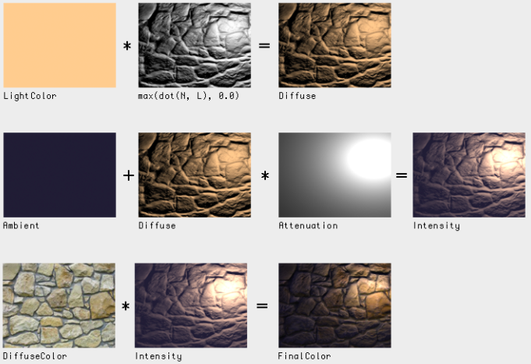
Application as a texture

Slide 5
Application as a texture
Bind as a normal texture:
gl.activeTexture(gl.TEXTURE1); gl.bindTexture(gl.TEXTURE_2D, normalTexture);
Fragment Shader (omitting color calculations)
vec3 NormalMap = texture2D(u_normals, vTexCoord).rgb; vec3 N = normalize(NormalMap * 2.0 - 1.0); vec3 Diffuse = (LightColor.rgb * LightColor.a) * max(dot(N, L), 0.0); gl_FragColor = vColor * vec4(FinalColor, DiffuseColor.a);

Slide 6
Some New Notation: Class Definition
In the file Classname.js:
Function Classname(parameter) {
var self = this;
this.a_variable = something;
// Do other processing here...
}

Slide 7
Some New Notation: Object Functions
In the file Classname.js:
Classname.prototype.doSomething = function(parameter) {
// Perform function here
…
gl.bindTexture(gl.TEXTURE_2D, null);
}

Slide 8
Some New Notation: JavaScript Class Instantiation
Instance1 = new Classname(parameter_list1);
Instance2 = new Classname(parameter_list2);

Slide 9
References
https://github.com/mattdesl/lwjgl-basics/wiki/ShaderLesson6
https://www.clicktorelease.com/code/spherical-normal-mapping/

