Slide 1
CS427: Software Engineering I
Grigore Rosu

Slide 2
Today’s goals
Logistics
Wiki
Piazza
Video lectures
MP0 – VMs should be available asap; optional anyway
What is K?
Needed for MPS and projects

Slide 3
Course Logistics
Any problems with Wiki?
http://wiki.cites.illinois.edu/wiki/display/cs427fa16
Any problems with Piazza?
https://piazza.com/class#fall2016/cs427
Email me (with “CS427” subject) if needed
Reminder: lot “broad but shallow” reading
Book chapters and papers will be on EXAMS

Slide 4
Grade
MPs (30%), exam (30%), project (40%)
Bonus up to 5% for active participation (lectures, quizzes, Piazza, team…)
For 4 hours of credit: additional work
Either contribute to K or read a book and write a book report
25% of your grade; rest of 75% same like for 3 credits
https://wiki.cites.illinois.edu/wiki/display/cs427fa16/4th+Credit+Hour+Task
Need to log in to access (because of FERPA)
Email me (with “CS427”) if you cannot access
Page currently outdated; please wait a few days before deciding

Slide 5
MP0
Due by 23:59:59pm on Tuesday, August 30
You can keep resubmitting until deadline
Please follow the rules and the format specified on Wiki
This MP is almost all about
“can you follow instructions?”

Slide 6
Last time: SE and processes
IEEE 610 (Software engineering)
“The application of a systematic, disciplined, quantifiable approach to the development, operation, and maintenance of software.”
IEEE 1074 (Software process)
“A set of activities performed towards a specific purpose [of building software]”

Slide 7
Reminder: Purpose of course
Be able to join a software project group and follow their process
Goals
Learn a particular process (XP)
Learn steps common to most processes
Software configuration management (SCM), testing, metrics, documentation, reverse engineering, refactoring
Learn how to follow a process
Learn how to change/improve a process

Slide 8
Reminder: Project
Learn architecture of large software project
K framework: www.kframework.org
Learn modern SE practices - SCM, unit testing, automated build, documentation, pair programming, refactoring
Learn modern SE environment – IntelliJ
Optional
Learn a process - XP
Start at bottom and work your way up

Slide 9
What is K ?
Framework / meta-language for defining / designing / implementing programming languages and analysis tools for them
Webpage with an online tutorial and links
http://kframework.org
Open-source:
https://github.com/kframework/k

Slide 10



A Semantic Framework for Programming Languages and Formal Analysis Tools
University of Illinois at Urbana-Champaign
Runtime Verification, Inc.

Slide 11
Ideal Language Framework Vision
…
Deductive program verifier
Parser
Interpreter
Formal Language Definition
(Syntax and Semantics)
Model checker
Compiler
Symbolic execution
(semantic) Debugger
Notes:
K is a language design framework and suite of tools.
Its vision is to allow and encourage the language designers to formally define their languages once and for all, using an intuitive and attractive notation, and then obtain essentially for free implementations as well as analysis tools for the defined languages.
This is a long-standing dream of the programming language community.
Our objective in the K project is to develop the foundations, techniques, and tools to make this dream a reality.

Slide 12
Towards an Ideal Language Framework
Does it really work, or it is just another dream?
We tried various semantic styles
Small-step and big-step SOS; Evaluation contexts; Chemical abstract machine; Continuation-based style; Denotational; Rewriting logic; …
But each of the above had limitations
Especially related to modularity, notation, verification
K framework initially engineered: keep advantages and avoid limitations of various semantic styles
Then theory came

Slide 13


K Team
http://kframework.org
UIUC, USA
Grigore Rosu (started K in 2003)
Brandon Moore
Daejun Park
Lucas Pena
Cosmin Radoi
Manasvi Saxena
Andrei Stefanescu
Former members
Kyle Blocher, Thomas Bogue, Peter Dinges, Chucky Ellison, Cansu Erdogan, Dwight Guth, Mike Ilseman, David Lazar, Patrick Meredith, Erick Mikida, Traian Serbanuta, Yuwen Shijiao
Runtime Verification, Inc., USA
Dwight Guth
Chris Hathhorn
Edgar Pek
Romania
Dorel Lucanu
Traian Florin Serbanuta
Andrei Arusoae
Stefan Ciobaca
Radu Mereuta
Former Members
Irina Asavoae, Mihai Asavoae, Denis Bogdanas, Gheorghe Grigoras
Notes:
Traian Serbanuta is currently the K tool development lead.

Slide 14
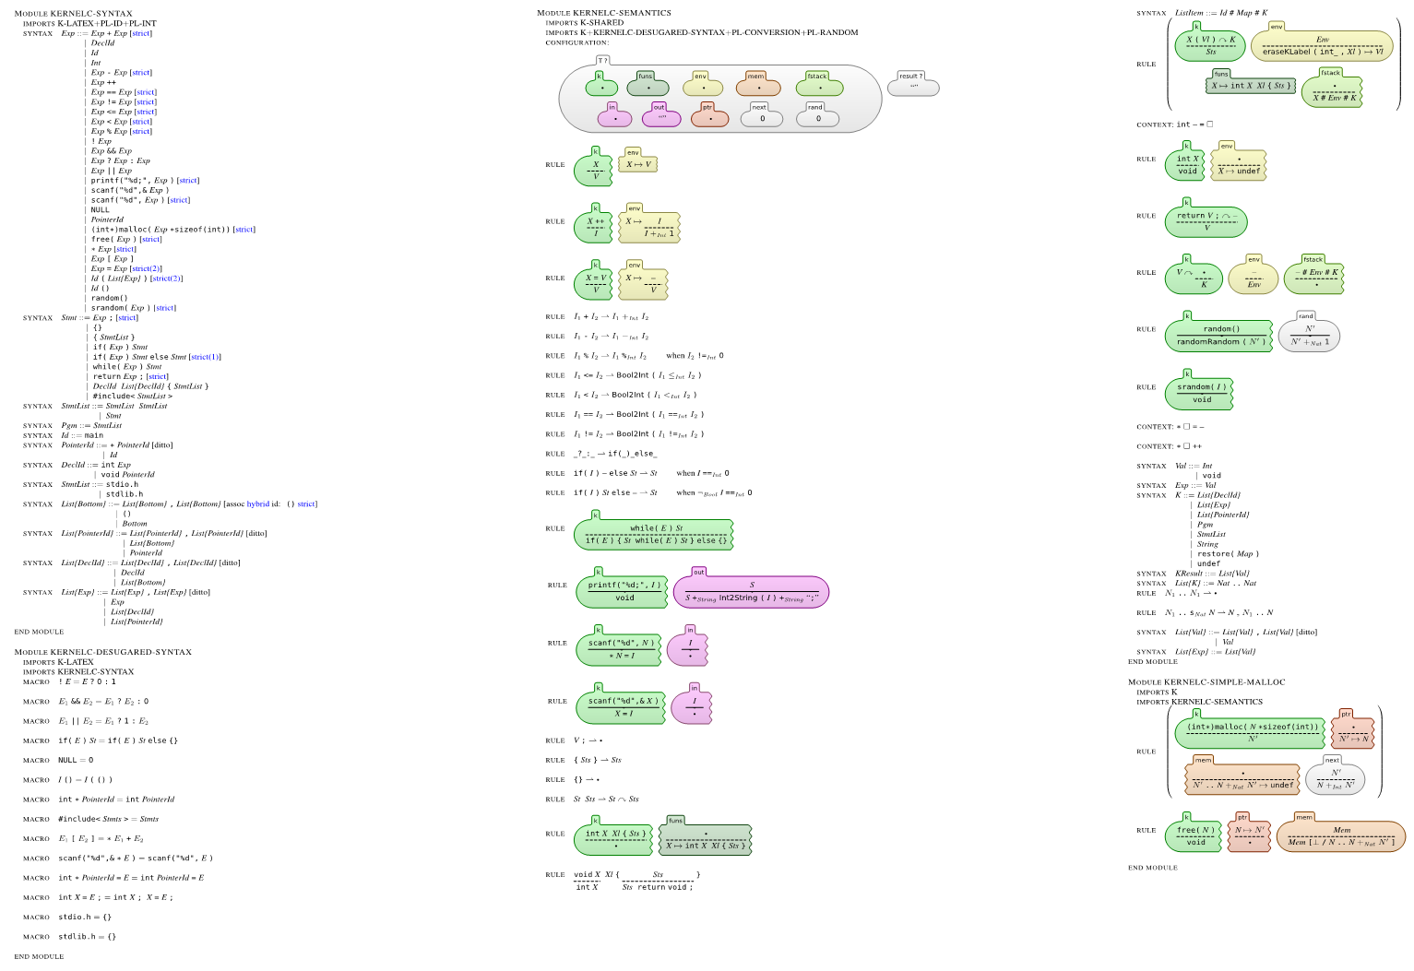
Complete K Definition of KernelC
Notes:
Here is a complete definition of a fragment of C, called KernelC, as generated by the K tool.
The left column defines its formal syntax and the other two its formal semantics.
I will next zoom through this definition and highlight some of the K tool’s features.

Slide 15
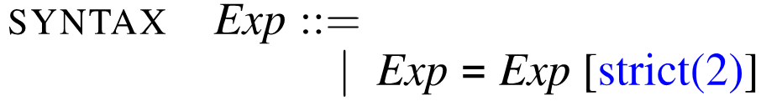
Complete K Definition of KernelC
Syntax declared using annotated BNF
Notes:
Here is a complete definition of a fragment of C, called KernelC, as generated by the K tool.
The left column defines its formal syntax and the other two its formal semantics.
I will next zoom through this definition and highlight some of the K tool’s features.

Slide 16
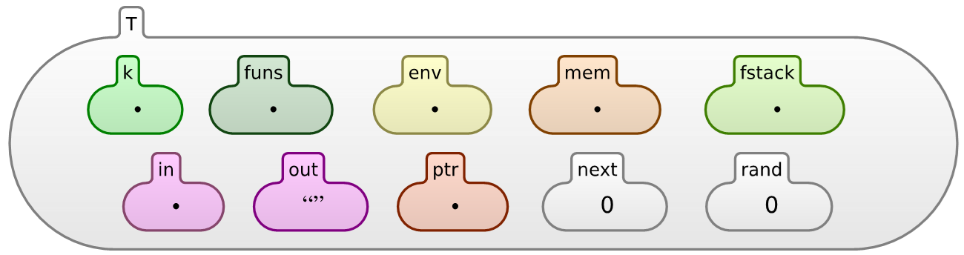
Complete K Definition of KernelC
Configuration given as a nested cell structure.
Leaves can be sets, multisets, lists, maps, or syntax
Notes:
Here is a complete definition of a fragment of C, called KernelC, as generated by the K tool.
The left column defines its formal syntax and the other two its formal semantics.
I will next zoom through this definition and highlight some of the K tool’s features.

Slide 17
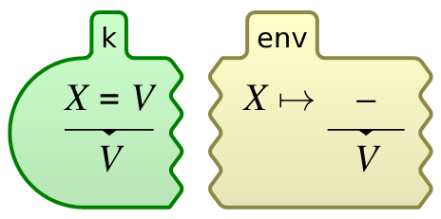
Complete K Definition of KernelC
Semantic rules given contextually
rule
<k> X = V => V …</k>
<env>… X |-> (_ => V) …</env>
Notes:
Here is a complete definition of a fragment of C, called KernelC, as generated by the K tool.
The left column defines its formal syntax and the other two its formal semantics.
I will next zoom through this definition and highlight some of the K tool’s features.

Slide 18
Defining Languages in K
Go to http://kframework.org; then Online interface; then folder tutorial; or in the k folder on your VM
Discuss the following languages and then kompile them and krun their programs:
1_k/1_lambda, 1_k/2_imp, 1_k/3_lambda++, 1_k/4_imp++, 1_k/5_types
2_k/1_simple, 2_k/2_kool, 2_k/3_fun, 2_k/4_logik
For each of the languages, read the README files; those explain everything better than I do it in the class (they form the contents of a forthcoming book)

Slide 19
K Scales
Several large languages were recently defined in K:
Java 1.4: by Bogdanas etal [POPL’15]
800+ program test suite that covers the semantics
JavaScript ES5: by Park etal [PLDI’15]
Passes existing conformance test suite (2872 pgms)
Found (confirmed) bugs in Chrome, IE, Firefox, Safari
C11: Ellison etal [POPL’12, PLDI’15]
Almost 200 different types of undefined behavior
Commercialized by startup (Runtime Verification, Inc.)
Startup looking for a good software engineer, BTW
…
Notes:
K scales!
Besides a series of smaller and paradigmatic languages that are used for teaching purposes, there are several large and real languages that have been given semantics in K, such as:
Java has been defined by Bogdanas;
Javascript by Park and Stefanescu;
C by Ellison etal;
just to mention a few.
Many other large K semantics are under development.

Slide 20
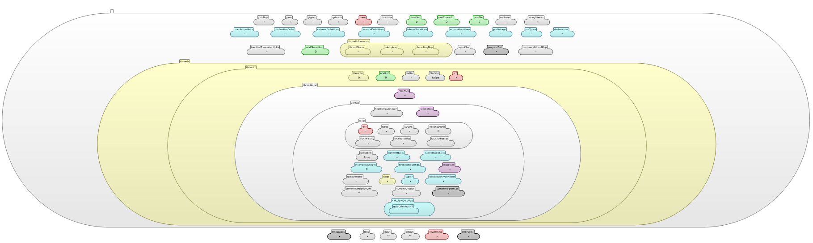
K Configuration and Definition of C
Heap
120 Cells!
… plus ~2500 rules …
Notes:
To give an idea what it takes to define a large language, here is, for example, the configuration of C.
It has more than 70 cells!
The heap, which is the subject of so many debates in program verification, is just one of them.

Slide 21
K Semantics are testable!
Parser
Interpreter
Formal Language Definition
(Syntax and Semantics)
(semantic) Debugger

Slide 22
Testing the K definition of C
Tested on thousands of C programs (several benchmarks, including the gcc torture test, code from the obfuscated C competition, etc.)
Passed 99.2% so far!
GCC 4.1.2 passes 99%, ICC 99.4%, Clang 98.3% (no opt.)
The most complete formal C semantics
[POPL’12, PLDI’15]
Notes:
The C definition has about 1200 rules.
Since a definition is correct by definition, it is important to gain as much confidence in it as possible.
Our approach in K is to extensively test our definitions by executing them. In the case of C, the semantics has been tested against several thousands programs in a regression test suite, including gcc’s torture test suite, code from the obfuscated C competitions, as well as many other programs found on the internet which were devised to explore the dark corners of the C language.
As of now (Septemeber 2012), the K semantics of C passes 99.2% of the programs in our large test suite.
Note that gcc only passes 99%, ICC 99.4%, and Clang 98.3%, all these without optimizations enabled (optimizations reduce these numbers by a few percentages).
The reason for which these compilers and even our semantics do not pass all programs, is partly because the semantics of C is not well explained in the manual and allows room for interpretation and confusion.
These tools simply do not agree on what a correct C program is.
Funny, isn’t it? Particularly when you want to actually verify C programs …
At our knowledge, the K semantics of C is the most complete C semantic to date.

Slide 23
How slow is it?
K Framework supports attaching backends
Initial translation to Maude became a backend
Java (symbolic) and OCAML (concrete) backends
C loop calculating 1 + 2 + … + 5,000,000
Compiled with gcc: 18 ms
Fastest hand-written C-fragment Interpreter: 2 sec (111 x C)
K[OCAML]: 14 sec (777 x C, 7 x I)
K[Java]: 20 min (66000 x C, 86 x O, 600 x I)
K[Maude]: 10 x slower than K[Java]
Further improvements coming soon (improving the semantics of C, LLVM backend, compilation)

Slide 24
How much K should I learn?
This is the first time we use the K codebase in teaching, so the honest answer is “don’t know yet”
But: you will not be punished if you do not understand K, nor if you do not like it
K itself not included in exams
However, you need to know enough to understand when you’ve done your MP or project right; we’ll make sure that is always crystal clear, same like in MP0
Nevertheless, if you like K then you are welcome to contribute and even joint the K team

Slide 25
Summary
K is a big and ambitious open-source UIUC project, but its codebase has not been used in the classroom yet, so please be prepared to run into issues; also please be patient and forgiving
Next: Software Configuration Management (SCM)
Components/systems evolve and change
How to manage these changes?

