Slide 1
CS427: Software Engineering I
Grigore Rosu

Slide 2
Today’s goals
Class Logistics
Discussing the Quiz and MP1
Software Configuration Management
Change control

Slide 3
Course Logistics
Wiki: http://wiki.cites.illinois.edu/wiki/display/cs427fa16
Piazza: https://piazza.com/class#fall2016/cs427
Compass: https://compass2g.illinois.edu
All class-wide announcements through compass
MP1 due Wednesday, September 7, 23:59 (one day grace period for Labor day holiday)
Follow the rules and the format specified on Wiki!
Need to know a bit of maven and JUnit

Slide 4
Quiz last Thursday Highlights (and what I learned)
Easy parts first:
git push (!) – add and commit not enough!
Record lectures
They are recorded, see link on wiki
Speak louder
I will; you should also remind me during lectures
Lectures too dry, monotone, not exciting, B/W slides
More examples, invited lecturers, demos
Talk about my experience, with examples
More interactive – you get more involved
B/W slides
You will appreciate simplicity in time; I will try to add more “color”

Slide 5
Quiz last Thursday Highlights (and what I learned)
Didn’t learn much, I already knew everything
Well, this is a hands-on class, we started easy
You will learn by doing, not by reading lecture notes
Didn’t know about the quiz
That’s the point! Participation is 5% extra. Generous grading
Contradictory feedback on MPs: too easy vs. too difficult, too much detail vs. too little detail
Contradictory feedback about class speed: move faster vs. move slower
We appreciate your feedback!
Keep up with the reading! Read previous final exams.

Slide 6
MP1 Highlights (following Piazza)
Java knowledge assumed in this class. We do NOT teach you Java in cs427! Google is your friend. And your colleagues and TAs though Piazza
Java’s classpath and package and their interaction is a pain, but there is nothing we can do about it … except to use tools like Maven, IDEs, etc.
Major point of first part of MP1 is to suffer by manually setting everything up! (Then you appreciate the tools) Also to understand how things really work!

Slide 7
Piazza
Feel free to ask questions, but try google and Piazza search before you ask
Many questions were repeated; we take the freedom from here on to just say “already answered”
Also attend lectures
If in doubt, make your post private
To schedule a meeting (office hours), send a private post with several time slots you can make

Slide 8
Previous lectures
Software engineering and process
Process = A set of activities/steps/practices
K
MP2 will teach you how to use K’s debugger
Software Configuration Management (SCM)
Four aspects of SCM: change control, version control (git), building (mvn), releasing
Testing introduction (junit)
All (non-logistic) slides and all reading can be on FINAL EXAM

Slide 9
Today’s goals
Cover change control aspect of SCM
Start on XP

Slide 10
Software Configuration Management (SCM)

Slide 11
SCM
Four aspects
Change control
Version control
Building
Releasing
Supported by tools
Requires expertise and oversight
More important on large projects

Slide 12
SCM
Four aspects
Change control
Version control
Building
Releasing
Supported by tools
Requires expertise and oversight
More important on large projects

Slide 13
Software product
Product = set of components/documents
Code
Test suites
Operation manuals (admins, end-users)
Requirements
Specifications
Design documentation
Plans/schedules

Slide 14
Software products
Need to keep track of how you created a product
Rules for building the executable
Version of code
Version of libraries
The compiler
The operating system
SCM tool should be able to keep track of all of these (and more)

Slide 15
SCM
Keep track of how software changes over time and be able to reproduce any version of the software
Control how software changes; make sure needed changes have been made and no improper changes have been made

Slide 16
Many Versions
Sequence of versions during development
Prototypes, daily (weekly) builds
Alpha/beta release
Final release
Different released versions
Linux - many versions
5ESS - tailored for each customer

Slide 17
Non-Code Resources
Test suite for version 6.4.3 does not work for other versions. It is almost like the test suites for 6.4.2 and 6.4.4.
Manual for version 6.4.3 is slightly different than for other versions.
Design …
Use cases ...

Slide 18
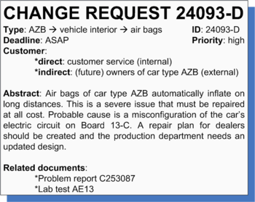
Change Request
We decided to implement a change
Has it been implemented fully? (tests, code, manuals, documentation)
What parts of the system were affected by that change?
I look at a program/document
Why is it like this?
When was it written, by whom?
Tracing both ways:
change control +
version control linked through IDs

Slide 19
Versions
release
3.1
3.2
3.3
mainline
branch
3.2.1.2

Slide 20
Branches
Traditional advice for old version control
Avoid (long-lived) branches if possible
Modern version control (Git, HG…)
Encourage use of (short-lived) branches
Good reasons to branch
Fixing bugs in customer version
Experimental version
Political fights

Slide 21
Bad reasons to branch
Support different hardware platform
Make subclasses / use conditional compilation / make portability library
Support different customer
Separate unchanged code and changed code
Unchanged code goes in a library
Make subclasses / use conditional compilation for changed code

Slide 22
SCM according to the SEI
A discipline for controlling the evolution of software systems
Has many aspects
Identification
Control
Status accounting
Audit and review

Slide 23
Identification
What are the configuration items? (I.e., what is under configuration management?)
How do you name them?
What is the relationship between items?
Versions
Baseline
Release

Slide 24
Versions
V3.1
V3.1.1
V3.1.2
V3
V3.2
V3.3.2
V3.3
V3.3.1

Slide 25
Baseline
Baseline is a software configuration item that has been reviewed and agreed upon, and that can be changed only through formal change control procedures
Intermediate versions that haven’t been reviewed are SCIs but not baselines

Slide 26
Release
Release is a software configuration item that the developers give to other people
Release should be a baseline

Slide 27
Control
Who is allowed to read/write configuration items?
How do you know if changes are allowed/correct?

Slide 28
Status accounting
Reporting the status of components and change requests
Which components have changed this week?
Which components did Bob change?
Which components have the most changes?
Which change requests are more than a month old and of priority 3 or greater?

Slide 29
Audit and review
How do we know that the build script is OK?
How do we know that only authorized people can change the main, customer-visible interface?
Can we actually run the version from September 8, 2015?

Slide 30
Change Control
Change request/engineering change order
New feature
Bug report
Change control authority - decides which changes should be carried out
Should link code changes to change requests

Slide 31
Example: Bugzilla
Originally developed for Mozilla
http://bugzilla.mozilla.org
https://developer.mozilla.org/en/Bug_writing_guidelines
Bugzilla is a database for bugs. It lets people report bugs and assigns these bugs to the appropriate developers. Developers can use Bugzilla to keep a to-do list as well as to prioritize, schedule and track dependencies

Slide 32
Bugzilla
Each bug report has ID, name of reporter, description of bug, component, developer, dependency, attachments
Status: unconfirmed, new, resolved, verified, closed
Severity: blocker, critical, major, normal, minor, trivial, enhancement

Slide 33
Resolving a bug
FIXED:
INVALID: not a bug, or not a bug in Mozilla WONTFIX : a bug that will never be fixed LATER: a bug that won’t be fixed now
REMIND: maybe now, maybe later
DUPLICATE
WORKSFORME

Slide 34
Topics to Ponder - Class Exercise, Groups of 3 -
What is the dynamics of people using a change control system?
Developers
Testers
Users
Managers
What about security issues in Bugzilla?

Slide 35
To Make SCM Work Requires:
Bureaucracy
Discipline/Training
Tools
Version control – git, subversion, cvs, …
Change control – bugzilla, mantis, jira, …
Building – mvn, ant, make, …
Releasing – Maven Central and Nexus, …

Slide 36
SCM Manager
Complex tools need expert to manage them
SCM expert will
Maintain tools
Maintain configuration files, make branches
Do the merging
Create policies on version control, change control

Slide 37
Alternatives
Toolsmith supports SCM tools
Architect defines configuration files
Developers merge their code back into mainline
Managers and technical leads define policies for version control and change control

Slide 38
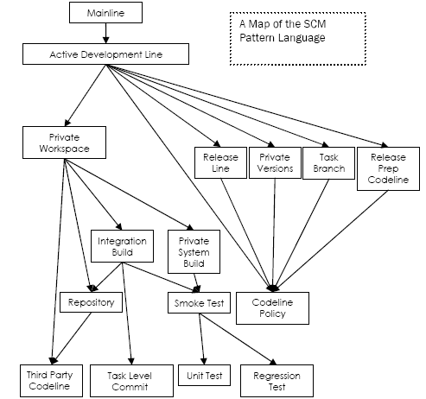
from “Software Configuration Management Patterns: Effective Teamwork, Practical Integration” by Steve Berczuk with Brad Appleton

Slide 39
Various tests
Smoke test
Ensure that the system still runs after you make a change
Unit test
Ensure that a module is not broken after you make a change
Regression test
Ensure that existing code doesn’t get worse as you make other improvements

Slide 40
Developer issues
Private Workspace
Prevent integration issues from distracting you, and from your changes causing others problems, by developing in a Private Workspace.
Private System Build
Avoid breaking the build by doing a Private System Build before committing changes to the Repository

Slide 41
Codeline Policy
Active Development Line
Release Line
Holds bug fixes for a release
Private Versions
Task Branch
Hide a disruptive task from the rest of the team
Release Prep Codeline

Slide 42
Summary of SCM
Four aspects
Change control
Version control
Building
Releasing
Supported by tools
Requires expertise and oversight
More important on large projects

