Slide 1
CS427: Software Engineering I
Code Smells

Slide 2
MP5 (Last MP)
MP5 released, due OCT 10 (Monday!)
Refactorings + code smells + reverse engineering
You’ll need to schedule a demo with TA
Time slots will be online soon
Will be asked which refactorings each of you did, etc
Lots of reading (CC2 and OORP)
Please ask for help if needed!
Office hours, email TAs or instructors to meet, Piazza
Follow the instructions carefully
Check the code with your teammate
Notes:
There will be NO further group changes for MP1. Even if someone's teammate drops the course, the student will need to finish MP1 alone. We expect the enrollment to be stable from now, the third week of classes.

Slide 3
Today’s goals
WHERE you may want to refactor?
Last time
WHAT are refactorings
HOW to perform them
WHEN to perform them

Slide 4
What are code smells?
Fowler: “... certain structures in the code that suggest (sometimes they scream for) the possibility of refactoring.”
Wikipedia: “… symptom[s] in the source code of a program that possibly indicate a deeper problem. … usually not bugs... not technically incorrect and don't currently prevent the program from functioning. Instead, they indicate weaknesses in design that may be slowing down development or increasing the risk of bugs or failures in the future.”

Slide 5
Why are code smells bad?
They are clear signs that your design is starting to decay
Long term decay leads to “software rot”

Slide 6
Example code smells
Duplicated code
Long method
Large class
Long parameter list
Message chain
Feature envy
Switch statements
Data class
Speculative generality
Temporary field
Refused bequest

Slide 7
Duplicated code
Duplicate methods in subclasses
What refactoring could address it?
Duplicate expressions in same class
What refactoring could address it?
Duplicate expressions in different classes
What refactoring could address it?

Slide 8
Duplicated code
Duplicate methods in subclasses
Move to superclass, possibly create superclass
Duplicate expressions in same class
Extract method
Duplicate expressions in different classes
Extract method, move to common component

Slide 9
Duplicated code example
sqrt(pow(loc1.getX() - loc2.getX(), 2)+
pow(loc1.getY() - loc2.getY(), 2))
sqrt(square(loc1.getX() - loc2.getX())+
square(loc1.getY() - loc2.getY()))
double square(double d) { return pow(d, 2); }

Slide 10
Long method
Won’t fit on a page
Can’t think of whole thing at once
What refactoring(s) could address it?

Slide 11
Long method
Won’t fit on a page
Can’t think of whole thing at once
Extract method
Loop body
Places where there is (or should be) a comment (don’t write comments but name functions)

Slide 12
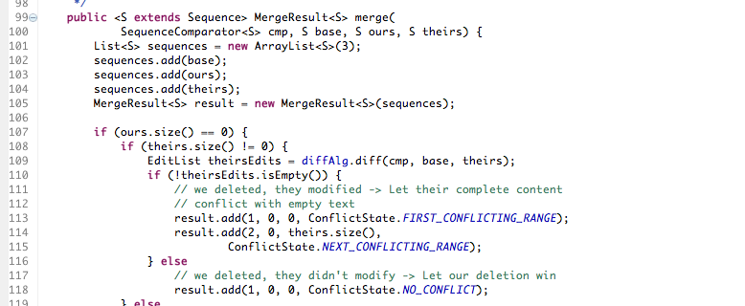
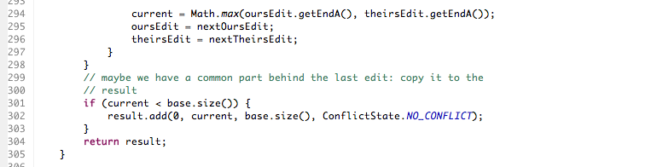
Long method example

Slide 13
Large class
More than a couple dozen methods, or half a dozen variables
Split into component classes
Create superclass
If using switch statement, split into subclasses

Slide 14
Long parameter list
Introduce parameter object
Only worthwhile if there are several methods with same parameter list, and they call each other

Slide 15
Message chain
Long list of method calls: customer.getAddress().getState() window.getBoundingbox().getOrigin().getX()
Replace with shorter calls: customer.getState() window.leftBoundary()

Slide 16
Feature envy
Code “wishes” it were in another class; move it
Example move from this:
teacher.getClasses().add(thisClass);
teacher.setClassLoad( teacher.getClassLoad()+1);
To this:
teacher.addClass(thisClass);

Slide 17
Data class
Class has no methods except for getter and setters
What to do:
Look for missing methods (feature envy?) and move them to the class
Merge with another class
Example: DateRange from last lecture

Slide 18
Switch statement
Replace switch (or nested if) with a method call
Make subclass for each case
Use dynamic dispatch/polymorphism
Special case: instanceof for “switch”

Slide 19
Library example
Consider this code: computeWeight(Element e) { if (!e.hasChildren()) { // e instanceof Book return ((Book)e).getBookWeight(); } else { return ((Collection)e).getTotalWeight();
Replace with a new method: computeWeight(Element e) { return e.getWeight();
Similar with getStringRepresentation
Will be discussed more with design patterns later

Slide 20
Speculative generality
Interfaces/abstract classes that are implemented by only one class
Unnecessary delegation
Unused parameters

Slide 21
Temporary field
Instance variable is only used during part of the lifetime of an object
For example, it is only used while the object is initialized
Move variable into another object (perhaps a new class)

Slide 22
Refused bequest
A is a subclass of B
A
Overrides inherited methods of B
Does not use some variables of B
Does not use some methods of B
Give A and B a common superclass and move common code into it

Slide 23
Other smells
Non-localized plans
Too many bugs
Too hard to understand
Too hard to change

Slide 24
Non-localized plan
Adding a feature requires a plan. If adding a feature requires changing many parts of a program, it is a “non-localized plan”.
Parallel class hierarchies: adding a class in one class hierarchy requires adding a class in another
Example: a new item class requires a new itemFactory class
Again, design patterns can help with this

Slide 25
Refactor non-localized plan
Make a new object that represents everything that changes
Methods that change together should stay together
Many design patterns address this kind of problem (we’ll cover design patterns later)

Slide 26
Too many bugs
If one part of the system has more than its share of the bugs, there is probably a good reason
Redesign, rewrite, refactor

Slide 27
Too hard to understand
Hard to fix bugs because you don’t understand
Hard to change because you don’t understand

Slide 28
Too hard to change
Because of lack of tests
Because of dependencies
Global variables
Very large modules
Importing too many classes
Because of duplication or non-localized plans

Slide 29
Summary
Code smells are code pieces with potentially bad design
Fairly subjective
Fowler: “You will have to develop your own sense of how many instance variables are too many instance variables and how many lines of code in a method are too many lines.”

Slide 30
More refactoring references
Video (IntelliJ IDEA) http://blog.jetbrains.com/idea/2011/09/refactoring-in-intellij-idea-live-by-robert-c-martin-uncle-bob/
Search for the title if video is broken
Reading (Eclipse) http://www.ibm.com/developerworks/library/os-ecref/
http://sourcemaking.com/refactoring

