Slide 1
CS427: Software Engineering I
Reverse Engineering

Slide 2
Today’s goals
How to learn an existing software system that is poorly documented?
What are some object-oriented reengineering patterns?
Fair warning: reading will be on the exam, keep up with it (82 pages on these patterns)
We may (or may not) have a quiz about this
Useful for your project, to navigate through the tens of thousands of Java LOC of K

Slide 3
From the reading
Foreword by Martin Fowler:
“For a long time it’s puzzled me that most books on software development processes talk about what to do when you are starting from a blank sheet of editor screen. It’s puzzled me because that’s not the most common situation that people write code in. Most people have to make changes to an existing code base, even if it’s their own. In an ideal world this code base is well designed and well factored, but we all know how often the ideal world appears in our career.”

Slide 4
What is reverse engineering?
Discovering design of an artifact
Given binary, discover source code
Given source code, discover specification & design rationale
Learn enough to change it or replace it or write book about it

Slide 5
Why to reverse engineer?
Replace entire system
Modify system
Use system
Write documentation for system
Know your purpose!

Slide 6
When to reverse engineer?
In the large:
Big changes: Y2K (99->00->01)
Technology change: desktop->web->mobile
In the small
Add a feature, fix a bug, improve performance
Your project: understand and modify parts of some large codebase

Slide 7
Some terminology
Forward engineering
From requirements to design to code
Reverse engineering
From code to design, maybe to requirements
Reengineering
From old code to new code via some design

Slide 8
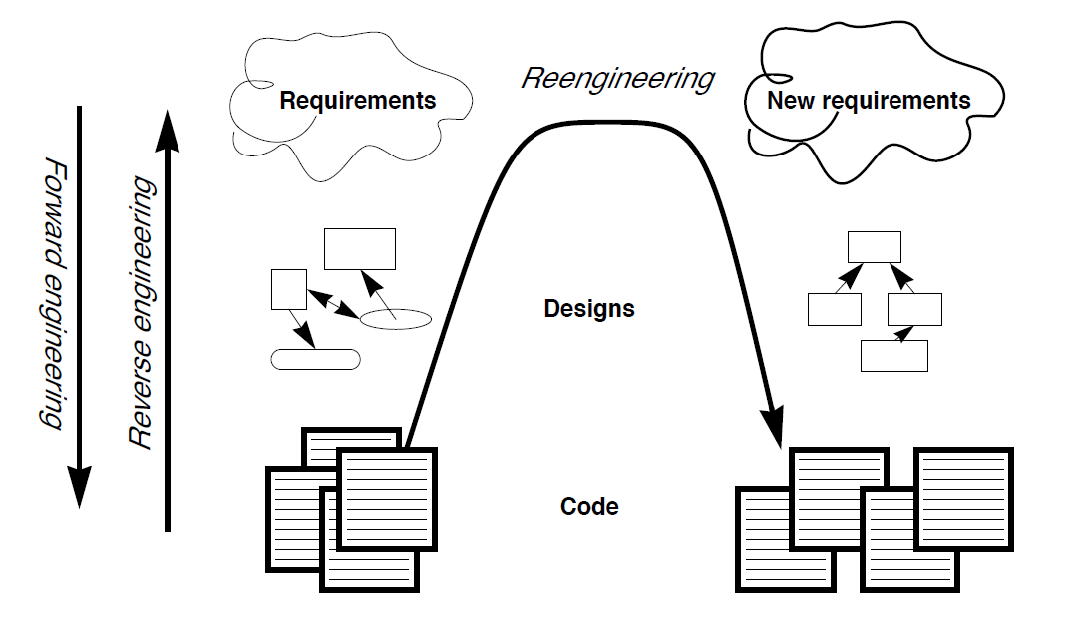
Forward & Reverse Engineering Re-Engineering

Slide 9

OORP book
Patterns = expert solutions to common problems
Described using names, context, forces
You may have heard of design patterns

Slide 10
Some aspects/forces
Limited resources
Techniques and tools
Reliable information
Accurate abstraction
Skeptical colleagues

Slide 11
First contact
Chat with the maintainers
Read all the code in one hour
Skim the documentation
Interview during demo
Do a mock installation
How would you read all code in one hour?
Spend 3 minutes for discussion

Slide 12
Example: Read All Code in 1 Hour
Intent: assess a software system via a brief but intensive code review
Problem: system is large/varied, unfamiliar
Solution: read code & document findings (important entities, “code smells”, tests)
Hints: what to look for?
Coding styles/idioms, tests (system and unit)
Abstract classes or classes high in hierarchy
Large entities, comments

Slide 13
Initial understanding
Analyze the persistent data
Speculate about design
Study the exceptional entities

Slide 14
Detailed model capture
The code and questions
Refactor to understand
Step through the execution
Look for the contracts
Learn from the past

Slide 15
Reverse engineering activities
Purpose: Learn the system from the system
Read documentation
Talk to people
Look at the code
Work with the system
Write documentation

Slide 16
Some activities
Read documents
Might not be accurate
Usually not enough
Talk to people
What does it do? Show me!
What does this mean?
Who uses it? How?
What is the input and output?

Slide 17
More activities
Look at the code
Find major modules and draw a picture of them
Spend no more than a few hours
Run a test case
Make a change
Fix a simple problem
Spend no more than a few hours

Slide 18
Draw a picture
Need big picture
Class hierarchy - class diagram
Modules
Tools
Diagramming tools
Code browsers
Debuggers

Slide 19
Diagramming tools
Java -> UML class diagram
C -> call graph
Smalltalk -> collaboration diagram
Language specific

Slide 20
What is really important?
The big picture – the layers
The problem modules
The ones that change
The ones with bugs
In your project: the ones you work on

Slide 21
Metrics for reverse engineering
Coupling
Top layers depend on lower layers
Lower layers do not depend on anything
Frequent changes
% of git changes that affect a module (class)
Bugs
Code coverage

Slide 22
Coverage metrics for finding bugs
Which modules are executed by this test?
Which modules are executed by this test and not by other tests?
Given a set of tests, coverage tool reports the functions/lines/paths that are executed
Infrastructure modules executed by all tests
“Feature” modules executed by few tests

Slide 23
Layers and coverage

Slide 24
Browsers
Tool for reading code
Cross reference
Definition of variable, procedure, class
Uses of variable, procedure, class
Interactive, multiple views

Slide 25
Debuggers
See how code executes
Singlestep
Breakpoints, watchpoints
Language specific

Slide 26
Dealing with size
Get an overview
Decompose
Examine each part individually
Experiment to test knowledge
Correct overview

Slide 27
Making changes to learn
Pick simple problems that are easy to fix
Fix bugs
Add simple features
Restructure
Purpose is learning, not fixing
Pick problems in various parts of the system

Slide 28
Existing documentation
Requirements
Architectural overview
Design of components
Interface descriptions
User manuals
Code comments

Slide 29
Documentation
Describe what exists
Describe what you had to learn
Simplify and abstract
Describe
The problem
The overall design
The pieces
Examples

Slide 30
Tests
Tests can be documentation
Executing tests helps you see how system works
Write tests to learn
Write tests to document what you’ve learned
Systems with bad structure are hard to test

Slide 31
Don’t get stuck!
Try many techniques! Be proactive!
Talk to people
Get help, help others
Stick with it
Take notes; otherwise you forget

Slide 32
Summary
Reverse engineering is analyzing an existing system
Instead of inventing design ideas, discover them
Tools useful, but people are more important and hard work is essential

