Slide 1
CS427: Software Engineering I
Team Projects

Slide 2
Today’s goals
How to succeed in your team project?
Discuss group work theory
Give tips for working in groups
aimed at groups working together for a semester but generalizes to most group situations
it is a beneficial skill (put it on your CV !)
Slides from Darko Marinov + Tao Xie + Laurie Williams + Brian Bailey

Slide 3
Group or team?
Most treat the terms equally
Some make a distinction
Group = people work more independently
Low (module) cohesion is bad in software design
Team = people work more cohesively
High (module) cohesion is good
XP advocates WHOLE TEAM (customer and developers sit and work together)
Not always possible in courses such as cs427

Slide 4
Team Project: Accepting and fulfilling a role
Why define roles?
Most projects include activities other than software development. e.g.,
Documenting requirements
Documenting test plans
Documenting designs
If no one takes these responsibilities, they’ll never get done
It is important to distribute responsibilities
But XP also requires COLLECTIVE (CODE) OWNERSHIP
Note: EVERYONE is a development engineer PLUS a role via iterations
©L. Williams

Slide 5
Roles
Team/development leader
Planning leader
Quality assurance leader
For detailed responsibilities of these roles, can see Section 2.3 of http://agile.csc.ncsu.edu/SEMaterials/PlanDriven.pdf
Rotate these roles for each iteration!
©L. Williams

Slide 6
Team Leader’s Goals
G1 Build and maintain an effective team
G2 Motivate all team members to work aggressively and enthusiastically on the project
G3 Resolve team-related issues
G4 Keep the instructor/TA fully informed about the team’s progress by communicating with the instructor/TA via Piazza, e-mail, or verbally when required
G5 Perform effectively as a team’s meeting facilitator
©L. Williams

Slide 7
Team Leader’s Characteristics
Enjoys being a leader and takes the role naturally
Is capable of identifying key problems and makes objective decisions
Does not worry too much about making unpopular decisions from time to time to keep the team going
Respects other team members and is willing to listen to points of view and to help
©L. Williams

Slide 8
Development Leader
Main goal
To lead the team through the system definition and design processes
To guide the team through the testing definition process
In your cs427 team project, team leader and development leader often will be a single student.
©L. Williams
Notes:
Note to instructors: The goals, and activities of the development and testing leaders are intertwined. In the absence of a testing leader (which will happen in a team of 5), lab instructors will be asked to split up all of the testing leader’s main activities among the other team members. It is likely that most of them will be assigned to the development leader.

Slide 9
Development Leader’s Characteristics
You enjoy building artifacts
You wish to be a software engineer and want to gain experience leading software developments
You are a competent designer and feel you could guide this system’s development
You are familiar with design methodologies
You are willing to listen to other’s design ideas and can objectively and logically compare them against yours
©L. Williams

Slide 10
Planning Leader
Main Goal
To guide the team in producing a detailed plan and precisely track progress against that plan
In cs427: you’ll have to keep track of your progress on Wiki
©L. Williams

Slide 11
Planning Leader’s Characteristics
You have a logical mind and you feel most comfortable when following a plan for doing your work
Although you may not always be able to produce a plan, you tend to plan your work when given an opportunity
You are willing to encourage people to track and measure their work
©L. Williams

Slide 12
Quality Assurance Leader
Main Goal
Supports the team in defining the process needs, in making the quality plan, and in tracking the process and product qualities
Guarantee the integrity, consistency, and completeness of all testing documents
Make sure that the system test plan is carried to completion prior to system delivery
©L. Williams

Slide 13
Quality Assurance Leader’s Characteristics
You are concerned about software quality
You are interested in process and process measurements
You have some experience with and awareness of inspection and review methods
You are willing and able to constructively review and comment on other people’s work without antagonizing them
©L. Williams

Slide 14
Group Observations
Group work can be an amazing experience or a challenging one
hard to predict which way it will go
good groups often have strong project buy-in and exhibit shared purpose
teams are groups that “jell” (or “gel”)
Group formation, benefits, and tips
©B. Bailey
Notes:
Student groups would sit together in class, I would see them together in Siebel, and when I observed them working together, they were all engaged positive, and clearly enjoying the group experience.
In other cases, it was obvious from the body language that one or more group members was not engaged. They would sit by themselves, or would sit near the group while working on other things.

Slide 15
Reflect on Group Work
Get together with your team
split into subgroups of 2-4
For three minutes:
discuss your best group experience, what you liked most about working in a group, and what techniques worked best for the group
discuss your least favorite group experience and what you disliked about working in a group
Switch your subgroups, discuss a bit more
©B. Bailey

Slide 16
Benefits of Group Work
Improve creativity and work quality
Learn to appreciate people from different disciplines and with different life experiences
Learn how to have constructive dialog
Increase motivation by drawing from the energy of team members
Keeps you focused since you are accountable
Build lasting friendships
Better prepare you for the workplace
©B. Bailey
Notes:
Improve work quality and creativity by drawing on each other’s knowledge, perspectives, and strengths.

Slide 17
Stages of Group Development*
Forming
Storming
Norming
Performing
Adjourning
©B. Bailey
*Tuckman & Jensen, Stages of Small-Group Development Revisited. Group & Organization Management, 2(4): 419-427, 1977.
Notes:
This is a general model of group developed that was inspired by observing groups in many situations, from therapy to the workplace It provides a general sense of what to expect. There are five stages. Some groups will spend more time in specific stages than others. Not necessarily linear progression.

Slide 18
Forming
Excitement, eagerness, high expectation
also anxiety, wondering how you will fit in and if performance will measure up
‘Ice-breaker’ task helps
suggestion: form a name for the team and elect someone to start your Wiki pages
update Wiki with name and your NetIDs
©B. Bailey
Notes:
During the Forming stage, excitement and eagerness abound about the work ahead. Members often have high expectations for the team experience but may also feel anxiety, wondering how they will fit in to the team and if their performance will measure up. A good ice breaking task can help get you started. A simple but effective activity is to form a name for the team and to elect a group coordinator. Send and I will enter into COMPASS.

Slide 19
Storming
Once group work sets in, realize that group structure required to attain goals
Conflict may arise due to disagreement on roles and procedures
agree on roles and procedures
©B. Bailey
Notes:
In storming, once group work sets in, realize that group structure may be required to attain your goals. This creates conflict because you may not all agree on what that structure is – therefore conflict. Overcome the conflict by defining procedures for working together.

Slide 20
Norming
Work to resolve the conflicts and begin to implement agreed upon procedures
Members should experience increased sense of comfort participating
©B. Bailey
Notes:
During the Norming stage of team development, team members begin to resolve the conflicts experienced in the prior stage and being to implement the agreed up procedures. Members should experience an increased sense of comfort participating in the group.

Slide 21
Performing
Make progress toward task goals
work fluidly together and focus on task rather than roles and procedures
Spend most time at this stage
may still experience conflict and temporarily revert back to prior stages
some groups never reach this stage
©B. Bailey
Notes:
In the Performing stage, the team makes significant progress towards its goals. Your are now working together and are focused on the task rather than defining group structure and conflict. Spend the most time at this stage, though you may still experience conflict and temporarily revert back to the storming stage.

Slide 22
Adjourning
Completion of task and end of group
may feel anxiety or sadness (or relief)
Suggestions
focus on completing remaining deliverables
reflect on "lessons learned" and use them to shape next group experience
celebrate the accomplishments of the team and contributions of individuals
©B. Bailey
Notes:
Adjuorning is the ending of the group and its work. Some may feel anxiety or even sadness about abruptly ending the group. During this stage, the team should focus on three tasks: Complete remaining deliverables, (2) Evaluate "lessons learned" and using them to guide your next group experience, (3) Host final celebration acknowledging the contributions of individuals and the accomplishments of the team.

Slide 23
Effective Teams
“Teams that trust each other, engage in constructive dialogue around conflict, commit to mutually beneficial decisions, and hold one another accountable are likely to work effectively together.”
“By being able to set aside individual needs and agendas to focus on what is best for the group, these teams foster a healthy and constructive dynamic to reach positive results.”
- Lisa Burgoon, Illinois Leadership Center
©B. Bailey
Notes:
Achieving these characterizations is not easy. You have to work at it. This means that you have to seek a balance …

Slide 24
Communication and Work Styles*
Seek a balance between task and relationship behaviors. Both keep the group functioning
Task behaviors help groups accomplish work
initiate, organize, direct, execute, etc.
Relationship behaviors help improve group cohesiveness
listen, trust, encourage, solicit opinions, etc.
*Via Illinois Leadership Center. Reference: Lencioni, P. (2002) Five Dysfunctions
of a Team. Jossey-Bass by Wiley, San Francisco CA.
©B. Bailey
Notes:
Task work and the work of working together.

Slide 25
Awkwardness and Conflict
Expect a little awkwardness in the early stages. That’s normal. It takes time to get to know others and figure out how the group will function best
Expect some conflict. That’s normal. Don’t worry. But don’t bury it. Do address and resolve it.
©B. Bailey
Notes:
Throughout the group experience, especially in the “storming” stage, expect awkwardness and conflict.

Slide 26
Tips for Group Work
From the literature in group, organization, and leadership studies
http://www.speaking.pitt.edu/student/groups/smallgrouptips.html
http://writing.colostate.edu/guides/pdfs/guide42.pdf
And our experience teaching the courses with (large) groups, working in groups, and related research
©B. Bailey

Slide 27
Work Hard
Do your share and add a little extra
sets an example
communicates you are willing to do your part
elevates the group
©B. Bailey
Notes:
Do this on the very first assignment

Slide 28
Be Inclusive
Include all group members in activities, discussions and decision making
feeling left out is hard to get over
if a critical decision is time sensitive, provide a reasonable deadline for participation
Give everyone a chance to speak
©B. Bailey

Slide 29
Take Turns
Don’t be the leader all the time
Don’t be the follower all the time
Don’t be the organizer all the time
Don’t be the note taker all the time
Don’t always dominate the discussion
Take turns doing these and other things
create an atmosphere of shared responsibility
©B. Bailey

Slide 30
Have Constructive Dialog
Be critical of the idea, NOT the person
avoid personal criticism at all costs
Listen to the ideas proposed by others
extend it, add to it, shape it to make it better
Discuss the ‘good’ of an idea first, then be critical of it if appropriate
©B. Bailey

Slide 31
Use Evidence
Disagreements rooted solely in personal preference are hard to overcome
“I don’t like it” is hard to argue against
When expressing disagreement, it helps to justify it with evidence
code/test examples, grading rubrics, known principles, communication with teaching staff, etc.
at least articulate what it is that you don’t like
©B. Bailey

Slide 32
Be Timely
Show up promptly for meetings and get your work done on time
if not, you have wasted their time, which makes them mad
first thing group members notice
Remember the group depends on you
©B. Bailey

Slide 33
Stay focused on the task
Make your time count
Come to meetings prepared
Remind each other of the goal
Take breaks
Schedule larger chunks of time for group work, even if the work is independent
©B. Bailey

Slide 34
Improve the mood of the group
Say something positive right away
Be agreeable
Speak up
Offer to bring something to make the meeting enjoyable (food, drinks, etc.)
©B. Bailey

Slide 35
Know when to move on
Sometimes you cannot agree
Take a break, agree to disagree, and move on if its not critical
Don’t hold a grudge
©B. Bailey

Slide 36
Don’t Cast Blame
Ask how you have contributed to the problem
Suggest ideas to fix it, don’t just complain
Understand the other viewpoint
Compromise and meet in the middle
Never use e-mail to express conflict
Remember that the best ideas are often seeded through disagreement and debate
©B. Bailey

Slide 37
Define the Process
Who is doing what and by when
Agree upon the workflow
one person take the lead for drafting the deliverable, others revise the draft? Or all write different sections?
do it well in advance, no broken builds in demos!
Take turns
©B. Bailey

Slide 38
Tools Can Help
Tools can help with:
organizing, allocating, and tracking the work
tracking discussions, issues, and decisions
versioning code and documents
collaborative programming and editing
Tools are just tools
keep it simple for the course
some recommendations (all free)
©B. Bailey

Slide 39
Create a Shared Space
Put your materials in one place so everyone can find and access them
CITES Wiki
Gitlab repo (follow required name convention!)
Can use others IF ALL MEMBERS agree (but instructors will only check the gitlab repo and wiki)
Google Drive/Docs
Box/Dropbox/FTP
GitHub even (but need to sync to gitlab)
…
©B. Bailey

Slide 40
Remote Communications
Skype (http://www.skype.com)
Google Hangouts
http://plus.google.com/hangouts
Several teams have online students
Some on-campus may travel
©B. Bailey

Slide 41
Group Formation
Composition of your group affects process and outcomes and learning of team skills
Bacon, D.R., Stewart, K.A. and Stewart-Belle, S. Exploring Predictors of Student Team Project Performance. Journal of Marketing education, 20 (1): 63-71.
Brickell, J.L., Porter, D.B., Reynolds, M.F. and Cosgrove, R.D. Assigning Students to Groups for Engineering Design Projects: A Comparison of Five Methods. Journal of Engineering Education, July: 259-262.
Hunkeler, D. and Sharp, J.E. Assigning Functional Groups: The Influence of Group Size, Academic Record, Practical Experience, and Learning Style. Journal of Engineering Education, 86 (4): 321-332.
Oakley, B., Felder, R.M., Brent, R. and Elhajj, I. Turning Student Groups into Effective Teams. Journal of student centered learning, 2 (1): 9-34.
©B. Bailey
Notes:
Group process and behavior is important, but there is also ample evidence that the composition of your group affects group process and outcomes, and learning of team skills.
In sum, who is on your team matters!

Slide 42
Approaches
Let students self-organize
select friends or those who sit near them
may reduce conflict, but group may lack useful skills, not ‘real-world’, and creates left overs
Assigned by the instructor
may use ineffective criteria, difficult to optimize by hand, does not scale, may be perceived as unfair
Problem is being spotlighted in CS
due to scale and inconsistency
©B. Bailey

Slide 43
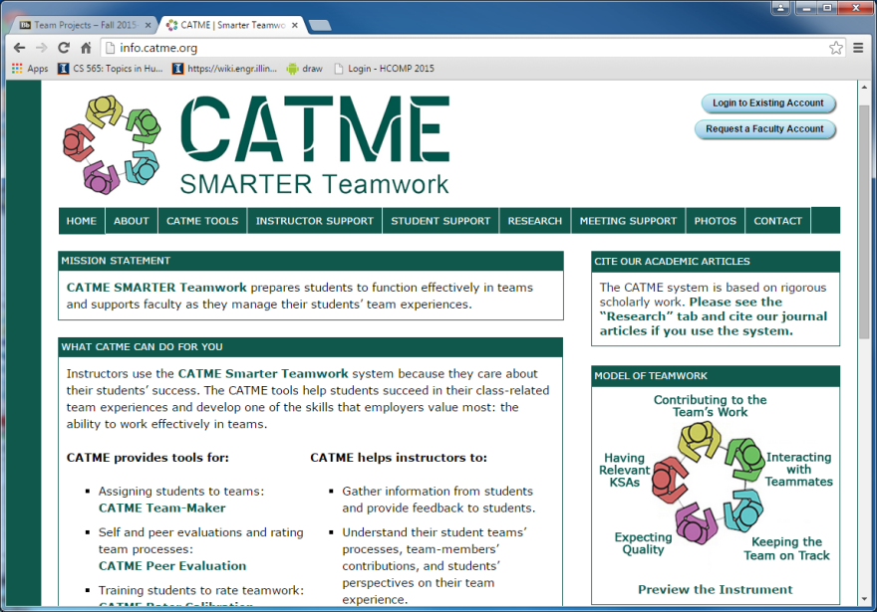
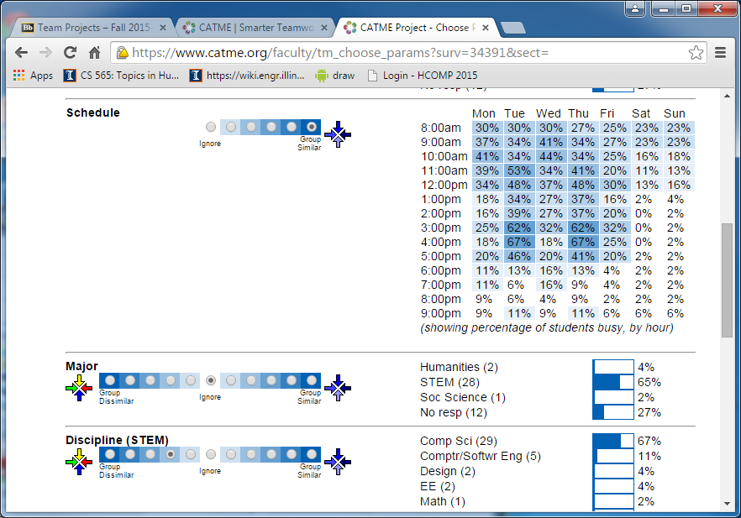
CATME
Organizes teams by optimizing criteria
leadership style, schedule, skills, abilities, etc.
based on research, but adaptable
©B. Bailey

Slide 44

Why This is Good
Gives best chance of success
Creates level playing field
Removes formation struggle
Helps teams work together
compatible schedules
©B. Bailey

Slide 45
In Summary
Group work is the norm
it should improve creativity and outcomes and be enjoyable, but can be challenging
Gave tips for improving group work
refer to them often
If you have a problem, please report early
postponing to report does not help anyone!
©B. Bailey

