Slide 1
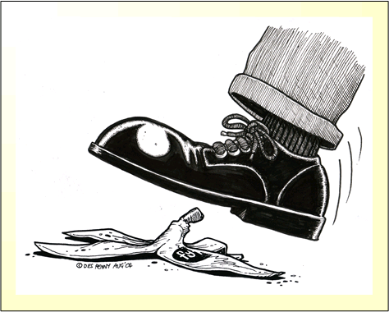
CS427: Software Engineering I
Requirements Engineering and Risk Management

Slide 2
Today’s goals
Requirements Engineering
Why is requirements engineering important?
What are the types of requirements and quality aspects of requirements?
Risk Management
What is a risk?
How to conduct risk management?
How to manage risks in your team project?

Slide 3
What Causes Software Project Failures
WHY PROJECTS FAIL %
1. Incomplete Requirements 13.1
2. Lack of user involvement 12.4
3. Lack of resources 10.6
4. Unrealistic Expectations 9.9
5. Lack of executive support 9.3
6. Changing requirements 8.7
7. Lack of planning 8.1
8. Didn’t need it any longer 7.5
9. Lack of IT management 6.2
10. Technology illiteracy 4.3
Jim Johnson, The Standish Group International Project Leadership
Conference, May 1995, Chicago

Slide 4
Relative Cost to Fix an Error
Boehm’s analysis of 63 s/w development projects (IBM, GTE, TRW, etc.) to
determine ranges in cost for errors created by false assumptions in requirements phase but not detected till later phases

Slide 5

Ford Pinto
Manufactured in the 1970s
The position of the fuel tank mounting bolts was a good design based on an assumption:
There will be no rear impact collisions!
Assumption proved to be false.
Ford spent $100 million in litigation & recall services

Slide 6
Requirements Engineering
Systematic way of developing requirements through an iterative process
Results in a specification of the system that stakeholders understand
Natural language
Potentially easy to understand pictures (UML Diagrams)
A stakeholder is a key representative of the groups who have a vested interest in your system and direct or indirect influence on its requirements
©L. Williams

Slide 7
Types of Requirements
Functional requirements: requirements that specify a function that a system or system component must be able to perform
The watch shall display the time.
Non-functional requirements: not specifically concerned with the functionality of a system but place restrictions on the product being developed
User visible aspects of the system not directly related to functional behavior
Usability; reliability; privacy; security; availability; performance
Best to translate non-functional to measurable.
The response time must be less than 1 second
Constraints (“Pseudo requirements”): not user-visible; imposed by the client that restricts the implementation of the system or the development process
The implementation language must be Java.
Unit tests must be written in JUnit.
©L. Williams

Slide 8
Requirements Validation
Critical step in the development process,
Usually after requirements engineering or requirements analysis. Also at delivery
Requirements validation criteria:
Correctness:
The requirements represent the client’s view
Completeness:
All possible scenarios through the system are described, including exceptional behavior by the user or the system
Consistency:
There are functional or nonfunctional requirements that contradict each other
Clarity:
There are no ambiguities in the requirements
©L. Williams

Slide 9
Requirements Validation Criteria (continued)
Feasible:
Requirements can be implemented and delivered
Traceability:
Each system function can be traced to a corresponding set of functional requirements
Understandable
Non-prescriptive
everything about what the customer wants and nothing about how the programmer(s) will do it.
Consistent language
Shall, should, may
“the physician” vs. “the doctor”
Testable
©L. Williams

Slide 10
Requirements Validation Criteria (continued)
Shall (== is required to): used to indicate mandatory requirements strictly to be followed in order to conform to the standard and from which no deviation is permitted: must or will is obsolete
Should (== is recommended that): used to indicate
among several possibilities one is recommended as particularly suitable, without mentioning or excluding others
or that a certain course of action is preferred but not necessarily required;
or that (in the negative form) a certain course of action is deprecated but not prohibited
May (== is permitted to): used to indicate a course of action permissible within the limits of the standard
Can (== is able to): used for statements of possibility and capability, whether material, physical, or causal
http://standards.ieee.org/guides/style/section5.html

Slide 11
Types of Requirements Statements
Traditional
“The system shall”
Use cases (cs428 next semester)
User story (cs427), in practice may have acceptance test to supply the detail
Agile requirements
Your project: need user stories for about 180-200 hours of work
©L. Williams

Slide 12
Risk
Risk is potential future harm that may arise from some present action
There is a harm to a project when it keeps a major participant in the software process from becoming a winner.
Major participants (stakeholders) and some of their major “harms":
customer, developer (budget overruns, schedule slips),
user (wrong functionality, unsatisfactory interfaces, performance, reliability, safety),
maintainer (poor quality software).

Slide 13
Risk Management
Risk management is a series of steps whose objectives are to identify, address, and eliminate software risk items before they become either threats to successful software operation or a major source of expensive rework.
Reactive teams: fly into action to correct the problem rapidly in a crisis-driven, fire-fighting mode.
Proactive teams: begin thinking about risks even before technical work is initiated.
Be proactive!

Slide 14
Risk Management Cycle
Risk Assessment
Monitor
Identify
Analyze
Communicate
Mitigate
Plan
Prioritize
Risk Control

Slide 15
What are risks in your term project?
Form a pair or 3-student group
List 3 risks in the ongoing course project
Brainstorm mitigation strategies for these risks
Write down:
A description of the risk
Probability of occurrence
Impact of the loss if it does occur
Your mitigation strategy/strategies

Slide 16
Risk Identification
Risk Item | Risk Management Technique
Overriding other people’s work, not having the latest versions of code | Use a configuration management tool effectively.
Lack of exposure to and/or experience with technologies | Take time to learn tools and technologies, seek help from teaching staff.
Being overwhelmed by work in other classes | Have a project management plan with deadlines and ownership, update the project management plan frequently.
Common meeting times | In the beginning of the project, determine all possible common times to meet based on class schedules and other commitments.
Requirements understanding | Meet with, e-mail, or phone customer.
Lack of communication | Set up a group Web page, group e-mail accounts, trade instant messaging IDs, meet regularly.
Project organization | Assign each team member a role, break down work in project management plan.
Loss of a team member | Assure files are uploaded and integrated consistently, use knowledge management strategies such as pair programming to understand each other’s work.
Difficulty integrating work | Increase communication, integrate often.
Planning taking up too much time, not enough time to work on product | Don’t get more detailed than necessary with the planning.

Slide 17
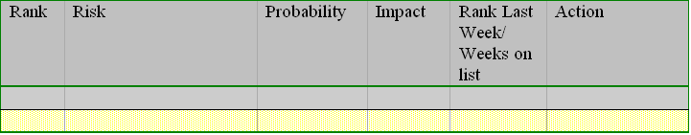
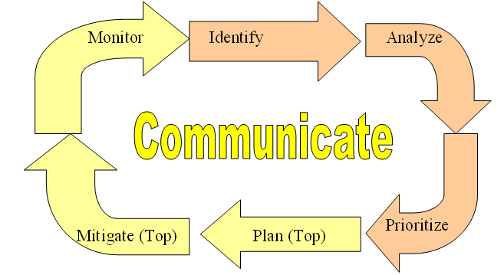
Risk Analysis
Assess probability of loss
Numeric or categorical (e.g. very improbable=10, improbable=40, probable=75, or frequent=90)
Assess impact of loss
Numeric or categorical (e.g. negligible=1, marginal=2, critical=3, or catastrophic=4)

Slide 18
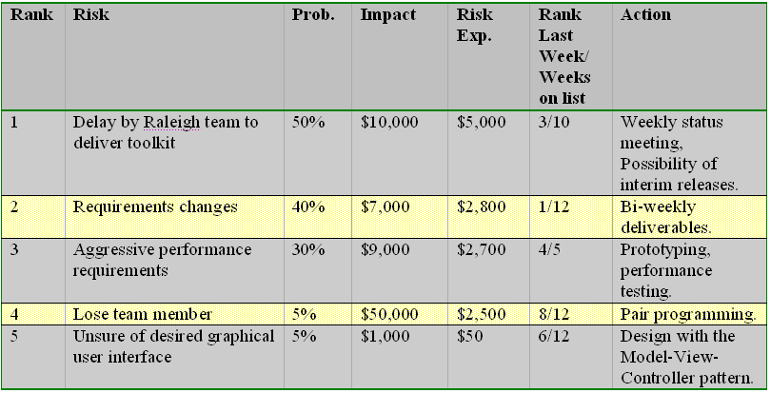
Risk Prioritization
Risk Exposure (RE) = P × C
P = probability of occurrence for a risk
C is the impact of the loss to the product should the risk occur
Planning (next step) for those risks that are “above the line.”

Slide 19
Risk Planning - I
Information buying. Perceived risk can be reduced by obtaining more information through investigation.
For example, in a project in which the use of a new technology has created risk, the team can invest some money to learn about the technology.
Throw-away prototypes can be developed using the new technology to educate some of the staff on the new technology and to assess the fit of the new technology for the product.
Contingency plans. A contingency plan is a plan that describes what to do if certain risks materialize.
By planning ahead with such a plan, you are prepared and have a strategy in place do deal with the issue.

Slide 20
Risk Planning - II
Risk reduction.
For example, if the team is concerned that the use of a new programming language may cause a schedule delay, the budget might contain a line item entitled “potential schedule” to cover a potential schedule slip, reducing financial risk to the organization.
Alternately, the team can plan to employ inspections to reduce the risk of quality problems.
Risk acceptance.
Sometimes the organization consciously chooses to live with the consequences of the risk (Hall, 1998) and the results of the potential loss. In this case, no action is planned.

Slide 21
Risk Mitigation
Develop strategies to reduce the possibility or the loss impact of a risk.
Documented in the Action column of the Risk Table
Risk avoidance.
E.g., a lose-lose strategy: the team can opt to eliminate the risk. Example: opting not to develop a product or a particularly risky feature.
Risk protection.
E.g., the organization can buy insurance to cover any financial loss should the risk become a reality.
E.g., a team can employ fault-tolerance strategies, such as parallel processors, to provide reliability insurance.
a lose-lose strategy: everyone gives something up, in the sense that neither side gets what they want, but everyone can live with the decision.

Slide 22

Risk Mitigation
Develop strategies to reduce the possibility or the loss impact of a risk.
Documented in the Action column of the Risk Table

Slide 23
Risk Monitoring
Monitor progress and “Top 10”
Reevaluate Risk Exposure
Re-draw the line

Slide 24
Risk Management Cycle
Risk Assessment
Risk Control
Be proactive, not reactive.

Slide 25
What is the risk?
A company has introduced object-oriented (OO) technology into its organization by selecting a well-defined project "X" with hard schedule constraints to pilot the use of the technology. Although many ”X" project personnel were familiar with the OO concept, it had not been part of their development process, and they have had very little experience and training in the technology's application. It is taking project personnel longer than expected to climb the learning curve. Some personnel are concerned, for example, that the modules implemented to date might be too inefficient to satisfy project "X" performance requirements. [CMU SEI]

Slide 26
Risk Example Case Answer
The risk is: Given the lack of OO technology experience and training, there is a possibility that the product will not meet performance or functionality requirements within the defined schedule. [CMU SEI]

Slide 27
Non Risk Example
A company is developing a flight control system. During system integration testing the flight control system becomes unstable because processing of the control function is not quick enough during a specific maneuver sequence.
The instability of the system is not a risk since the event is a certainty - it is a problem. [CMU SEI]

Slide 28
Summary
Requirements engineering is important
XP has several activities for requirements
Customer on site – you have no real customer
COMMUNICATE with your teaching staff person!
Risk management is also important
Consider risks in your project
The key is that someone is not contributing
Again, communicate (with one another), communicate (with TAs/me), communicate…

